Slide 1
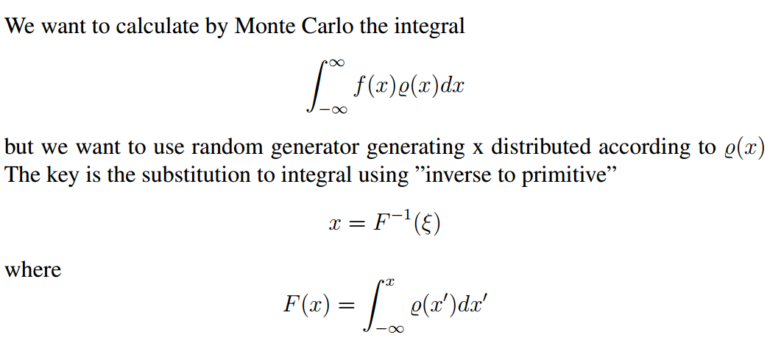



Slide 2



Importance sampling
Numerically

Slide 3




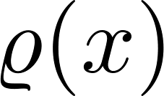



accept - reject

Slide 4

Importance sampling for normal distribution

Slide 5


Slide 6
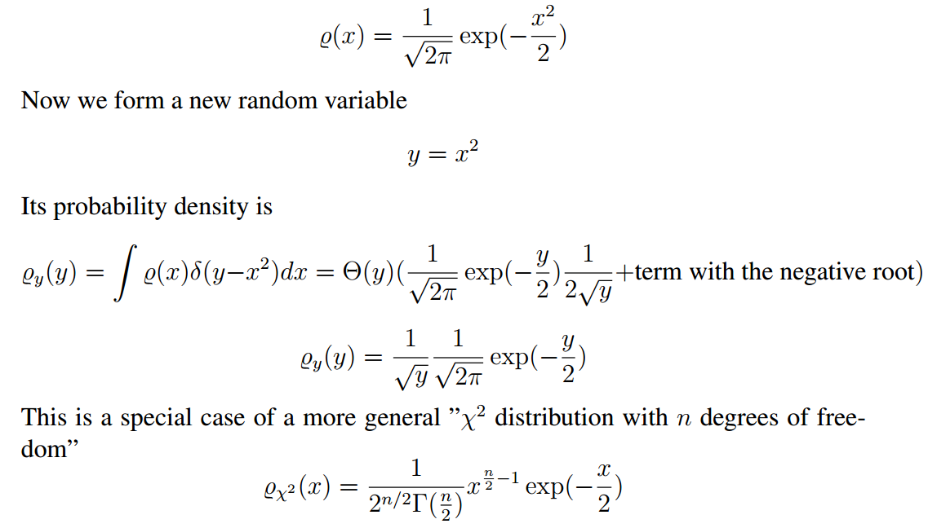

Slide 7
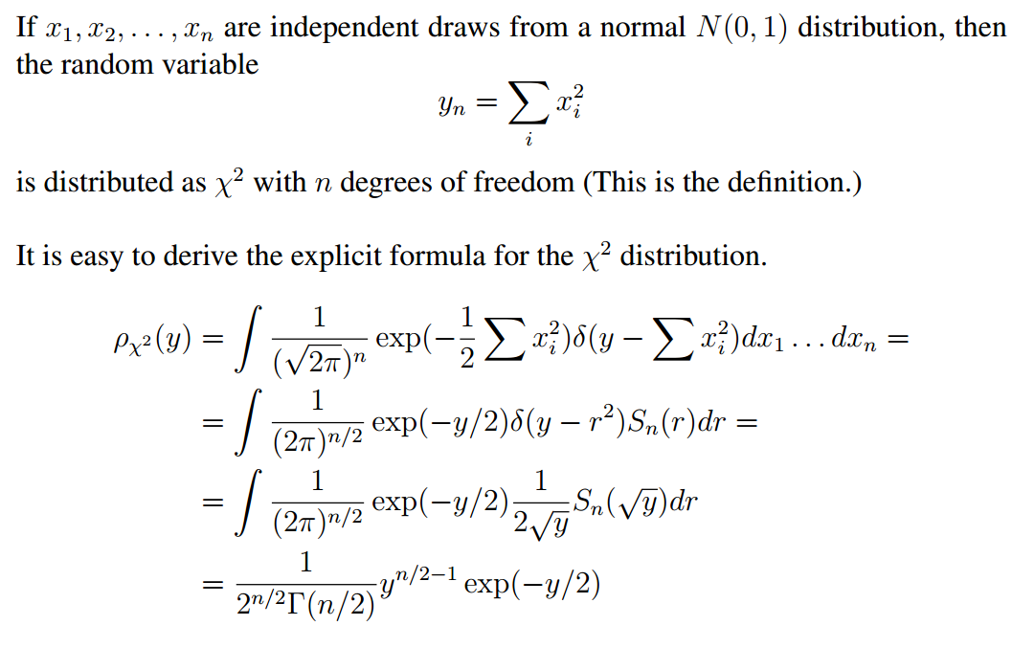

Slide 8
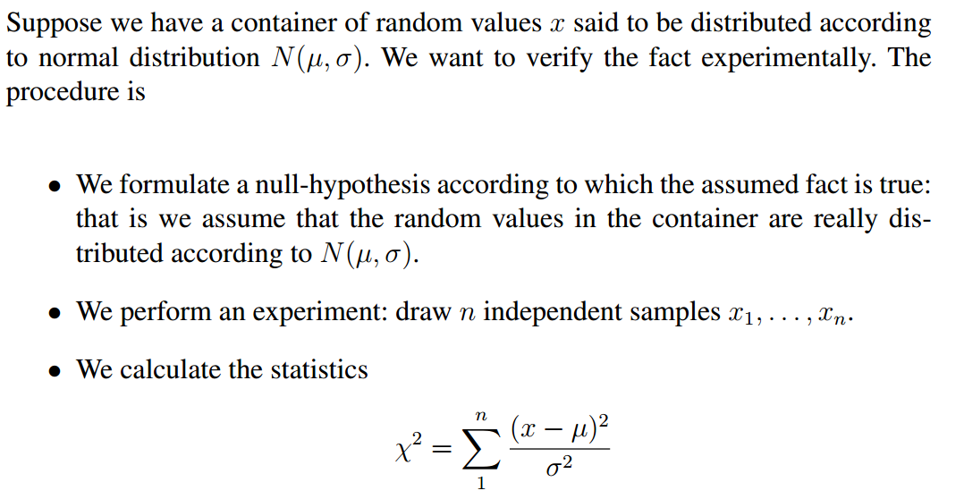


Slide 9

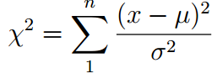
Expected $χ^{2}$ value is of the order of $n$.

