Slide 1
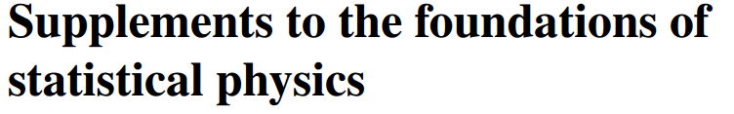

Slide 2


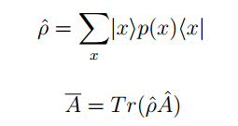
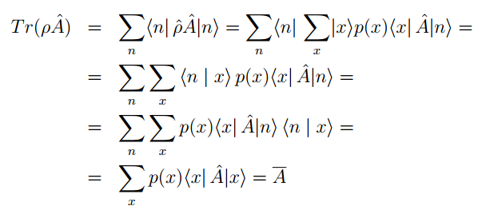

Slide 3
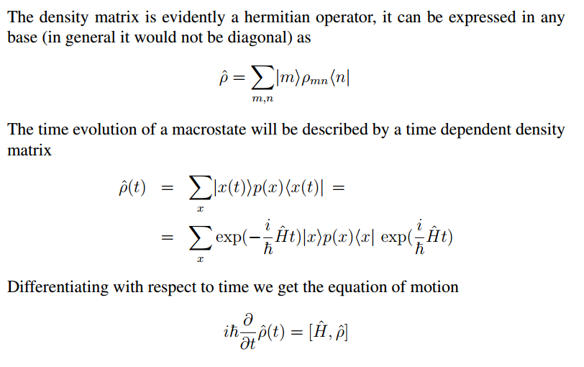

Slide 4
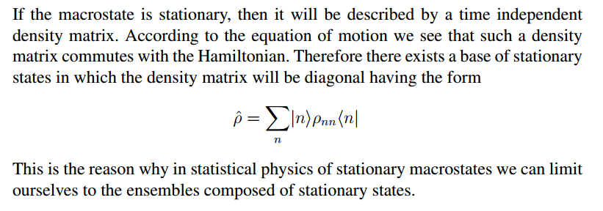

Slide 5
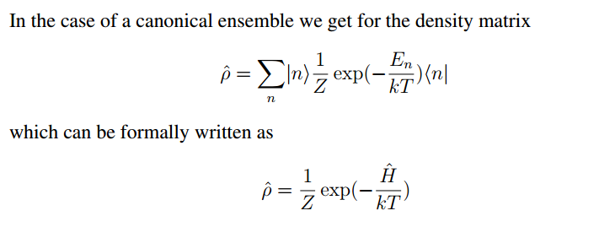

Slide 6


How to measure the quantity of information?
The starting point is the requirement that the message saying an improbable event happened carries more information then a message reporting that a probable event happened. The quantity of information is therefore related to the probability of the message carrying the information. Information about the event is related to the probability of that event before it happened.
Now we require that the information can be communicated in parts. For example
I can first announce that the unknown number is odd, and then only the number
itself. It is natural to require that the information from partial messages should be
added to get the total information. Having in mind that the probability of independent events combine multiplicatively, but the corresponding independent pieces of
information should be combined additively it is natural to assume that the amount
of information is given by the logarithm of the corresponding probability.

Slide 7
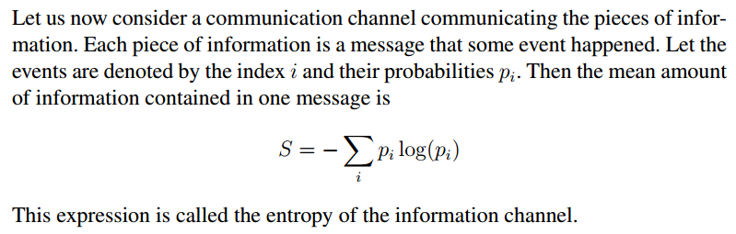
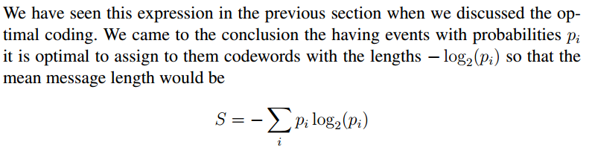
Information is, in fact, measured by the price of telex carrying that information. If telex is priced by some amount of money per letter.
Using the logarithms of different bases just changes the units in which we measure the amount of information. (Changing the base just multiplicatively renormalizes the logarithm.) The unit corresponding to binary logarithm is called bit, the unit corresponding to natural logarithm is called nat.

Slide 8
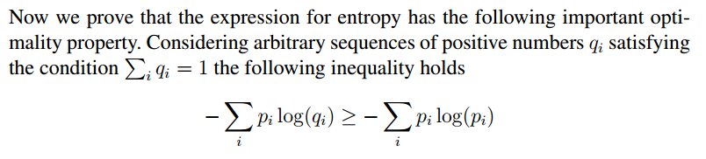
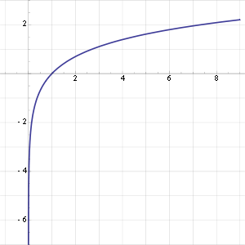
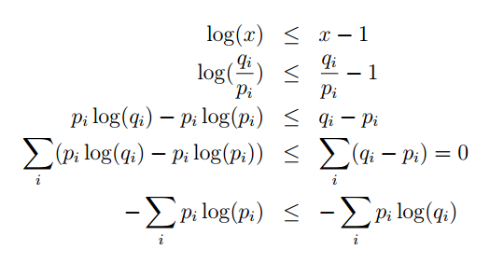
By the way we have proved again the optimal coding theorem, that is that
one should use the codewords of the length log(qi) = log(pi).

Slide 9
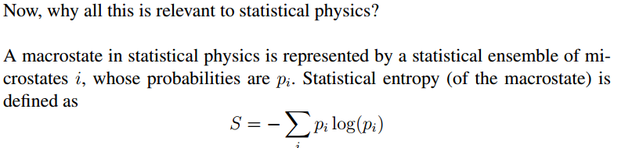
So we see that the statistical entropy can be interpreted in the following way.
Let us imagine that somebody gives us a sample of some macrostate. A macrostate is a virtual notion, he must actually give us some specific microstate. He just does not tell us which specific microstate from the corresponding ensemble he gave us.
So our knowledge about the system considered just corresponds to its macrostate,
we are completely unaware of the microstate actually delivered. Now imagine
that someone tells us which particular microstate was actually delivered. Then
our original unawareness is changed to a complete knowledge. The amount of
information contained in the message was −log(pi) where pi is the probability
assigned in the statistical ensemble to the microstate actually delivered.

Slide 10


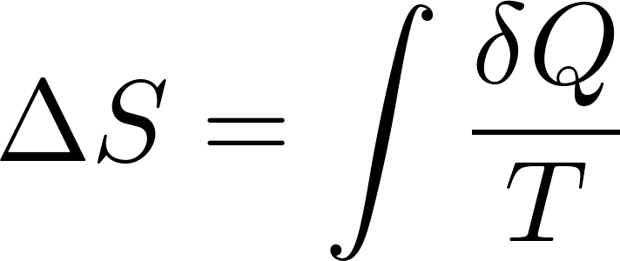
So the mean amount of information needed to complete our knowledge from macrostate to microstate level is
In thermodynamic:
therefore thermodynamical entropy is measured in J/K

Slide 11

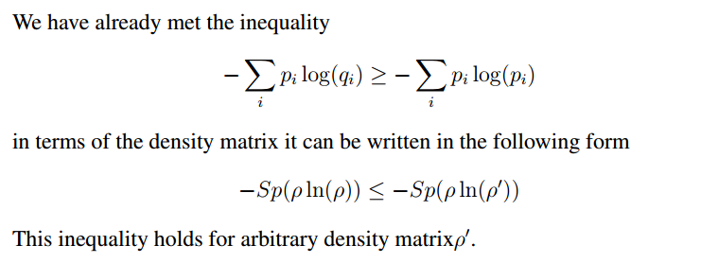

Slide 12
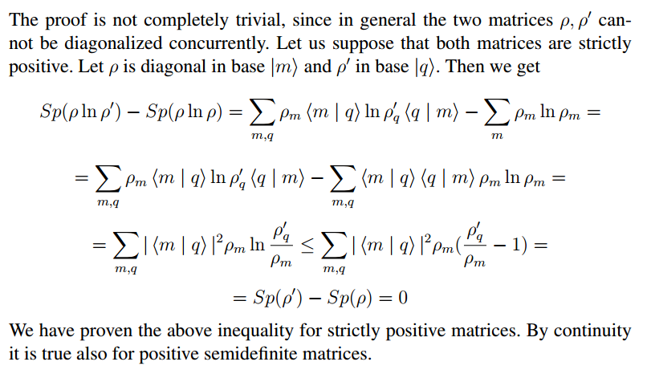

Slide 13
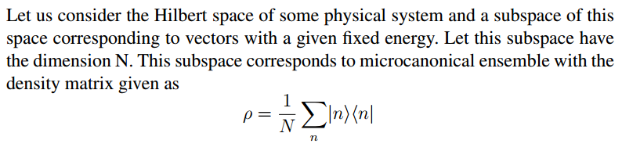

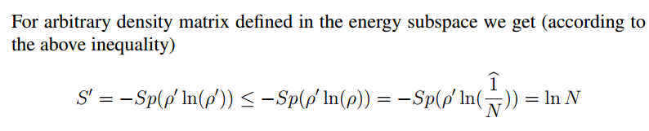
Entropy is maximal

Slide 14
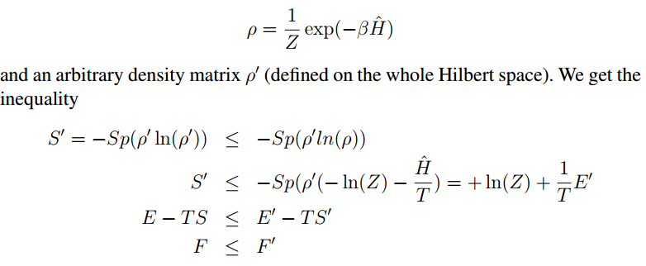
Free energy is minimal
$F′$ is different from canonical, so it is non-equilibrium free energy

Slide 15
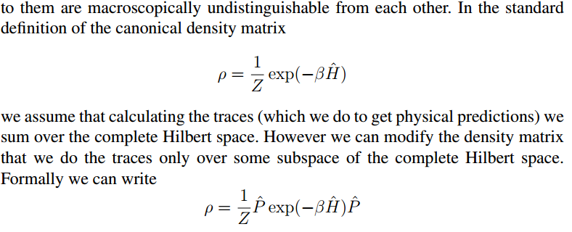
How to calculate a non-equilibrium free energy at a given temperature

Slide 16
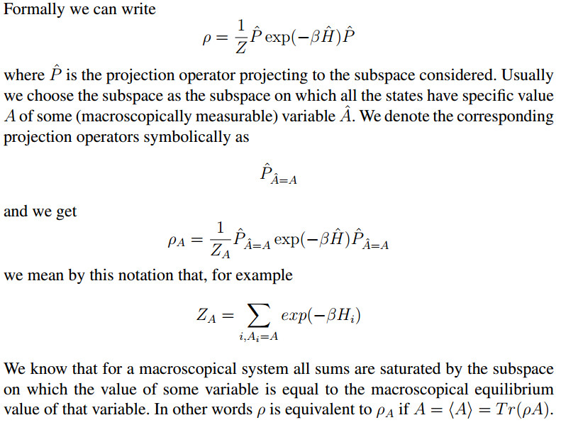

Slide 17
