Slide 1


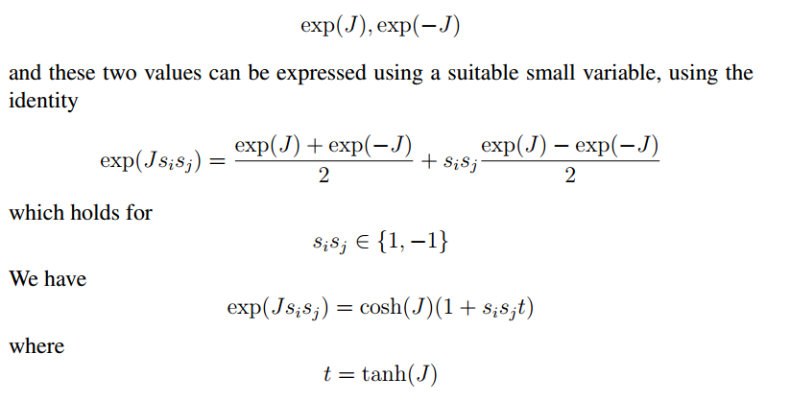
Small $t$ means large $T.$ High temperature expansion.

Slide 2
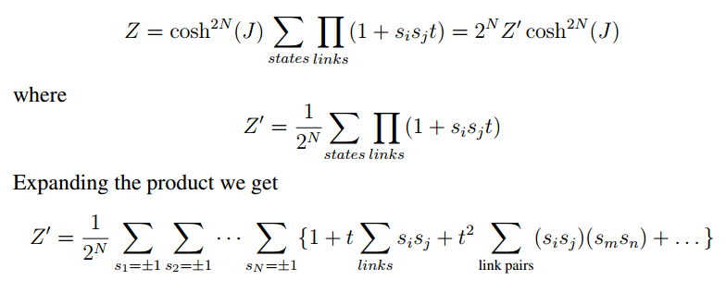
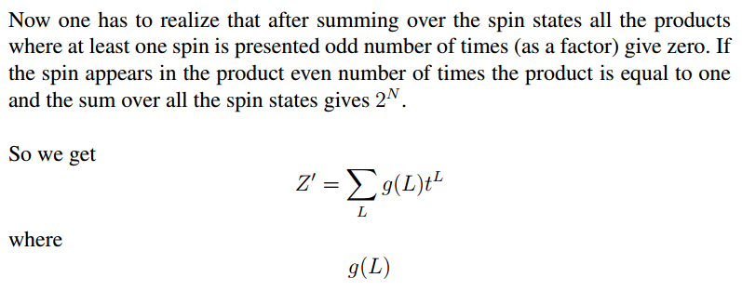

Slide 3
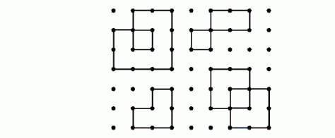
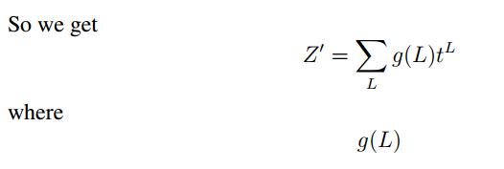


Slide 4
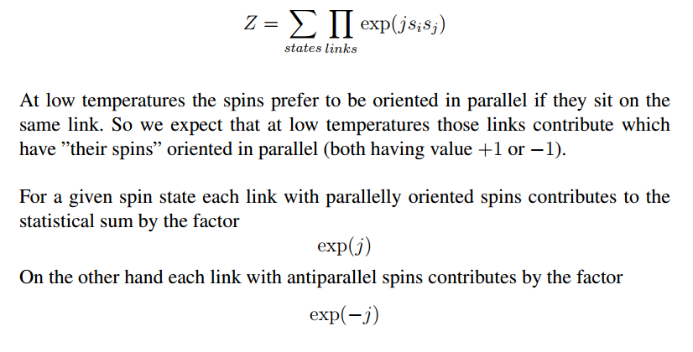

Low temperature expansion

Slide 5
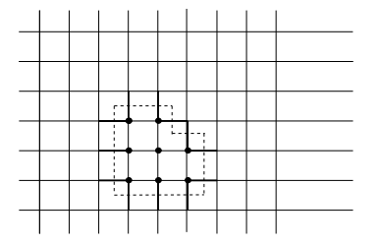
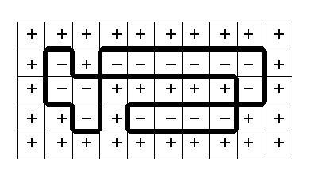


Dual latices

Slide 6
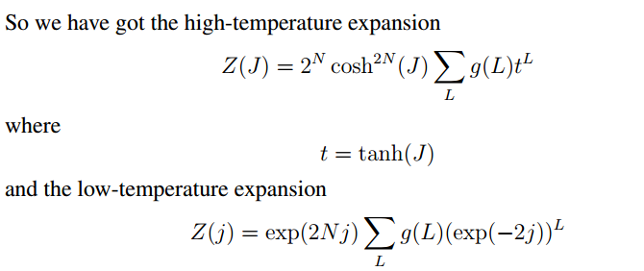
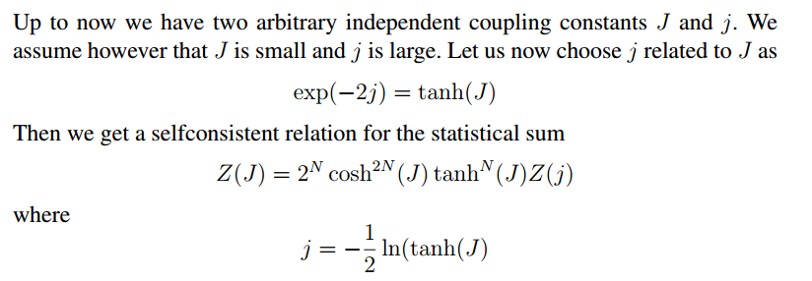

Slide 7
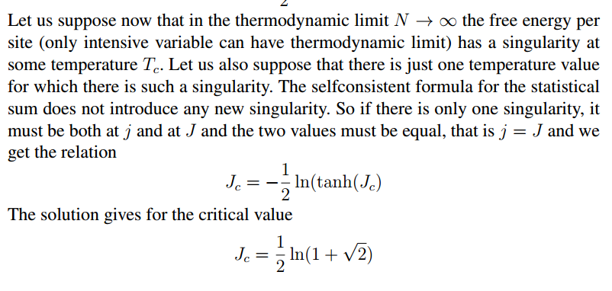

Slide 8

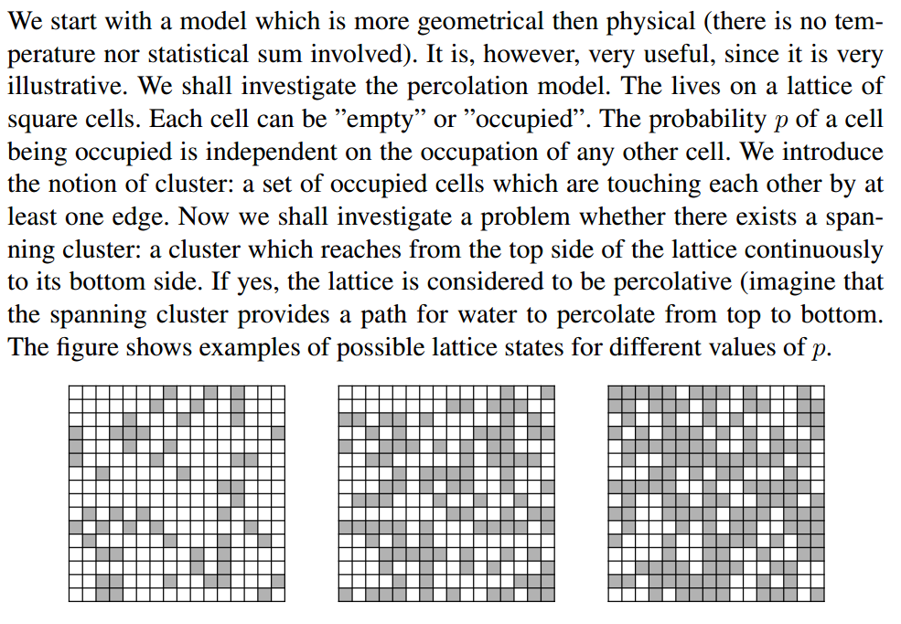

Slide 9

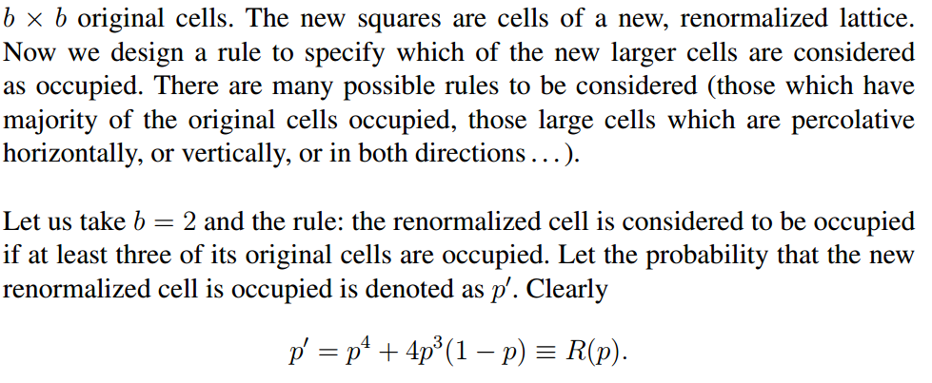

Slide 10
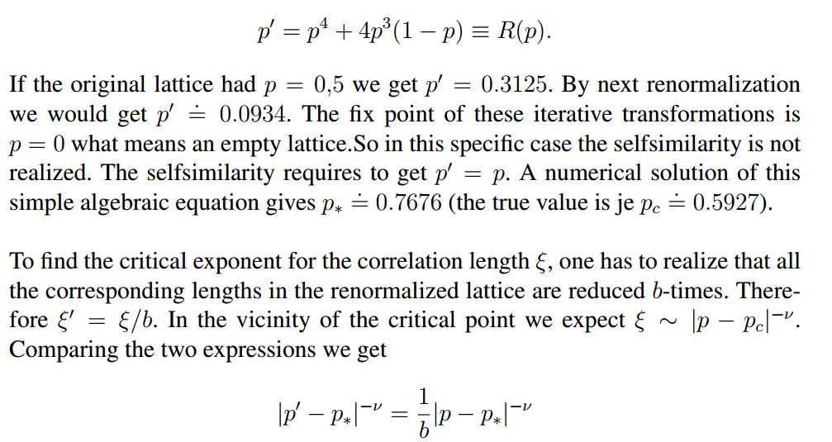


Slide 11




Slide 12


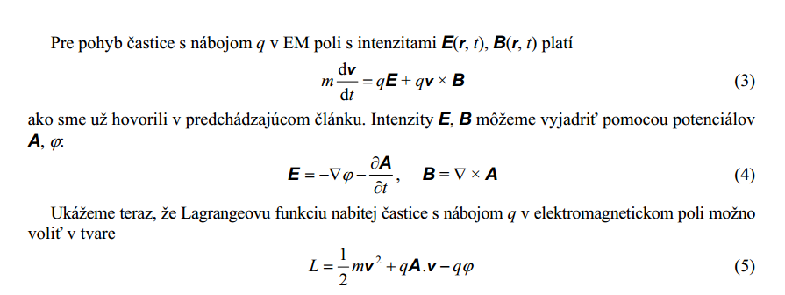

Slide 13










Slide 14



Slide 15





Fluctuation – Response Theorem
This is how one calculate $C_{V}$ numerically, since calculating it via
$\overline{E}\left(T+dT\right)−\overline{E}(T)$ is numerically intractable
Note: cumulant

Slide 16

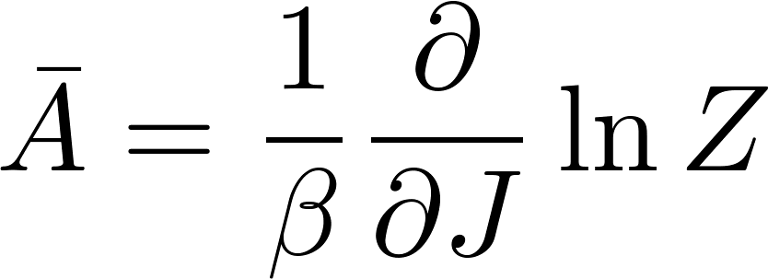



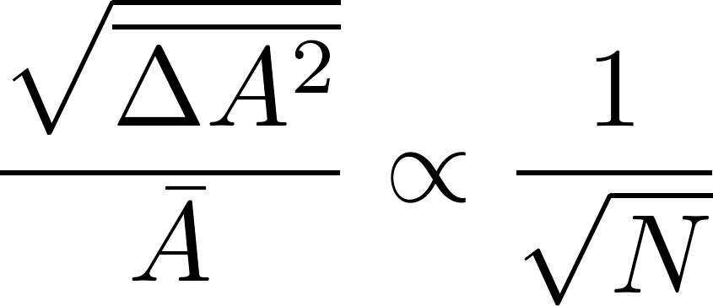
Fluctuation – Response Theorem for arbitrary quantity
Note: if $A$ is extensive, then $χ_{A}$ is extensive, so

Slide 17

$Z\left(J\right)$ is a generating function of moments of $A$
$\text{ln}\text{(}\text{Z}\text{(}\text{J}\text{))}$ is a generating function of cumulants of $A$.

