Slide 1
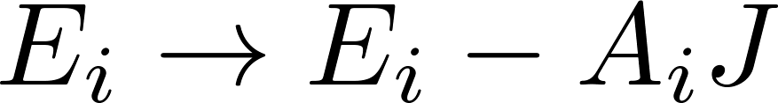
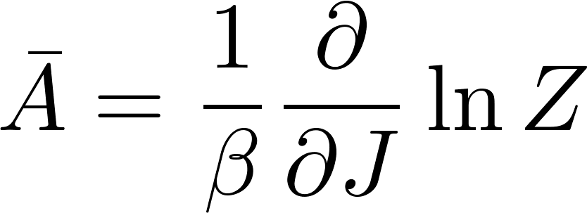
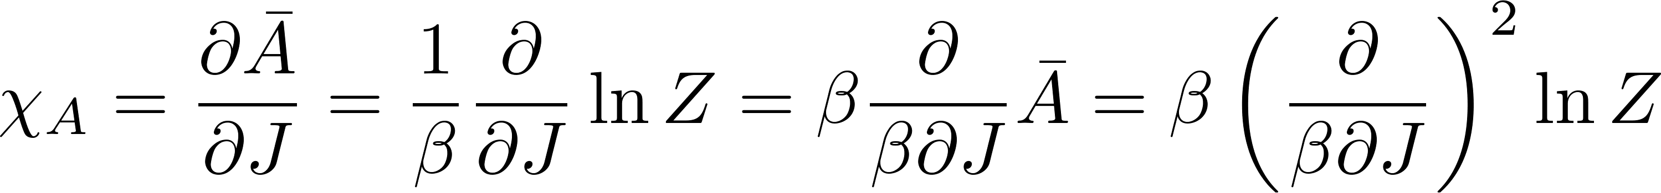
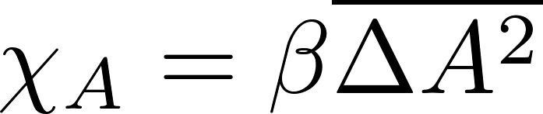

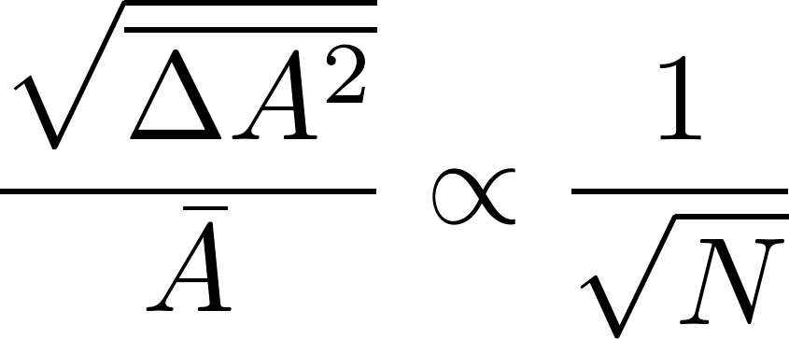
Fluctuation – Response Theorem for arbitrary quantity
Note: if $A$ is extensive, then $χ_{A}$ is extensive, so

Slide 2
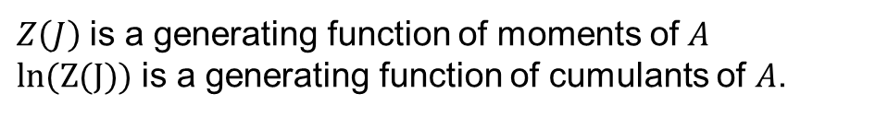
$Z\left(J\right)$ is a generating function of moments of $A$
$\text{ln}\text{(}\text{Z}\text{(}\text{J}\text{))}$ is a generating function of cumulants of $A$.

Slide 3
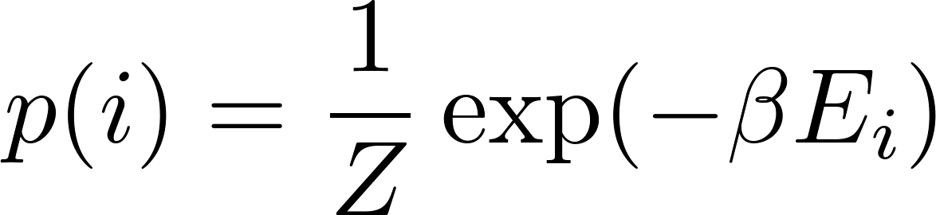
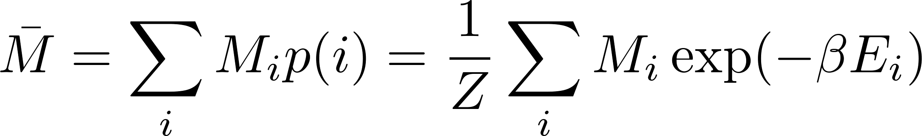
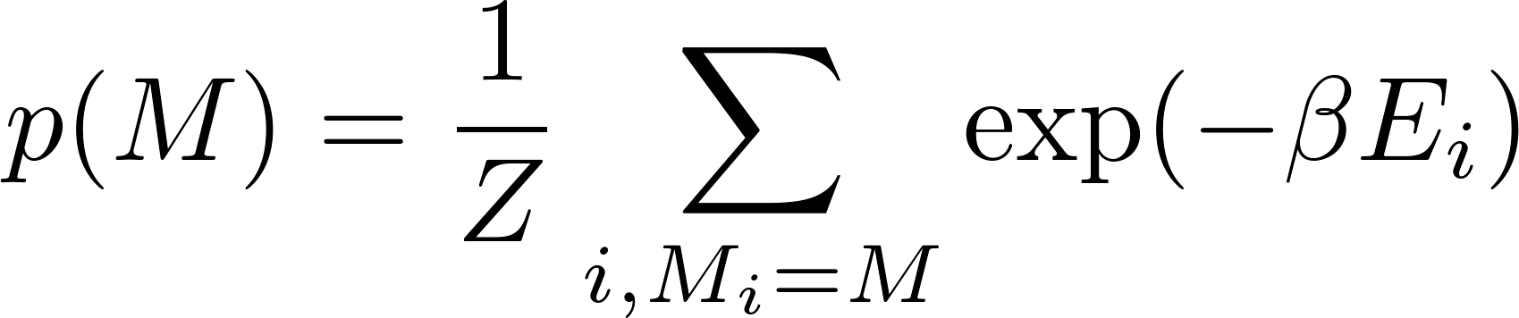
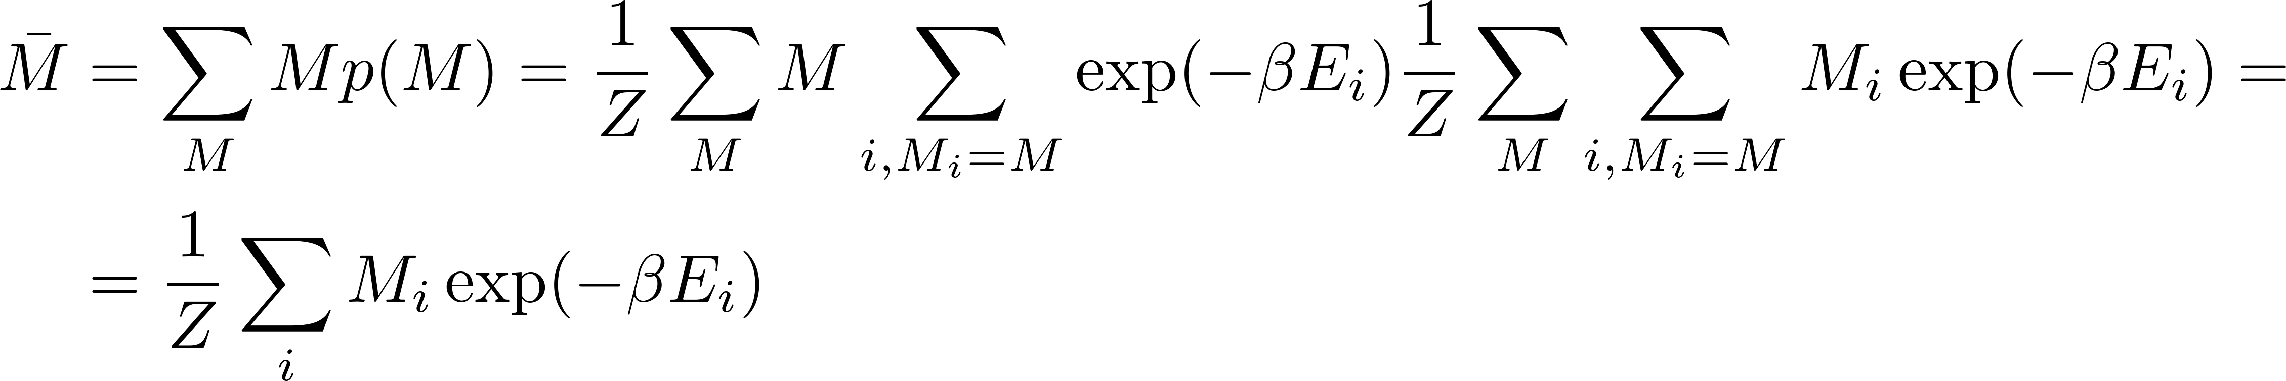
Probability of fluctuations

Slide 4
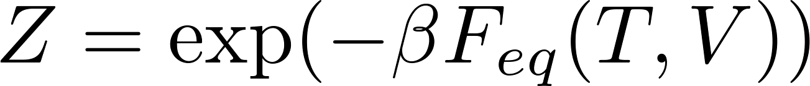
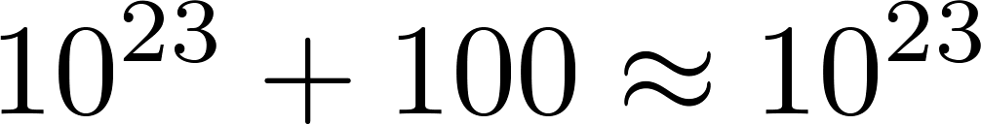
Be careful:
but

Slide 5
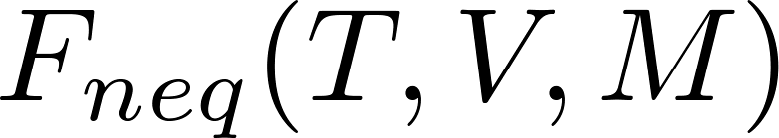
Sometimes we can reasonably guess the dependence of
on M. Like in the Landau model of phase transitions. Then we can have a phenomenological effective theory like
Then $Z$ need not be calculated from the original microscopic Hamiltonian, but as a normalization of an effective theory

Slide 6
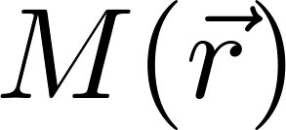
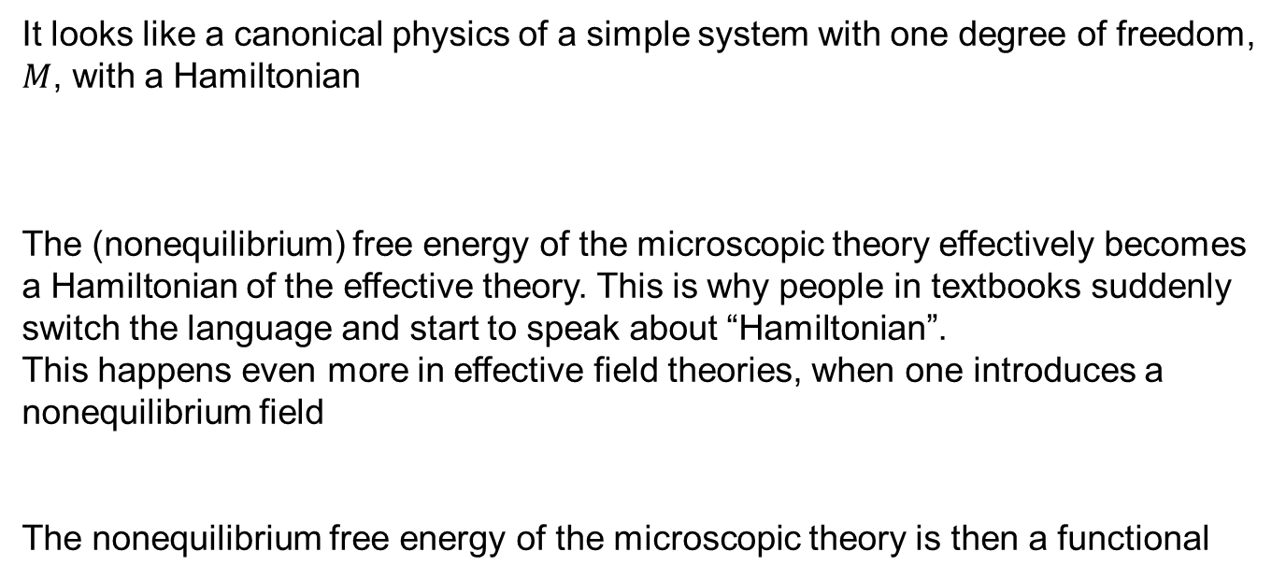
It looks like a canonical physics of a simple system with one degree of freedom, $M$, with a Hamiltonian
The (nonequilibrium) free energy of the microscopic theory effectively becomes a Hamiltonian of the effective theory. This is why people in textbooks suddenly switch the language and start to speak about “Hamiltonian”.
This happens even more in effective field theories, when one introduces a nonequilibrium field
The nonequilibrium free energy of the microscopic theory is then a functional

Slide 7

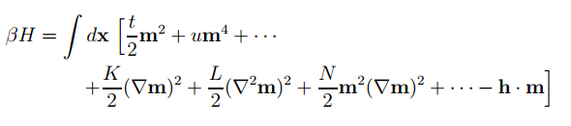
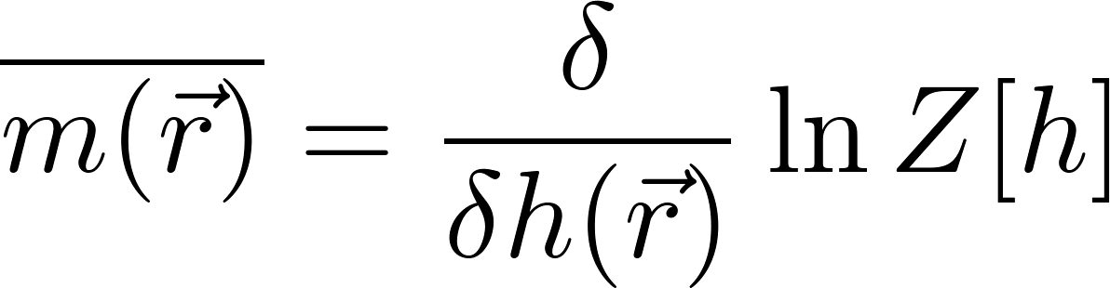
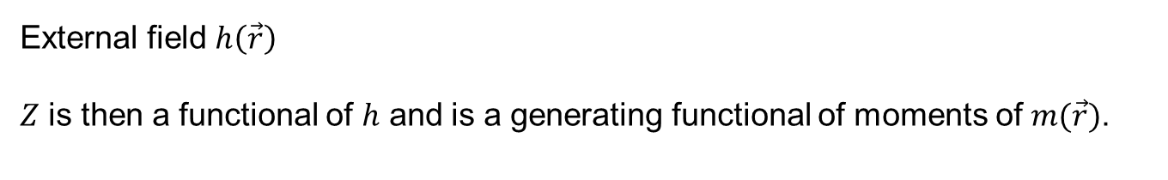
Phenomenological hamiltonian
External field $h\left(\vec{r}\right)$
$Z$ is then a functional of $h$ and is a generating functional of moments of $m(\vec{r})$.
All moments and correlations can be calculated as certain variational derivatives of the generating functional.

Slide 8
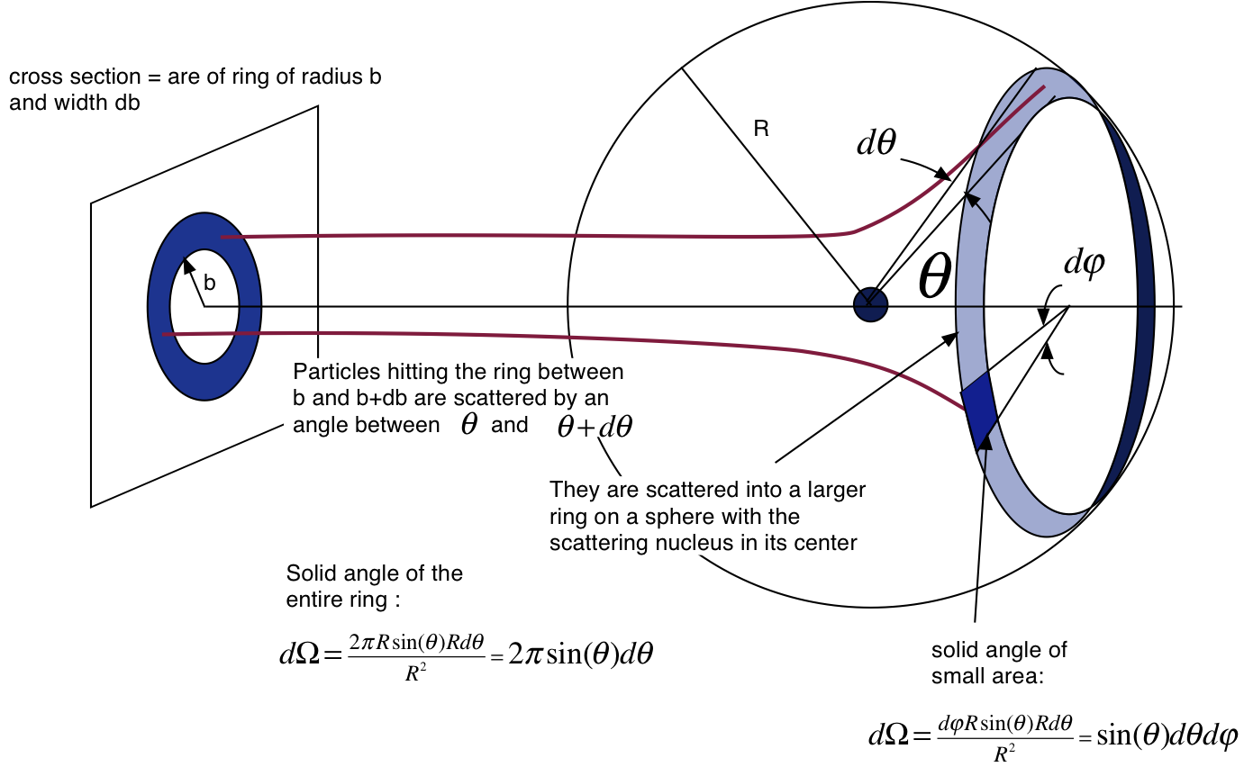

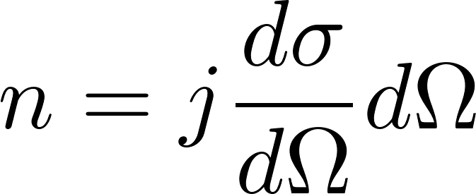
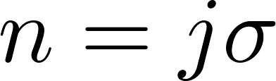


Scattering cross section
$j$ particles/cm⁻²/s
$n$ detector_clicks/s

Slide 9
Assumption: all collision events are independent of each other
This may not be true. If a collision destroys the target particle, the target particle is no more available for colliding with the next beam particles, so there would be only one click of the detectors eventually.

Slide 10
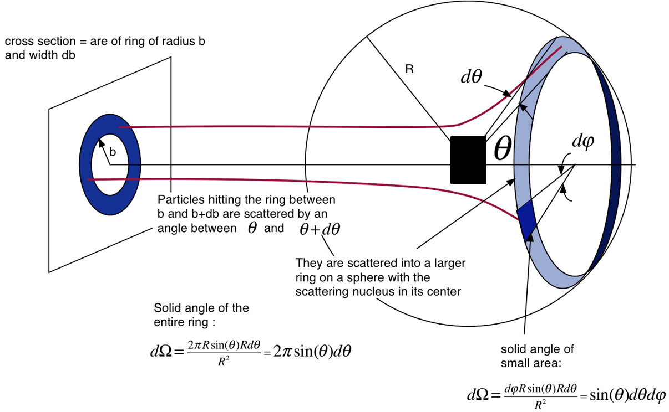
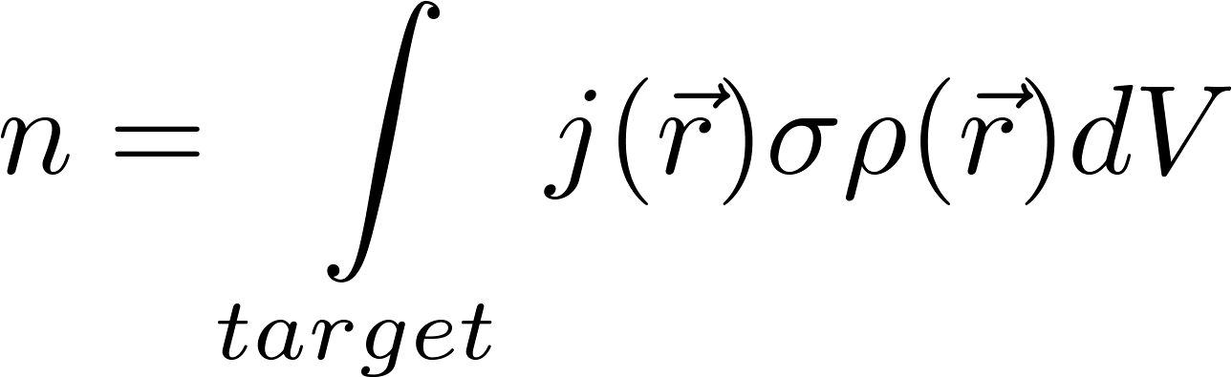

massive target $ρ$ volume density of scattering centers

Slide 11
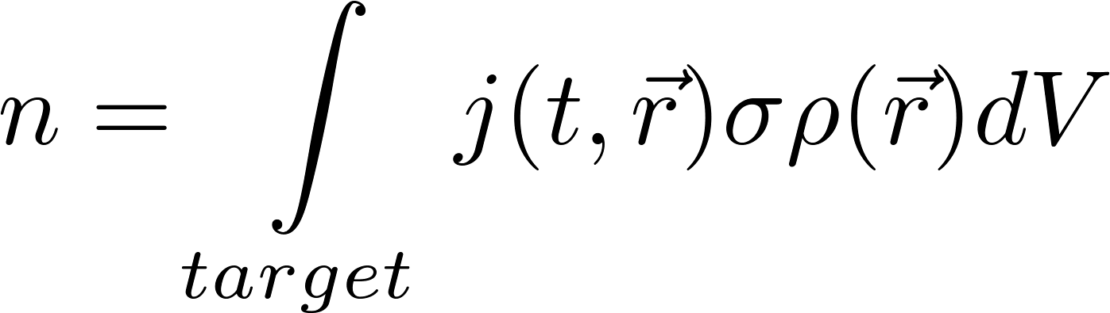
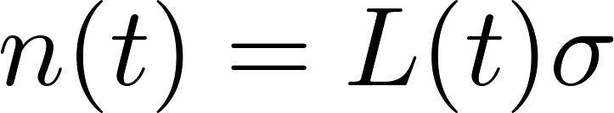
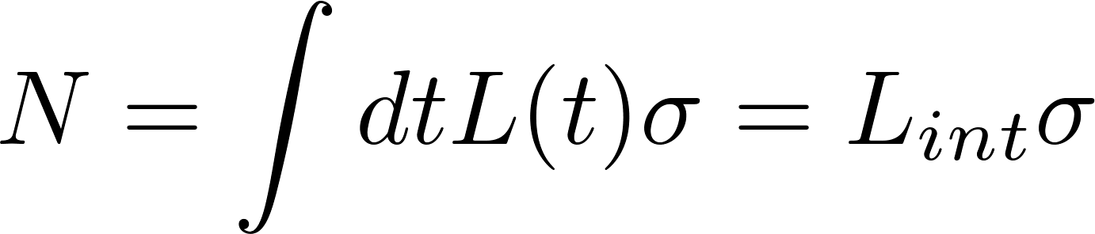
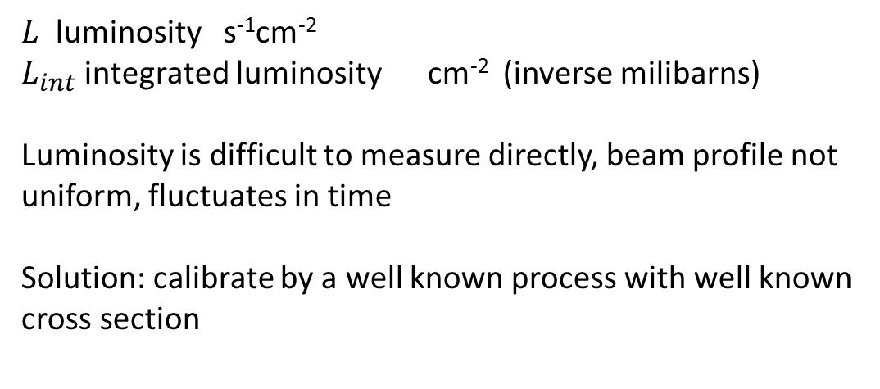
$L$ luminosity s⁻¹cm⁻²
$L_{int}$ integrated luminosity cm⁻² (inverse milibarns)
Luminosity is difficult to measure directly, beam profile not uniform, fluctuates in time
Solution: calibrate by a well known process with well known cross section

Slide 12
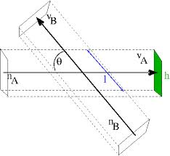
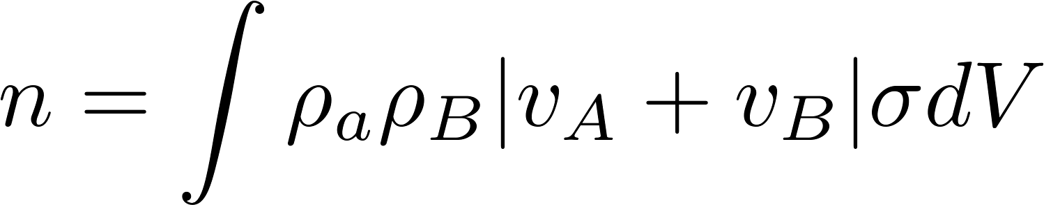
Colliders
for head-on collisions

Slide 13
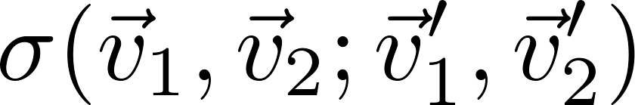
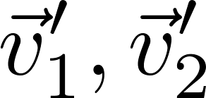
$σ$ may be differential cross section or even may contain $δ$-functions like
If detectors measure they measure with certain precision (discrete histograms, not points). So the number of detector counts is the integral over the sensitivity volume, the delta functions for energy momentum conservation get integrated-out.

Slide 14
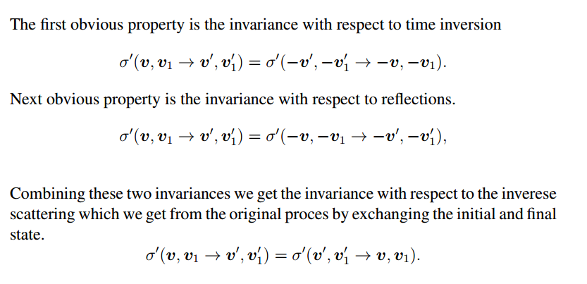

Slide 15

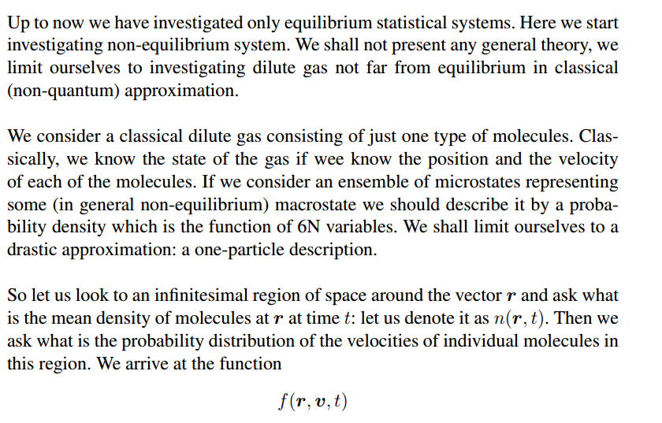

Slide 16
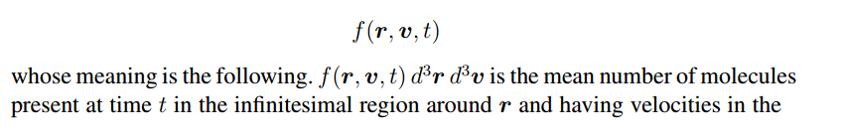
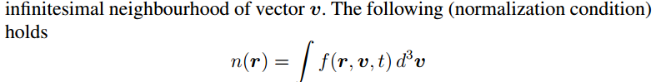

It becomes to be the oneparticle approximation when we say that it contains whole statistical information. By that we mean, that all statistical results (like mean values of all the physical variables) can be obtained just from function
f(r, v, t).

Slide 17
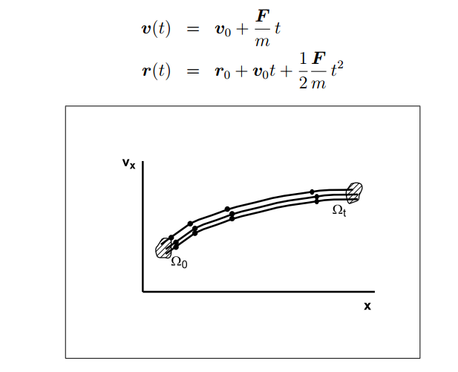
Ideal gas, no collisions

Slide 18
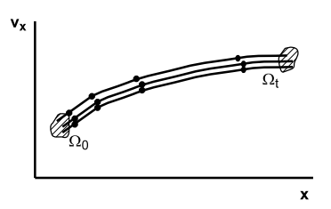
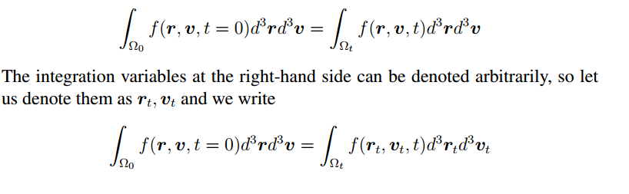

Slide 19
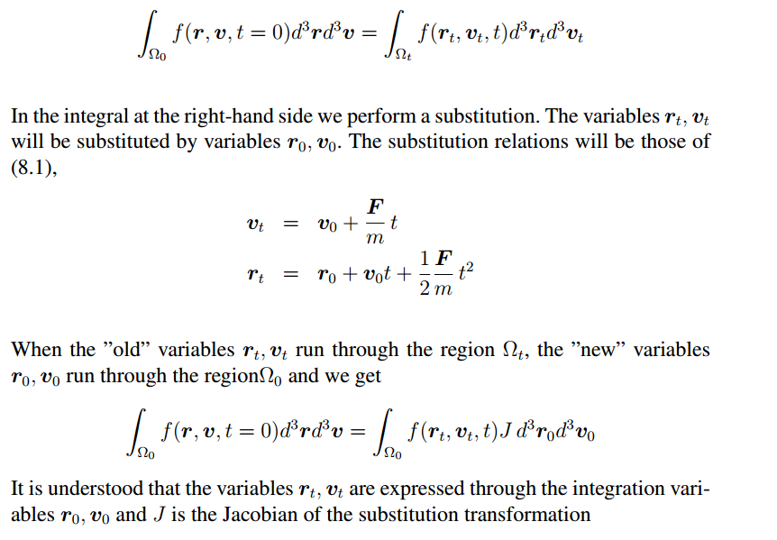

Slide 20
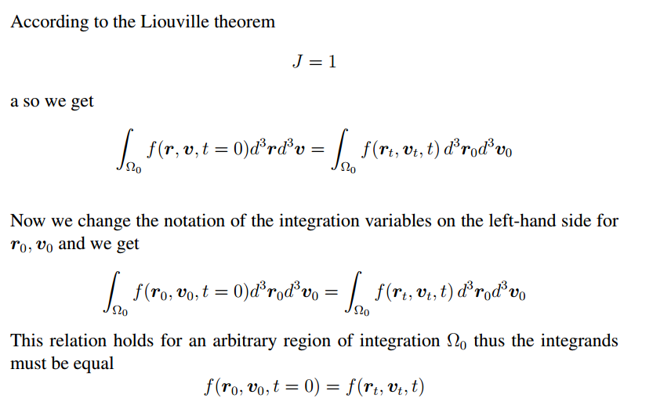

Slide 21
