Slide 1
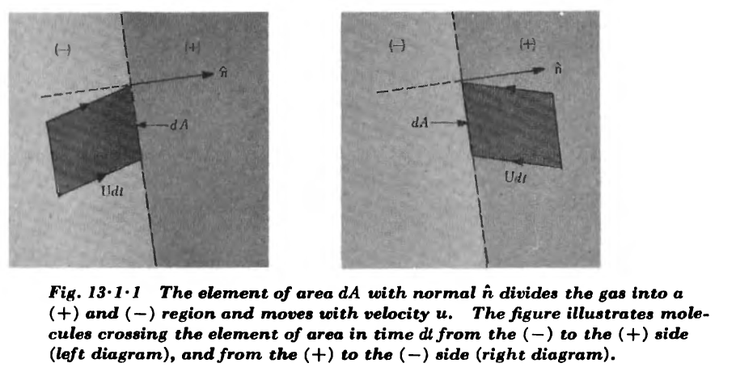


Slide 2




Slide 3



Tlak:
Note: even power of $v$! Nonzero also for Maxwell (equilibrium) distribution. How it is possible to have non-zero flux of some quantity in equilibrium. Symmetry prohibits equilibrium flux for a scalar quantity, but for a vector quantity like momentum it is possible. Look to the glass of water in equilibrium

Slide 4

Tlak:
Note: even power of $v$! Nonzero also for Maxwell (equilibrium) distribution. How it is possible to have non-zero flux of some quantity in equilibrium. Symmetry prohibits equilibrium flux for a scalar quantity, but for a vector quantity like momentum it is possible. Look to the glass of water in equilibrium

Slide 5




Tlak:
Note: even power of $v$! Nonzero also for Maxwell (equilibrium) distribution. How it is possible to have non-zero flux of some quantity in equilibrium. Symmetry prohibits equilibrium flux for a scalar quantity, but for a vector quantity like momentum it is possible. Look to the glass of water in equilibrium

Slide 6
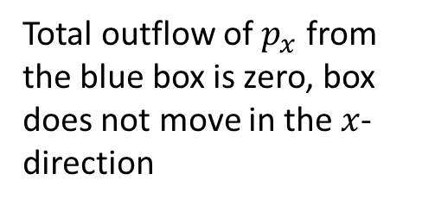
Total outflow of $p_{x}$ from the blue box is zero, box does not move in the $x$-direction

Slide 7

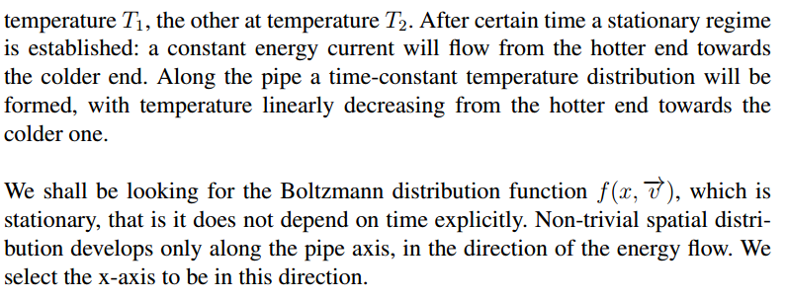

Slide 8
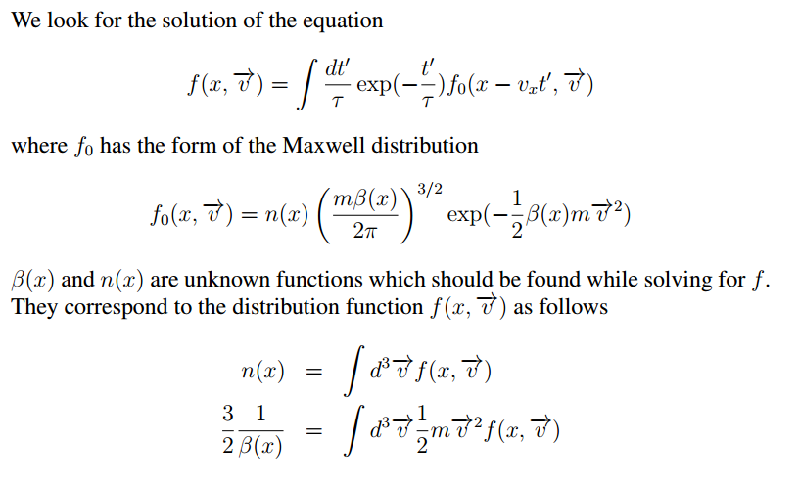

Slide 9
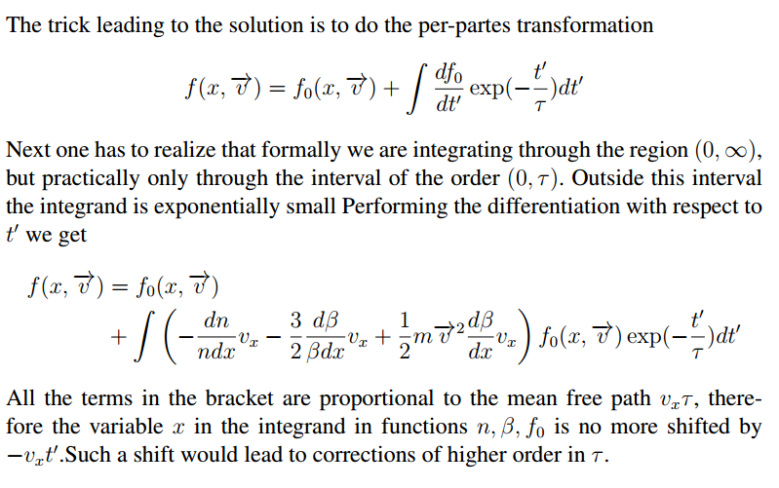

Slide 11


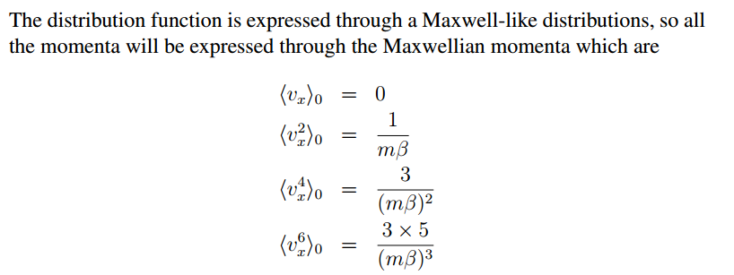

Slide 12

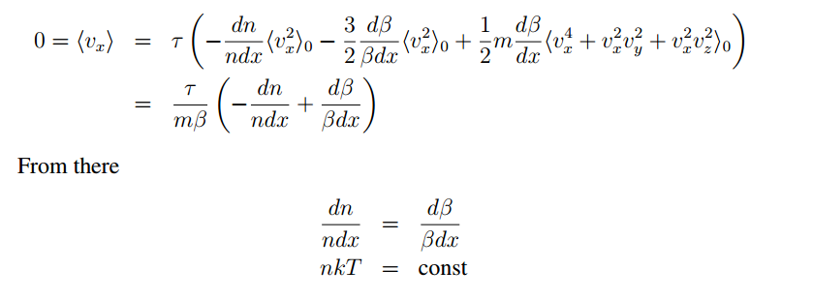

Slide 13


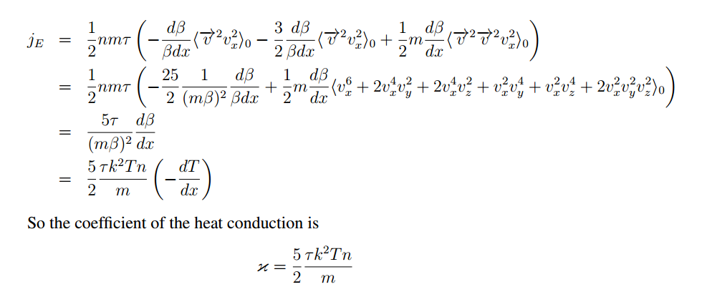

Slide 14
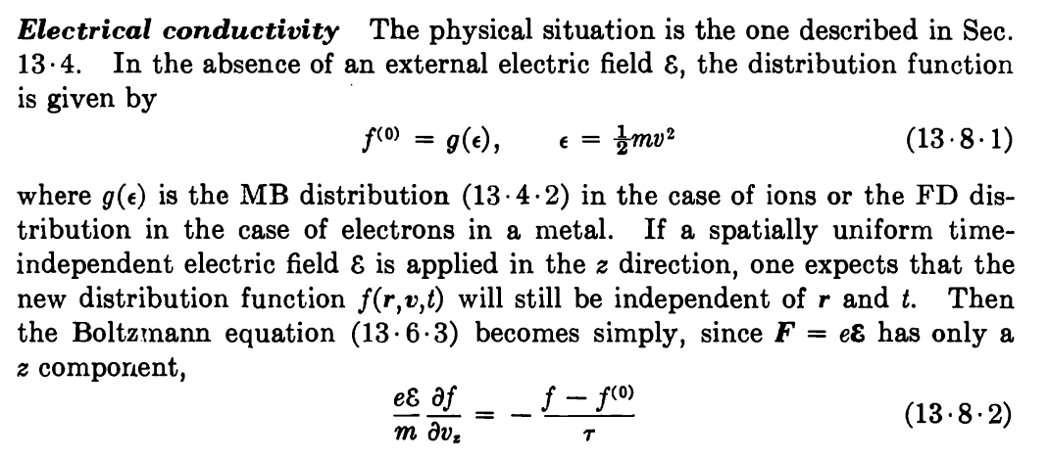



Slide 15

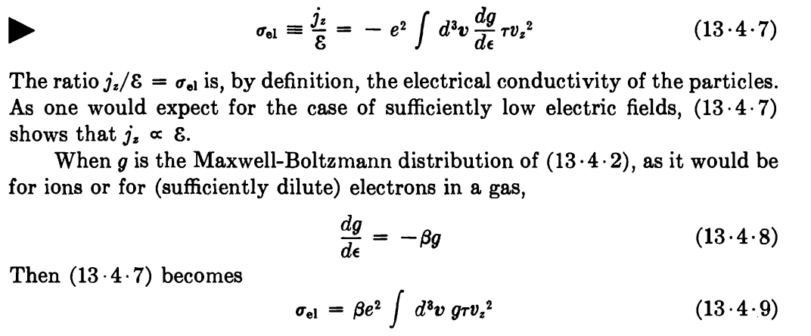

Slide 16


Slide 17

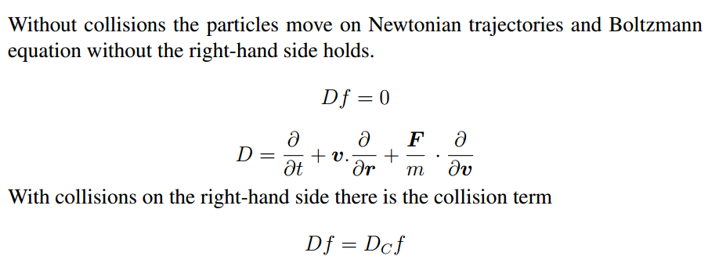
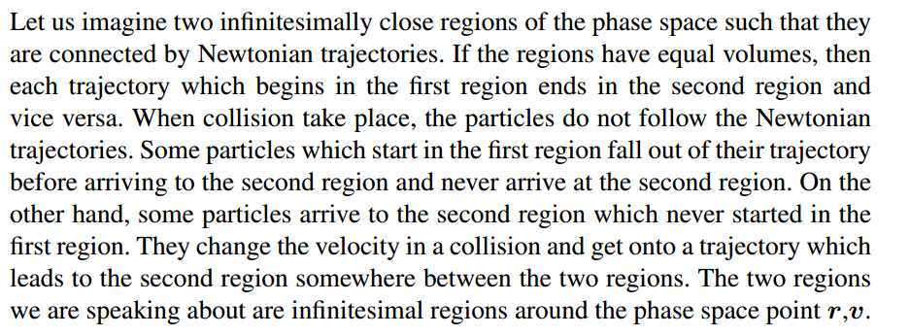

Slide 18

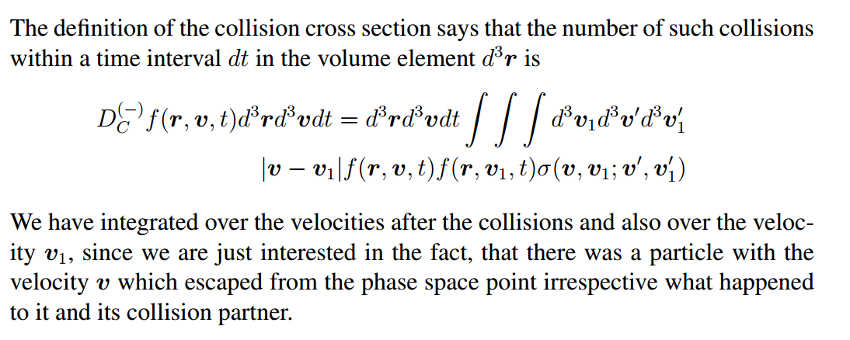

Slide 19

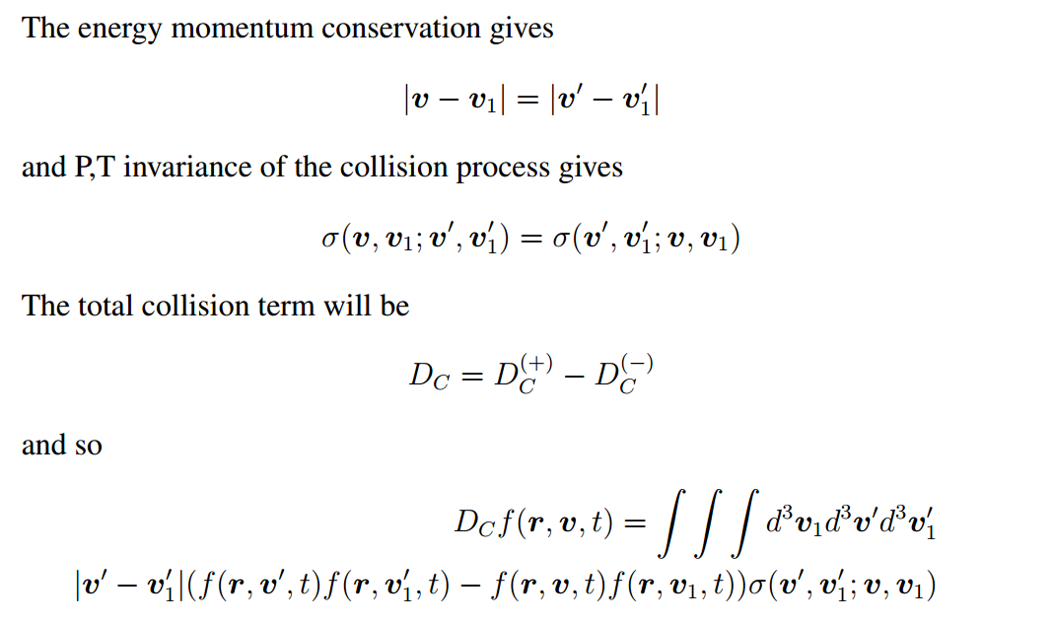

Slide 20
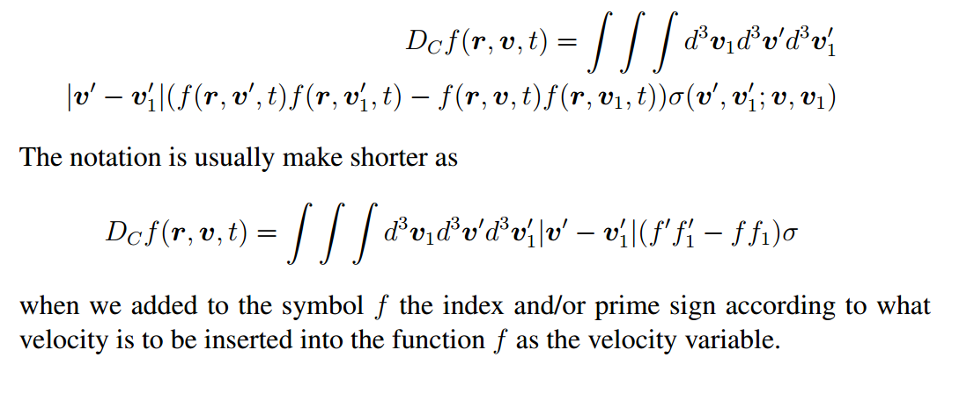

Slide 21







Equilibrium distribution
Maxwell

Slide 22

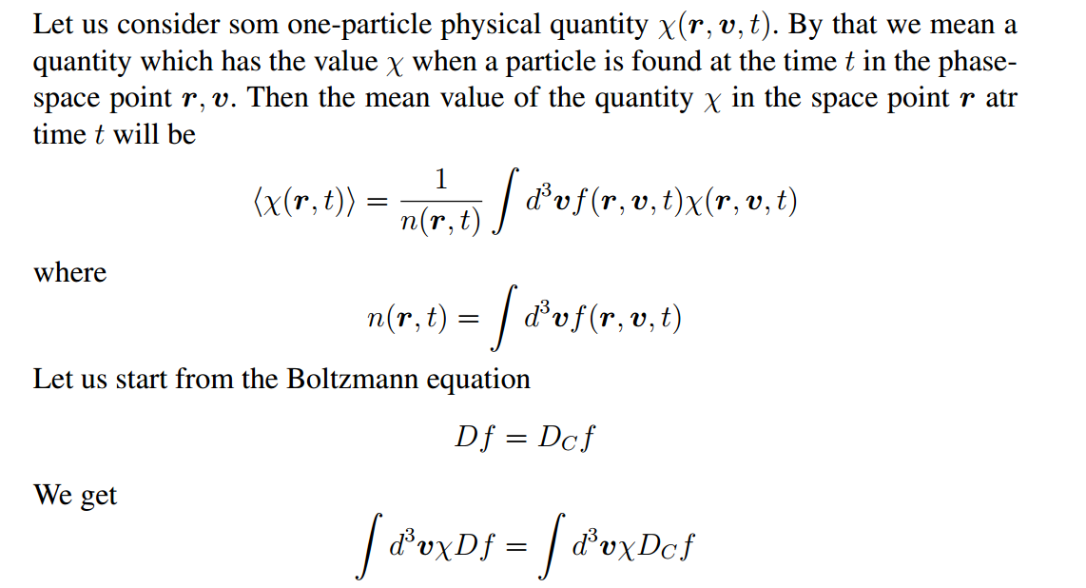

Slide 23
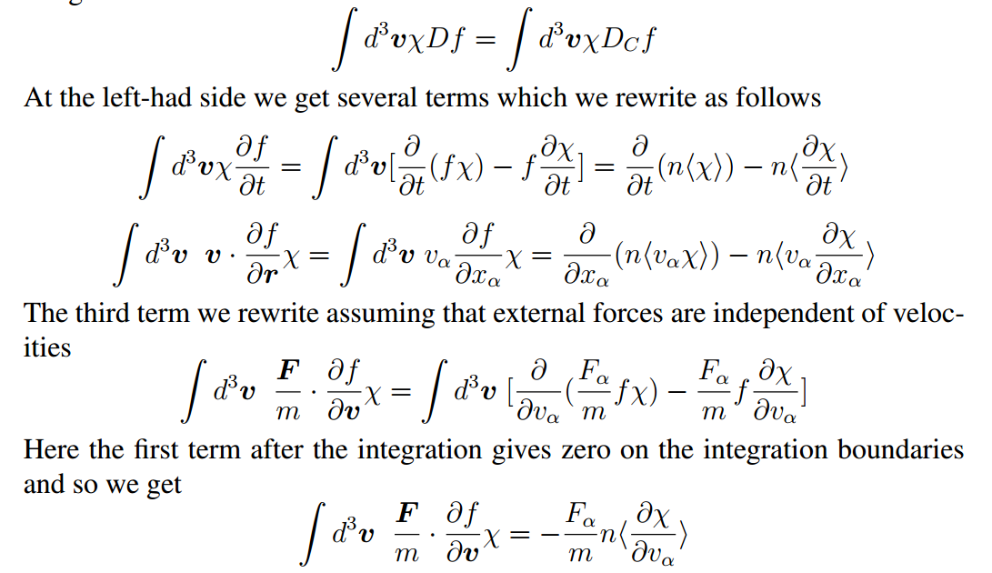

Slide 24

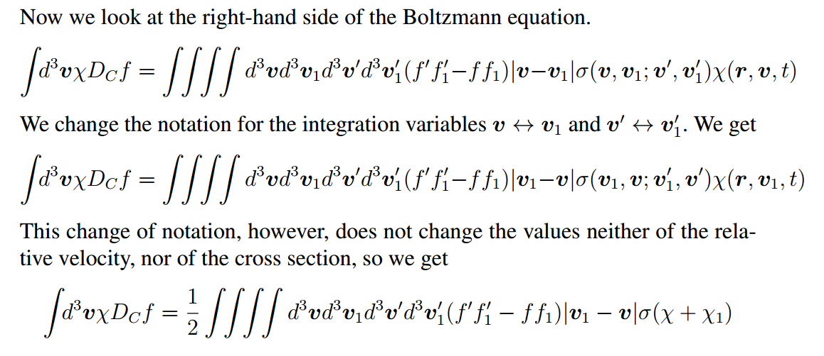


Slide 25



Slide 26


Slide 27

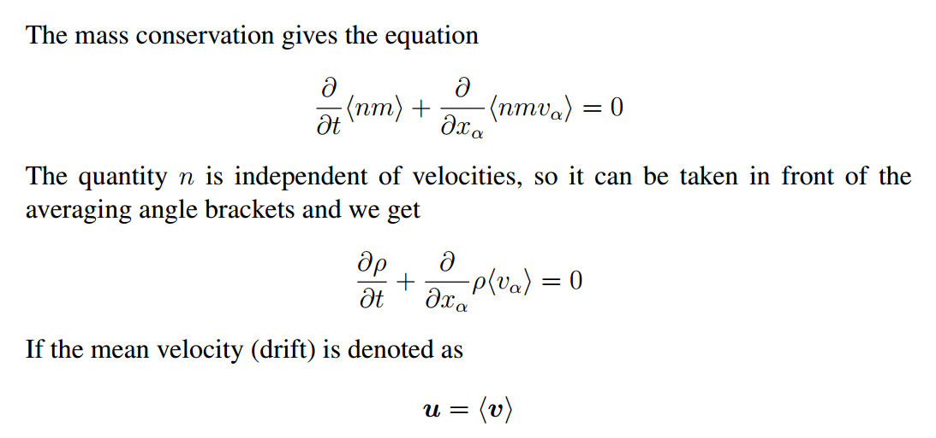


Slide 28
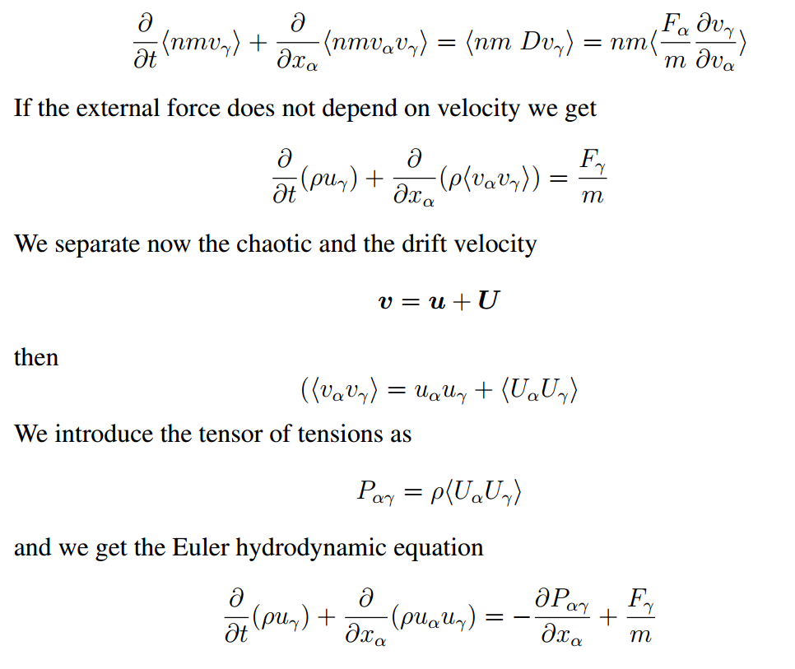

Slide 29

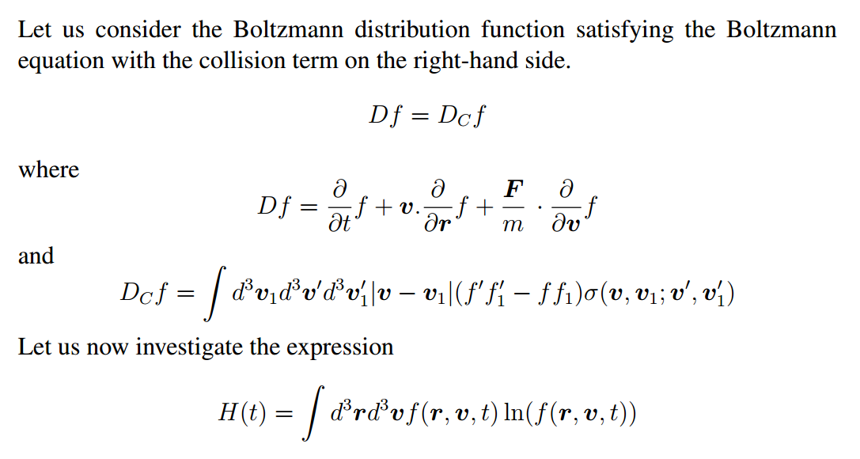


Slide 30
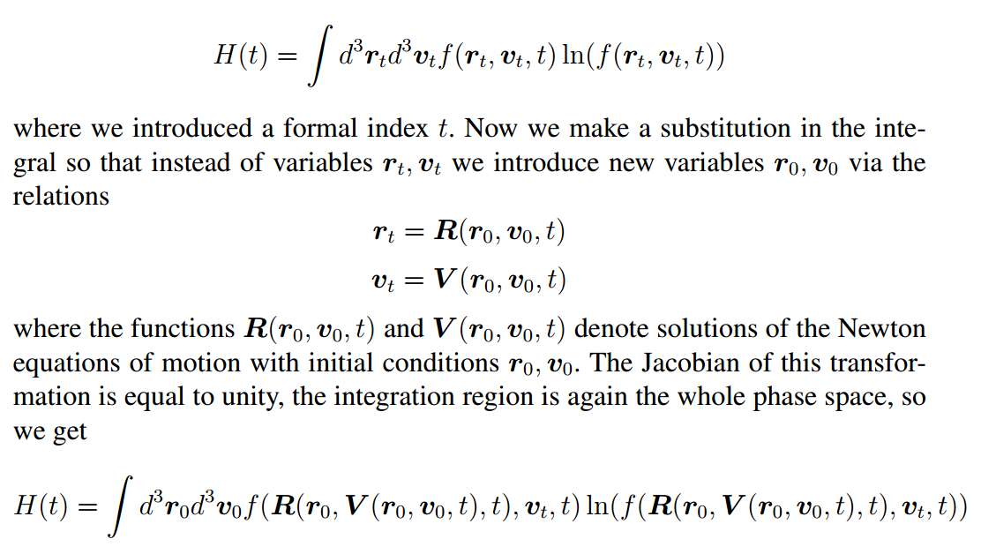


Slide 31
