Slide 1

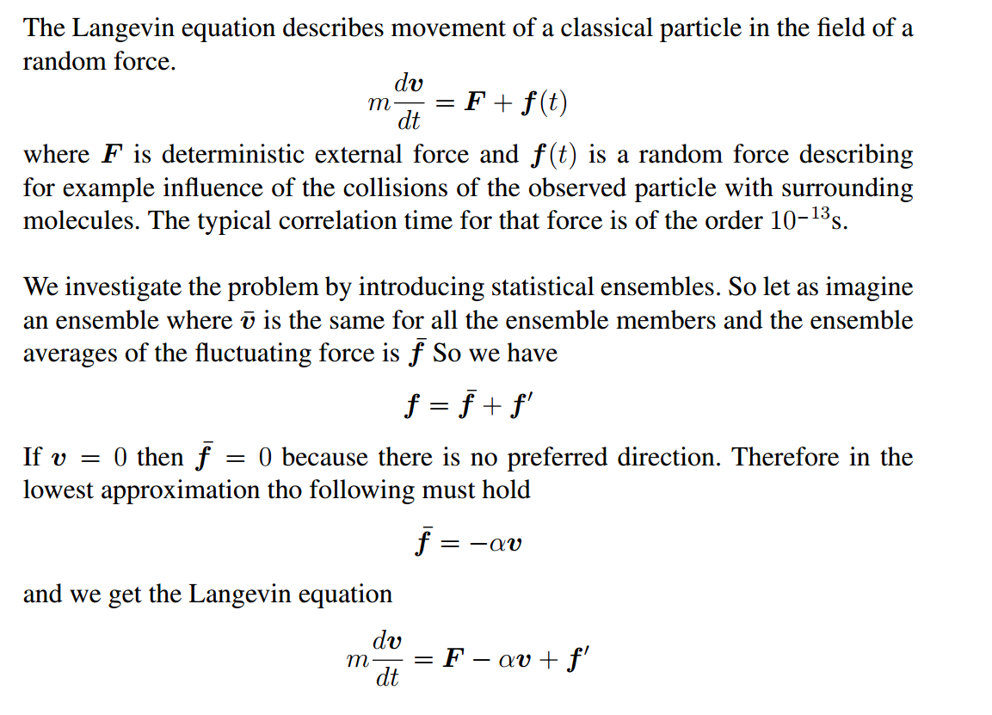

Slide 2
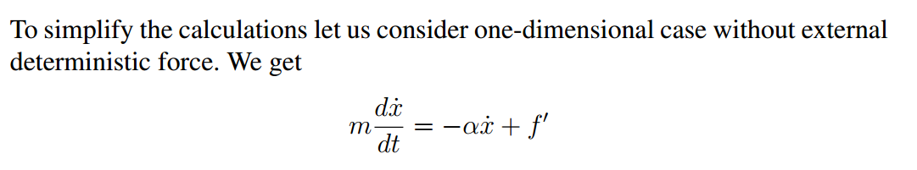
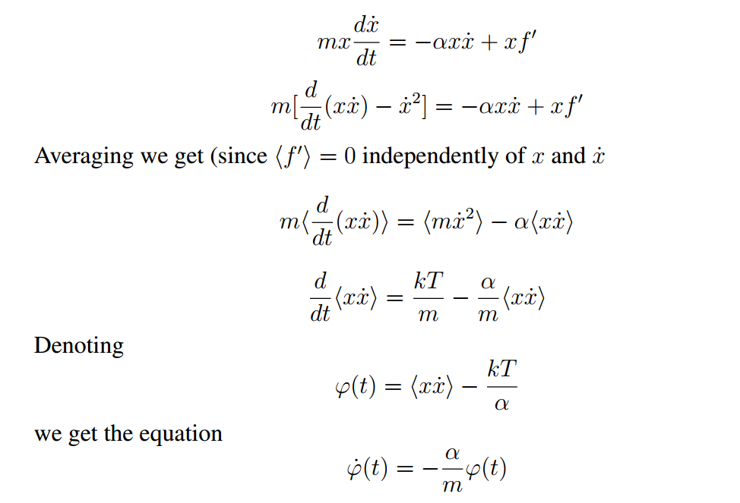

Slide 3
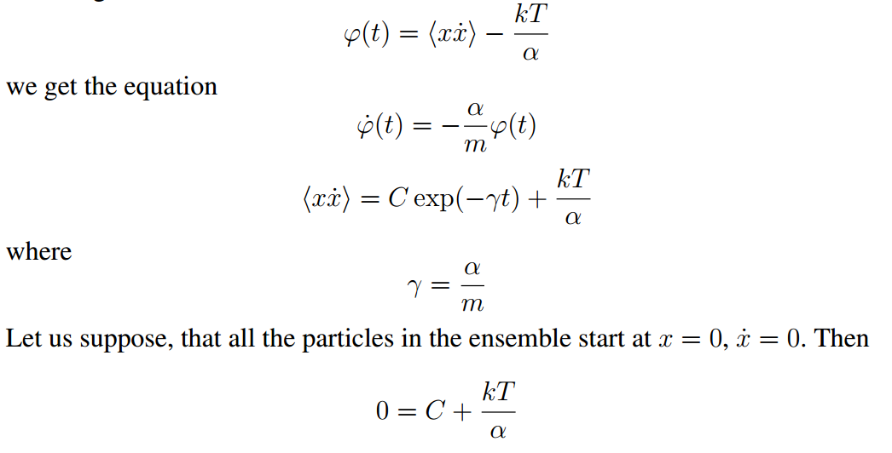
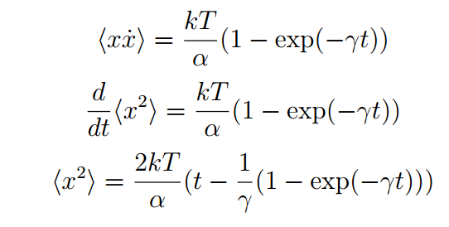

Slide 4
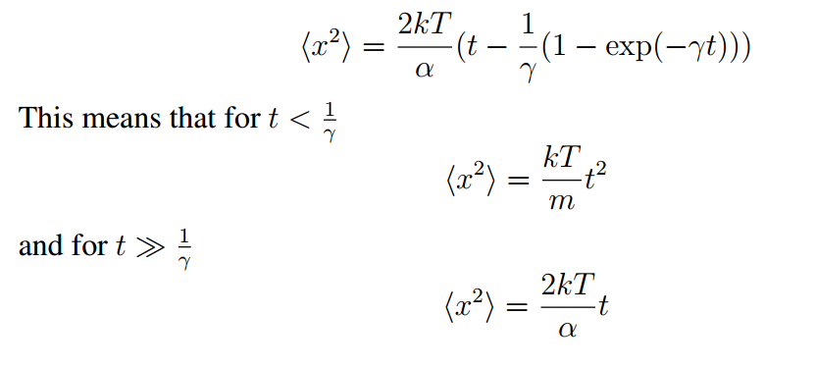

Slide 5
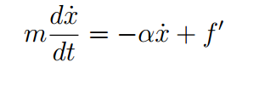
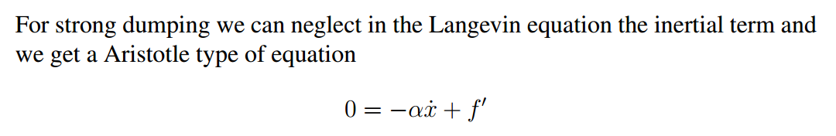
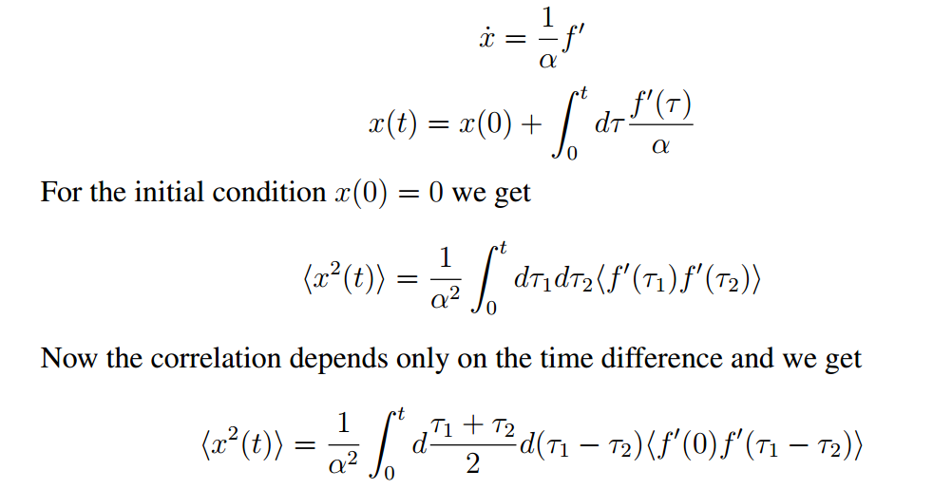

Slide 6
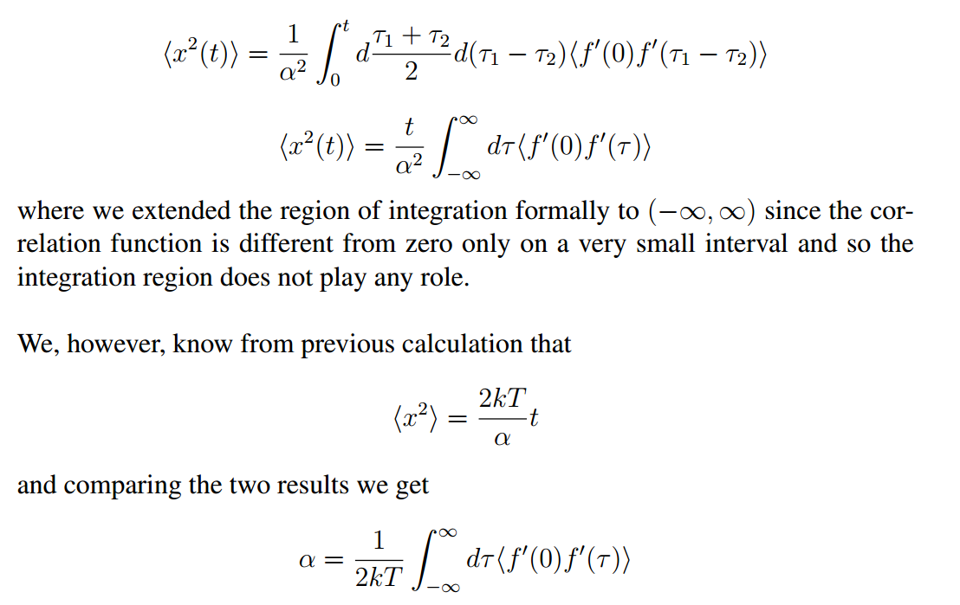

Slide 7
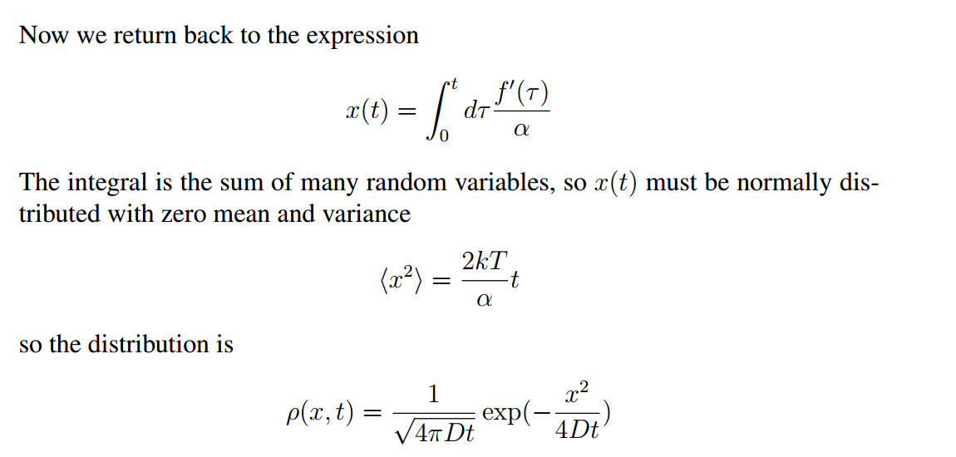
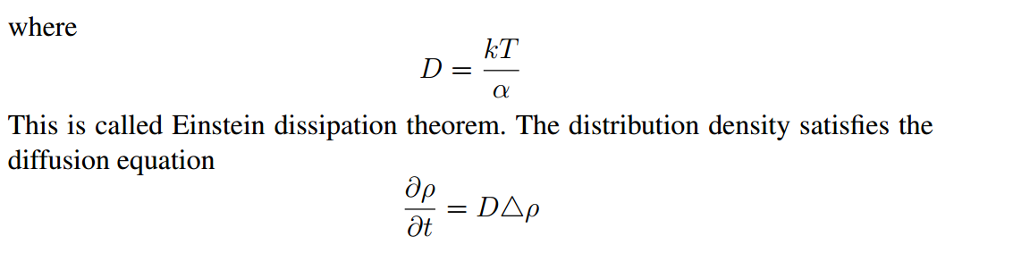

Slide 8
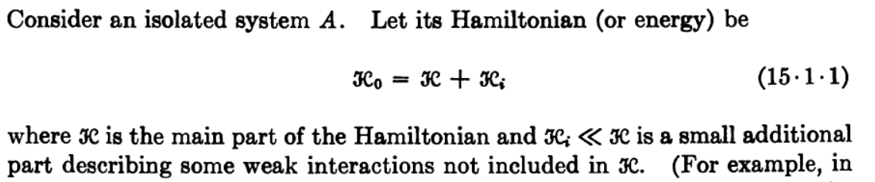
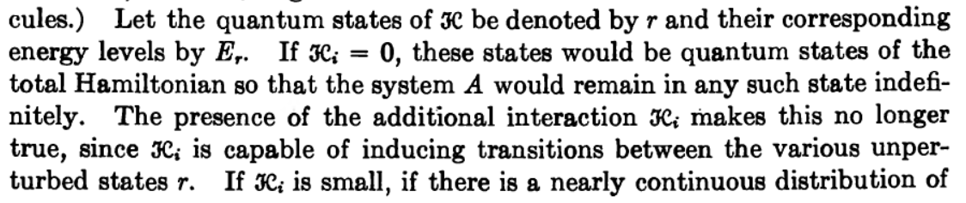
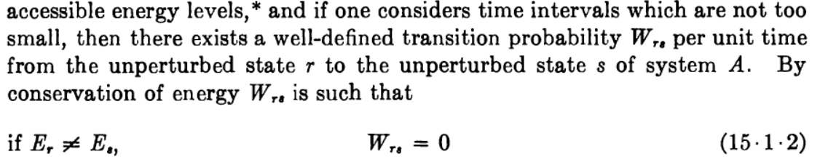

Slide 9
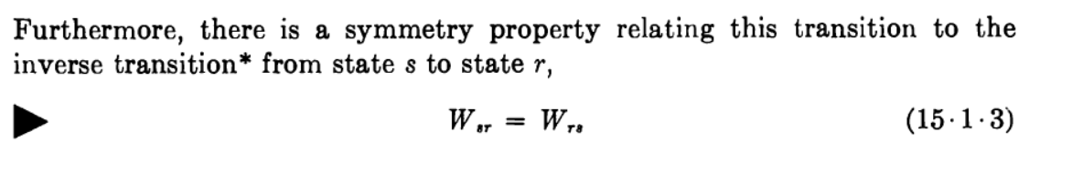

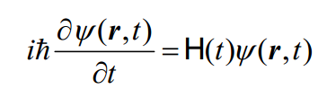
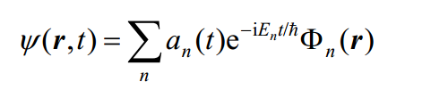
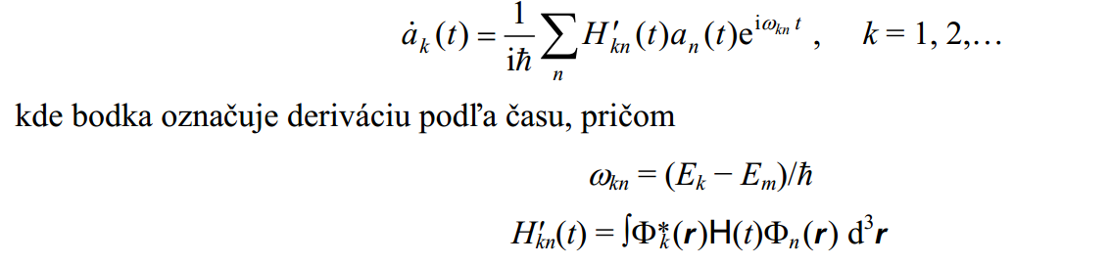


Slide 10
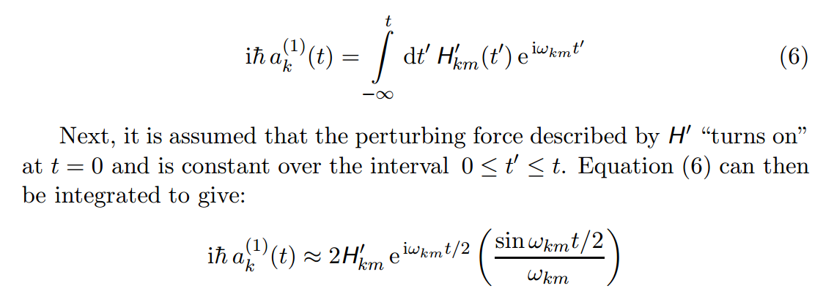
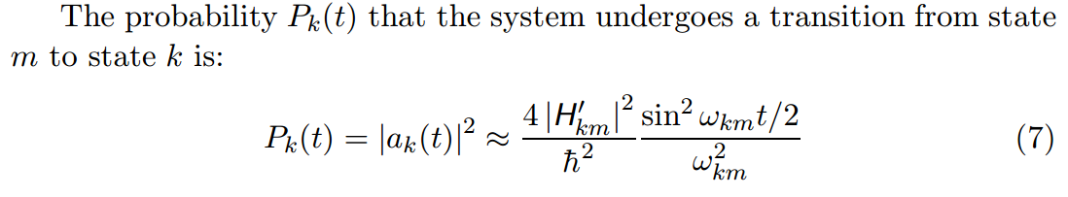

Slide 11
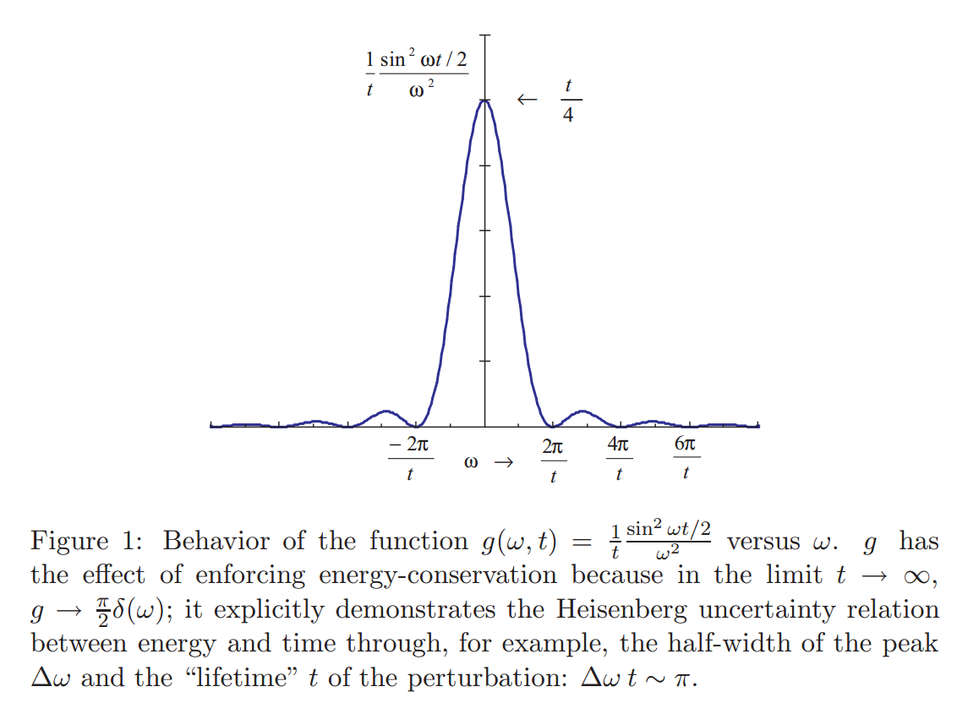

Slide 12
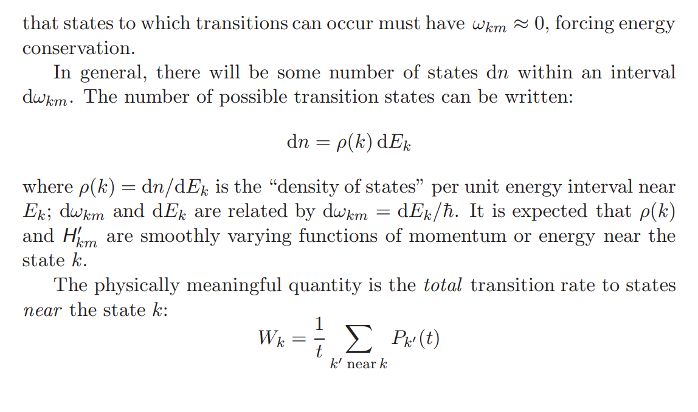

Slide 13
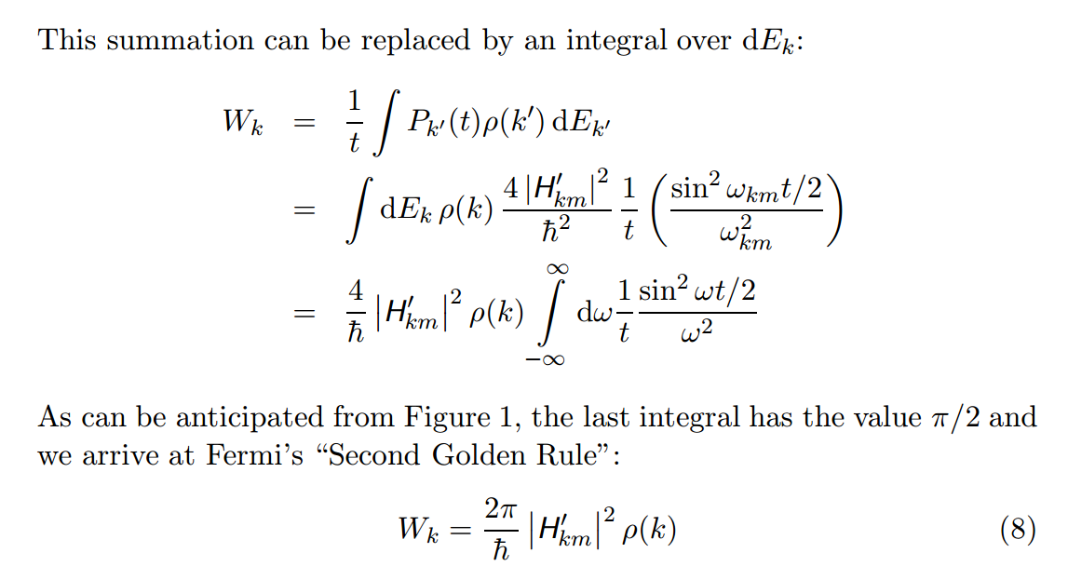

Slide 14
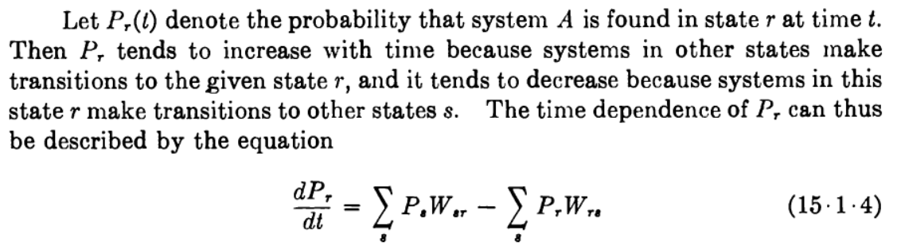
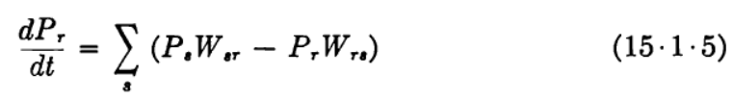
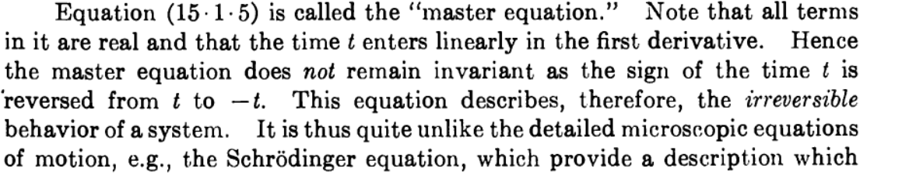

Slide 15



detailed balance

Slide 16
Decoherence,
quantum measurement,
master equation, exponential decay
and all that

Slide 17
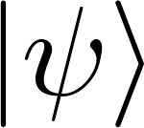

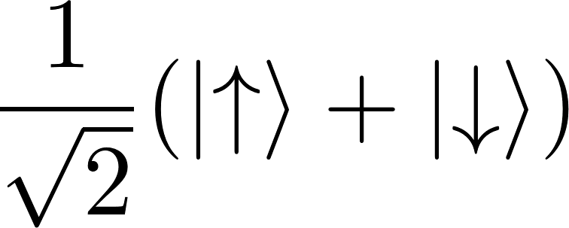


Quantum mechanics and measurement
states (pure states) are vectors in Hilbert space
measuring devices correspond to Hermitian operators
superposition states
measuring devices are classical devices, described by classical, not quantum mechanics
quantum system state collapses to an eigenstate of the measuring device’s operator
Stern-Gerlach shows “up”
Stern-Gerlach shows “down”
Problem of measurement in QM:
We would like to describe the measuring device also by quantum mechanics (by Schrodinger equation), but this is incompatible with state collapse as shown by von Neuman because state collapse is a non-unitary operation

Slide 18
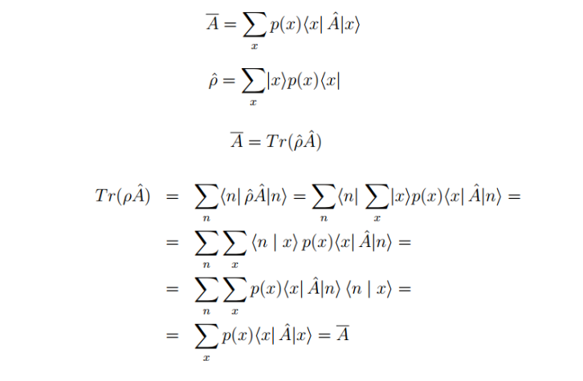
Density matric, statistical

Slide 19
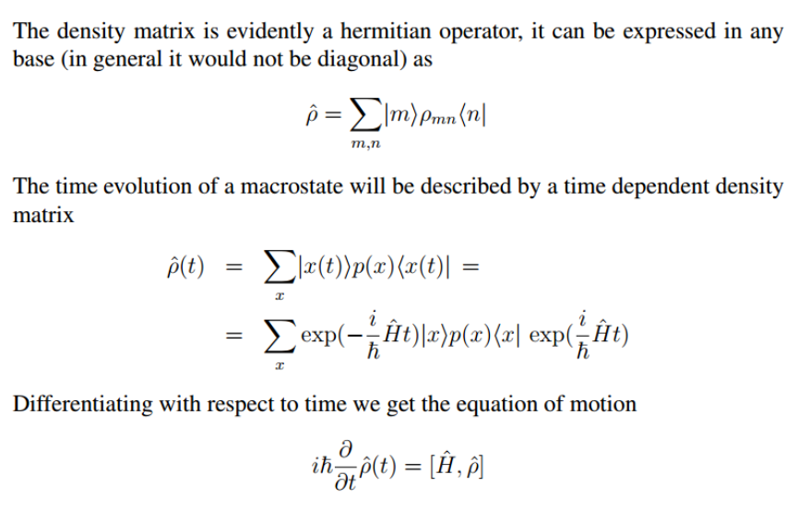

Slide 20
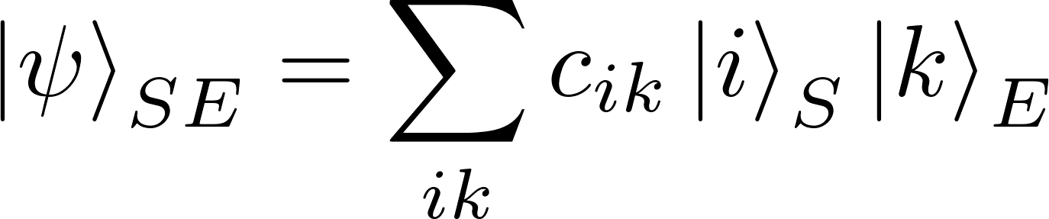
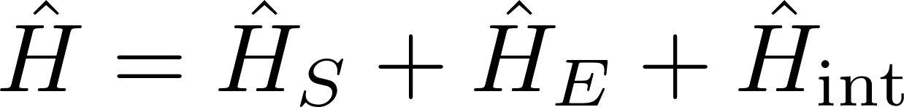
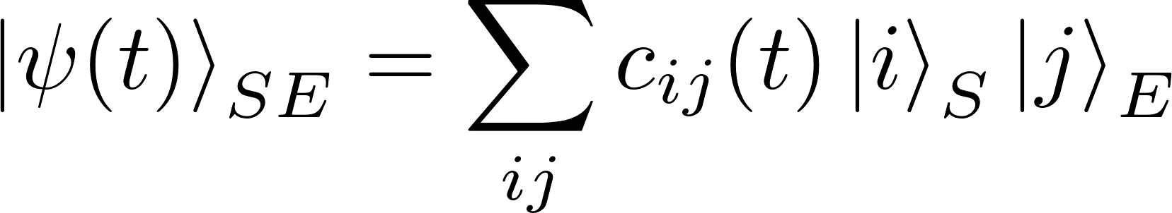
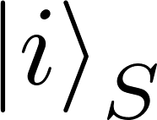
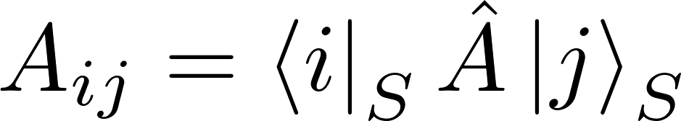
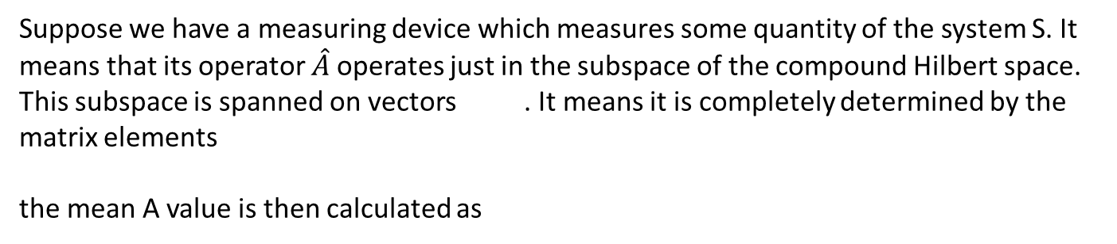
Density matric, subsystem
Compound system (S,E)
Suppose we have a measuring device which measures some quantity of the system S. It means that its operator $\hat{A}$operates just in the subspace of the compound Hilbert space. This subspace is spanned on vectors . It means it is completely determined by the matrix elements
the mean A value is then calculated as

Slide 21
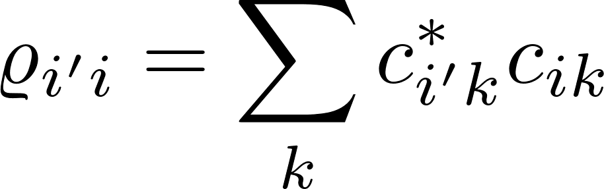
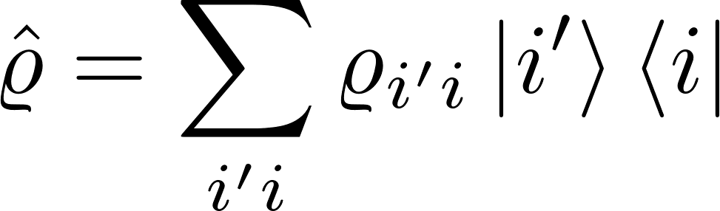
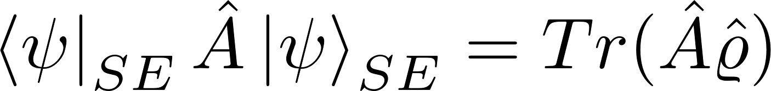
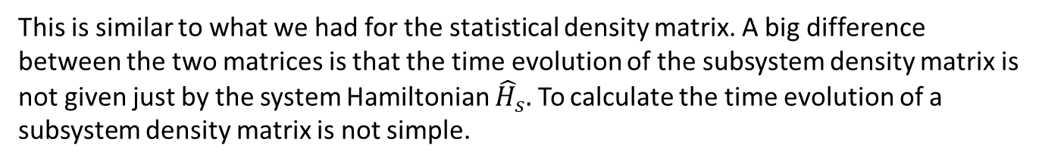
Density matric, subsystem
So we see that all information about the state is hidden in the expression
We can introduce a density matrix operator
and the mean A value can be written as
This is similar to what we had for the statistical density matrix. A big difference between the two matrices is that the time evolution of the subsystem density matrix is not given just by the system Hamiltonian ${\hat{H}}_{s}.$ To calculate the time evolution of a subsystem density matrix is not simple.

Slide 22
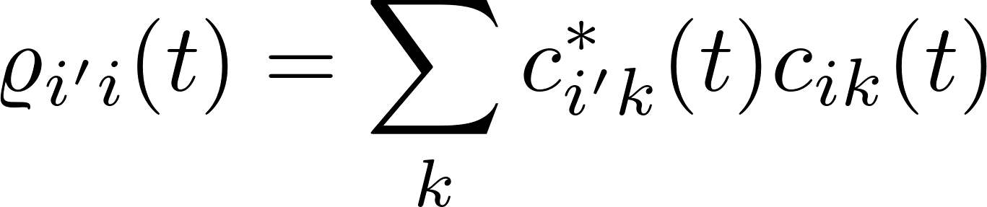
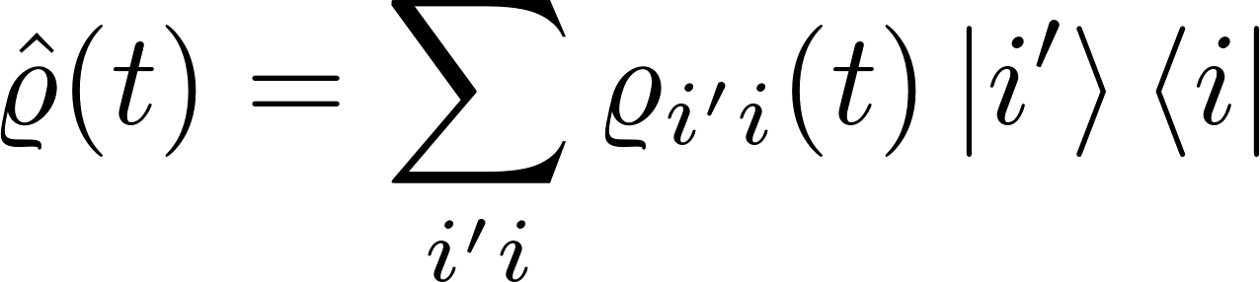
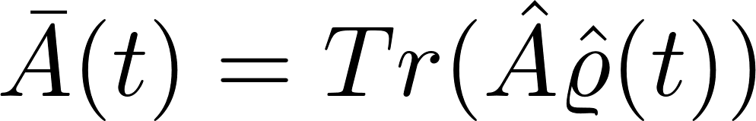
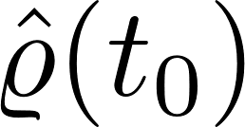
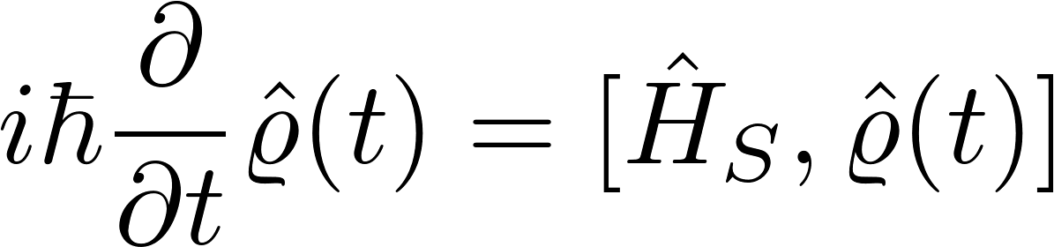
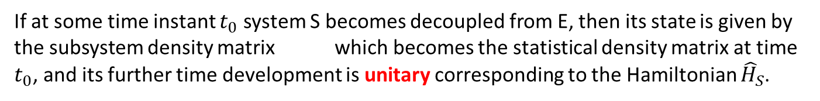
Density matric, subsystem
The time evolution of a subsystem density matrix can clearly be calculated by keeping the pure state of the overall system SE:
Using the total Hamiltonian
we calculate its time development (using the Schrödinger equation)
and then calculate the subsystem density matrix in each time instant anew:
The time development of the subsystem density matrix is clearly non-unitary.
If at some time instant $t_{0}$ system S becomes decoupled from E, then its state is given by the subsystem density matrix which becomes the statistical density matrix at time $t_{0}$, and its further time development is unitary corresponding to the Hamiltonian ${\hat{H}}_{S}$.

Slide 23
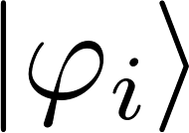
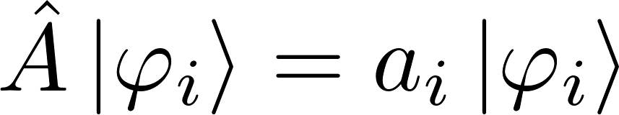
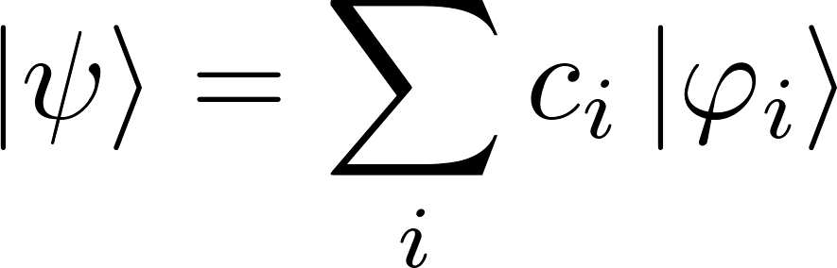





Measurement, wave function collapse, statistical density matrix
Suppose we have a pure quantum state of some system S given as a superposition of eigenstates of a Hermitian operator $\hat{A}$
We perform the measurement of the quantity $A$ and the measuring device shows the value $a_{k}$ (it always shows one of the eigenvalues $a_{i}$). The wave function collapse happens immediately after the measurement the system wave function becomes . The probability of this to happen is .
If we repeat the identical measurement experiment many times, we get various vales $a_{i}$ with probabilities leading the wave function collapse into the state .
So repeating the measurement experiment we get a statistical ensemble of states described by the statistical density matrix

Slide 24

Measurement, wave function collapse, statistical density matrix
So a measurement of a quantity $A,$ leads to the non-unitary wave function collapse, the state of the system after the measurement can be described by a statistical density matrix
Problem of measurement in QM:
We would like to describe the measuring device also by quantum mechanics (by Schrodinger equation), but this is incompatible with state collapse as shown by von Neuman because state collapse is a non-unitary operation
Our aim is to show that a process of quantum decoherence can lead to “effective” wave function collapse and thus can “mimic” a measurement process.

Slide 25










Decoherence due to interaction with environment
System and environment. is an arbitrary base in system subspace, is a base in environment subspace. Time development is given by the total Hamiltonian (via Schrödinger equation)
is a set of some vectors in the subspace of the environment, indexed by $i$.
These vectors do not form a base in the environment subspace: the environment has much more degrees of freedom. We can introduce normalized vectors in the environment subspace as We get
Suppose we have a physical quantity which from the system subspace (not sensitive to the state of environment. Then

Slide 26

Decoherence: collapse to diagonal density matrix
Now we can introduce a subsystem density matrix:
Compaer this with the wave function collapse after measurement

Slide 27




Decoherence: collapse to diagonal density matrix
For a different choice of the basis we would get different accompanying environment vectors . So even if for some choice of we get , for a different choice , the accompanying environment vectors will not converge to diagonal matrix
It means that we can have a decoherent collapse for some choice of basis states of the system and not have a decoherent collapse for some other choice. Or perhaps a bit weaker: for some choice we could observe a decoherence collapse after just a small time of interaction with environment and for other choice of basis states the decoherence time would be much larger

Slide 28

Decoherence: collapse to diagonal density matrix
Do notice that the definition of the density matrix does not depend at all on what operator $\hat{A}$ we have chosen for the derivation of the density matrix.
If the density matrix is diagonal, it means that all measurements on the system S can discover superpositions of the basis states.
Be careful: we cannot deduce from the results of any measurement, that the system S was in some superposition of states before the measurement was performed. Of course after the measurement the system would be in an eigenstate of the measured quantity, which can be a superposition of the states .
Be careful: we did not prove that decoherence exists. We did not prove that
We just said that “perhaps it may happen”.

Slide 29

Decoherence and quantum kinetics:
master equation
The following is a snippet from Reif: Fundamentals of statistical and thermal physics

