Slide 1
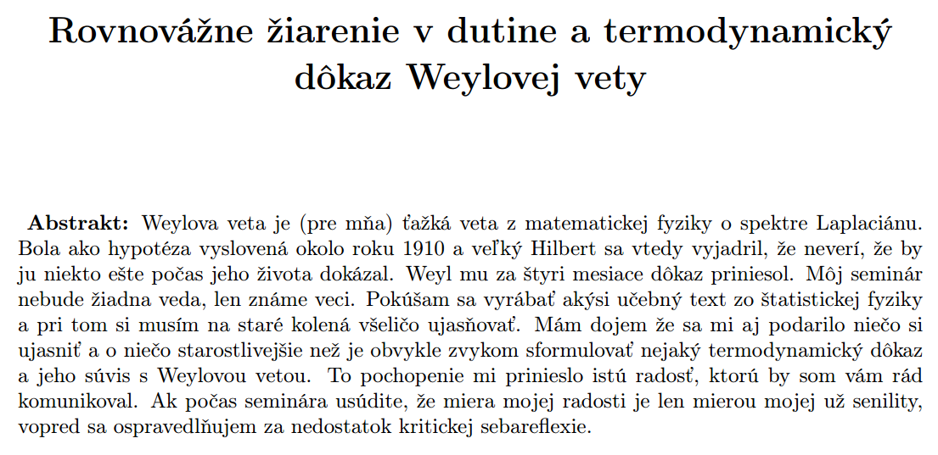

Slide 2
Statistical physics of electromagnetic field

Slide 3
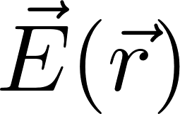
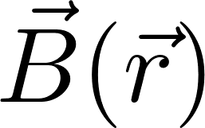
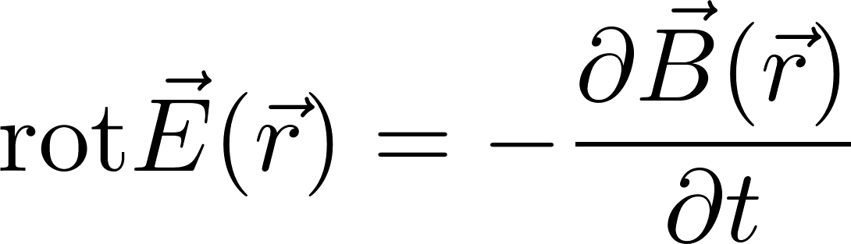
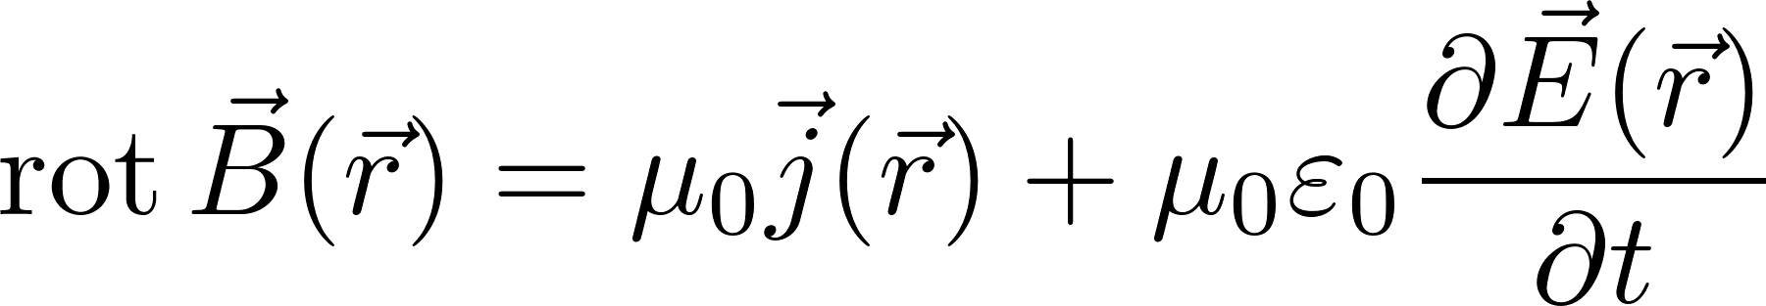
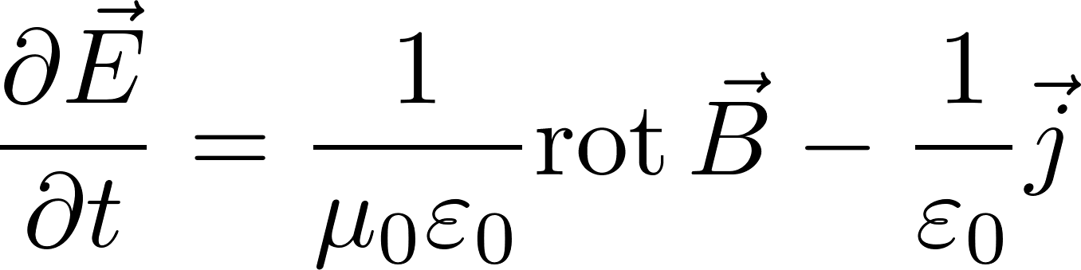
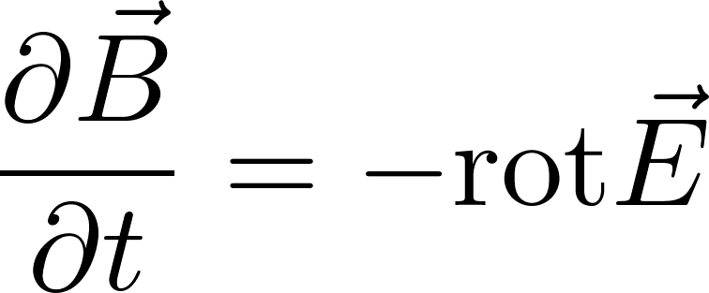
Physics manifesto
We have a new physical system: electromagnetic field. It is a new animal in the physics ZOO. So we have to show how the physics manifesto works for this new animal.
Find how to describe “current” state of the animal
Find the equation of motion
Predict future states
If you cannot write down current state in sufficient details do statistical physics instead
State of electromagnetic field: two vector fields
What are the equations of motion, how to predict future?
Suppose we know the state $\vec{E}\left(t,\vec{r}\right), \vec{B}(t,\vec{r})$. The state after time $dt$ should be

Slide 4
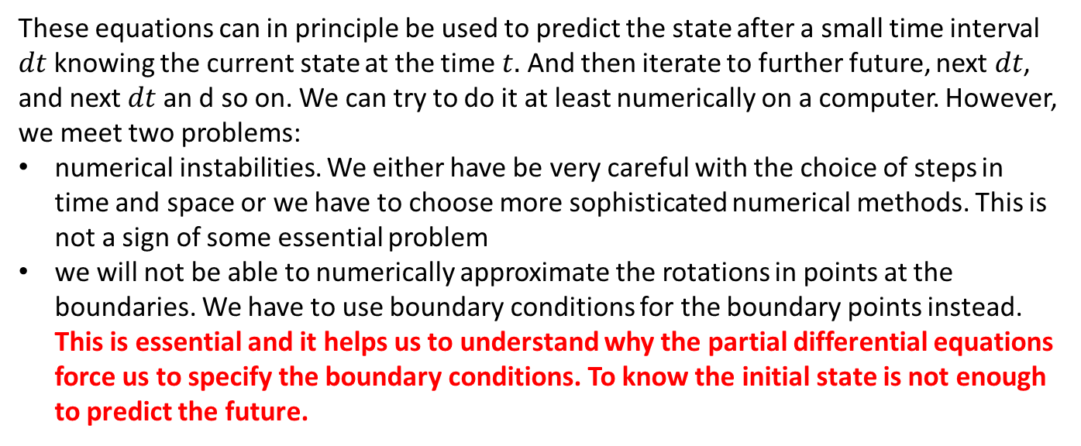
Note: boundary conditions
These equations can in principle be used to predict the state after a small time interval $dt$ knowing the current state at the time $t.$ And then iterate to further future, next $dt$, and next $dt$ an d so on. We can try to do it at least numerically on a computer. However, we meet two problems:
numerical instabilities. We either have be very careful with the choice of steps in time and space or we have to choose more sophisticated numerical methods. This is not a sign of some essential problem
we will not be able to numerically approximate the rotations in points at the boundaries. We have to use boundary conditions for the boundary points instead. This is essential and it helps us to understand why the partial differential equations force us to specify the boundary conditions. To know the initial state is not enough to predict the future.

Slide 5
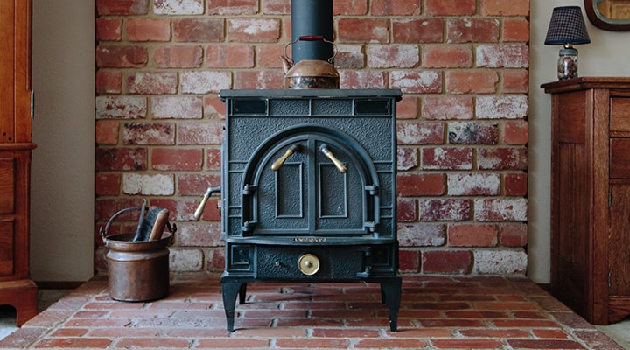
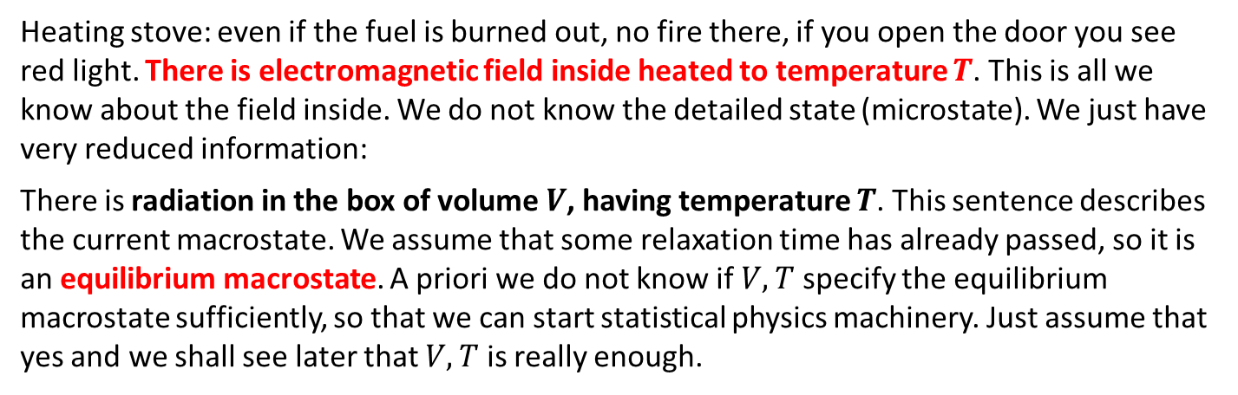
If you cannot write down current state in sufficient details do statistical physics instead
Heating stove: even if the fuel is burned out, no fire there, if you open the door you see red light. There is electromagnetic field inside heated to temperature $T$. This is all we know about the field inside. We do not know the detailed state (microstate). We just have very reduced information:
There is radiation in the box of volume $V$, having temperature $T$. This sentence describes the current macrostate. We assume that some relaxation time has already passed, so it is an equilibrium macrostate. A priori we do not know if $V,T$ specify the equilibrium macrostate sufficiently, so that we can start statistical physics machinery. Just assume that yes and we shall see later that $V,T$ is really enough.

Slide 6
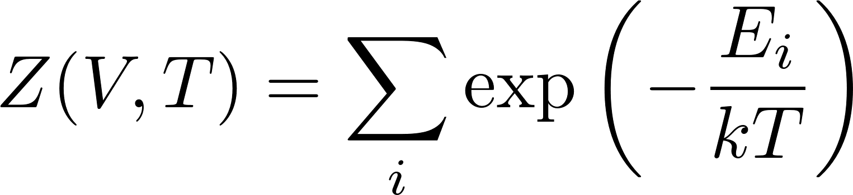
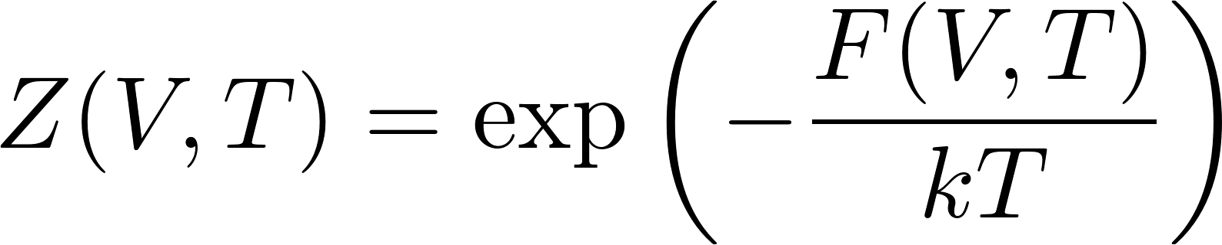
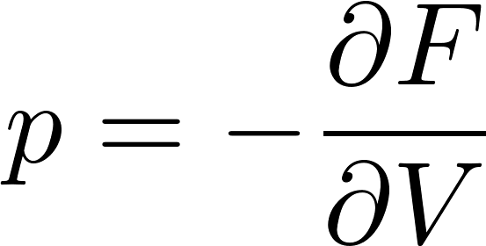
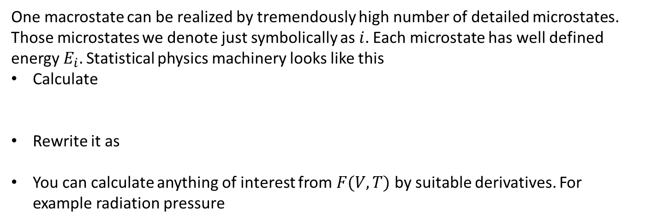
Statistical physics machinery
One macrostate can be realized by tremendously high number of detailed microstates. Those microstates we denote just symbolically as $i.$ Each microstate has well defined energy $E_{i}.$Statistical physics machinery looks like this
Calculate
Rewrite it as
You can calculate anything of interest from $F(V,T)$ by suitable derivatives. For example radiation pressure

Slide 7
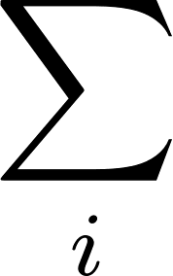
Statistical physics machinery
Looks easy, if you know hot to calculate sums over all possible microstates
for the new physics animal: the electromagnetic field.
The states are given by fields. It is a field theory. The sum is a sum over all possible fields!
Wiener functional integrals !? ☹
A way out: write down the states differently in a simpler but equivalent way. At least for a free electromagnetic field in a box (possibly of arbitrary shape).
The first thing is to find what the states of the field look like.

Slide 8
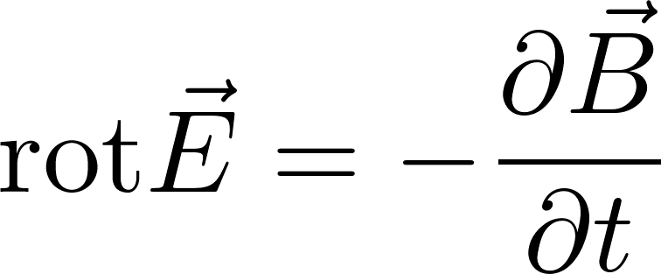
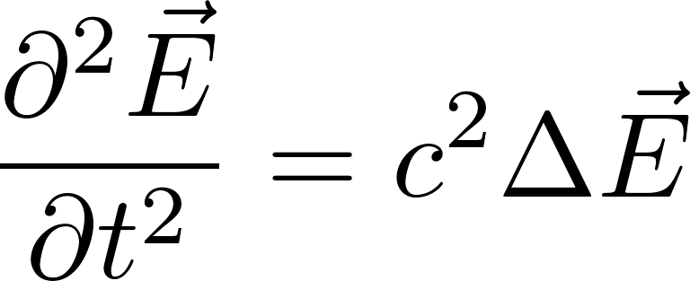
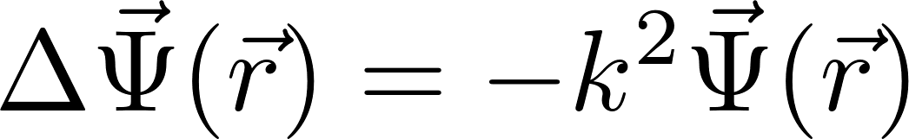
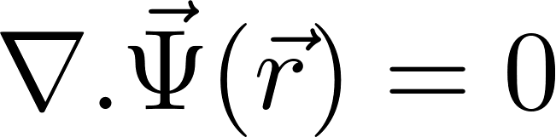
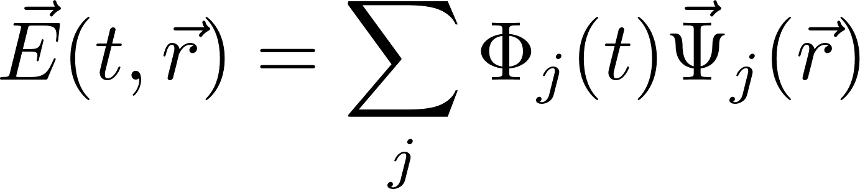
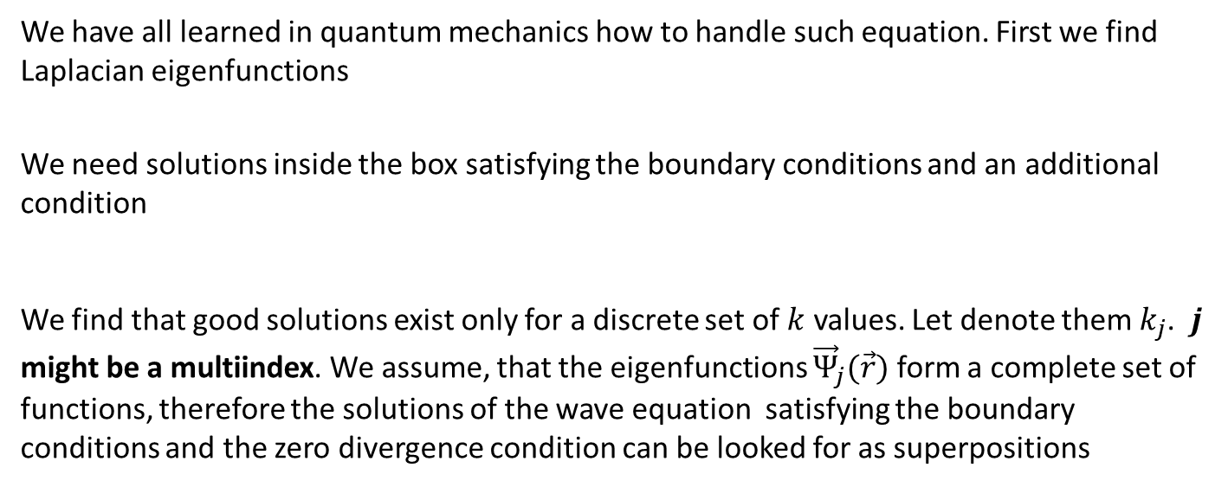
Free field in a box
make rot rot
We have all learned in quantum mechanics how to handle such equation. First we find Laplacian eigenfunctions
We need solutions inside the box satisfying the boundary conditions and an additional condition
We find that good solutions exist only for a discrete set of $k$ values. Let denote them $k_{j}$. $j$ might be a multiindex. We assume, that the eigenfunctions ${\vec{Ψ}}_{j}(\vec{r})$ form a complete set of functions, therefore the solutions of the wave equation satisfying the boundary conditions and the zero divergence condition can be looked for as superpositions

Slide 9

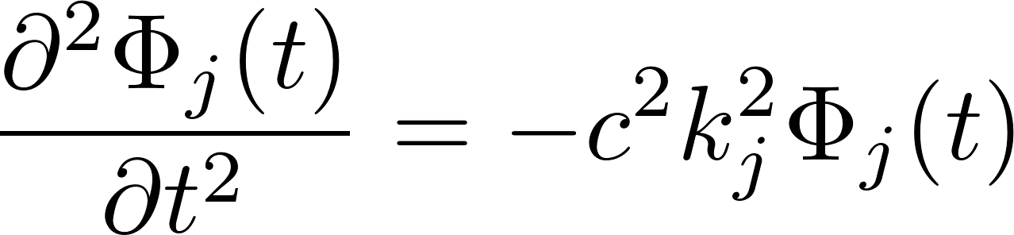
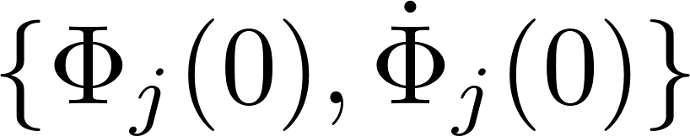
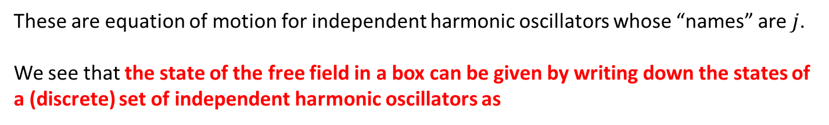
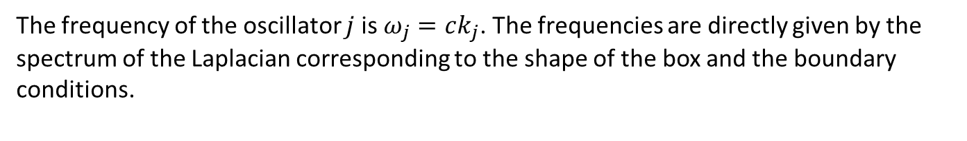
Free field in a box, states, discrete formulation
Inserting this into the wave equation (equation of motion) we get
These are equation of motion for independent harmonic oscillators whose “names” are $j$.
We see that the state of the free field in a box can be given by writing down the states of a (discrete) set of independent harmonic oscillators as
The frequency of the oscillator $j$ is $ω_{j}=ck_{j}$. The frequencies are directly given by the spectrum of the Laplacian corresponding to the shape of the box and the boundary conditions.

Slide 10
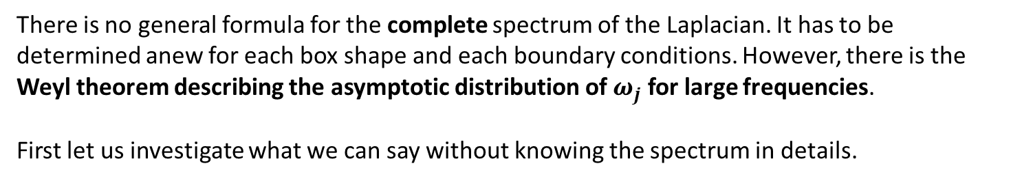

Free field in a box: how to do statistical physics
We have retold the whole story about our physics animal: the electromagnetic field in a box.
its state is given as a set of states of independent harmonic oscillators with frequencies $ω_{j}$
its future can be predicted by predicting the time development of the set of independent harmonic oscillators starting with their initial states. This is trivial.
statistical physics can be done by creating a canonical ensemble for the set of harmonic oscillators. This is trivial once the spectrum $ω_{j}$ is found. However, we have a choice:
The oscillators can be considered as classical or quantum objects
There is no general formula for the complete spectrum of the Laplacian. It has to be determined anew for each box shape and each boundary conditions. However, there is the Weyl theorem describing the asymptotic distribution of $ω_{j}$ for large frequencies.
First let us investigate what we can say without knowing the spectrum in details.

Slide 11
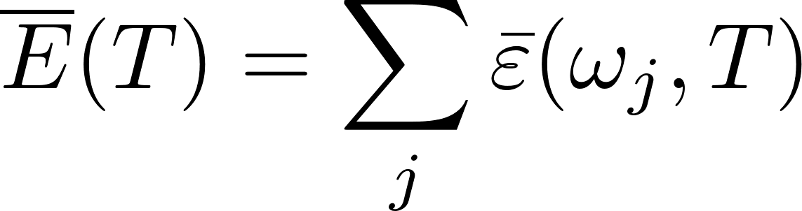
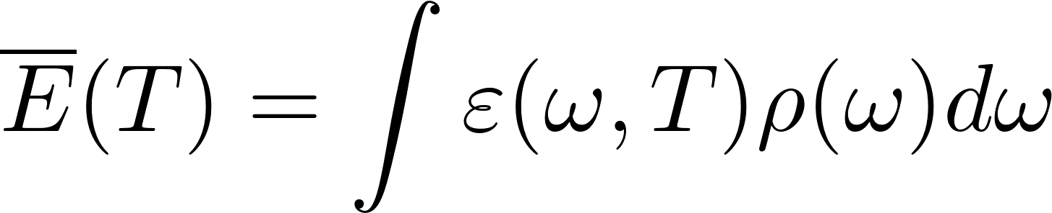
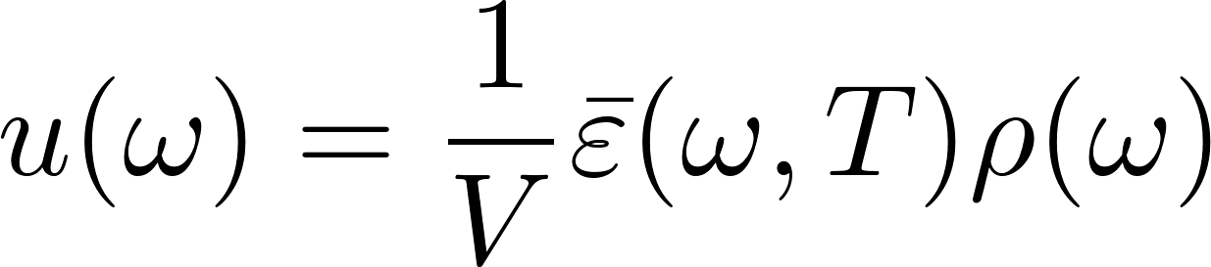
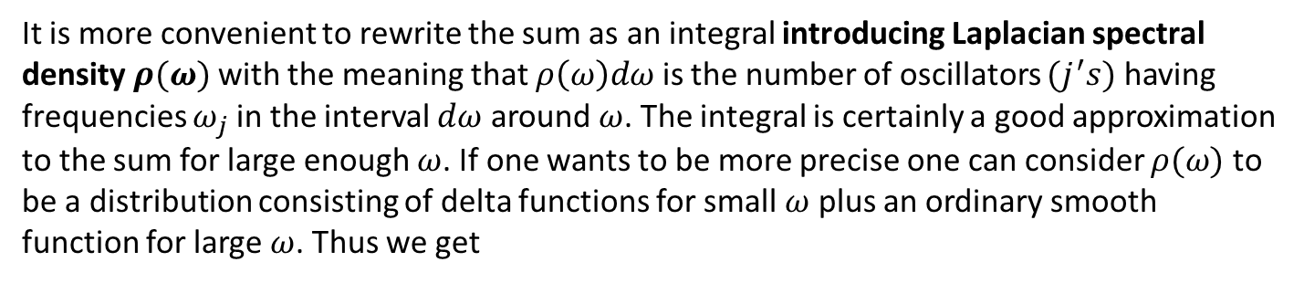
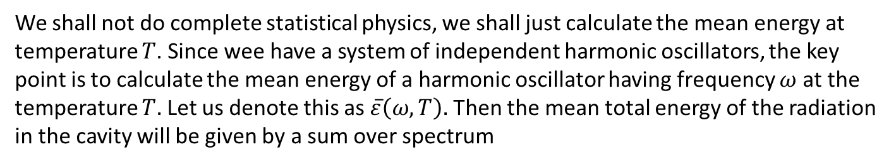
Calculating mean energy
We shall not do complete statistical physics, we shall just calculate the mean energy at temperature $T$. Since wee have a system of independent harmonic oscillators, the key point is to calculate the mean energy of a harmonic oscillator having frequency $ω$ at the temperature $T.$ Let us denote this as $\overline{ε}\left(ω,T\right).$ Then the mean total energy of the radiation in the cavity will be given by a sum over spectrum
It is more convenient to rewrite the sum as an integral introducing Laplacian spectral density $ρ(ω)$ with the meaning that $ρ\left(ω\right)dω$ is the number of oscillators $(j^{′}s)$ having frequencies $ω_{j}$ in the interval $dω$ around $ω$. The integral is certainly a good approximation to the sum for large enough $ω$. If one wants to be more precise one can consider $ρ(ω)$ to be a distribution consisting of delta functions for small $ω$ plus an ordinary smooth function for large $ω$. Thus we get
From there we get for the spectral energy density (energy per unit volume per unit frequency interval)

Slide 12
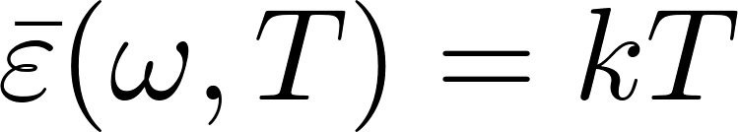
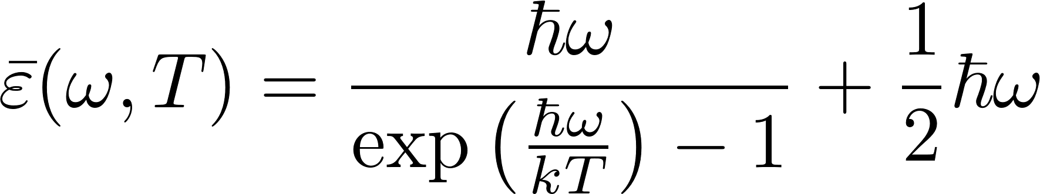
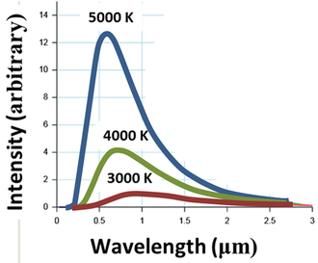
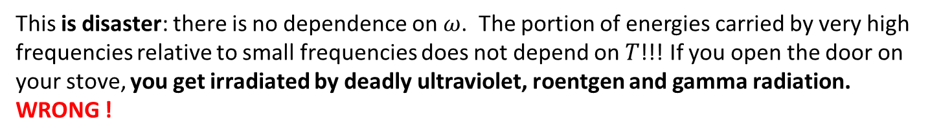
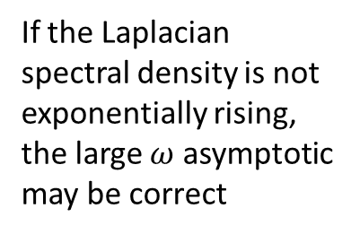
Energy spectral density
For classical oscillator we have
This is disaster: there is no dependence on $ω$. The portion of energies carried by very high frequencies relative to small frequencies does not depend on $T$!!! If you open the door on your stove, you get irradiated by deadly ultraviolet, roentgen and gamma radiation. WRONG !
For quantum oscillator we have
If the Laplacian spectral density is not exponentially rising, the large $ω$ asymptotic may be correct

Slide 13
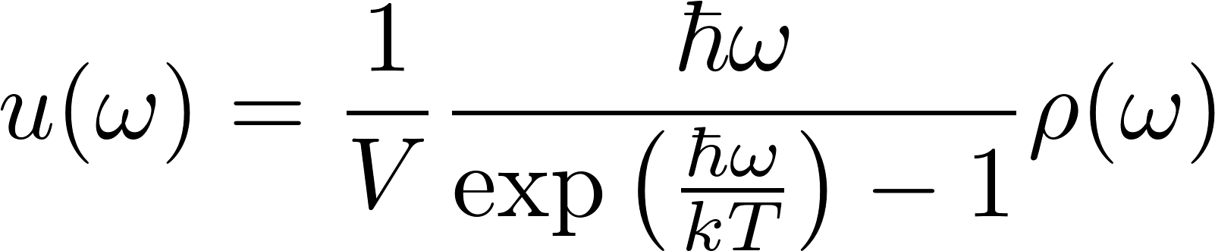
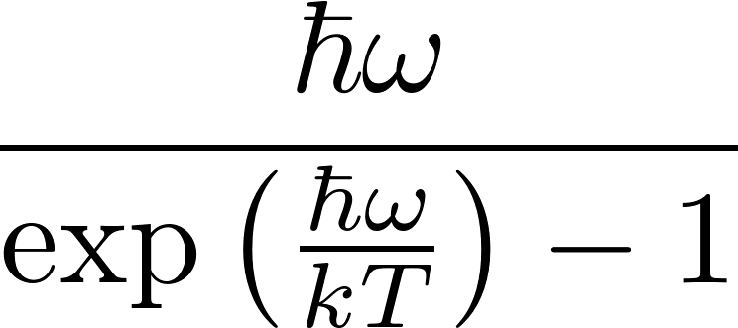
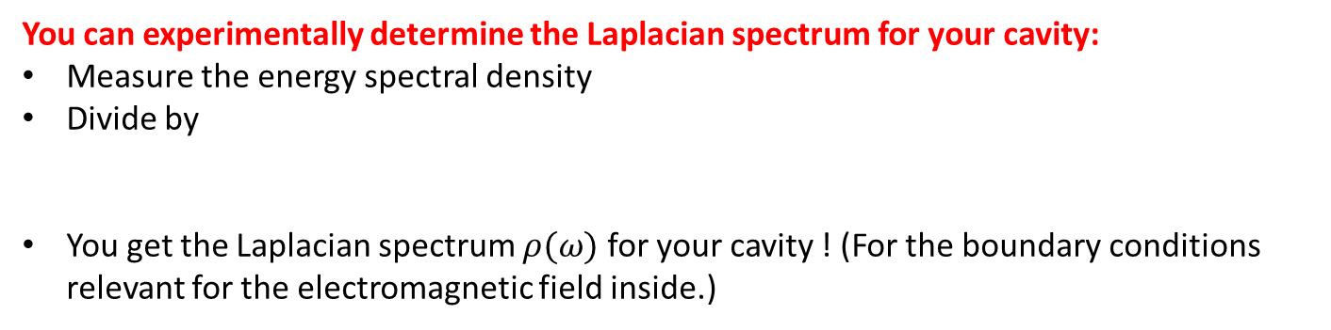
Energy spectral density
You can experimentally determine the Laplacian spectrum for your cavity:
Measure the energy spectral density
Divide by
You get the Laplacian spectrum $ρ(ω)$ for your cavity ! (For the boundary conditions relevant for the electromagnetic field inside.)

Slide 14



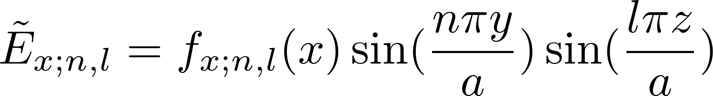
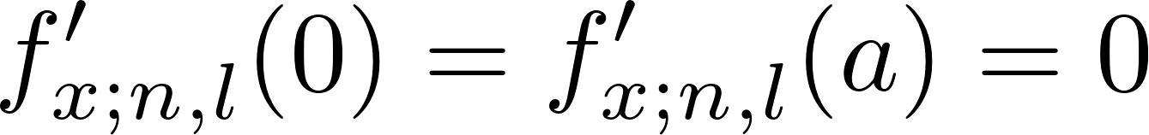
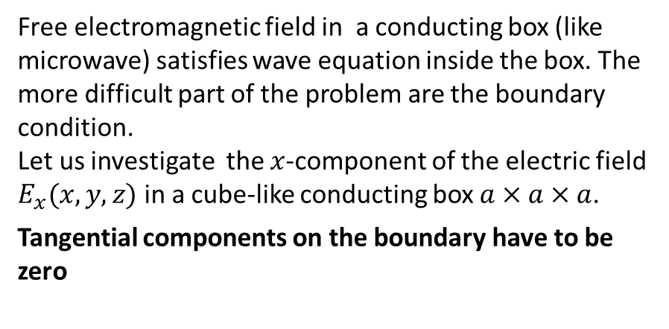
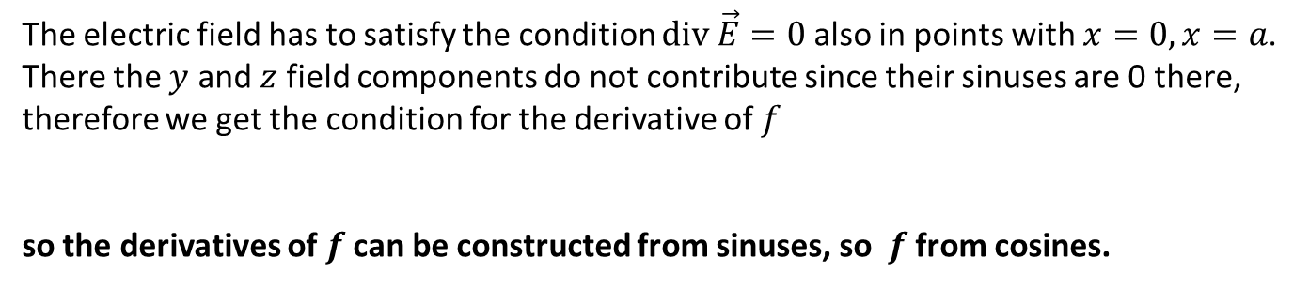

Example of boundary conditions
Free electromagnetic field in a conducting box
Free electromagnetic field in a conducting box (like microwave) satisfies wave equation inside the box. The more difficult part of the problem are the boundary condition.
Let us investigate the $x$-component of the electric field $E_{x}(x,y,z)$ in a cube-like conducting box $a×a×a$.
Tangential components on the boundary have to be zero
According to Fourier: function $E_{x}(x,y,z)$ satisfying such conditions can be constructed from the set of functions (cyclically for other components)
where $f$-s are so far unknown functions
The electric field has to satisfy the condition $\text{div} \vec{E}=0$ also in points with $x=0, x=a$. There the $y$ and $z$ field components do not contribute since their sinuses are 0 there, therefore we get the condition for the derivative of $f$
so the derivatives of $f$ can be constructed from sinuses, so $f$from cosines.

Slide 15
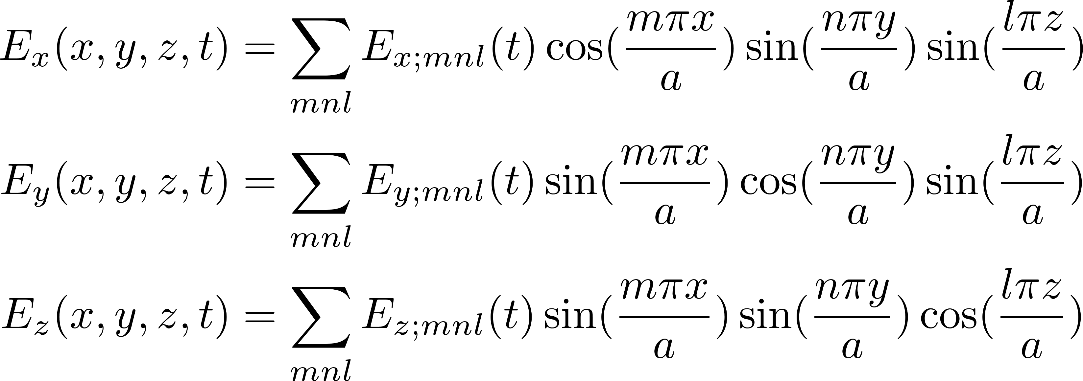
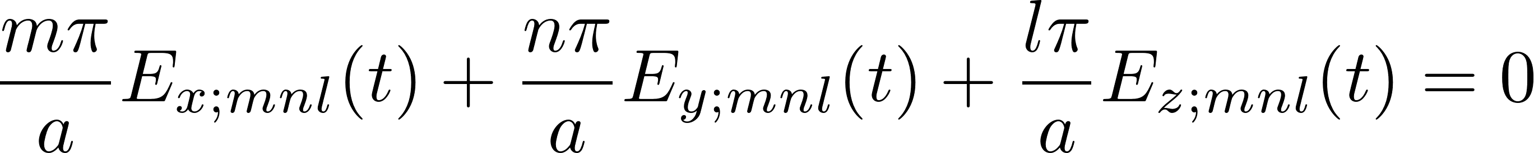
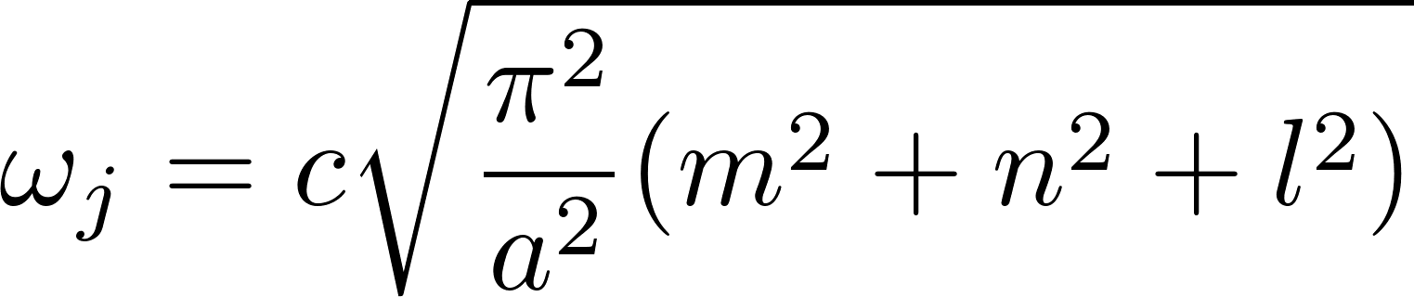
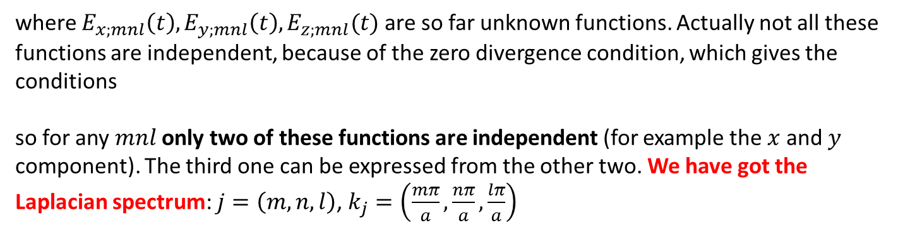
Free electromagnetic field in a conducting box
We have found that the electric field automatically satisfying the boundary conditions can be looked for in the form
where $E_{x;mnl}\left(t\right), E_{y;mnl}\left(t\right), E_{z;mnl}(t)$ are so far unknown functions. Actually not all these functions are independent, because of the zero divergence condition, which gives the conditions
so for any $mnl$ only two of these functions are independent (for example the $x$ and $y$ component). The third one can be expressed from the other two. We have got the Laplacian spectrum: $j=\left(m,n,l\right)$, $k_{j}=\left(\frac{mπ}{a},\frac{nπ}{a},\frac{lπ}{a}\right)$

Slide 16
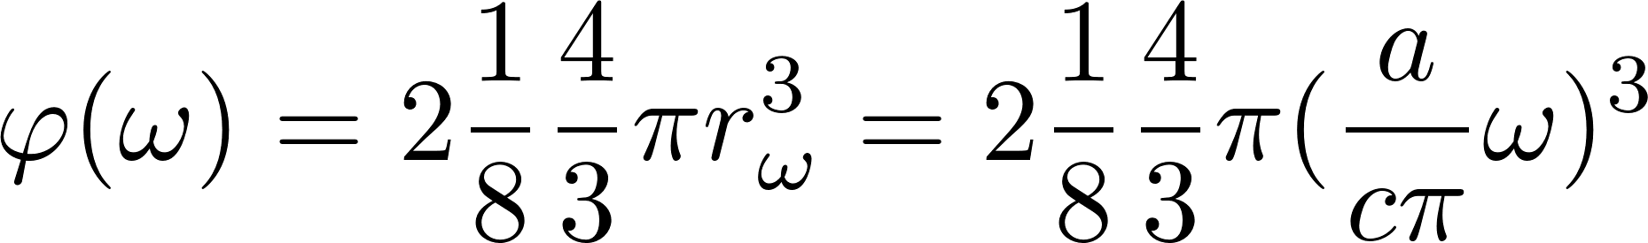
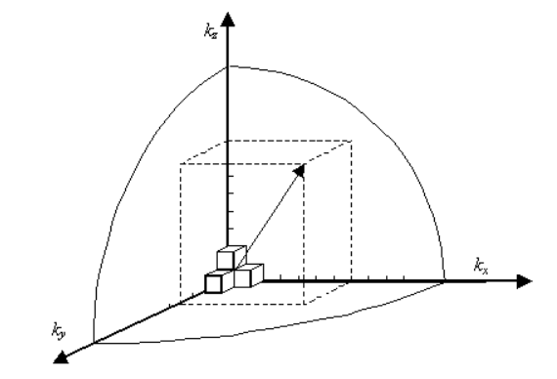



Laplacian spectral density
The states $(m,n,l)$ can be visualized in an abstract $(m,n,l)$-space as points with integer coordinates in the positive octant. To each unit cube belongs on average one its vertex, so number of integer-coordinate points for which $ω_{j}<ω$ denoted as $φ(ω)$is 1/8 of the volume of a sphere with radius $r_{ω}=\sqrt{m^{2}+n^{2}+l^{2}}=\frac{a}{cπ}ω$
The pre-factor 2 is for 2 “polarizations” for each $(m,n,l)$.

Slide 17



Energy spectral density
We have got this for a special case cube-like box cavity with perfectly conducting walls

Slide 18



How to measure $u\left(ω\right)$: make hole into the cavity
spectral energy density flow (energy per unit of the hole area per unit of time per unit of frequency
Easy argument using photons: photons have velocity $c$, averaging over angles gives 1/4.
How photons enter the game ? Be patient, we come to it soon

Slide 19

Kirchhoff Sommerfeld thermodynamic universality proof

Slide 20


Total $u(ω)$ universality cannot be true
If $u\left(ω\right)$ is universal, then $ρ\left(ω\right)$ is universal as well, that is Laplacian spectrum is universal for a cavity of arbitrary shape. This cannot be true for small $ω$.
So there is a flow in the thermodynamic argument as was presented .
Small frequencies mean large wave lengths, which do not get through a small hole.
Everybody knows that: you can look into running microwave oven through net full of small
holes. Visible light gets out, 15 cm microwaves do not: our eyes are not burned.

Slide 21

Kirchhoff Sommerfeld thermodynamic universality proof
The thermodynamic universality proof survives only for frequencies for which the formula
is a good approximation, that is for large frequencies. Conclusion:
Laplacian spectral density $ρ(ω)$ is asymptotically universal.
This is roughly what Weyl’s theorem says.

Slide 22
We have presented a thermodynamic proof of the Weyl theorem

Slide 23
We have presented a thermodynamic proof of the Weyl theorem
Well, no.
There is another flow in the thermodynamic argument
Actually the thermodynamic conclusion is correct, just the argumentation is not clean enough.
We have first to learn more about photons.

Slide 24

What is electromagnetic field?
We have retold the whole story about our physics animal: the electromagnetic field in a box.
its state is given as a set of states of independent harmonic oscillators with frequencies $ω_{j}$
Electromagnetic field in a box
is
a set of harmonic oscillators
Stupid naive question: the oscillators run out from the hole?

Slide 25
What is electromagnetic field? Alternative formulation
Electromagnetic field in a box
is
a set of stationary waves
Stupid naive question: why standing waves run out from the hole?
Easy answer: a superposition of standing waves can give you a running wave, which gets out. Il si muove.
Never formulate statements of ontological character in physics.

Slide 26
?
Easy answer: a superposition of standing waves can give you a running wave, which gets out.
But
Where are the superposition microstates in the statistical physics calculation of the statistical sum?

Slide 27




Free electromagnetic field:
still another alternative description - photons
The complete (micro)state of the electromagnetic field we have represented by the table where the excitation numbers are any integers. If you see the table do you recall
that you have already met a similar table in a very different context? Here it is: The state of non-interacting indistinguishable spinless bosons was given by the list of one-
mnl,s | excit.number
111,x | $$n_{111x}$$
111,y | $$n_{111y}$$
112,x | $$n_{112x}$$
112,y | $$n_{112y}$$
121,x | $$n_{121x}$$
121,y | $$n_{121y}$$
$$…$$ | $$…$$
one particle state | occup. number
1,1,1 | 1
1,1,2 | 3
1,2,1 | 0
1,2,2 | 2
2,1,1 | 0
2,1,2 | 0
2,2,1 | 12
2,2,2 | 4
$$⋮$$ | $$⋮$$
particle states each with its occupational number which could be any integer. The total energy was
For the electromagnetic field the total energy is
The same (almost) description of the states, the same formula for the total energy.

Slide 28


Free electromagnetic field:
still another alternative description - photons
Now to the problem of “spin labels”. The particles we want to “invent and introduce” must be bosons, since the excitation numbers interpreted as occupational numbers are any integers. The bosons should not be spinless since we have to interpret the labels $x,y$ as some spin-state labels. So far we do not know any bosons which would have just two spin states. Spin 1 bosons should have 3 “spin projections”. Two spin
projections suggest spin 1/2, but spin 1/2 particles are fermions!
However, the above mentioned classification is valid if we consider only nonrelativistic particles. Relativistic particles with the mass equal to zero with the total spin 1 have only two spin-projection states +1 and -1. Projection 0 is not possible. The reason is hidden deeply in relativistic quantum mechanics (better: field theory). We skip the detailed argumentation, just take it as a fact.
So there is a chance for a particle-like alternative description of the states of the electromagnetic field introducing relativistic mass=0 particles with spin 1 named photons. The “spin-projection labels” for photons do not necessarily mean true spin projections: other quantum mechanical base of “spin states” can be used equally well. For photons we most other use the “polarization basis”.

Slide 29





Free electromagnetic field: photons
We found that the energy and momentum formulas for photons should be
This gives us the following relation between energy and momentum
Such a relation is expected for relativistic massless particle because of the general relativistic formula for the particle rest mass
For photons this gives the rest mass 0. The general formula for the relation between the
energy, rest mass and velocity of a particle is
To get non-zero energy, the zero-mass particle velocity must always be $\text{v} =c$. So photons always move with the velocity $c$.
We have discovered photons !!!

Slide 30



Thermal radiation in a cavity as a photon gas
We have arrived at a conclusion that we can consider the electromagnetic field in a cavity as a photon gas. So we can try to calculate the properties of the thermal radiation by calculating the properties of a photon gas in equilibrium with the cavity walls at the temperature $T.$
How to do that? we certainly do not know a priori the total number of photons in the cavity so we try to work within the grand canonical technology pretending to know the chemical potential of photons, calculate with it as with a symbolical abstract number $μ$ and finally find the correct value of it by adjusting this value to get the correct thermal radiation results which we already know.
So we have a the photon gas with one-particle-states $mnl$s. The mean occupational number a one-particle-state will be (Bose-Einstein)
The total energy of the photon gas will be

Slide 31





Thermal radiation in a cavity as a photon gas
Let us compare the formula we have just got with the formula we have got for “equivalent oscillators” where we had “mean excitation numbers” instead of “mean occupational numbers”
The formula for $ω_{mnl}$ is the same in both cases, the only difference is that there is $μ$ in the formula on the left. The conclusion is: we get exactly the same results for the thermal radiation if calculated as for oscillators and if calculated as for photons if we set $μ=0.$
We discovered a new law of nature: chemical potential of photons is (always) zero.
Putting $μ=0$ we continue in exactly the same way as we did for the “equivalent oscillators”: we replace the sum by an integral using formula for the density of one-particle-states which would be for photons the same as was the formula for the density of oscillators and we will get the same result

Slide 32
Kirchhoff Sommerfeld thermodynamic universality proof

Slide 33



Kirchhoff Sommerfeld thermodynamic universality proof
applied to ordinary ideal gas. Why not, particles like particles
Two containers with monoatomic ideal gas, same temperatures, common hole with filter allowing to go through only to particles with specified that is with specified kinetic energy.
Let the energy density per unit of absolute velocity will be denoted as than the spectral energy flow through the hole would be
If the energy density is not the same on both sides, them net energy flow would result, changing temperatures originally equal ! Forbidden by thermodynamics. Conclusion:
the energy density in an ideal gas is a universal function of temperature. That is grossly wrong! But the logical syntax is the same as in Kirchhoff Sommerfeld proof, just semantics is different.

Slide 34


Kirchhoff Sommerfeld thermodynamic universality proof
applied to ordinary ideal gas
Where is the error?
For standard ideal gas there is additional independent parameter: particle density. The containers can have the same temperature but different particle densities (different pressures). After making the hole pressures will be equalized, the temperatures will not change.
The energy flow does not necessarily change the temperature for ordinary gas
For radiation Sommerfeld calls the energy flow as heat flow (wärmestrahlung).

Slide 35



What is the difference between
the ordinary gas and the photon gas?
Why is there no independent parameter like photon density for the photon gas?
Because photons have zero chemical potential.
Actually the logic is reverse: photon have zero chemical potential because there is no independent parameter like photon (spatial) density
Ordinary gas Oscillators
one particle state | occup. number
1,1,1 | 1
1,1,2 | 3
1,2,1 | 0
1,2,2 | 2
2,1,1 | 0
2,1,2 | 0
$$⋮$$ | $$⋮$$
mnl,s | excit.number
111,x | $$n_{111x}$$
111,y | $$n_{111y}$$
112,x | $$n_{112x}$$
112,y | $$n_{112y}$$
121,x | $$n_{121x}$$
$$…$$ | $$…$$
No state independent sum here

Slide 36



What is the role of the number of photons in a box?
Parameter of non-equilibrium
Start with empty box at $T=0.$ Heat the walls suddenly to $T$.
No photons inside, so the system is not in equilibrium.
Observe relaxation to equilibrium: $N\left(t\right)$
Number of photons finally reaches the equilibrium value $\overline{N}$.
How to recognize equilibrium at a given temperature:
Free energy is minimal
Close to equilibrium
Landau:

Slide 37





Chemical potential definition
After the final common equilibrium is established the total entropy will be
The final values of energies will be the same as in the case when we have considered just a thermal contact. The only unknown value in this relation is $N_{1}^{′}$, since $N_{2}^{′}$ is given by the total number of particles conservation $N_{2}^{′}=N_{1}+N_{2}−N_{1}^{′}$.

Slide 38




Photon strange stoichiometry

Slide 39


What is the difference between
the ordinary gas and the photon gas?
Bose-Einstein distribution is derived by grand canonical technology. Needs conservation of the total number of particles!
No grand canonical calculations for photon gas!
Well, you can do grand canonical calculations but then you have to understand well why you can do it.
Ordinary gas Oscillators
one particle state | occup. number
1,1,1 | 1
1,1,2 | 3
1,2,1 | 0
1,2,2 | 2
2,1,1 | 0
2,1,2 | 0
$$⋮$$ | $$⋮$$
mnl,s | excit.number
111,x | $$n_{111x}$$
111,y | $$n_{111y}$$
112,x | $$n_{112x}$$
112,y | $$n_{112y}$$
121,x | $$n_{121x}$$
$$…$$ | $$…$$
No state independent sum here

Slide 40
Kirchhoff Sommerfeld thermodynamic universality proof
We conclude that $u$must be asymptotically a universal function of $ω$and $T$ .
If $u\left(ω\right)$ is asymptotically universal, then $ρ\left(ω\right)$ is asymptotically universal as well, that is Laplacian spectrum is asymptyotically universal for a cavity of arbitrary shape.

Slide 41
The end

