Slide 1
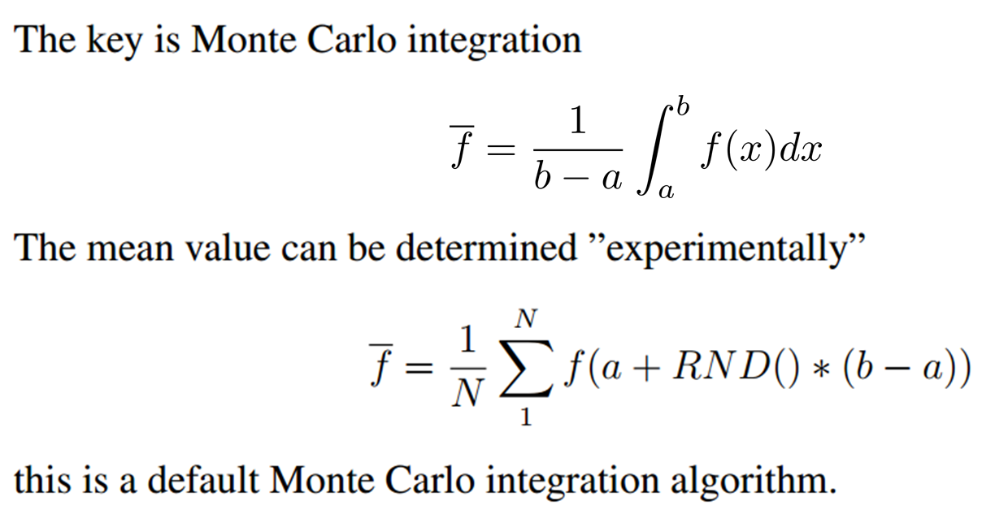

Slide 2
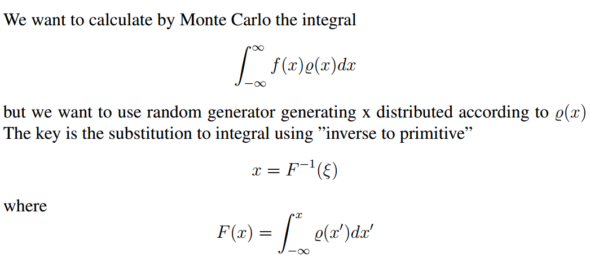



Slide 3



Importance sampling
Numerically

Slide 4




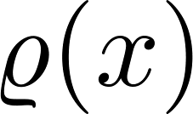



accept - reject

Slide 5

Importance sampling for normal distribution

Slide 6


Slide 7
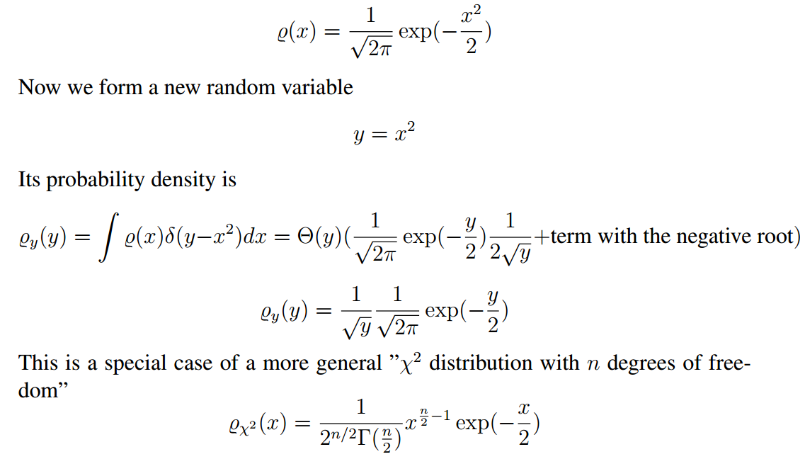

Slide 8
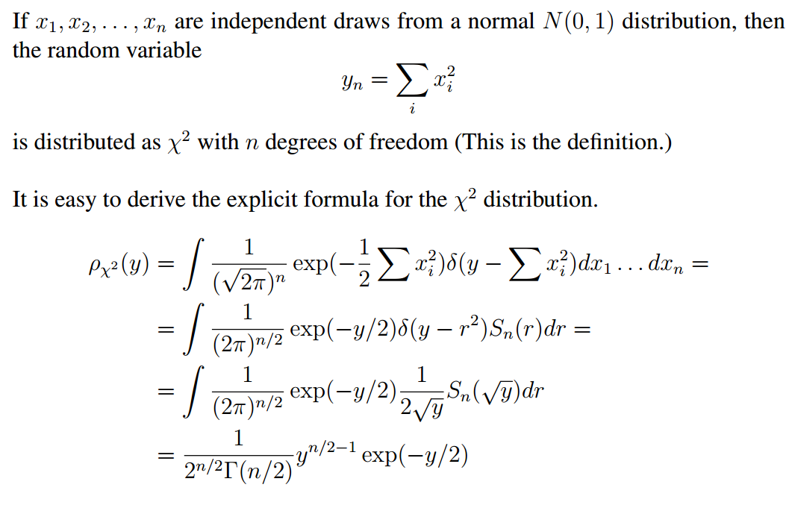

Slide 9
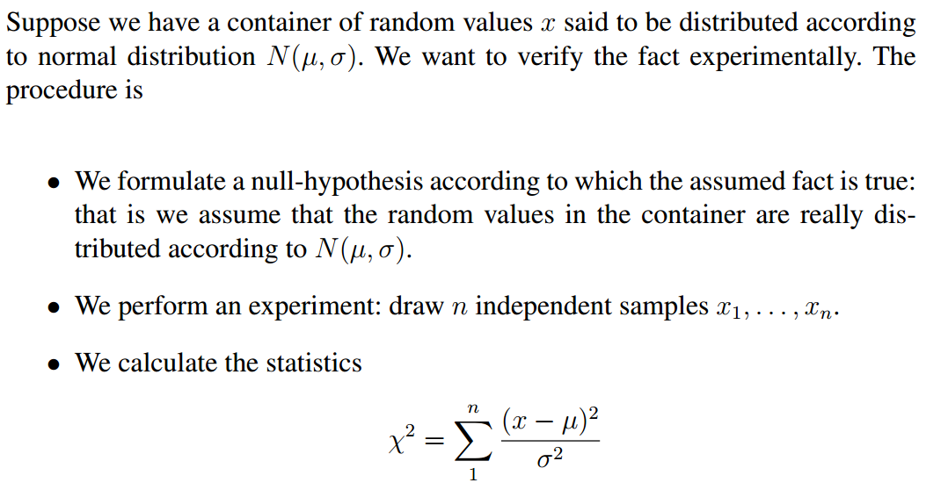


Slide 10

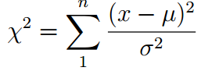
Expected $χ^{2}$ value is of the order of $n$.

