Slide 1


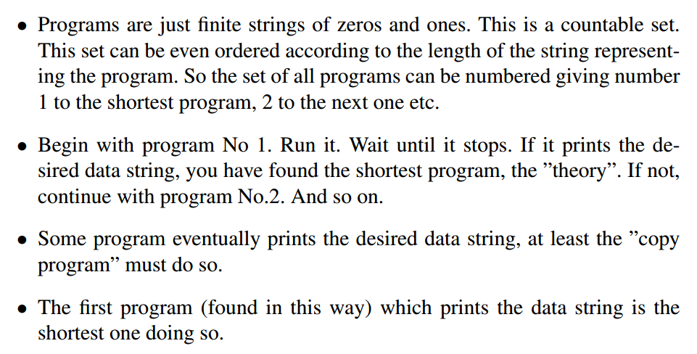
THEORY

Slide 2

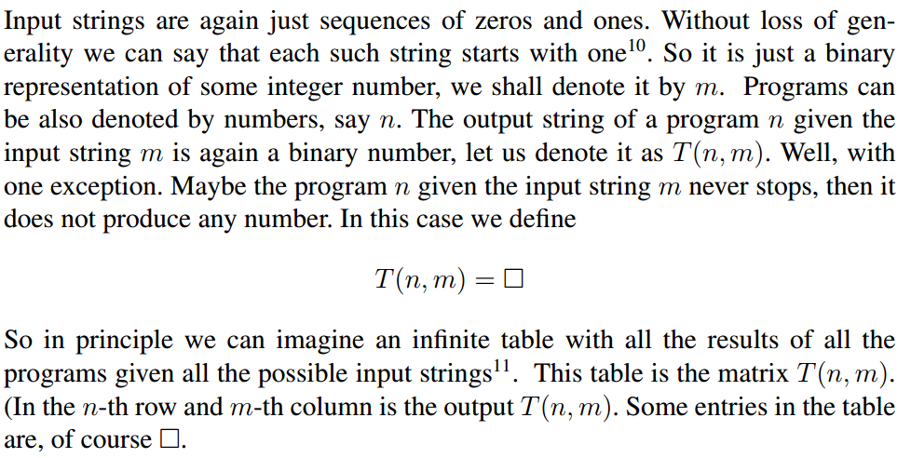
The argumentation was wrong. Halting theorem!

Slide 3
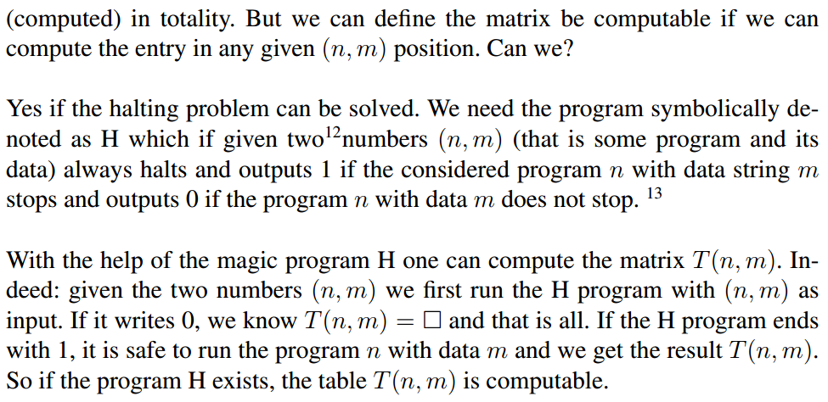

Slide 4


Slide 5


It is possible to construct codes for letters such that no sequence of symbols which is a true code for some symbol appears as a prefix in the sequence of some other letter. Then a sequence of symbols without any gaps can be cut into pieces representing individual letters (the gaps can be introduced automatically).

Slide 6
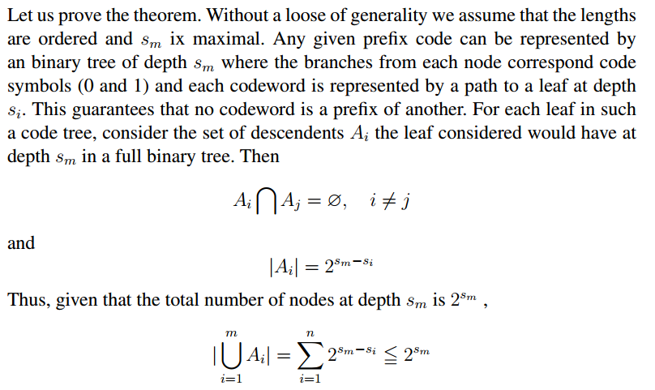


Slide 7

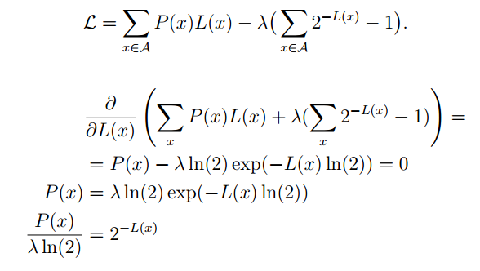
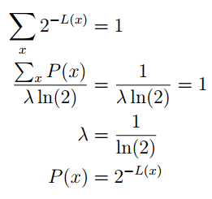


Slide 8


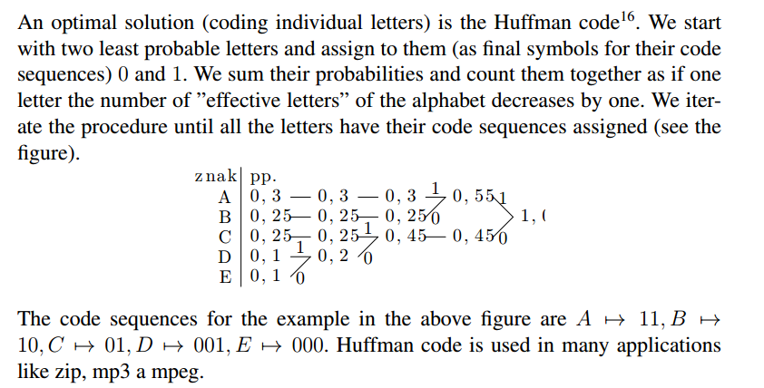

Slide 9


Slide 10


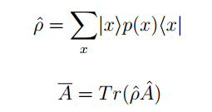
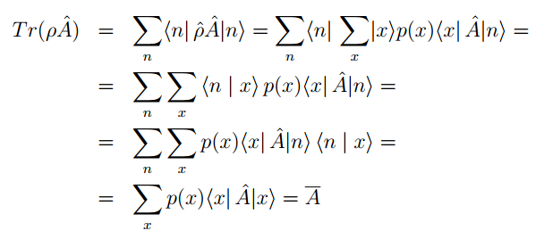

Slide 11
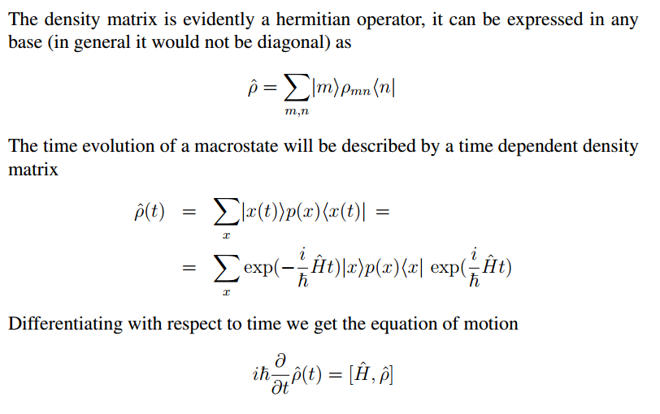

Slide 12
