Slide 1



Slide 2
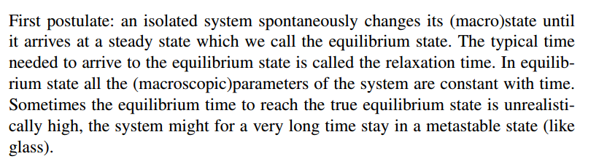
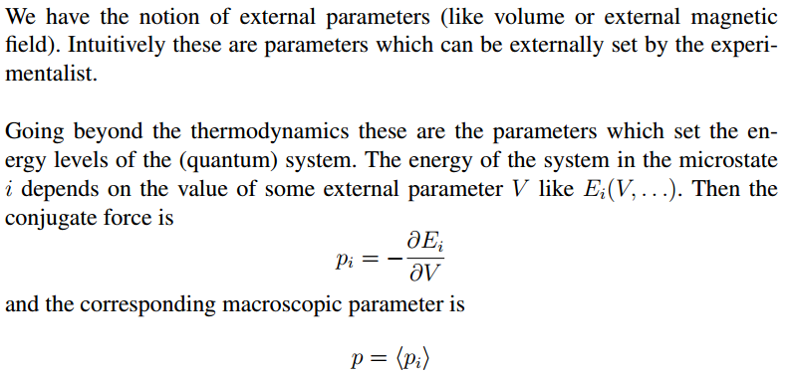

Slide 3
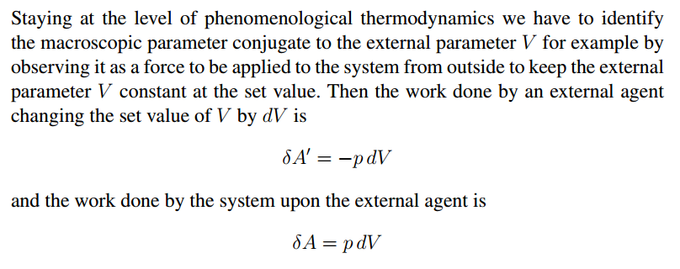
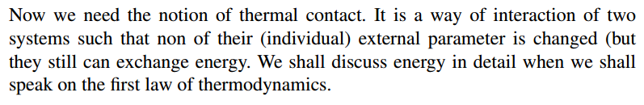
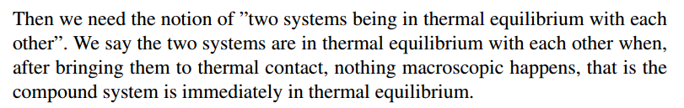

Slide 4
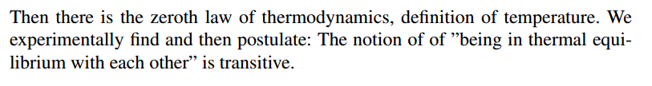
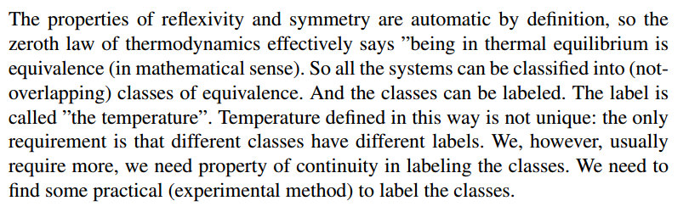
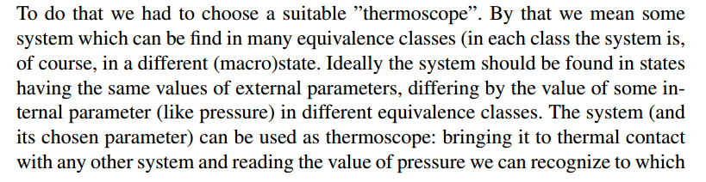
Zeroth law of thermodynamics

Slide 5
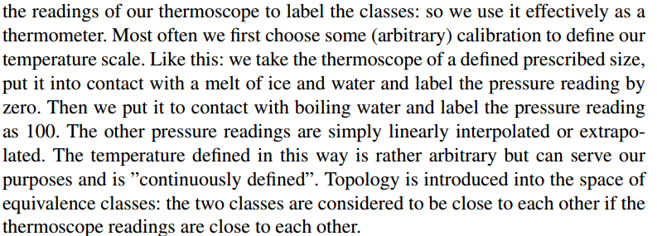

Slide 6
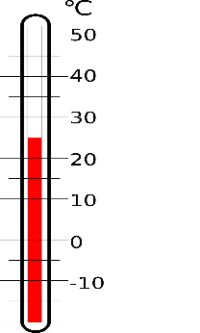
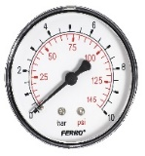
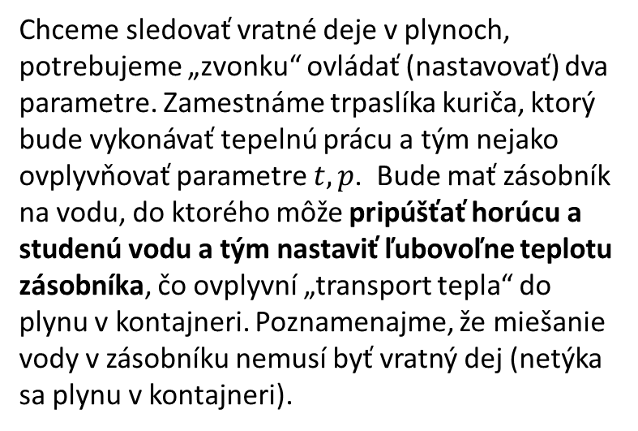

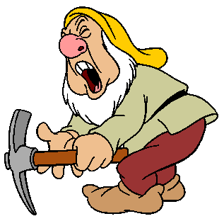

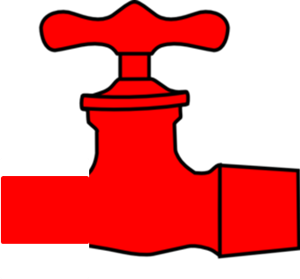

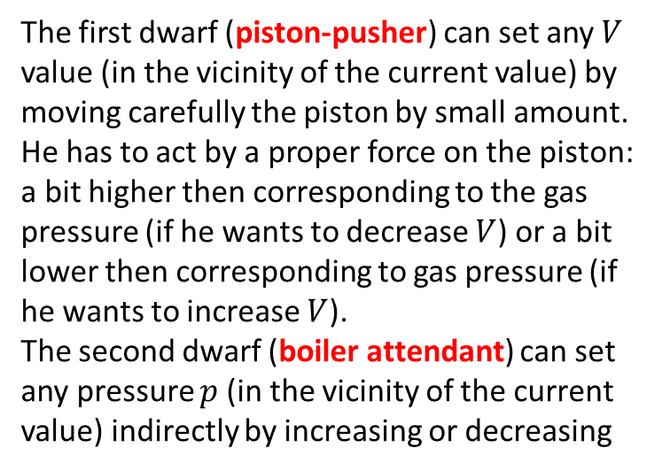
Reversible processes in gas – experimental setup
The first dwarf (piston-pusher) can set any $V$ value (in the vicinity of the current value) by moving carefully the piston by small amount. He has to act by a proper force on the piston: a bit higher then corresponding to the gas pressure (if he wants to decrease $V$) or a bit lower then corresponding to gas pressure (if he wants to increase $V$).
The second dwarf (boiler attendant) can set any pressure $p$ (in the vicinity of the current value) indirectly by increasing or decreasing
the current temperature of the gas. To control temperature in a reversible manner is a tricky task. Here it is how it can be done. The boiler attendant control roughly the water temperature (by manipulating the valves with hot and cold water) in an external boiler which serves as a heat exchanger. The boiler is in thermal contact with the gas through an interface with low coefficient of heat transfer. If the boiler water is a bit hotter then the gas, energy slowly flows from the boiler to the gas thus increasing its temperature. If the boiler is colder then the gas, energy slowly flows from the gas into the boiler thus decreasing slowly the gas temperature. The energy exchange between the boiler and the gas is an irreversible process (the boiler and the gas are not in the state of mutual equilibrium), but the gas remains in internal equilibribrium because the energy transfer is slow.

Slide 7
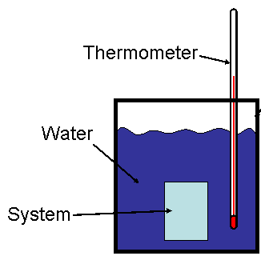
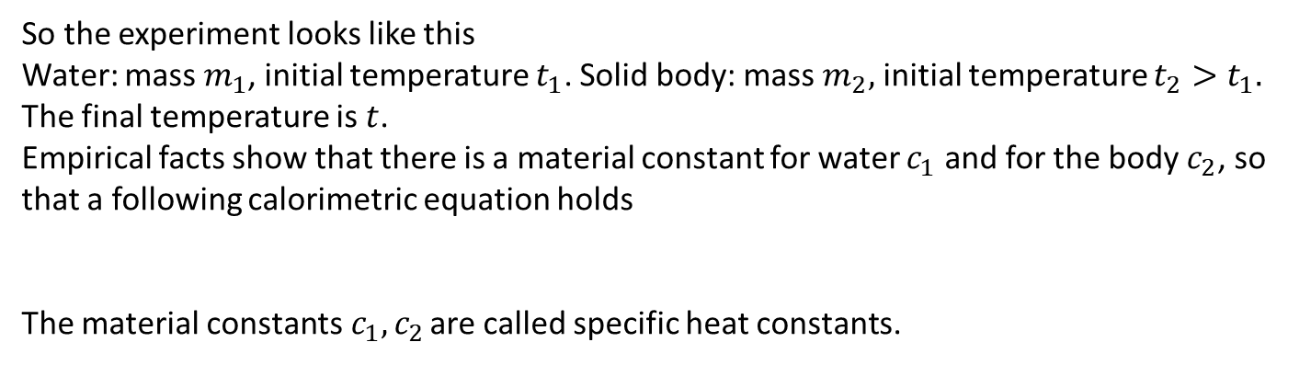
Calorimetry
Quantitative experiments about heating or cooling were done using calorimeters.
A calorimeter is a thermally isolated vessel. Inside the vessel we bring into contact two physical objects having initially different temperatures. Typically one object is a liquid like water, the other may be some solid body.
After some time the thermal equilibrium is established, both object having the same temperature which we measure.
So the experiment looks like this
Water: mass $m_{1}$, initial temperature $t_{1}$. Solid body: mass $m_{2},$ initial temperature $t_{2}>t_{1}.$
The final temperature is $t$.
Empirical facts show that there is a material constant for water $c_{1}$ and for the body $c_{2}$, so that a following calorimetric equation holds
The material constants$c_{1}, c_{2}$ are called specific heat constants.

Slide 8
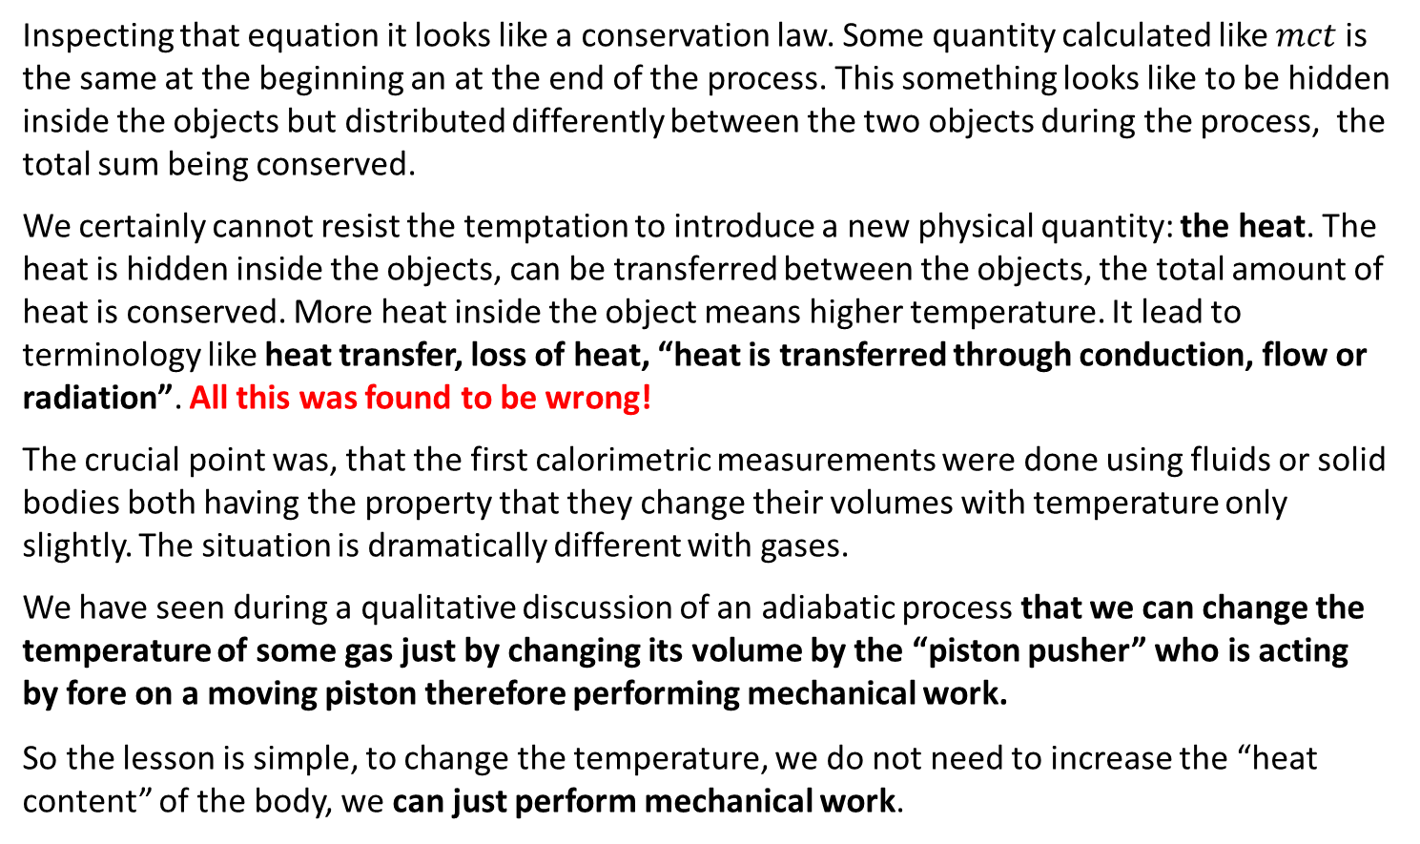
Calorimetric equation as a conservation law
Calorimetric equation can be rewritten as:
Inspecting that equation it looks like a conservation law. Some quantity calculated like $mct$ is the same at the beginning an at the end of the process. This something looks like to be hidden inside the objects but distributed differently between the two objects during the process, the total sum being conserved.
We certainly cannot resist the temptation to introduce a new physical quantity: the heat. The heat is hidden inside the objects, can be transferred between the objects, the total amount of heat is conserved. More heat inside the object means higher temperature. It lead to terminology like heat transfer, loss of heat, “heat is transferred through conduction, flow or radiation”. All this was found to be wrong!
The crucial point was, that the first calorimetric measurements were done using fluids or solid bodies both having the property that they change their volumes with temperature only slightly. The situation is dramatically different with gases.
We have seen during a qualitative discussion of an adiabatic process that we can change the temperature of some gas just by changing its volume by the “piston pusher” who is acting by fore on a moving piston therefore performing mechanical work.
So the lesson is simple, to change the temperature, we do not need to increase the “heat content” of the body, we can just perform mechanical work.

Slide 9
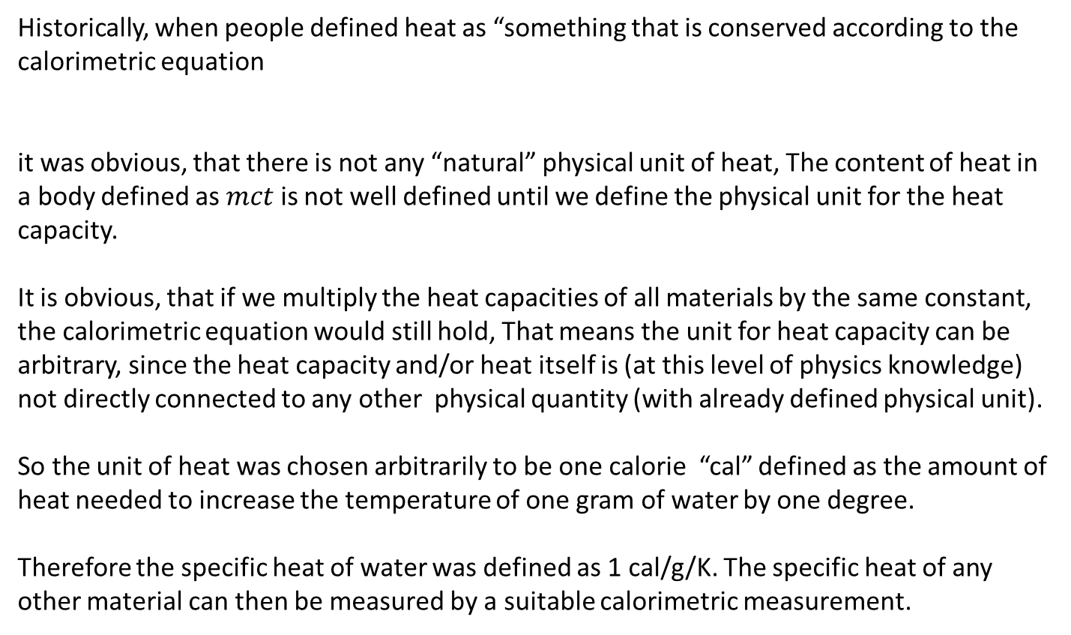
Phenomenological units of heat
Historically, when people defined heat as “something that is conserved according to the calorimetric equation
it was obvious, that there is not any “natural” physical unit of heat, The content of heat in a body defined as $mct$ is not well defined until we define the physical unit for the heat capacity.
It is obvious, that if we multiply the heat capacities of all materials by the same constant, the calorimetric equation would still hold, That means the unit for heat capacity can be arbitrary, since the heat capacity and/or heat itself is (at this level of physics knowledge) not directly connected to any other physical quantity (with already defined physical unit).
So the unit of heat was chosen arbitrarily to be one calorie “cal” defined as the amount of heat needed to increase the temperature of one gram of water by one degree.
Therefore the specific heat of water was defined as 1 cal/g/K. The specific heat of any other material can then be measured by a suitable calorimetric measurement.

Slide 10
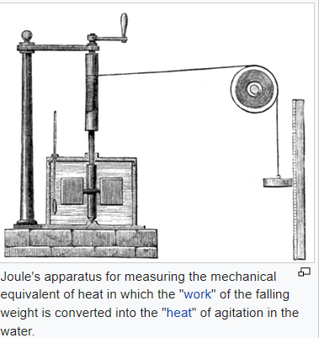
Mechanical equivalent of heat
Benjamin Thompson, Count Rumford, had observed the frictional heat generated by boring cannon at the arsenal in Munich, Germany circa 1797. More prcecise measurements were done by James Prescott Joule in the 1840s.
Finally it was found that the same increase of temperature of some object as achieved by “transfer of heat” of 1 cal can be achieved by performing a mechanical work of
4186 J.
So it was found that the “amount od heat” can be more naturally measured by the units of work, Joules. In this way a “mechanical equivalent of heat” was found. Calories can be universally converted to Joules by the conversion constant 4186 J/cal.

Slide 11
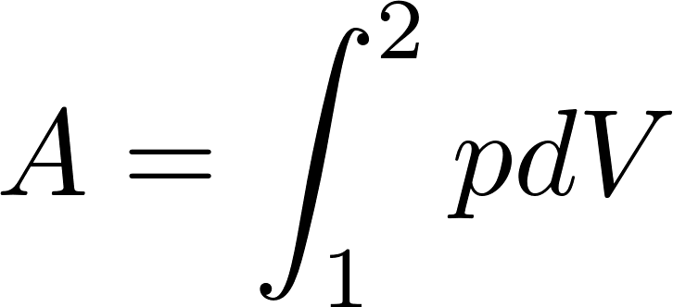
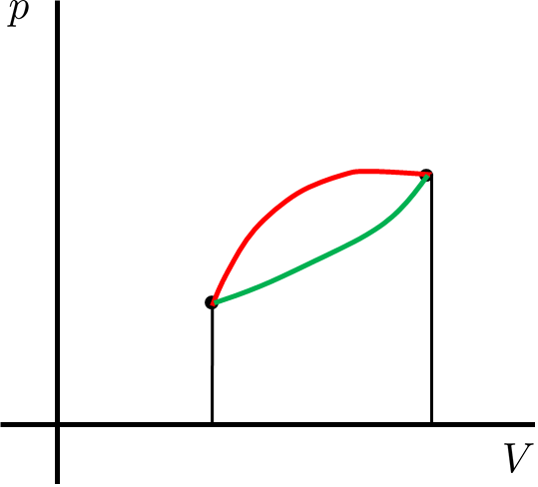
Work and heat for reversible processes in gas
We have found that the work performed by the “piston-pusher” during a reversible process changing the state of gas from the state “1” to the state “2” can be calculated as
and this work depends on “the trajectory” of the process between the initial and final states, as it is clearly seen from the figure below.
The obvious question is how much heat is to be provided by the boiler attendant on a particular process (trajectory). A careful investigation of this problem has lead to precise specification of the concept of energy formulating the law called “first law of thermodynamics”.

Slide 12
First law of thermodynamics
For any process between the two states “1” and “2” we can calculate the work performed by the piston pusher
and we can measure the heat “transferred” to the gas by calorimetric consideration of the actions performed by the boiler attendant. The following empirical law was established.
The sum of mechanical work and heat (converted to Joules) depends only on the initial and final states of the system and so this sum is the same for any (reversible) process (trajectory) between those two states.
Let us stress again: the work by itself and the heat by itself depend on the specific trajectory, their sum does not.
This means that the sum of work and heat must be calculable from the characteristics of the initial and final states only.
This means that we can define a physical quantity of state in such a way, that the difference of this quantity between the two states is equal to the sum of work and heat performed during (any reversible) process between the two states.

Slide 13
First law of thermodynamics
Repeating: the first law of thermodynamics says, that there must be a physical quantity of state such that the sum of work and heat is calculable as a difference of this quantity between the final and initial state.
This quantity was given a name: energy. More precisely, the phenomenological thermodynamics used the name internal energy. The reason perhaps was, that it was not obvious that the state function “energy” as found by thermodynamical considerations has anything common with the quantity “energy” as found in the studies of Newtonian mechanics of particles.
Of course, there was a connection: the internal energy can be changed at the expense of mechanical work, the same work as found in classical mechanics.
Only after molecules were discovered, it was clear that the “internal energy” is just a “standard” mechanical energy of molecules, just macroscopically “not directly visible”.
In what follows we shall just use the terminology “energy”, without the attribute internal.

Slide 14
First law of thermodynamics
The obvious task for a phenomenologist is to find the formula for energy as a function of quantities defining the macrostate.
Obviously, the first law of thermodynamics can determine only the difference of energies of twos states, so energy in thermodynamics is defined up to an arbitrary additive constant.
The phenomenologist has to define some arbitrary reference macrostate whose energy is set to 0 by definition. Then he has to measure the sum of work and heat going from the reference state to an arbitrary macrostate. Based on experimental data he has to “guess” a formula for energy.
A theoretician, who already knows that behind the macrostate there is some microstate of molecules can in principle calculate the (mechanical) energy of molecules in the chosen representing microstate and, based on statistical considerations, express the energy of the microstate through the macroscopic quantities defining the macrostate considered.

Slide 15
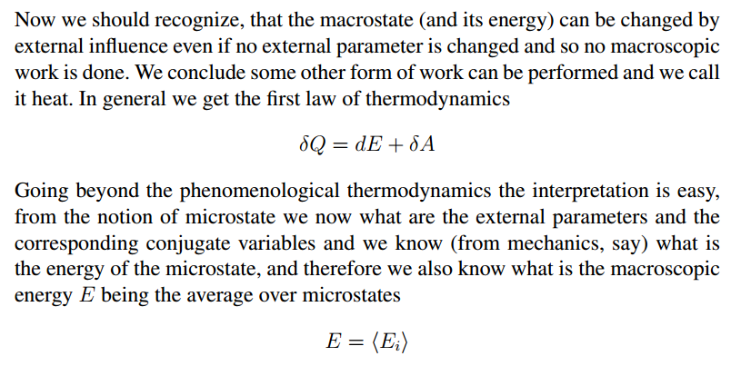
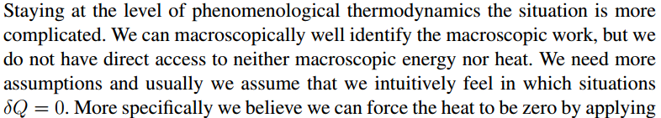
The problem is that an arbitrary final state cannot be reached from the reference state via the quasi-static adiabatic curve.

Slide 16
Energy conservation law holds for irreversible processes as well. So we can measure in principle the energy of any macrostate.
We first go from the reference state by adiabatic process to the state which has the same values of the external parameters as the desired final state, but is still a different state differing for example by the value of the conjugated parameters (practically it means by temperature). Now we keep the external parameters constant and perform heat to get to the desired final state. We perform (”produce”) heat by an irreversible process (Joule) performing mechanical work on some other (macroscopic but very small with respect to our system of interest) auxiliary system which is in contact with our system and exchanges heat with it, with the auxiliary system performing an irreversible process where external work is performed upon it. The auxiliary system is small, so even if its temperature is gradually increasing its energy increases by negligible amount.
Historically the procedure was still different from the procedure using the Joule irreversible (work to heat transfer) process as described above. The notion of heat was older then the fact that it can be measured using the units for work. The notion of heat developed in calorimetric measurements.

Slide 17

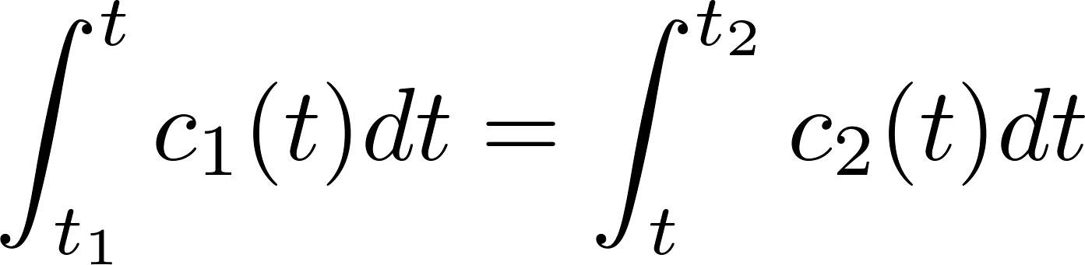
Problem: heat capacity may depend on temperature, so the more realistic calorimetric equation is
Idea: parametrize heat capacity by a function with a few free parameters, then perform a fit.
How to measure heat. Fixed volume, no work. Contact with hot water until desired temperature reached. Measure heat exchanged by measuring the hot water the hot water final temperature.
measure heat
measure work

Slide 18
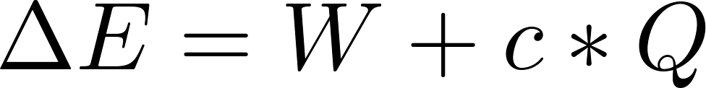
Historical problem: work and heat measured by different units.
First law of thermodynamics:
there exists a universal unit converting constants that the sum lof work and converted calories to get from an initial state to a final state does not depend on trajectory
Therefore there exists a state function E, which can be determined as
thus the energy conservation law was discovered: any energy change is balanced by the work (mechanical work + heat). To perform work there must be an agent. The work performed by an agent on the system is the same but with an opposite sign as the work performed by the system on the agent. Therefore the energy change of the agent is just opposite to the energy change of the system and the overall energy of system + agent is conserved.

Slide 19
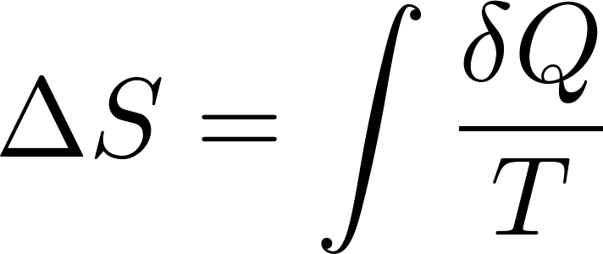
Second law of thermodynamics:
does not depend on the trajectory. So entropy is a state function.
Cyclic reversible engine:

Slide 20
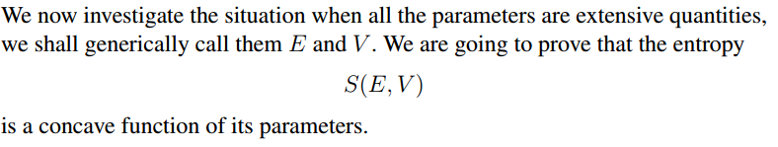




Slide 21
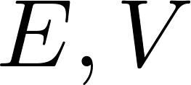
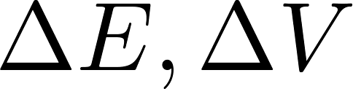
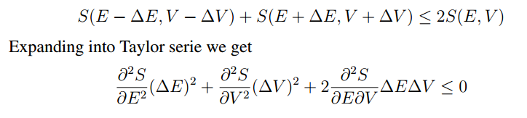
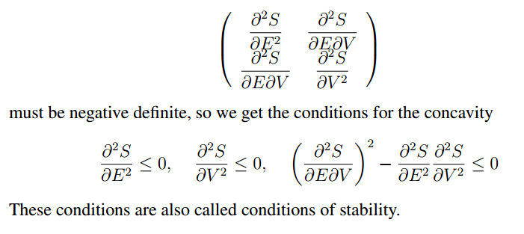

Slide 22
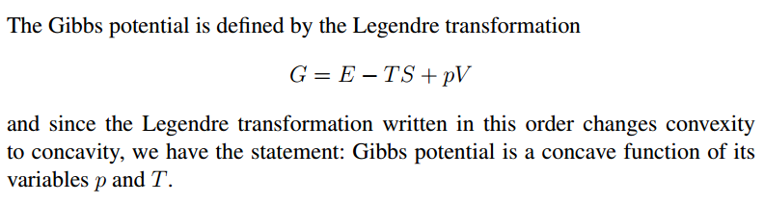
What was essential to derive the concavity property was that the parameters were extensive.
Other thermodynamic potentials do not have extensive natural parameters. However, they are derived by Legendre transformation. And the Legendre transformation preserves (or changes the sighn) of concavity. So we get concavity property for other thermodynamic potentials as well.

Slide 23
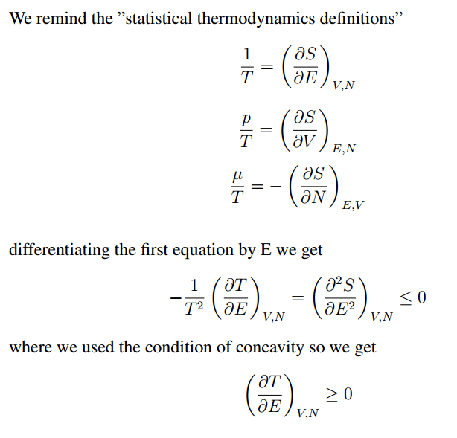

Slide 24
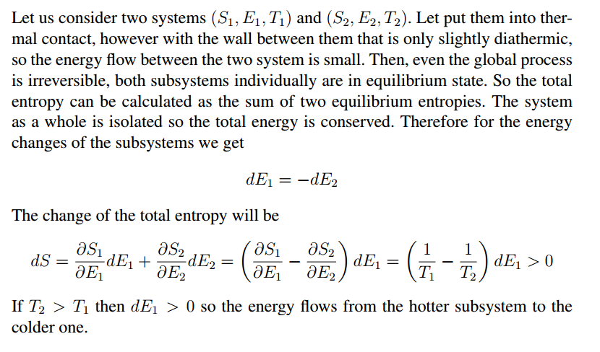

Slide 25
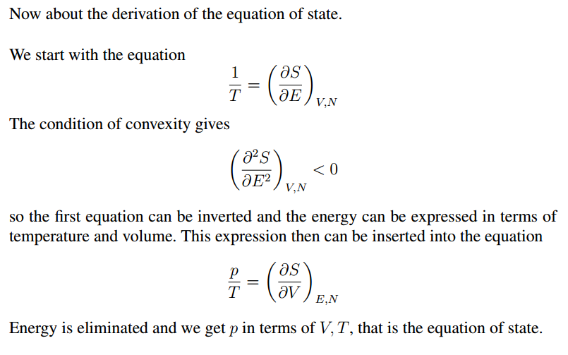

Slide 26
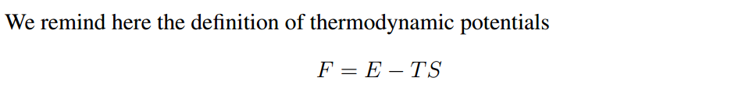
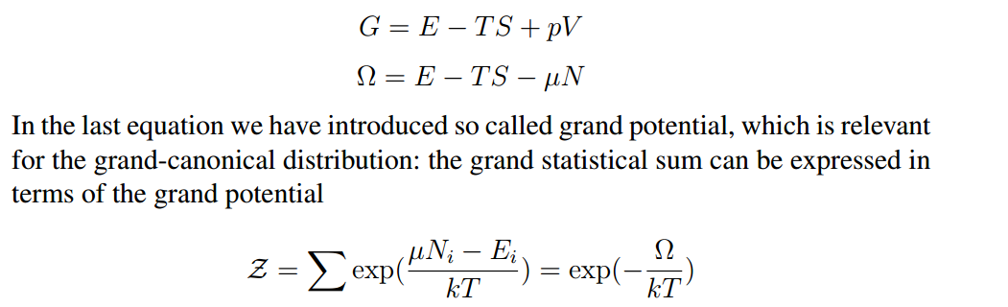
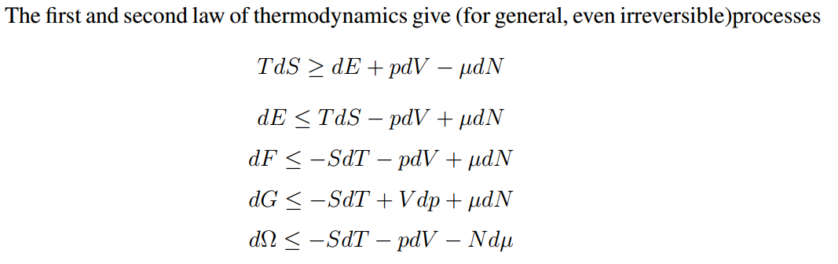

Slide 27
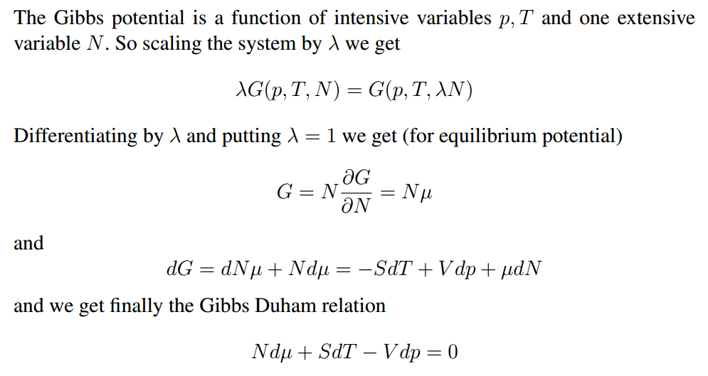

Slide 28

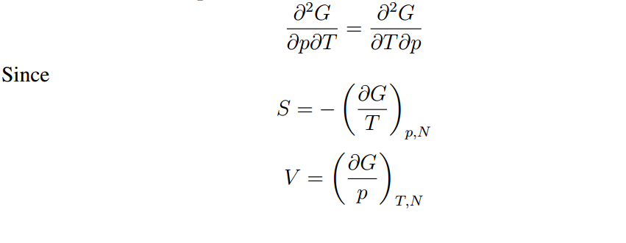
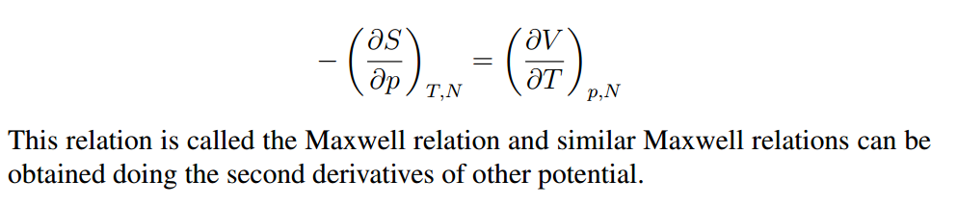

Slide 29
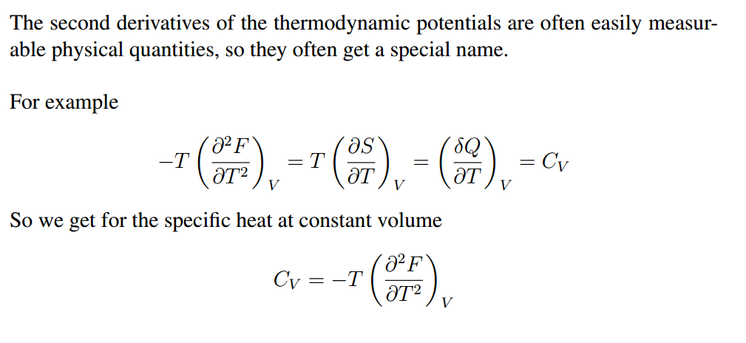

Slide 30
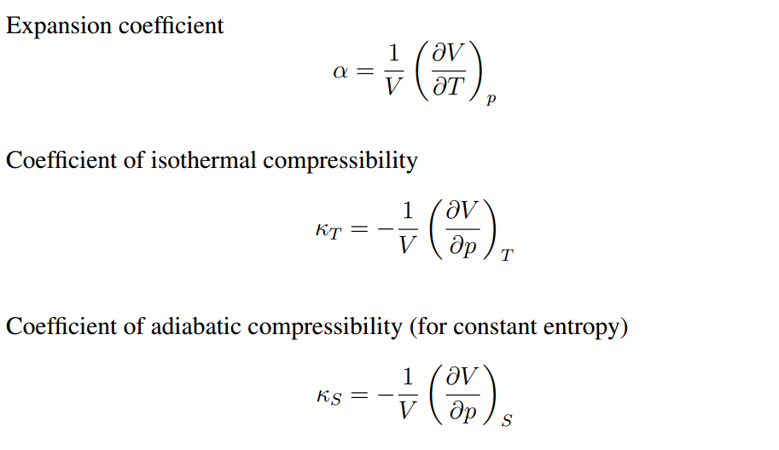

Slide 31
