Slide 1
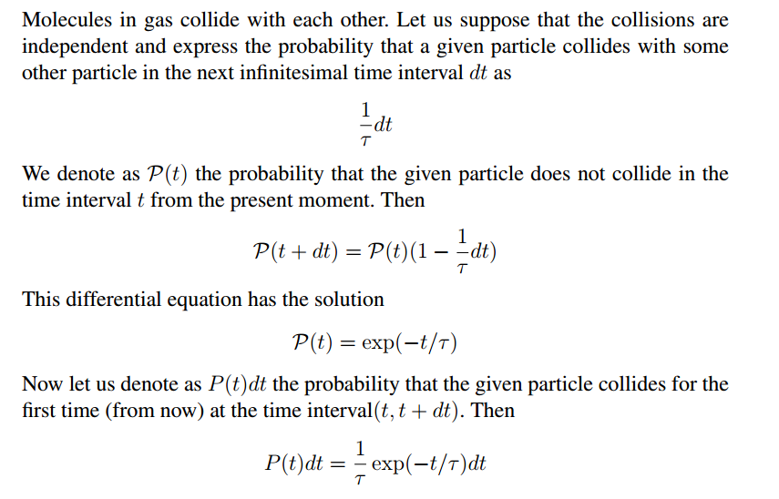
Mean time between collisions

Slide 2

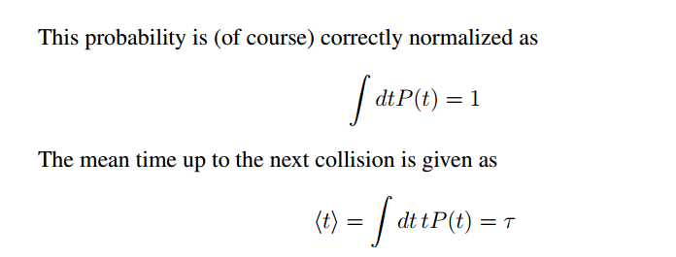


Slide 3
Thought experiments
catch a molecule. Ask her to send you the time of the next collision from now
catch a molecule. Ask her to tell you the time of the last collision before now
catch a molecule. Ask her to tell you the time of the last collision and then the time of the next collision. Subtract the two numbers
catch a molecule. Ask her to give you the recordings of the times of collisions. Subtract always the two consecutive times

Slide 4
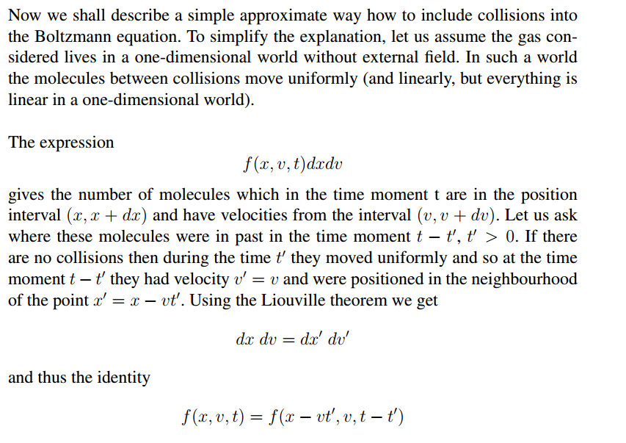

Slide 5
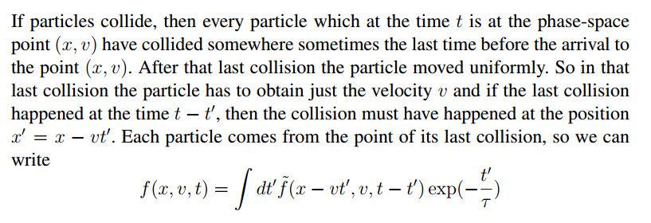
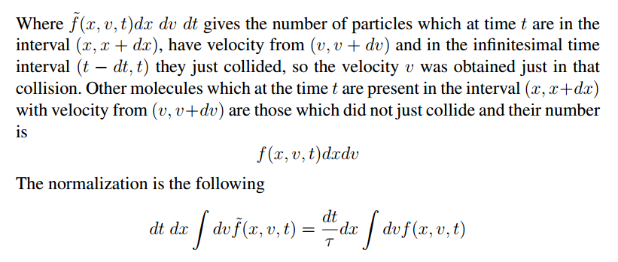

Slide 6
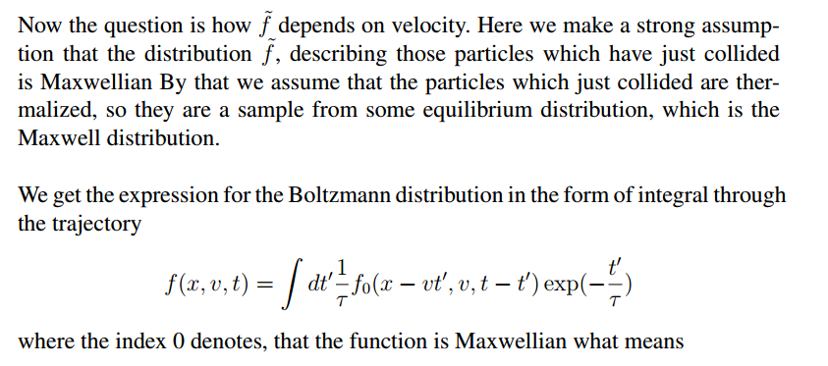



Slide 7
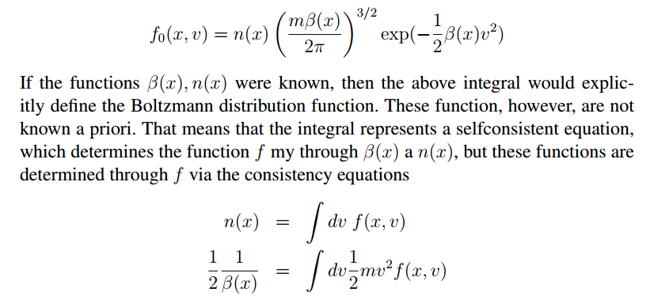

Slide 8

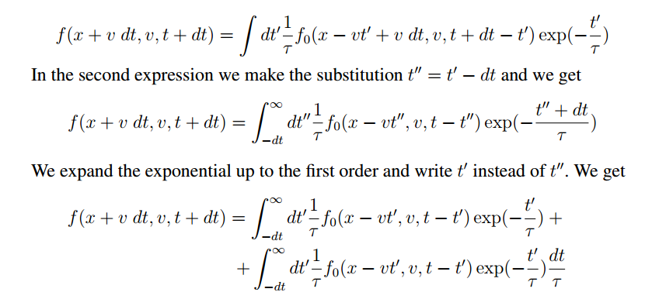

Slide 9


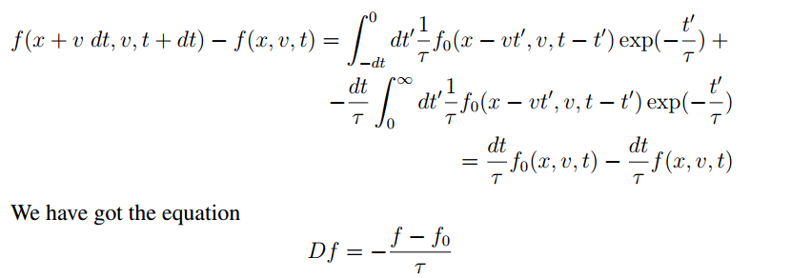

Slide 10


Slide 11
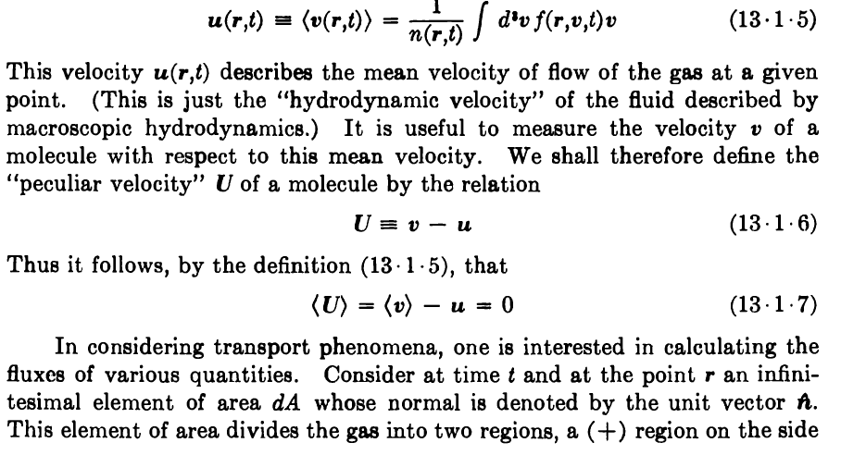

Slide 12
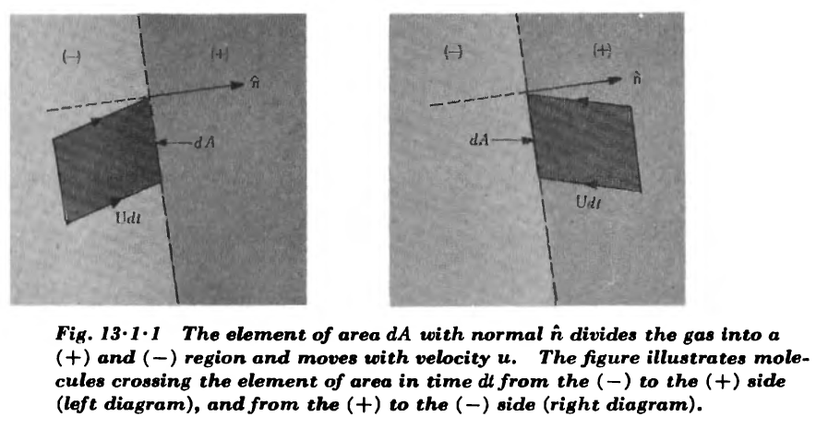


Slide 13




