Slide 1
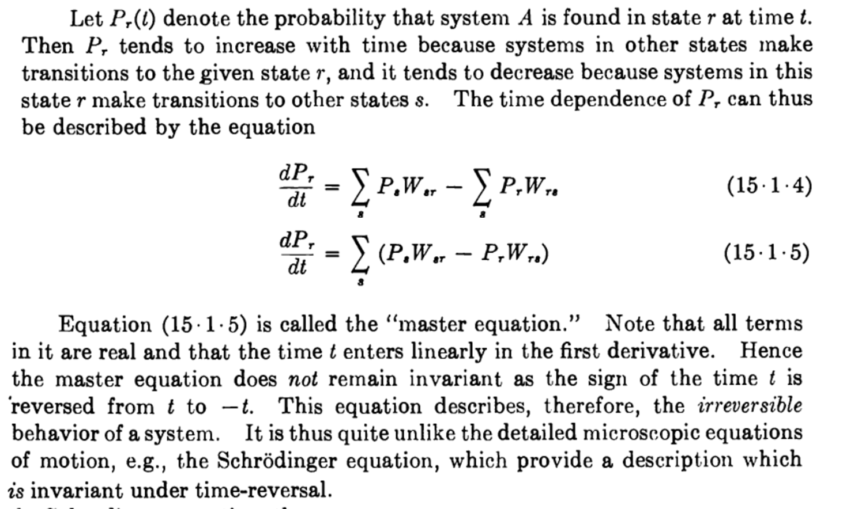
Decoherence and quantum kinetics:
master equation
The following is a snippet from Reif: Fundamentals of statistical and thermal physics

Slide 2


Decoherence and quantum kinetics:
master equation
Reif stresses the fact of time irreversibility of the master equation used to describe the kinetics of a quantum object.
For me, reading the book, a more important question is this: where are the superposition states?
The master equation deals only with probabilities, not with amplitudes! How this can be justified for a quantum object?
The answer may be this:
Consider the time steps in the differential master equation as not infinitesimally small. So net derivatives in a strict mathematical sense. Just small time denominators (Newton had no $ε , δ$, just fractions of small quantities). If the small time increments are larger than decoherence time due to continuous interaction with environment, we get it!
In this way an exponential decay is acceptable, which otherwise can hardly be justified in “orthodox” quantum mechanics.

Slide 3


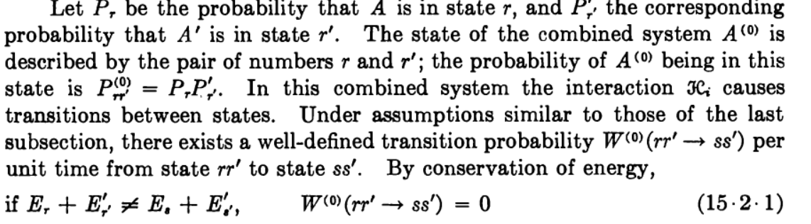

Slide 4


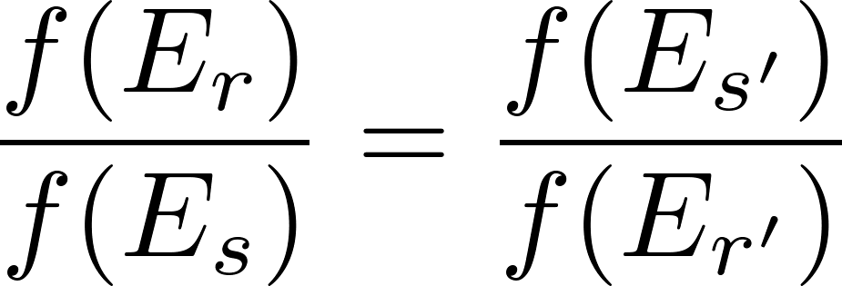
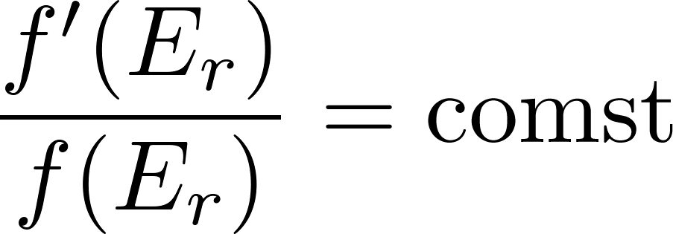


detailed balance

Slide 5




Slide 6


detailed balance

Slide 7
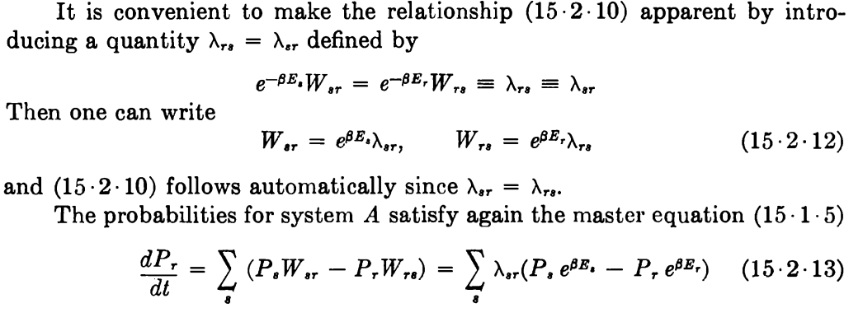

Slide 8

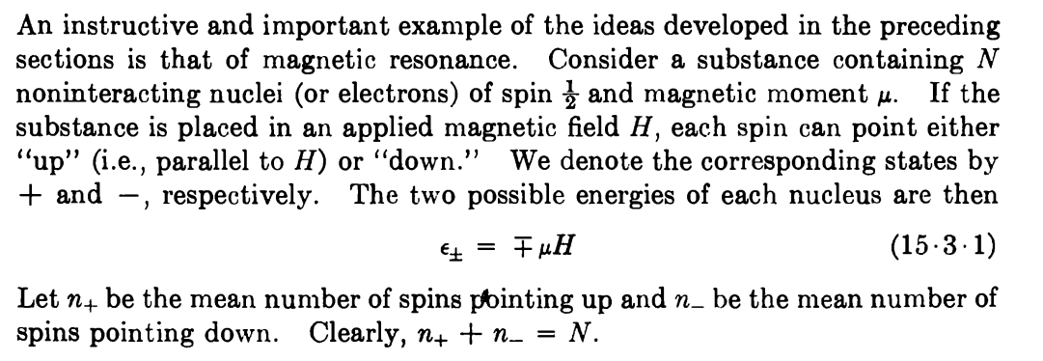

Slide 9
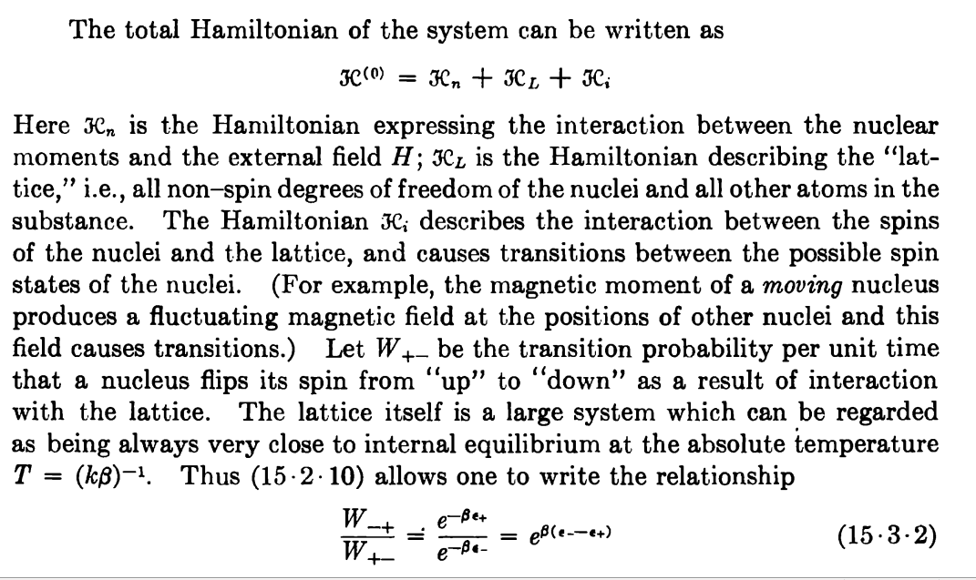

Slide 10
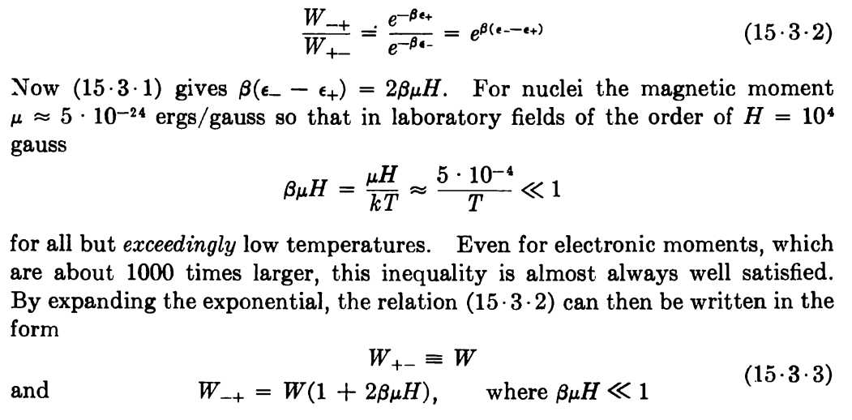

Slide 11
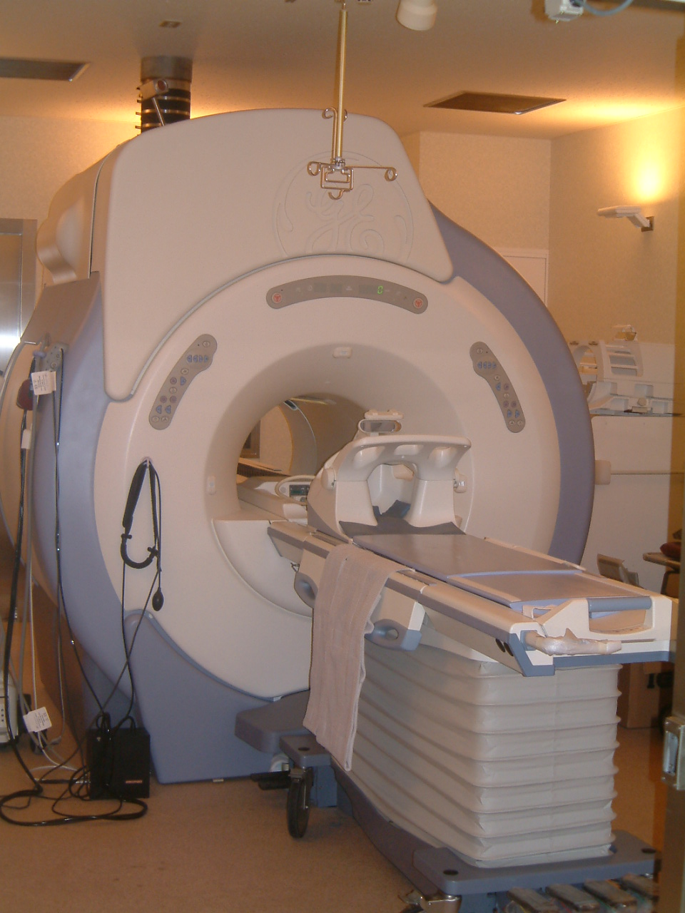

Slide 12



Slide 13
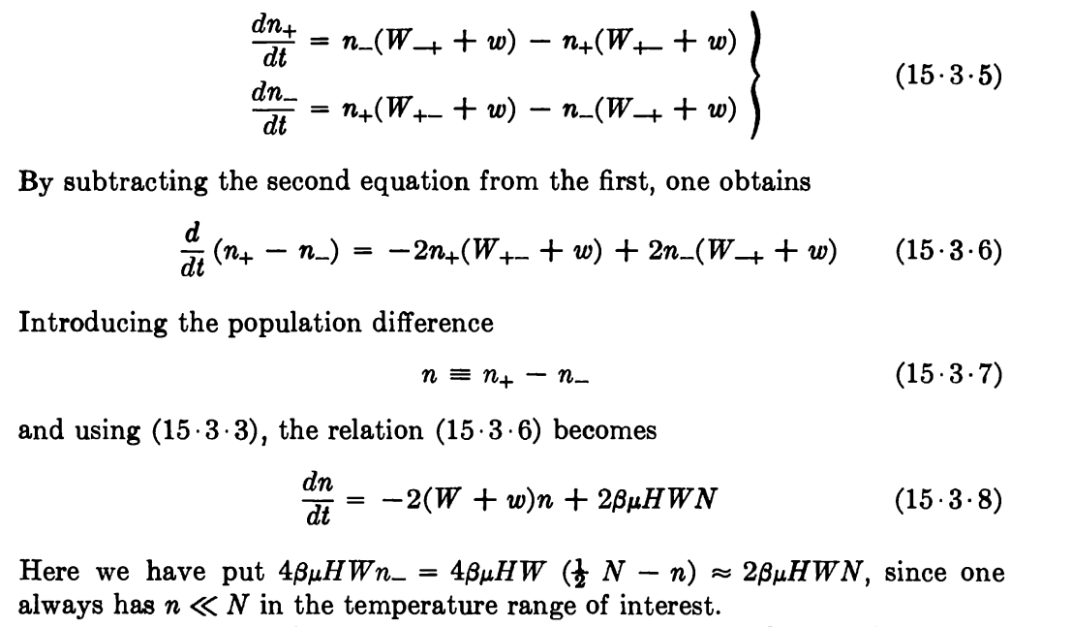

Slide 14
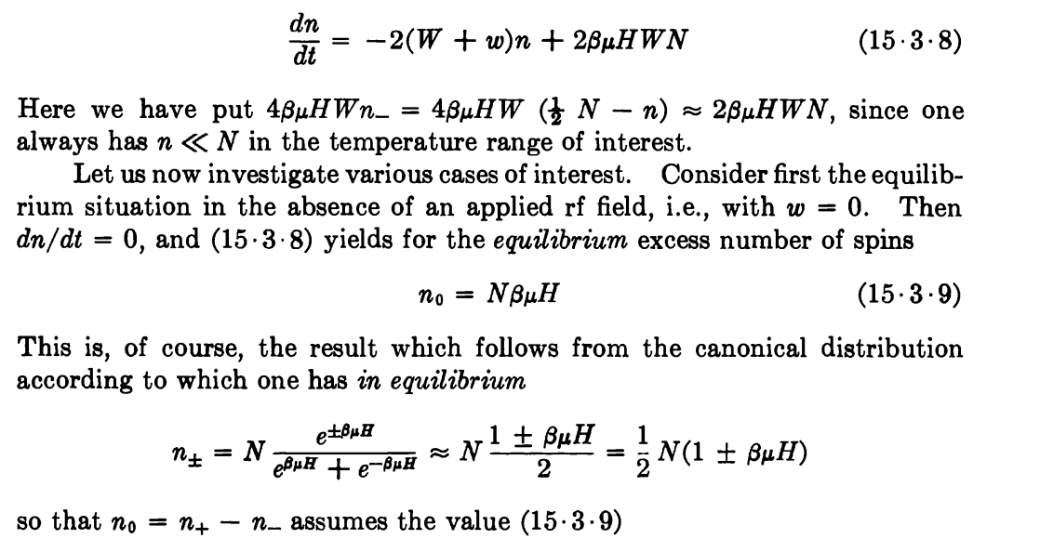


Slide 15
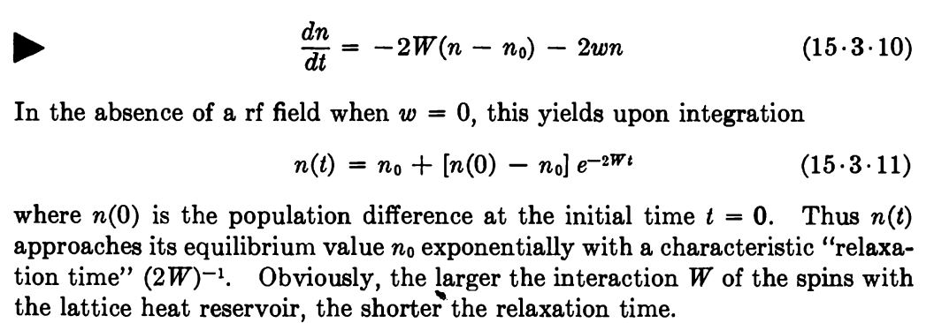


Slide 16
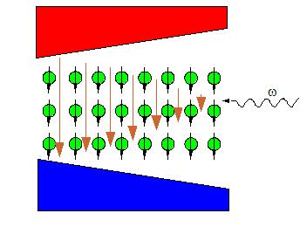
ω=γB

Slide 17
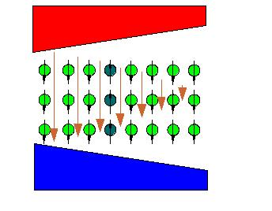
ω=γB

Slide 18
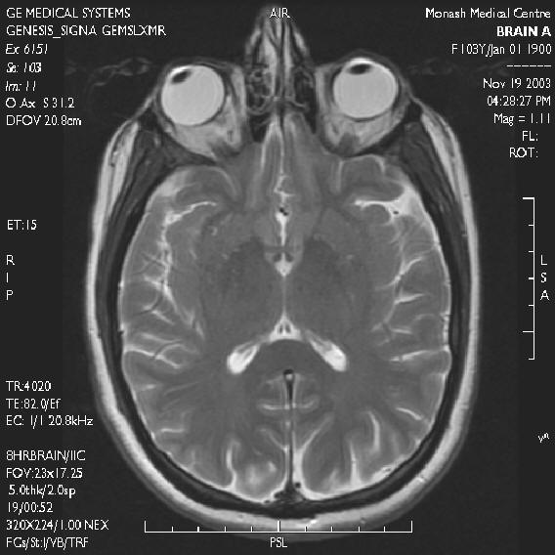

Slide 19

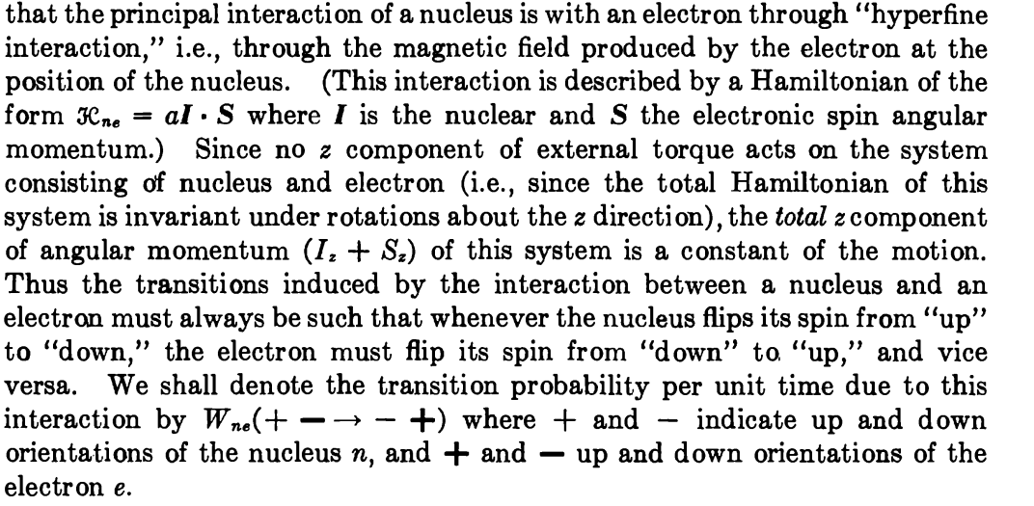

Slide 20
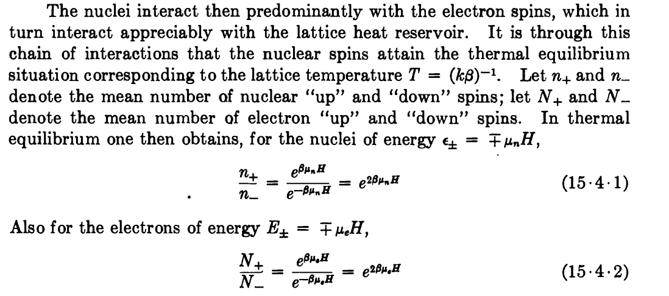


Slide 21
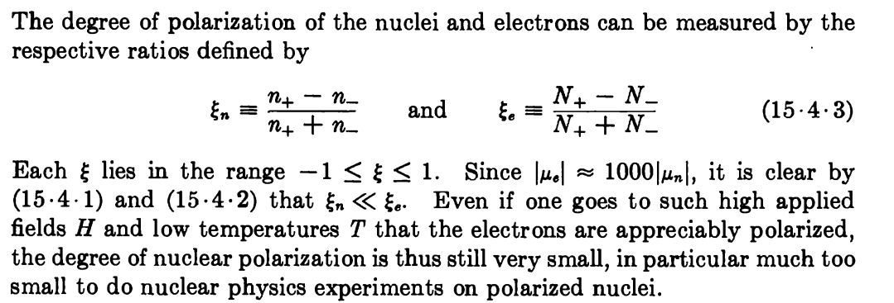


Slide 22


detailed balance

Slide 23

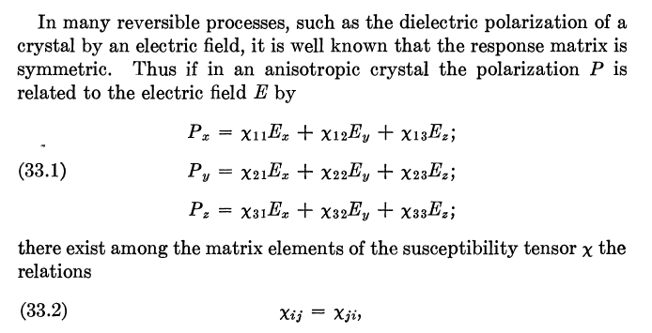

Slide 24

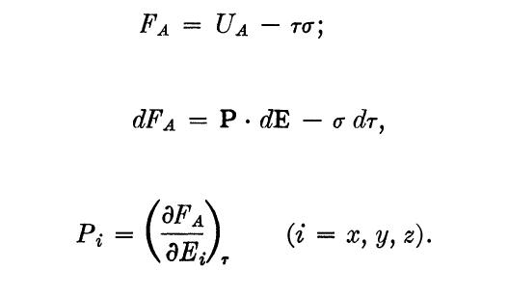
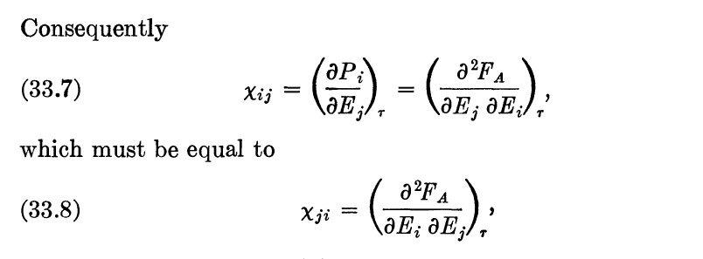

Slide 25
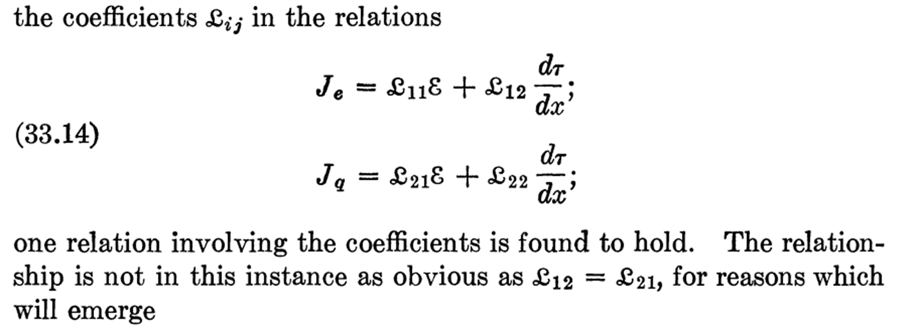

Slide 26


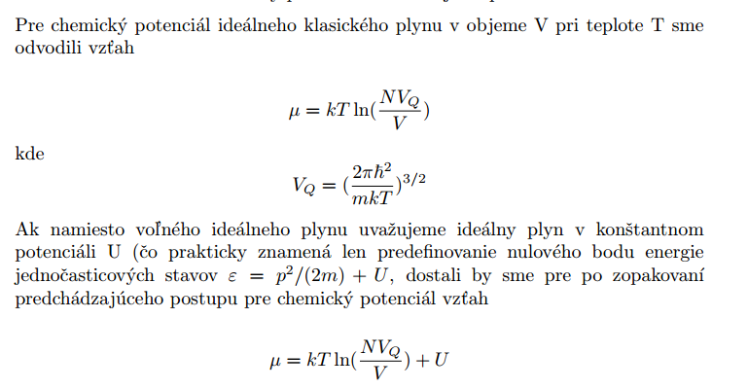
Vsuvka

Slide 27
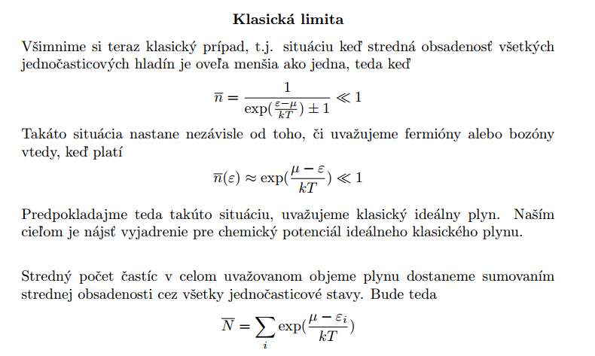

Slide 28
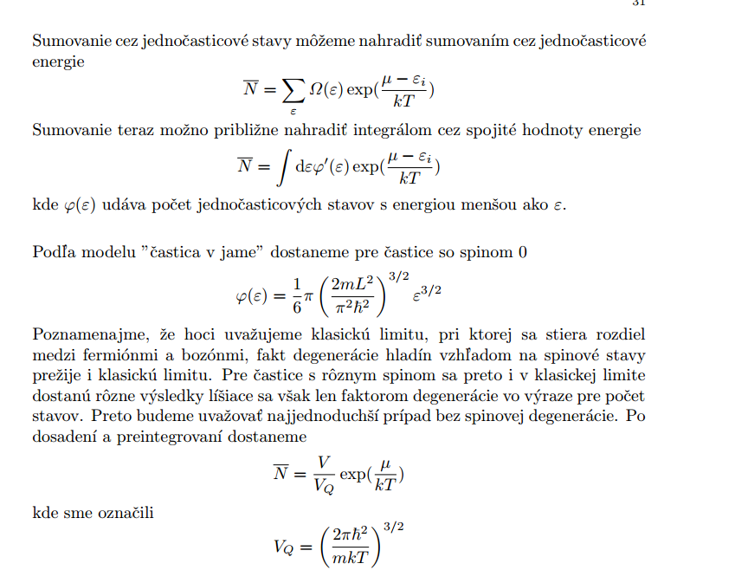

Slide 29
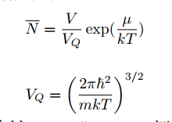
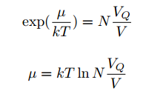

Slide 30
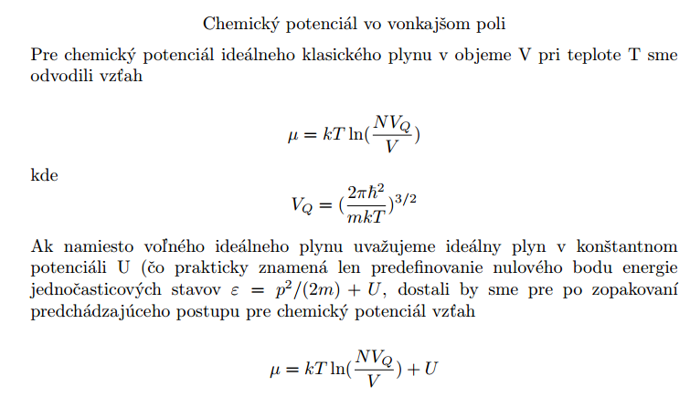

Slide 31
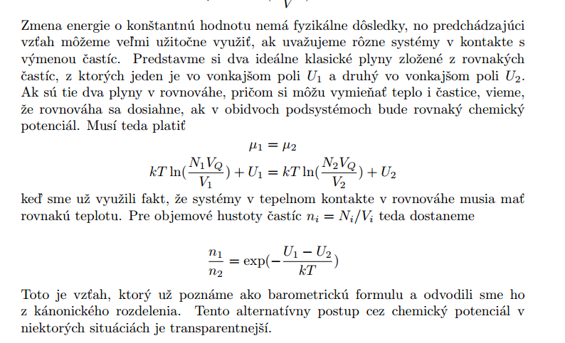

Slide 32

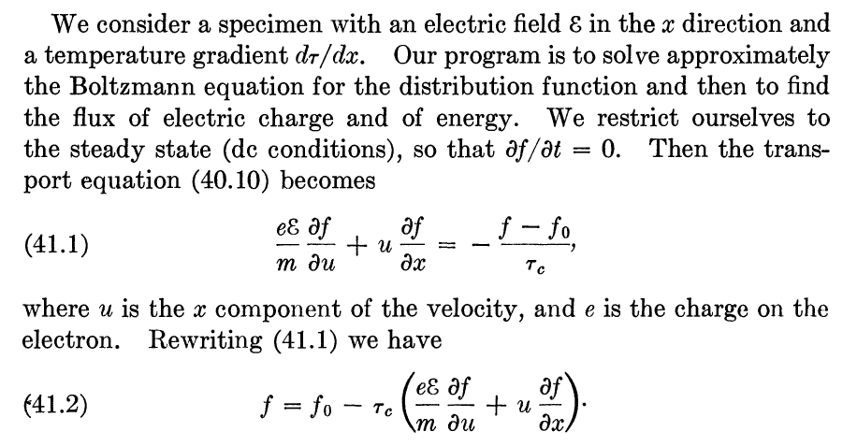

Slide 33



Slide 34

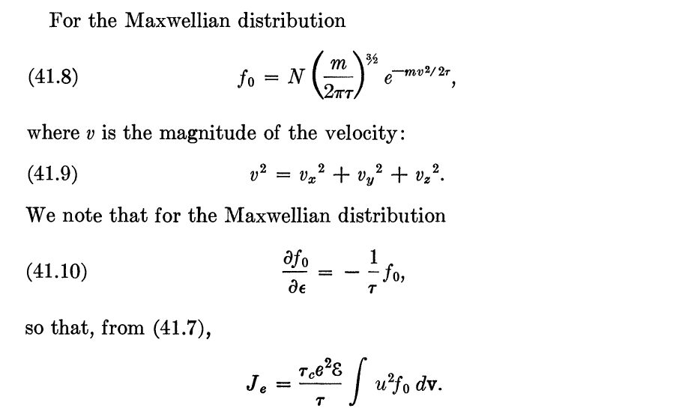

Slide 35
