Slide 1
Java Quick Info
Notes for C++ programmers who will be supposed to do passive programming in Java
By passive programming we mean reading Java programs and do minor changes
(passive programming = programming by example)
It is often said that you must use objects when programming in Java. Well, it is not quite true. You can do procedural and not object programming in Java just wrapping the standard procedural code within one formal overall class with no object instances created. You just have to prepend function definitions with a magic word “static”.
We shall later use also some objects in this short course, but we start with this quasi-procedural programming.

Slide 2
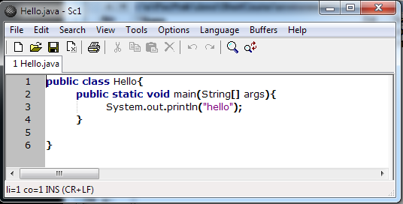
Text editor (not word processor like Word!) : Scite
http://www.scintilla.org/SciTEDownload.html

Slide 3
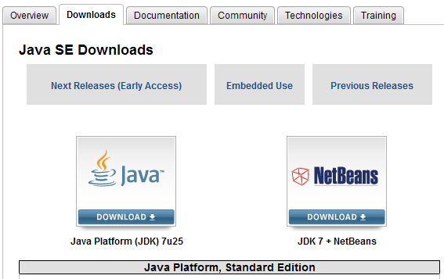
Java environment
Install Java: http://www.oracle.com/technetwork/java/javase/downloads/index.html
Two binaries:
javac.exe “compiler”
java.exe “java virtual machine” (run time)
Java installer puts java.exe on PATH , but not javac.exe
You have to arrange, that javac.exe is on PATH or call it by full-path-name like
“C:\Program Files\Java\jdk1.7.0_17\bin\javac.exe”
observe the double quotes, required because of space in the name Program Files

Slide 4
Text editor (not word processor like Word!) : Scite
http://www.scintilla.org/SciTEDownload.html
Work cycle: Save .....Build (F7) .....Go (F5)
Build can be run by hand as:
javac Hello.java
This creates the “compiled code” Hello.class
Go can be run by hand as
java Hello
This runs the compiled code Hello.class, but observe no class extension in the command! java.exe must bne on PATH!

Slide 5
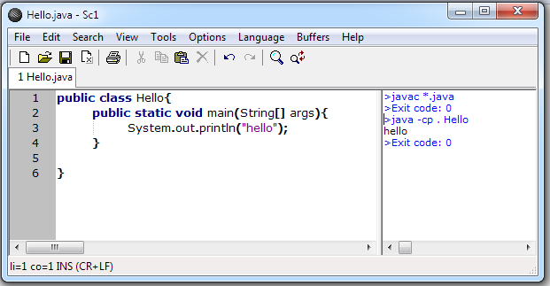
To ensure that javac.exe is on path when called from Scite by pressing F7
either put javac.exe permenantly on PATH via
Control Panel -> System ->Advanced ->Environment Variables -> Edit
or write and use Scite .bat file to start scite (sc333.exe) as
Scite.bat
PATH = C:\Program Files\Java\jdk1.7.0_17\bin;%PATH%
sc333.exe
Test whether your Java/Scite installation is working: Press F7, F5 and you should see

Slide 6
Procedural (not object) programming in Java:
wrap everything as static data and methods in a single class
file: noobjects.java
public class noobjects{
public static int c; //static variable acts like a global variable
//static method addc acts as a global function in c++
public static int addc(int x){ //adds c to x
return(x+c);
}
public static void main(String[] args){
c=4; //sets the value of global variable c
int a = 5; //a: local variable variable only inside the function main
int y = addc(a); //y is another local variable
System.out.println("result: "+y);//observe friendly conversion of //integer y to string and adding strings
}
}
static: it roughly means something as “global”
public: it roughly means that public parts of code can be used outside of defining class
filename (noobjects.java) must correspond to the name of the outermost public class in the file

Slide 7
Passive programming example
Find and correct errors in bubblesort.java and run the code.
You have not yet been formally informed about Java arrays, loops and do..while statements but you should understand the following code, if you know c++.
public class bubblesort{ //consult wikipedia what is bubblesort if you do not know
public static int N=6;
public static int [] c = {0,4,-1,2,8,4}; //array of ints to be sorted
public static void swapNeighbors(int i){ //swaps value at index i with its next neighbor
int tmp = c[i];
c[i]=c[i+1];
c[i+1]=tmp;
}
public static void main(String[] args){
boolean done = true;
do{
done=true; //assume no swap will be needeed
for(int i = 0; i<N; i++){ //this will lead to run-time error! Correct it!
if (c[i]>=c[i+1]) { //another error here: find the logic error in this line!
swapNeighbors(i);
done=false;
}
}
}while(!done);
for(int i = 0; i<N; i++){
System.out.print(c[i]+",");
}
System.out.println("");
}
}

Slide 8
Primitive types in Java
Primitive types are
byte, short, int, long, float, double, char, boolean
Technically, they are not objects (not instances of any class)
There is nothing like unsigned keyword like in c++. The numerical types are all signed, so even the byte represents a signed 8 bit number, so the range of byte is from -128 to +127
Primitive type variable declaration and initialization examples:
int value;
value = 4;
boolean ready;
ready = true;
char letter;
letter = ‘A’;

Slide 9
Arrays in Java
Example:
int [] a; //array declaration
a = new int[5]; //memory allocation, default initialization
for(int i=0; i<5; i++) a[i]=i; //setting values
Comments:
Variable a does not hold the array values, it is a reference (something as a pointer) to memory where the array data is stored.
After declaration int[] a; there is no memory allocation performed, so the variable a holds a “null” value: it does not refer to any memory position
The statement a = new int[5]; allocates space in the memory, now the variable a holds the reference to the (first byte) of the allocated space.
There is a major difference from c++: the array “knows its length at run time”, you can get it as
int n = a.length;
The array index runs from 0 to a.length-1
If you try to write or read outside the index range, like
a[5]=3;
you get a run time error and the program is immediately stopped (in c++ you do not get an exception and you can easily overwrite the memory position with disastrous postponed effects).

Slide 10
Strings in Java
Example:
String s1=“Hello”;
String s2=“world”;
String s= s1+” “+s2+”!”;
int pos = s.indexOf(“rl”); //this returns 8
Comments:
String is a built-in class to manipulate arrays of characters. However you do not hav access directly to the array of characters which (internally, inside the String object) holds the character data. You just have to use some of the String class method to get access to the individual characters of the string.
The spectrum of String methods is huge (much larger then the c++ string methods) . There is a special method to do practically anything you would like to do with the string data.
Lear how to find information on web, for example just google: “java String” and you get as a first hit the details about the String class.
A complete API documentation of all the Java classes is at
http://docs.oracle.com/javase/7/docs/api/

Slide 11
Program BasicJava.java
It often happens for a programmer that he has to switch to other language which he has not been using for quite some time. Then he does not remember what is the exact formulation of some statements or declarations.
It is useful to have at hand a simple program demonstrating the usage of basic statements or declaration. We provide the file BasicJava.java which is just such a quick overview of basic usage, there are following sections:
simple control statements (loop, while, do while)
if, else
switch
arrays (simple arrays, two-dimensional arrays)
mathematical functions
string operations
exception handling
Read the program, you will most probably understand what is going on.

Slide 12
Classes and Objects
Class is a more complex and more structured type than a primitive type.
A primitive type variable holds just one unstructured piece of data like one integer number.
A class type variable can hold a structure of
several pieces of data
several methods (functions) handling that data
The idea is that very often several pieces of data as well as the functions for their processing are logically interconnected to such extent that it is wise to keep them wrapped in one “object” which can be then created, processed, copied, or sent as justy one item whose complex internal structure is not important for a particular action.
Similarly to primitive types, there might exist more objects as instances of a single type.
For example the two declarations
int a = 4;
int b = 6;
create two instances of the same type int.
Primitive types are language-defined. Classes are custom-defined structured types according to a particular need. So before an instance (object) can be created, the class type should be declared.

Slide 13
Class declaration
public class point{
public double x; //x coordinate of a point
public double y; //y coordinate of a point
public point(double xin, double yin){ //constructor initializing the point coordinates
x=xin;
y=yin;
}
public void translate(double a, double b){ //translate the point by a vector (a,b)
x=x+a;
y=y+b;
}
}
All fields (= data items) and all methods (= internal functions) are declared here as public. This means that the data items and methods can be used from outside the object (= not only internally within internal functions)

Slide 14
Creating objects (creating instances of a class)
public class testPoint{
public void main(String[] args){
point A = new point(1.4, 2.8);
point B = new point(-3.2, 6.4);
A.translate(2., 3.);
System.out.println(A.x + “ “+A.y);
System.out.println(B.x + “ “+B.y);
}
}
This program produces the output
3.4 5.8
-3.2 6.4
Comment:
it is clear, that we refer to individual data items or method using the dot (.) operator, like
A.x
A.translate(..., ...)

Slide 15
Static fields and methods
public class point{
public static int size;
public double x; //x coordinate of a point
public double y; //y coordinate of a point
public point(double xin, double yin){ //constructor initializing the point coordinates
x=xin;
y=yin;
}
public void translate(double a, double b){ //translate the point by a vector (a,b)
x=x+a;
y=y+b;
}
public static int getDimension(){
return 2;
}
}
public class testPoint{
public void main(String[] args){
point.size=3;
System.,out.println(“Dimension: “+point.getDimension);
point A = new point(1.4, 2.8);
point B = new point(-3.2, 6.4);
A.translate(2., 3.);
System.out.println(A.x + “, “+A.y+” size: “+A.size);
System.out.println(B.x + “, “+B.y+” size: “+B.size);
}
}

