Slide 1
Študijný materiál
davinci.fmph.uniba.sk/~cerny1
miniskriptá (rozšírený sylabus)
minizbierka úloh (podobné príklady budú na skúške)
postupne budú pribúdať detailné prezentácie
Fundamentals of statistical and thermal physics / Federick Reif. Singapore : McGraw-Hill
Thermal Physics Charles Kittel
cerny@fmph.uniba.sk
0907 848 104
Hodnotenie
Počas semestra 40 bodov
Písomka na skúške 35 bodov
Ústna skúška 25 bodov
Navyše možný žolík (malá semestrálna práca na dohodnutú tému) za max. 10 bodov
Po skúškovej písomke sa musí dosiahnuť (vrátane žolíka) aspoň 41 bodov, inak Fx
Prvá časť ústnej skúšky je typu „modré obrazovky“ a môžu byť za ňu aj záporné body.
Celkové hodnotenie 41-E, 51-D, 61-C, 71-B, 81-A

Slide 2
Statistical physics is about the world of molecules
A few typical numbers

Slide 3
Physics manifesto
(western civilization understanding of our world)
We do not attempt for holistic approach to understand the world as a whole. We always identify a portion of universe, call it “physical system” and analyze it.
It is possible to record a time instant snapshot of a physical system called state of the system (on paper, as a computer file,...) by recording a set of values of some physical quantities. From this record, the time instant of the system can be completely reconstructed, that means to calculate the “would-be” outcome of any measurement or observation of the system at that time instant
The state of systems is generally changing with time either because of internal reasons or because of interaction with environment. Time development can be imagined as time sequence of states (better as a function which in any time provides the system state).
The ambition of physics is to learn how to predict the time development of physical systems. We believe, it is possible. It is possible to “forecast the future”.
The technology used to forecast the future are mathematical equations of motion. Often the equations of motion for a system are differential equations. We believe the time development of a system is found as (a unique) solution of the equations of motion satisfying the initial condition: knowing the state of a system at some (initial) time instant we aim to determine the future states.
The words like “unique” and “predict” have to be modified if quantum mechanics has to be used to describe the system properly.
Notes:
audio:1_3

Slide 4
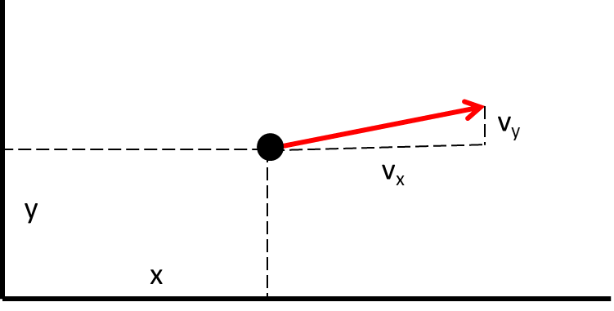
Physics manifesto
Classical (non quantum) point-like particle
Particle state
position (a point in the 3-dimensional space)
velocity (vector in the abstract space of velocities)
So the particle state can be represented by 6 numbers
It is a point in and abstract 6-dimensional space of states

Slide 5
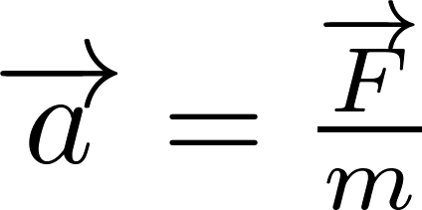
Physics manifesto
Classical (non quantum) point-like particle
The ambition of physics is to learn how to predict the time development of physical systems. We believe, it is possible. It is possible to “forecast the future”.
The technology used to forecast the future are mathematical equations of motion. Often the equations of motion for a system are differential equations. We believe the time development of a system is found as (a unique) solution of the equations of motion satisfying the initial condition: knowing the state of a system at some (initial) time instant we aim to determine the future states.
For a classical point-like particle the equation of motion is the Newton equation

Slide 6
For simplicity: one dimensional problem
Suppose I know F_{x}($x$) for all $x$, how I forecast the future?
I know the initial state at t=0
I know
Then, using Newton eq. I know the acceleration in time 0
Knowing the initial velocity, I can determine the position after a short time interval $dt$.
Knowing the acceleration I can determine the velocity in the new position
So I know the complete state in time $0+dt$ and can continue the procedure to time $0+2dt$
Continue up to arbitrary time instant $t$.

Slide 7
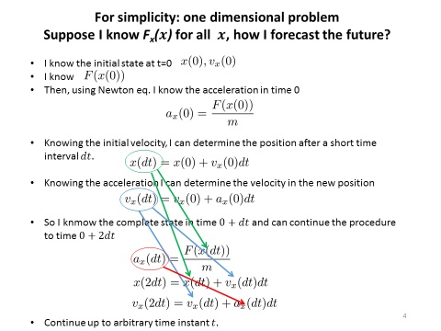
Newtonian mechanics is enough to handle any (non-quantum) system made of particles. But only in principle. Real systems around us are often made of huge amount of particles, of the order of ${10}^{26}$.
It is just technically impossible to write down a state using ${10}^{26}$ numbers and then solve ${10}^{26}$ differential equations simultaneously.
However, practical problems can still be handled using statistical methods. This is where statistical physics was born.

Slide 8
Statistical physics manifesto
we have to handle systems with huge number of degrees of freedom $≈{10}^{26}$
exact physical state of such a system ($≈{10}^{26}$ numbers) is called a microstate
a complete information on microstate is experimentally unfeasible
experimentally in a state of a large system we have just a few values of macroscopically measurable physical quantities
these macroscopic numbers define what we call a macrostate
macrostate is just drastically reduced information on microstate
we have to live with the fact that we just know a macrostate instead of a microstate. Still, we want to “forecast the future” at least on the level of macrostates
the technique how we handle macrostates in physics is statistics
we know the macrostate, but the system is in fact in some unknown microstate
there is tremendously huge number of microstates compatible with our information on macrostate
a particular macrostate can be realized by tremendously huge number of different microstates. This set of compatible microstates is called a statistical ensemble. We shall see that the number of microstates in an ensemble is of the order ${{10}^{10}}^{26}.$
We imagine a procedure which virtually forecast the future of each microstate from the ensemble, make a virtual average and get the average characteristics of the final macrostate which we assume will be the final macrostate of our particular initial macrostate.

Slide 9
Statistical physics manifesto
How do we know this:
we have to handle systems with huge number of degrees of freedom $≈{10}^{26}$
for a system with $≈{10}^{26}$ degrees of freedom there exist ${{≈10}^{10}}^{26}$ different microstates which cannot ne macroscopically distinguished from each other
At the beginning of the 19th century, we discovered that matter around us is composed of atoms and molecules and. Typical number of atoms or molecules is (by the rough order of magnitude) ${10}^{26}$.
The major breakthrough was achieved by changing alchemy to chemistry essentially by introducing quantitative chemical recipes.
Here important phenomenological laws were discovered
law of definite proportions
law of multiple proportions
Avogadro’s law
Beautiful collection of historical papers on these topics can be found here:
http://web.lemoyne.edu/~giunta/papers.html#atomic

Slide 10
The law of definite proportions, sometimes called Proust's Law, states that a chemical compound always contains exactly the same proportion of elements by mass. This observation was first made by the French chemist Joseph Proust, based on several experiments conducted between 1798 and 1804.
In chemistry, the law of multiple proportions is one of the basic laws of stoichiometry used to establish the atomic theory, alongside the law of conservation of mass and the law of definite proportions. It is sometimes called Dalton's Law after its discoverer, the English, who published it in the first part of the first volume of his "New System of chemist John Dalton Chemical Philosophy" (1808). The statement of the law is:
If two elements form more than one compound between them, then the ratios of the masses of the second element which combine with a fixed mass of the first element will be ratios of small whole numbers.
Consider the difference between “chemical recipes” and “cooking recipes”:
If the “chemical recipe says” take 1g hydrogen + 7.94 g oxygen and you get water than you cannot take 1g hydrogen + 10 g oxygen and hope to get “somewhat more dense water”. What you observe is water and 2.06 g of “unused” oxygen.
This is different from “cooking recipes”. If it says take 4 eggs and 200 g of flour to get pancakes, you can take 220 g of flour and still get pancakes but somewhat more dense.
Notes:
http://en.wikipedia.org/wiki/Law_of_definite_proportionsthe law of definite proportions, sometimes called Proust's Law, states that a chemical compound always contains exactly the same proportion of elements by mass

Slide 11
A few slides follow on people who change alchemy to chemistry

Slide 12
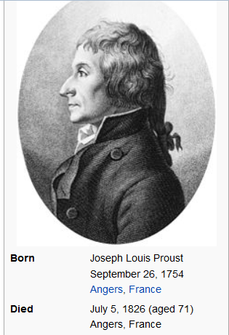
http://en.wikipedia.org/wiki/Joseph_Proust
Proust's best known work was derived from a controversy with C.L. Berthollet. Berthollet did not believe that substances always combine in constant and definite proportions as Proust did. Proust eventually was able to prove Berthollet wrong in 1799 and published his own hypothesis.
law of definite proportions, which is sometimes also known as Proust's Law
chemical compound always contains exactly the same proportion of elements by mass.

Slide 13
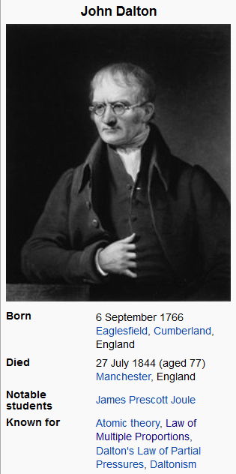
http://en.wikipedia.org/wiki/John_Dalton
He is best known for his pioneering work in the development of modern atomic theory, and his research into color blindness (sometimes referred to as Daltonism, in his honor).
In chemistry, the law of multiple proportions is one of the basic laws of stoichiometry used to establish the atomic theory, alongside the law of conservation of mass (matter) and the law of definite proportions. It is sometimes called Dalton's Law after its discoverer, the English chemist John Dalton, who published it in the first part of the first volume of his "New System of Chemical Philosophy" (1808). The statement of the law is:
If two elements form more than one compound between them, then the ratios of the masses of the second element which combine with a fixed mass of the first element will be ratios of small whole numbers.
In 1803 Dalton orally presented his first list of relative atomic weights for a number of substances. This paper was published in 1805, but he did not discuss there exactly how he obtained these figures.

Slide 14
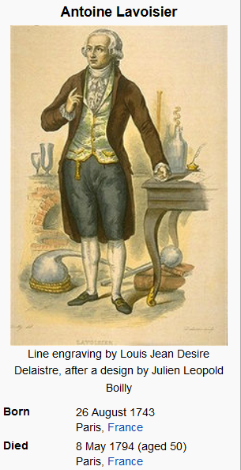
http://en.wikipedia.org/wiki/Lavoisier
It is generally accepted that Lavoisier's great accomplishments in chemistry largely stem from the fact that he changed the science from a qualitative to a quantitative one. Lavoisier is most noted for his discovery of the role oxygen plays in combustion. He recognized and named oxygen (1778) and hydrogen (1783)
At the height of the French Revolution, he was accused by Jean-Paul Marat of selling adulterated tobacco and of other crimes, and was eventually guillotined
Lavoisier's experiments supported the law of conservation of mass. In France it is taught as Lavoisier's Law and is paraphrased from a statement in his "Traité Élémentaire de Chimie" to "Rien ne se perd, rien ne se crée, tout se transforme." ("Nothing is lost, nothing is created, everything is transformed."). Mikhail Lomonosov (1711–1765) had previously expressed similar ideas in 1748 and proved them in experiments; others whose ideas pre-date the work of Lavoisier include Jean Rey (1583–1645), Joseph Black (1728–1799), and Henry Cavendish (1731–1810).
His Traité élémentaire de chimie (Elementary Treatise on Chemistry), published in 1789. This work represents the synthesis of Lavoisier's contribution to chemistry and can be considered the first modern textbook on the subject.

Slide 15
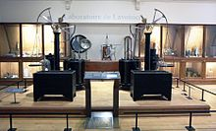
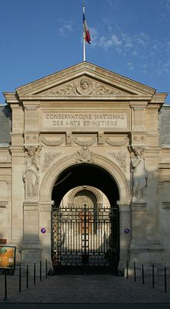
Lavoisier's Laboratory, Musée des Arts et Métiers, Paris

Slide 16
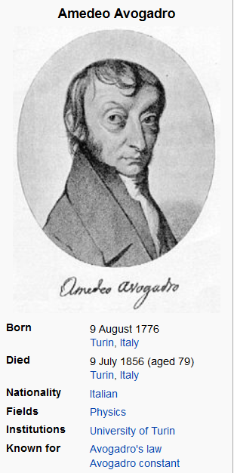
http://en.wikipedia.org/wiki/Amedeo_Avogadro
He is most noted for his contributions to molecular theory, including what is known as Avogadro's law. In tribute to him, the number of elementary entities (atoms, molecules, ions or other particles) in 1 mole of a substance, 6.02214179(30)×10²³, is known as the Avogadro constant
For an ideal gas, the volume and amount (moles) of the gas are directly proportional if the temperature and pressure are constant. In 1811, he published an article with the title Essai d'une manière de déterminer les masses relatives des molécules élémentaires des corps, et les proportions selon lesquelles elles entrent dans ces combinaisons ("Essay on Determining the Relative Masses of the Elementary Molecules of Bodies and the Proportions by Which They Enter These Combinations"), which contains Avogadro's hypothesis

Slide 17
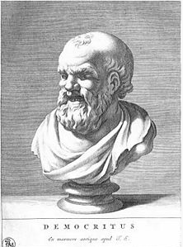
Atomic hypothesis solves the enigma why “The law of definite proportions” (why chemical recipes are so strict with respect to cooking recipes). If “chemical cooking “ is just combining elementary discrete atoms then it is possible that 2 atoms of hydrogen combine with 1 atom of oxygen, but it is not possible that 2 atoms of hydrogen combine with 2.12 atoms of oxygen.
Combining stoichiometric rules are automatically rules of whole numbers
This automatically also solves the enigma why “the law of multiple proportions “ that is why the ratios of mass ratios are ratios of whole numbers.
In textbooks the atomic hypothesis is traced back to ancient Greeks (Democritus)
It is obvious that classical atomists would never have had a solid empirical basis for our modern concepts of atoms and molecules. Bertrand Russell states that they just hit on a lucky hypothesis.
Well, maybe the belief that the observed immense diversity of the world around us should be based on simple principles gives you an “atomic hint” as a LEGO principle. Because of the combinatorial explosion you can build from just a few types of elementary LEGO blocks very diverse objects.

Slide 18
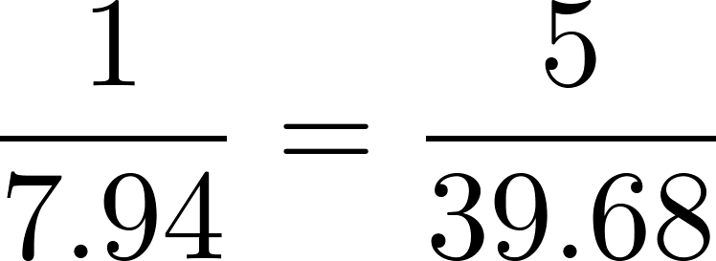
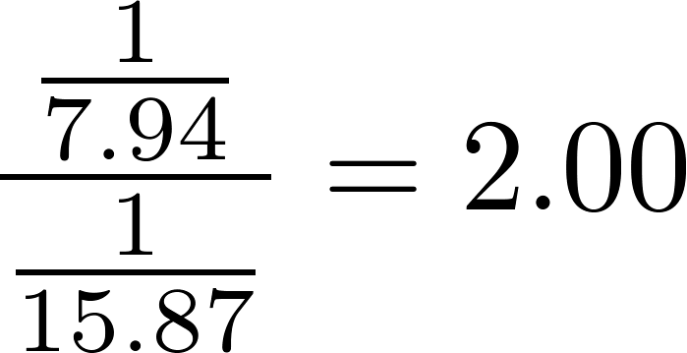
experiment:
1g hydrogen + 7.94 g oxygen = 8.94 g water
5g hydrogen + 39.68 g oxygen = 44.68 g water
The law of definite proportions
Experiment:
1g hydrogen + 15.87 g oxygen = 16.87 g hydrogen peroxide
law of multiple proportions
Simplest atomic interpretation: water= HO, peroxide = HO₂

Slide 19
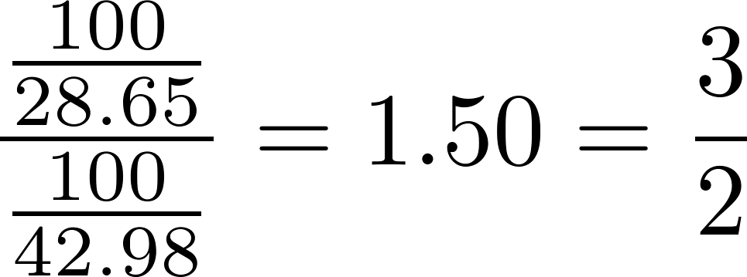
Experiment:
100 g iron + 28.65 g oxygen = 128.65 g iron oxide called wüstite
100 g iron + 42.98 g oxygen = 142.98 g iron oxide called hematite
Simplest atomic interpretation: wüstite = FeO, hematite = Fe₂O₃
Reminder:
1g hydrogen + 7.94 g oxygen = 8.94 g water
Simplest atomic interpretation: water= HO, peroxide = HO₂
Conclusion:
I atomic weight of hydrogen is assigned to be 1, than
atomic weight of O is 7.94
atomic weight of Fe is

Slide 20
Experiment:
10g oxygen + 7.56 g carbon = 17.51 g carbon oxide called carbonyl
10g oxygen + 3.78 g carbon = 44.68 g carbonic oxide
Simplest atomic interpretation: carbonyl = CO, carbonic oxide = CO₂
Atomic weight od carbon =
Experiment:
10g hydrogen + 29.79 g carbon = 39.79 g methane
If atomic weight of carbon is 6 than the simplest atomic interpretation: methane = CH₂
Experiment:
10g methane + 39.90 g oxygen = 27.43 carbonic oxide + 22.46 g water
Recalculated for number of moles:
1.43 CH2 + 5.03 O = 1.25 CO2 + 2.51 HO, number of O is OK , not ok for C and H
WRONG!

Slide 21
Solution of the problem is not simple:
atomic hypothesis of non-divisible atoms as combining to chemical products has to be corrected: even simple chemical elements like hydrogen or oxygen are made of not single atoms but molecules which are build from elementary atoms.
Hypothesis which leads to good stoichiometry is hydrogen and oxygen molecules are two-atomic, then water is H₂O , not HO and methane is CH₄.
Question:
If the chemical reactions are just combinations of the integer numbers of atoms, why only ratios of mass ratios are ratios of small integers and not the mass ratios themselves?

Slide 22
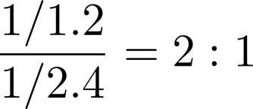
Solution of the problem is not simple:
atomic hypothesis of non-divisible atoms as combining to chemical products has to be corrected: even simple chemical elements like hydrogen or oxygen are made of not single atoms but molecules which are build from elementary atoms.
Hypothesis which leads to good stoichiometry is hydrogen and oxygen molecules are two-atomic, then water is H₂O , not HO and methane is CH₄.
Question:
If the chemical reactions are just combinations of the integer numbers of atoms, why only ratios of mass ratios are ratios of small integers and not the mass ratios themselves?
Answer:
If the recipe for “standard fruit salad” is take 3 apples and 3 oranges, then the mass ratios of apples and oranges is not equal to 1:1 because an orange had different mass than an apple, so the mass ratio for this recipe might be 1:1.2.
But if the recipe for “French fruit salad” is take 3 apples and 6 oranges then the ratio of ratios would be

Slide 23
Question:
Then why very often even the ratios of masses are close to ratios of integers, like for water 1g hydrogen + 7.94 g oxygen gives water, thus the mass ratio is almost 1:8?

Slide 24
Question:
Then why very often even the ratios of masses are close to ratios of integers, like for water 1g hydrogen + 7.94 g oxygen gives water, thus the mass ratio is almost 1:8?
Answer:
This suggests that there might be integer numbers involved below the level of atoms, some “atomic principle” in the word of atoms. And indeed, there are particles inside the atoms: protons, neutrons and electrons. The trick is that protons and neutrons have almost equal masses (apples and oranges having equal mass) and electrons have negligible mass so ratios of masses of atoms are close to ratios of integers.
Questions:
Then why sometimes the chemical mass ratios are sometimes significantly different from ratios of (small) integers?

Slide 25
Question:
Then why very often even the ratios of masses are close to ratios of integers, like for water 1g hydrogen + 7.94 g oxygen gives water, thus the mass ratio is almost 1:8?
Answer:
This suggests that there might be integer numbers involved below the level of atoms, some “atomic principle” in the word of atoms. And indeed, there are particles inside the atoms: protons, neutrons and electrons. The trick is that protons and neutrons have almost equal masses (apples and oranges having equal mass) and electrons have negligible mass so ratios of masses of atoms are close to ratios of integers.
Question:
Then why sometimes the chemical mass ratios are sometimes significantly different from ratios of (small) integers?
Answer:
Mainly because the chemists find their input ingredients in nature, and these are mixtures of different isotopes, 76% of chlorine atoms have 18 neutrons, 24% have 20 neutrons. So an “average” chlorine atom has something like 18.48 neutrons, thus significantly non-integer atomic weight of “natural” chlorine 35.45.

Slide 26
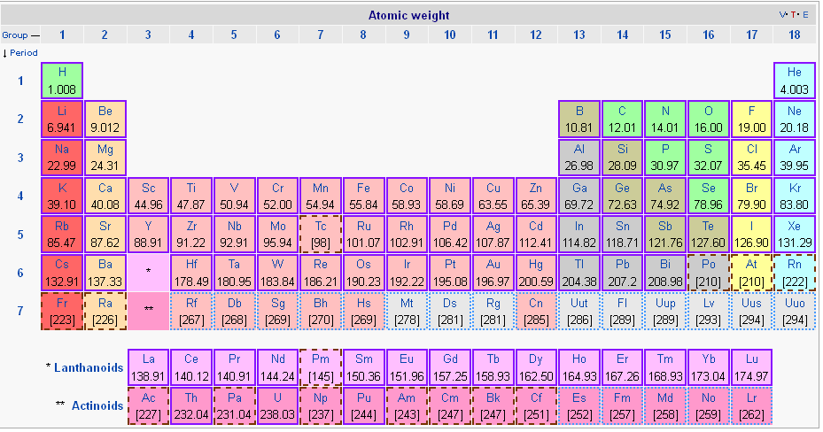
Finding atomic weights from chemical recipes is a puzzle to be solved by making hypotheses on stoichiometry and checking that atomic weight thus found are consistent

Slide 27
What are the reasons for non-integer atomic masses of natural elements?
isotopic proportions
non-equality of proton and neutron mass
binding energy of nucleus: the mass of a nucleus the sum of masses of protons and neutrons minus the binding energy divided by c² (according to famous Einstein formula).
non-negligible mass of electrons

Slide 28
Avogadro’s law
The law is named after Amedeo Avogadro who, in 1811, hypothesized that two samples of ideal gases, of the same volume and at the same temperature and pressure, contain the same number of molecules.
This law is a direct consequence of observation (Guy-Lussac, 1908) that chemical recipes expressed (for gases at equal pressure and temperature) not by gas masses but by gas volumes say that the volume ratios themselves are ratios of small integers (no need to do ratios of ratios).
It looks like saying that gasses of apples and oranges have the same volume. Since it is not plausible to assume that the sizes of atoms themselves are equal, it is natural to assume that gas is presumably “empty space”, so that careful distinction must be drawn between the volume available to a particle and the volume of a particle.
Avogadro says, that the volume available to a particle is the same for all particles while the total volume of particles is negligible (at usual conditions).

Slide 29
Avogadro’s law has immediate consequence for elementary stoichiometry.
The chemical recipe for water expressed in volumes is
1 liter of hydrogen + 0.5 liter of oxygen gives 1 liter of water vapor
Since 1 liter of hydrogen has the same number of molecules than 1 liter of water, there would be not enough molecules of oxygen to mate with hydrogen molecules in just 0.5 liter of oxygen. If each hydrogen particle (molecule) has to find its oxygen particle to mate with, the original oxygen particles must be somehow torn to two pieces to satisfy the Avogadro’s law.
Therefore the oxygen gas has two-atomic molecules and the stoichiometry for water reads
2H₂ +O₂ = 2H₂O

Slide 30
The mole
So far we have expressed the chemical recipes either in masses or in volumes. However since integer number of particles take part in the reaction, it would be most natural to express chemical recipes in integer numbers.
In fact, this is done in the stoichiometric expressions like
2H₂ +O₂ = 2H₂O
But experimentally not acceptable to read the recipe as “Take two molecules of hydrogen and let it react with one molecule of oxygen and you get one molecule of water”.
We need to work with very big numbers of molecules. Big numbers are usually given special names like million, billion etc. These are still too small numbers for practical chemical recipes. Practical big number would be for example 10²³.
One could call this number “chem” and the recipe would be “take two chems of hydrogen and one chem of oxygen and you get two chems of water.
This is again impractical, because an assistant cannot take “one chem” of atoms just counting them one, two, three, four, ..., chem.

