Slide 1
Probability technology:
Continuous random variables

Slide 2
Continuous random events
Continuous random event:
throwing a dart
If the tip of the dart is absolutely sharp, then it hits just and ideal point of the dartboard, so the event set is continuous. However the absolute sharpness of the dart tip means that the same random event never reappears. The chance to hit the same (ideal) point on the dartboard is just zero. Therefore we cannot assign probabilities to continuous random events.
This does not mean, however, that we cannot assign names to random events. Just the names should be elements of a “continuous set”. The best way is to use some variable the value of which uniquely identifies the random event. For example for “one-dimensional dart game” the random event is a point on a line and as the “name of the event” we can use the coordinate of the point.

Slide 3
Continuous random events
Continuous random event:
throwing a dart
Coming back to the problem of “random event unrepeatability”:
Every event has a name which is a real number (a number with infinite number of decimal places). In principle, it may happen, that the hit point has the coordinate equal exactly to $π.$ But it never happens again. Well, this example seems to be psychologically unacceptable, but do consider, that saying that the hit-point coordinate is exactly 2 (with infinite number of decimal zeros following) is equally unacceptable.
The psychological problem is due to the fact, that if I consider any real number as a possible hit-point coordinate before the dart is thrown, I will never observe it as a hit-point. However, if I throw the dart, it hits some point, and for the ideal case of absolutely sharp tip its coordinate is some real number with infinitely many decimal places.

Slide 4
Continuous random events
Continuous random event:
throwing a dart
The difference with respect to the discrete case is that the random events cannot be enumerated or listed (the set is not countable).
Having in mind that we cannot define the probabilities to individual random events, we have to introduce probabilities in some other way.
We can consider not individual events but some subset of events (with non zero measure) and assign probability to the “compound events” that any of the points from the subset was hit.
Let us discuss it more specifically for the one dimensional case. As the subsets we shall consider just intervals on the real line.

Slide 5
So suppose we can (for example experimentally) to assign probabilities that an arbitrary interval $(a, b)$ was hit. Let is denote as the probability, that the coordinate (name of the event) $ξ$ is within the interval $(a, b)$
So to have the complete probabilistic information about the process, we need to collect the probabilities for arbitrary values of $a, b$. But if we think a bit more, we do not need a two dimensional set of probability data, what is enough to collect is just one dimensional function
since then, of course
$F(x)$ is, obviously, a non-decreasing function, since
Also:

Slide 6
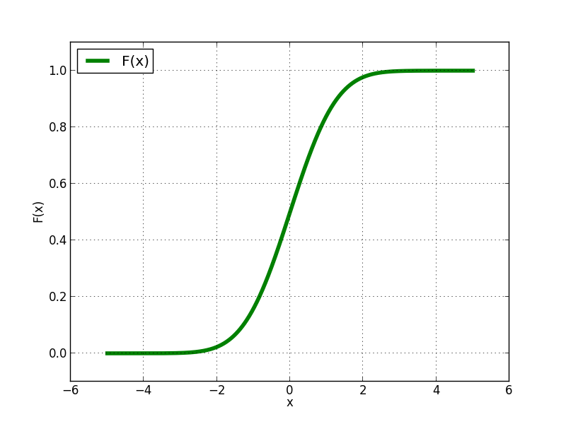
Function
is called cumulative distribution function (CDF). Other names like probability distribution function, cumulative probability distribution function are also used. Typically it looks like a “sigmoid curve”

Slide 7
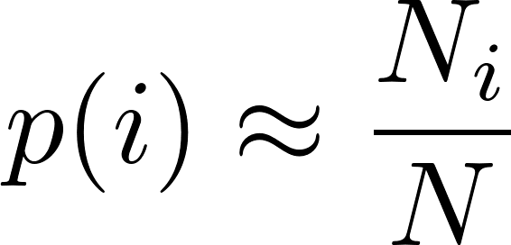
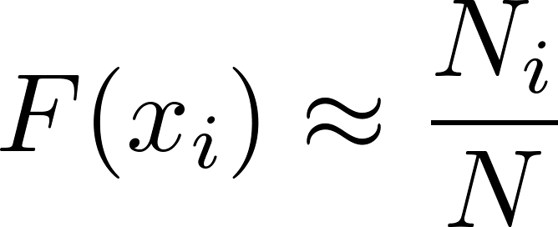
For discrete events we could approximately determine the event probabilities experimentally. We perform $N$ experiments and observe how many times $\left(N_{i}\right)$ the event $i$ happens. Then
How we can determine the distribution function experimentally? We have to discretize the space $x$ of the “event names”. Typically we define $n$ discrete values
We perform $N$ “dart throws”, recording the coordinates of individual hits and calculate the numbers $N_{i}$ defined as the number of hits with coordinates less than $x_{i}$. Than

Slide 8
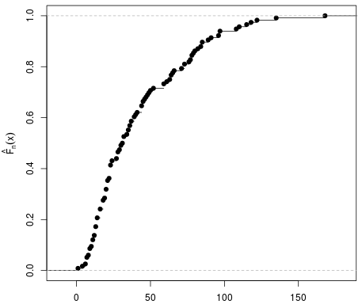
Experimentally we get something like this
The true (theoretical) distribution function should somehow “smoothly interpolate” the experimental points. In the particular case represented by the figure the smooth interpolation is not easy to be drawn, due to experimental errors.
The error to our formula
is easy to estimate from binomial distribution and can be symbolically written as (see also http://en.wikipedia.org/wiki/Empirical_distribution_function)
Having data values and errors we can do “curve fitting” described on the next slide.

Slide 9
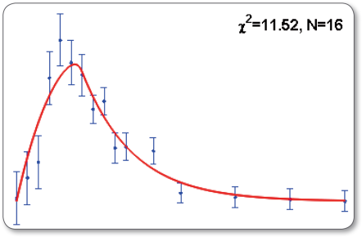
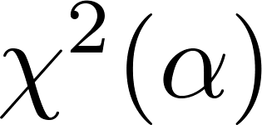
Supplement: curve fitting
Suppose we have some experimental data, a set of triplets
where $ε_{i}$ are experimental errors of $y_{i}$, so that the measured values are
Now we have a hypothesis, that the data points are to be described by a smooth curve
where $α$ is a set of parameters to be determined so that the data is optimally described. We do it like this. For any given value of $α$ we calculate the test value
and we let the computer find optimal set of parameter values so that is minimal. Without going into the theory, the rule of thumb is that the fit is good when
where $n$ is the number of experimental points and $p$ is the number of fitting parameters $α$.

Slide 10
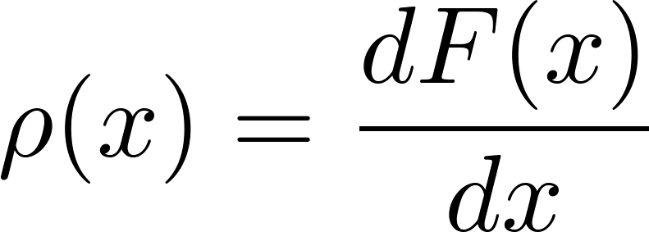
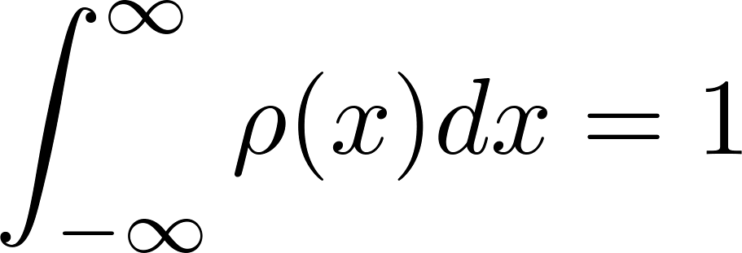
Probability density
The formula suggest by its notation to play with the derivative of the cumulative probability distribution function. So let us define
It is clear, that the information contained in the function $ρ(x)$ enables to calculate any probability we need, in particular
Since $F(x)$ is a non-decreasing function, $ρ(x)$ is non-negative. Having in mind the analogy with mass density function for which the mass of any volume within a body is calculated as the integral of (non-negative) mass density over that volume, we call the function $ρ(x)$ “probability density function”. It is clear, that instead of the cumulative distribution function we can consider the probability density function as a primary carrier of the information on probability of the process considered. Actually, in many textbooks, the authors start the discussion of continuous random variables with introducing probability density and then derive the cumulative distribution function as a secondary concept. The normalization is obvious:

Slide 11
Probability density
Having the formula
we can calculate the probability to hit a small interval around the value $x$ as
This is the closest analogy to the discrete-random-variable notion “probability of $x$” we have for the case of continuous random variables. This is how the proponents of the “priority of probability density over cumulative distribution” intuitively define the probability density. The argumentation is: for an infinitesimal interval dx the probability to hit that interval is “obviously” proportional to its length dx, so
with the “factor of proportionality” possibly depending on the position $x$. Denoting this factor of proportionality as $ρ(x)$, we get

Slide 12
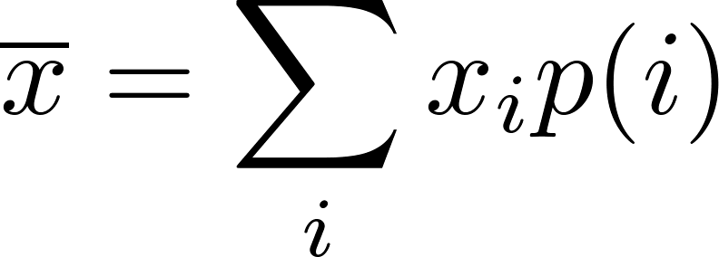
Mean and variance
In analogy with the discrete case, where we have defined the mean value of a random variable $x$ as
we define the mean value of any variable $f(x)$ (depending on the random event $x$ as
in particular for the random variable $x$ (used to give a name to random events considered) we get
We define the variance of $f$ as
and for “the name” $x$

Slide 13
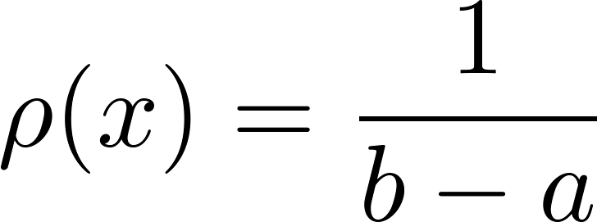
Examples
Uniform distribution
can be defined only on a finite interval $\left(a,b\right)$:
We use this probability if we want to describe the situation when “no x is preferred with respect to others”. So something like “no bias”, “maximal democracy”, “equal chance”.
However, one should be very careful here. For discrete random events, it is obvious what is meant under “no bias”:
Naively one would say that generalization to a continuous case is
But one should be careful: generally there is no canonical naming of continuous events! We can use in principle any variable as “a name” for random events, but the probability density which is constant with respect to a certain variable is not constant with respect to an arbitrary other variable.

Slide 14
Supplement: probability density, change of variables
Suppose we have same probability density function $ρ(x)$ defined with respect to a variable $x$. Let us define a new variable $y$ by the transformation formula.
Since we are going to use the new variable $y$ as a new “name” for the event $x$, the transformation should be one-to-one. Let us assume it is a rising function. Our task is to find the probability density with respect to the variable $y$, which we denote as $\tilde{ρ}(y)$. It is easy, by definition:
Now we make a substitution in the integral and get
we should get, however

Slide 15
Supplement: probability density, change of variables
Comparing the two formulas, we get
So the “new” probability density is not obtained just by inserting the inverse transformation as an argument to the “old” probability density: the Jacobian of the transformation plays a role as well!
So even if the original probability density was a constant function, the Jacobian need not be constant and so the “new” probability density will not be constant in general.
Conclusion:
“No bias probability density” cannot be canonically defined for a general case of continuous random events!

Slide 16
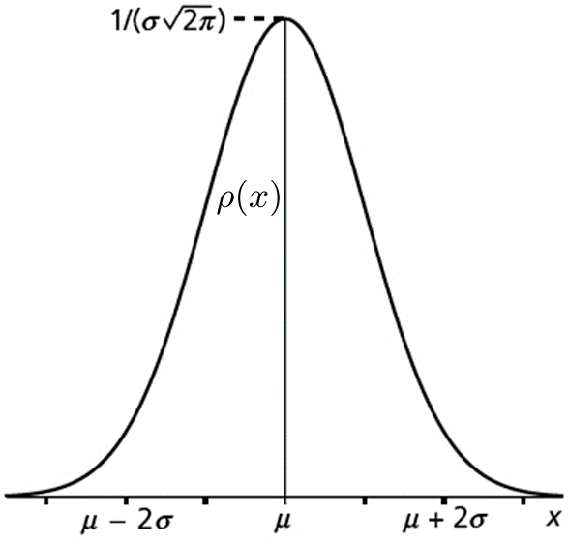
Examples
Gauss (normal) distribution
is defined by the formula
we see, that it is a whole “family” of probability distributions, differing by the choice of two parameters $μ$ and $σ$. The meaning of these parameters is almost obvious:
A typical shape is presented in the figure.

Slide 17
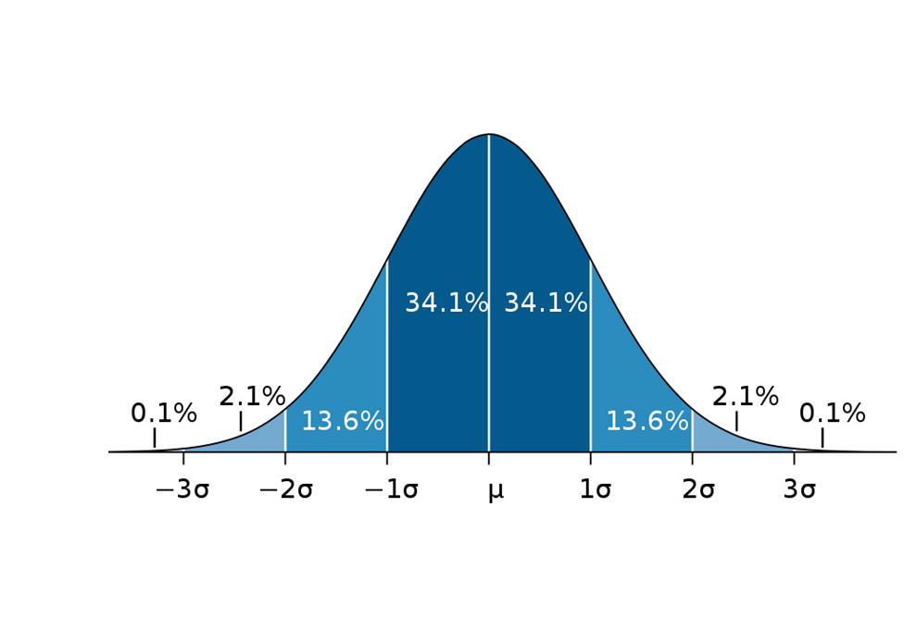
Examples: Gauss distribution
The following figure is instructive. It is worth to remember how often can one meet the deviation larger than a few standard deviations (assuming Gauss distribution)

Slide 18
Examples: Gauss distribution
Gauss (normal) distribution is frequently used in physics and generally in any science discipline.
Sometimes we use Gauss distribution because we have good theoretical reasons that the probability density describing the random process we consider is a Gauss distribution
Sometimes we use Gauss distribution because of a lack of any theoretical reasons. We just have a rough feeling about the mean and variance and the Gauss probability density is a nice bell-like shape corresponding to a simple analytical formula. Moreover, it is practically the only elementary formula known to a good high school student corresponding to a bell-like curve. Moreover, it is fully specified by just two parameters: mean and variance. So we use it having nothing better in the pocket.

Slide 19
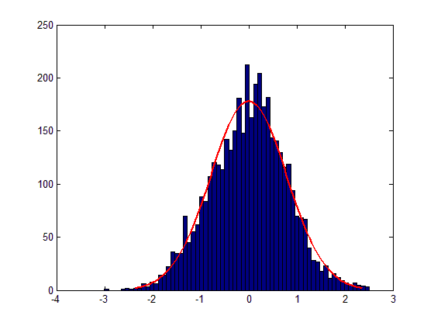
Probability density: experimental determination
We have already discussed how to estimate experimentally the cumulative distribution function. We can estimate directly the probability density using essentially the same technique.
discretize the space defining “bins” (intervals)
The bins are usually called “underflow bin” and “overflow bin”, the bins in-between are usually (but not necessarily) chosen as equal-sized.
Perform $N$ experiments to obtain $N$ random events and record the numbers $N_{i}$ of how many times the event falls into the bin . (For simplicity we neglect underflows and overflows.)
You can visualize the results in the form of a histogram
Then let the computer to find a smooth curve describing the histogram

Slide 20
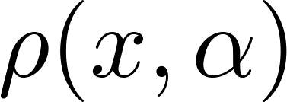
Probability density: experimental determination
Then let the computer to find a smooth curve describing the histogram. To do this properly, wee need experimental errors of the number of hits in every bin.
If the bins are reasonably small, we can estimate the errors as
and the expected values are
Assuming some formula for the probability density having a few free parameters $α$,
we write the test function (to be minimalized) as
and find the optimal parameters $α$, thus estimating the probability density.

Slide 21
Continuous random events: more dimensions
Quite often the events from the event space considered cannot be properly named using just one real number. The event space might have more dimensions. We do not want to discuss here what is exactly meant by the dimensionality of the space considered. An intuitive feeling is enough to accept, that a good naming scheme requires n-tuples of real numbers like
Those who want to know more about dimensionality and related things should read some textbook on manifolds, for example
M.Fecko, Differential Geometry and Lie Groups for Physicists, http://www.amazon.com/Differential-Geometry-Lie-Groups-Physicists/dp/0521187966
The generalization of the probability machinery for more dimensions is straightforward. We use many-dimensional probability density function in the event space
and the probability to observe a random event within a subset $S$ of the whole space is
In some cases the volume element in the event space might be given by a more complicated formula instead of a simple .

Slide 22
Continuous random events: more dimensions
Example
A typical example is a multidimensional Gauss distribution as one finds, for example, in Maxwell distribution of the velocities of molecules in gas.
If I randomly select a molecule in gas and ask: “What is currently your velocity” I get an answer containing three numbers: projects of the velocity vector on three orthogonal axes.
So I have a three-dimensional random variable: a velocity vector. Maxwell has derived a simple formula for the probability density in three-dimensional velocity space

Slide 23
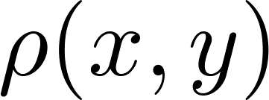
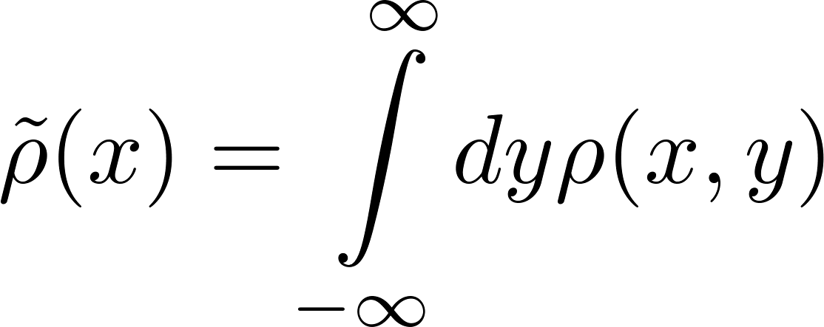
Continuous random events: more dimensions
Marginal distribution
Sometimes I have a many-dimensional probability distribution and I am interested just for a subset of events having smaller dimension. For example having a two-dimensional probability density
I want to now only how the variable$x$ is distributed, so I need to find, what is the probability $p(x,x+dx)$ to find the coordinate $x$ in the interval $(x, x+dx)$ irrespective of what is the value of $y$. Graphically it means, that the two-dimensional event hits the shadowed area below.
We are searching for the probability density $\tilde{ρ}\left(x\right)$ defined as
Comparing the two expressions we get
$\tilde{ρ}\left(x\right)$ is called a marginal distribution derived from the more-dimensional distribution

Slide 24
Continuous random events: more dimensions
Conditional probability
Suppose we have a two-dimensional distribution
Suppose we have an interval $X$ on the axis $x$, and an interval $Y$ on the axis $y$. Then the joint probability to find $x∈X$ and $y∈Y$ is
The probability to find $y∈Y$ with $x$ being anywhere is
The conditional probability to find $x∈X$ given that $y∈Y$ is defined as
Experimentally what we speak about is to observe $(x,y)$ events but record only those values of $x$which were accompanied by $y∈Y$. Then we analyze the probability distribution of the recorded values of $x$. What we get is the conditional probability.

Slide 25
Continuous random events: more dimensions
Independent variables
Variable $x$ is independent of $y$ if the conditional probability
does not depend on $Y$ for any $X$. It means that knowing information about $y$ does not change our expectation about $x$. We shall prove that $x$ is independent of $y$ if and only if the two dimensional probability density factorizes, that is if it can be written as
where on the right side we have the marginal distributions. First we prove the sufficient condition. Suppose $ρ(x,y)$ factorizes. Then
and the result obviously does not depend on $Y$.

Slide 26
Continuous random events: more dimensions
Independent variables
Now we prove the necessary condition. Let us choose the regions $X,Y$ to be very small intervals around specific (but arbitrary) values $x_{0}{,y}_{0}$. Let us denote those small intervals as $dx_{0},dy_{0}$. We get
Since the conditional probability is independent of $Y$, we can write
Comparing the two results, we get
since the values $x_{0}{,y}_{0}$ are arbitrary, we have proven the factorization.

Slide 27
Continuous random events: more dimensions
Mean values
We have two random variables $x, y$ with probability density $ρ(x,y)$. Then the following is true in general
Proof:
We have two independent random variables $x, y$ with probability density Then the following is true

Slide 28
Continuous random events: more dimensions
Mean values
Proof: for independent variables
and we get
Note: if holds, it does not necessarily mean that the variables are independent, even if it often considered as a strong hint for independence.

Slide 29
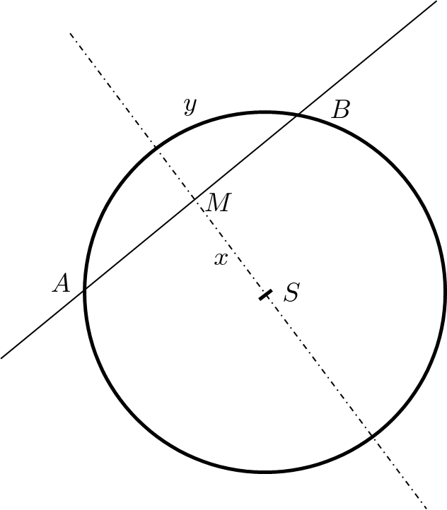
Continuous random events: no bias distribution counterexample
Consider the following problem. A thin long rigid rod is randomly thrown onto a circle and intersect the circle in two points A,B forming a chord (segment AB). Denote the length of the chord as $ξ$. Find the probability density for the random variable $ξ$.
“Solution” 1:
Without loss of generality we can assume that all the thrown rods are parallel, perpendicular to the dash-dotted line in the figure. So the random event is fully specified by the size of the segment SB denoted as $x$. Using “non-biased” uniform distribution of $x∈\left(−r,r\right)$ we get

Slide 30
Continuous random events: no bias distribution counterexample
Consider the following problem. A thin long rigid rod is randomly thrown onto a circle and intersect the circle in two points A,B forming a chord (segment AB). Denote the length of the chord as $ξ$. Find the probability density for the random variable $ξ$.
“Solution” 2:
Without loss of generality we can assume that all the thrown rods intersect the circle in the specific point A. So the random event is fully specified by the angle ASB denoted as $φ$. Using “non-biased” uniform distribution of $φ∈(0,2π)$ we get
So two equally plausible “solutions”, two different results!

Slide 31
Demo random processes

Slide 32
Random walk in one dimension: Drunken sailor
Consider one-dimensional world, a line with a coordinate denoted by $x$.
In the point $x=0$ there is a pub. At time $n=0$ (we use discrete time) a sailor gets out of the pub and starts to make random steps of equal size $Δ$ but random direction (with equal probability either to the left or to the right).
Suppose that after making $n$ steps he has got into the point with the coordinate $x_{n}$. Then after making the next step he would be in the point
The equation describes the dynamics of what is called a random process. If we observe one sailor during his motion, we observe one particular realization of the random process. This means, that for this particular realization in each time step a particular sign (plus or minus) is randomly chosen (for example by tossing a coin) and a particular position history is realized. Observing another sailor, the random choices in each time step would be different and we get a different realization of the random process. Each realization is described by the same dynamical equation as presented above.

Slide 33
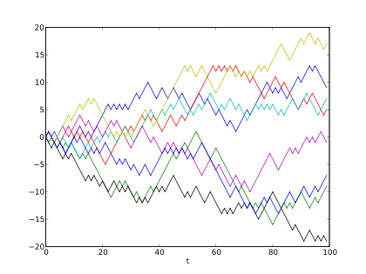
Random walk in one dimension: Drunken sailor
In the figure, there are 8 different realizations of the drunken sailor random process denoted by different colors. The plot shows the current position on the line (vertical axis) versus the time steps (horizontal axis).

Slide 34
Random walk in one dimension: Drunken sailor
We have observed in the figure that with increasing time (number of steps) there is a tendency that the sailors typically get to increasing distances from the origin.
Very often our primary interest is just one realization of the random process (one drunken sailor) and we would like to understand how his distance from the origin changes in time. We, of course, know, that for one sailor his particular distance from the origin is not a monotonic function of time. It might happen quite often that he would appear in the pub (at zero distance). Analyzing one particular trajectory with the aim to understand qualitatively its characteristics might be fairly complicated.
Instead of that we often switch to a different problem: to understand a typical behavior within a statistical ensemble of many realizations of the same random process (as it was visualized in the figure).
So we write dynamic equations for an ensemble of $N$ sailors performing random walk synchronously in parallel (making their n-th step in the same time instant). We get a set of equations

Slide 35
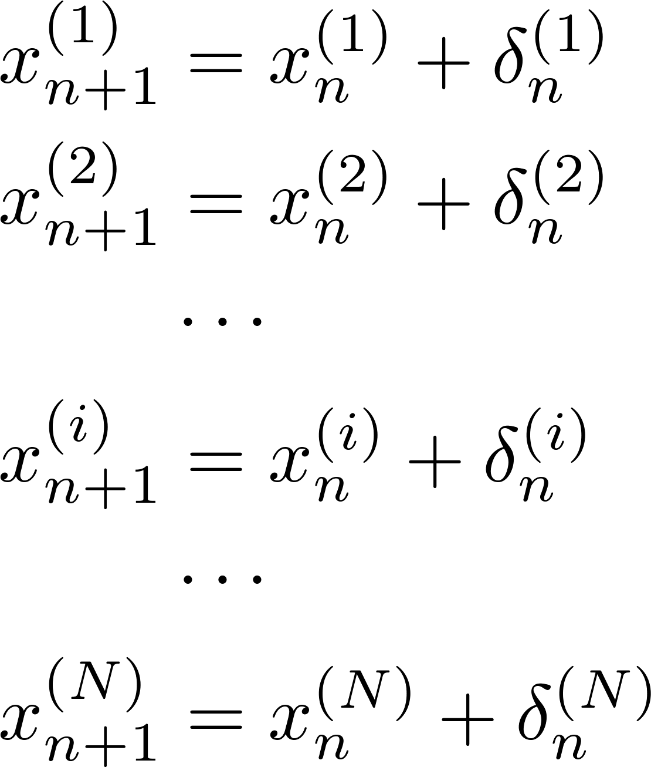
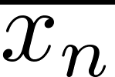
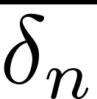
Random walk in one dimension: Drunken sailor
the superscript in the parenthesis is the index denoting individual sailors in the ensemble
Now we sum the equations and we get
The overlines denote the average values over the ensemble, that is denotes the mean coordinate of the sailor ensemble after $n$ steps. For very large $N$ the mean step is zero, since the random signs cancel.
The last recurrent equation is easily solved as

Slide 36
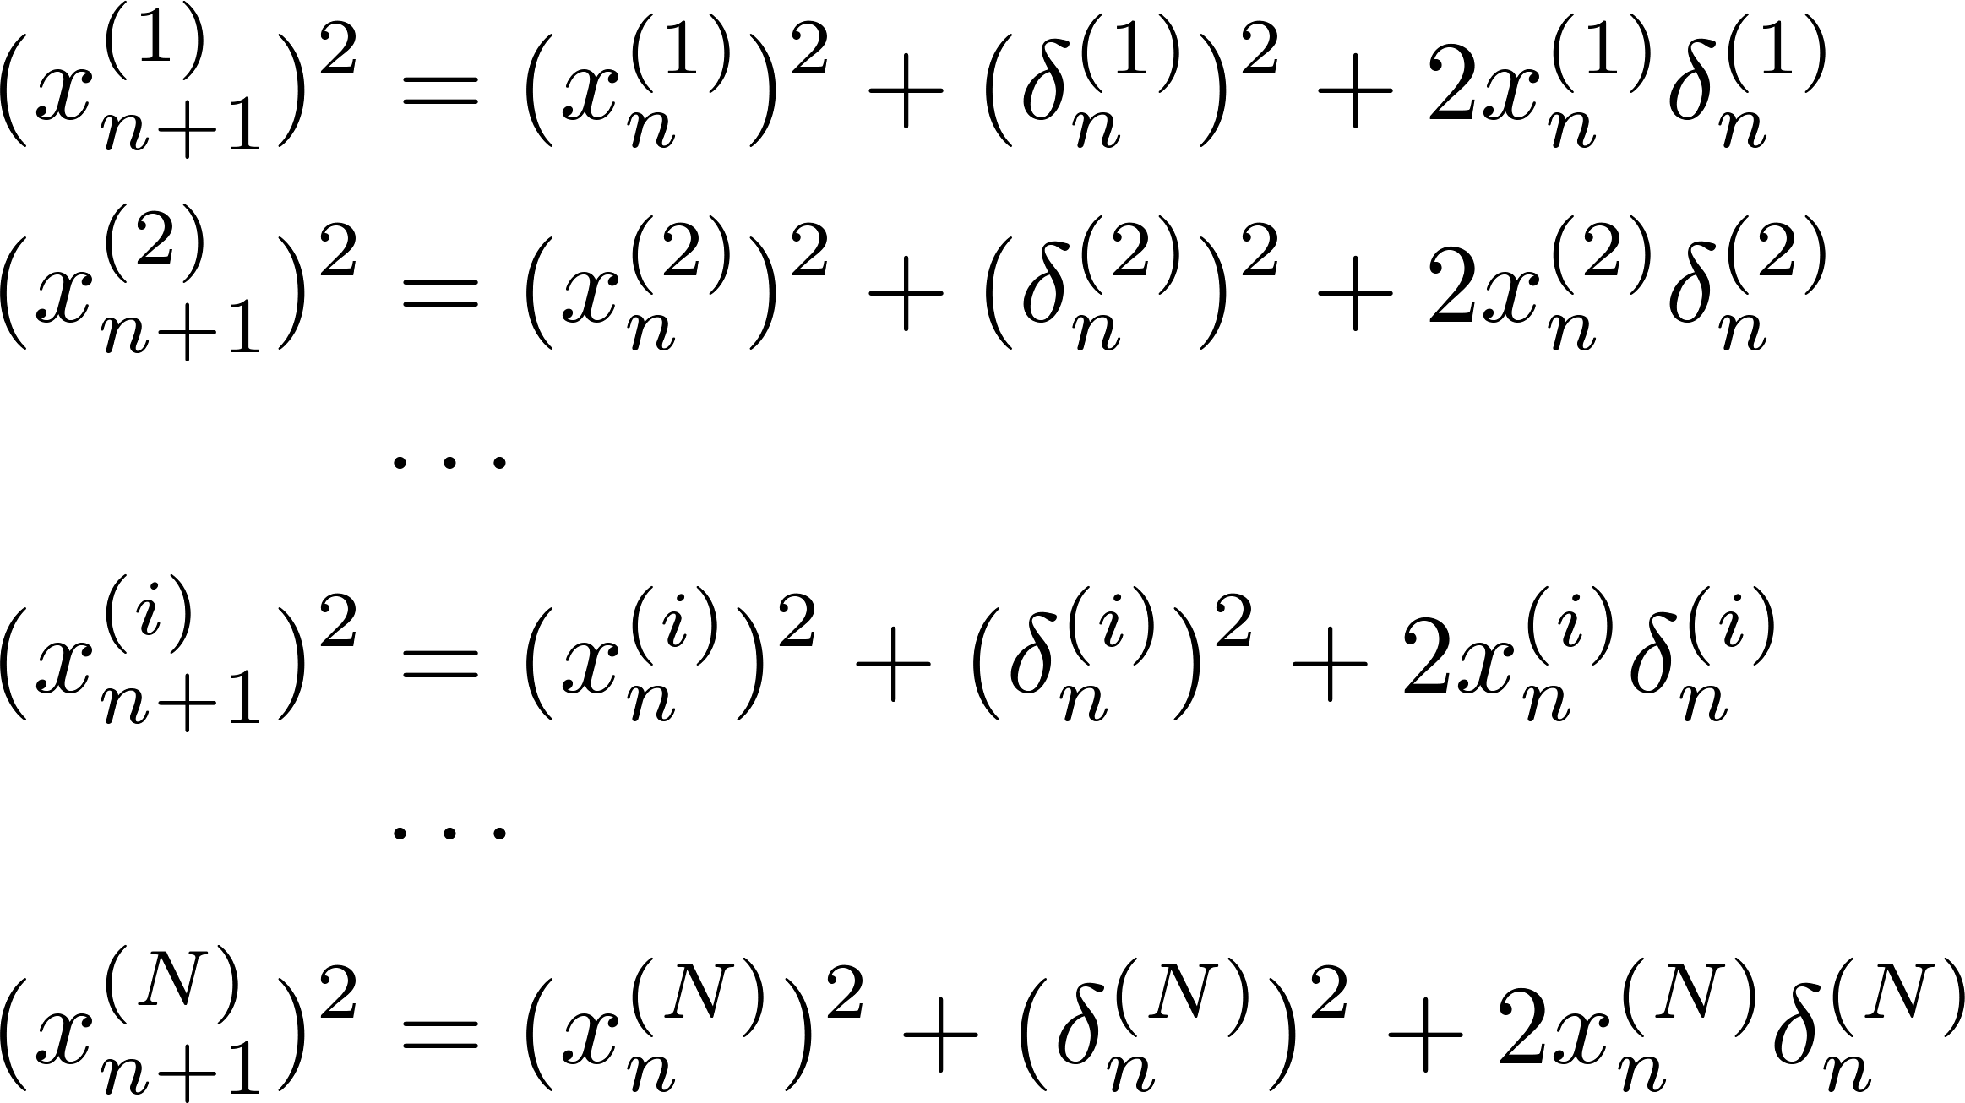
Random walk in one dimension: Drunken sailor
This results can be qualitatively expressed as: In the mean the sailor is to be found in the pub in each time instance. The statement is almost obvious due to the left-right symmetry of the problem.
However this “first law of a drunken sailor” does not characterize the observed fact that with increasing time the probability to find a sailor in a distance larger than something increases. To investigate this effect it is useful to square all the ensemble equations before calculating the averages.

Slide 37
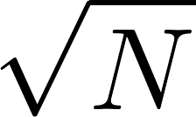
Random walk in one dimension: Drunken sailor
Averaging over the ensemble we get
The last recurrent equation is easily solved as
The “second law of the drunken sailor” therefore reads:
Mean square of the distance of the sailor from the pub increases proportionally to the number of steps. Said alternatively the typical distance of a drunken sailor from the pub increases as the square root of the number of steps.
This contrasts with the “law of non-random (directional) walk”: the distance (and not the square of it) increases proportionally to the number of steps.
So the characterizing logo of the drunken sailor is

Slide 38
Drunken sailor application: Standard error of an arithmetic mean
In mathematics and statistics, the arithmetic mean is the sum of a collection of numbers divided by the number of numbers in the collection.
It is often use to decrease the measurement error of some quantity by performing the measurement several times and taking the arithmetic mean as a better estimate of the true value of the measured quantity compared to the result of a single measurement.
Let the statistical error of a single measurement be (symbolically) expressed by the formula
Let us make $N$ individual independent measurements, denoted as
and calculate the arithmetic mean
then the typical statistical error of the average can be estimated as

Slide 39
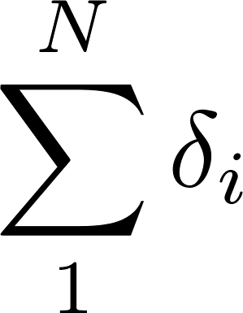
Drunken sailor application: Standard error of an arithmetic mean - proof
Let us investigate the outcome of the i-th measurement, it differs from the true value by a random error
where $δ_{i}$ is the (individual) measurement error, usually assumed to be Gaussian-distributed with mean $\overline{δ}=0$ and variance $\overline{δ^{2}}=Δ^{2}$. Then
The difference between the true value and the arithmetic mean is expressed through the sum of independent individual errors
this expression is the same as that giving the coordinate of a drunken sailor after $N$ random steps

Slide 40
Drunken sailor application: Standard error of an arithmetic mean - proof
In the final formula we clearly recognize the “drunken sailor $\sqrt{N}$rule”.

