Slide 1


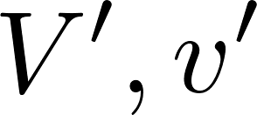
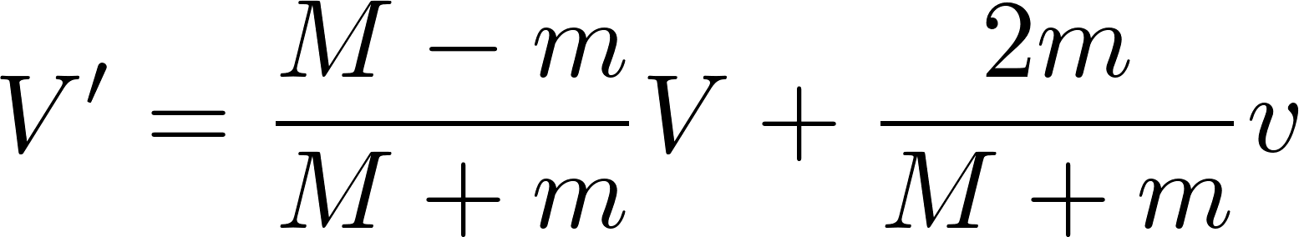
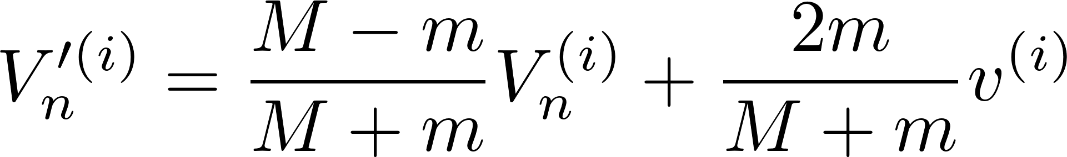
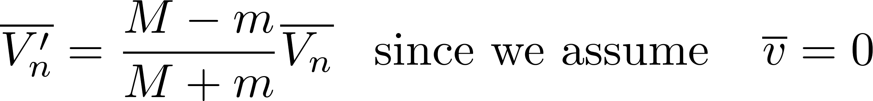
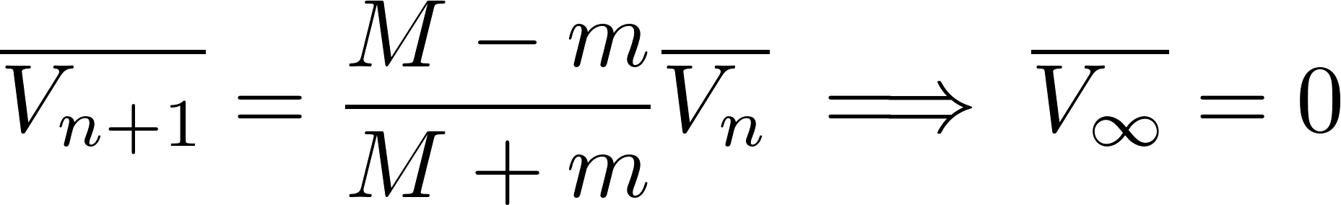
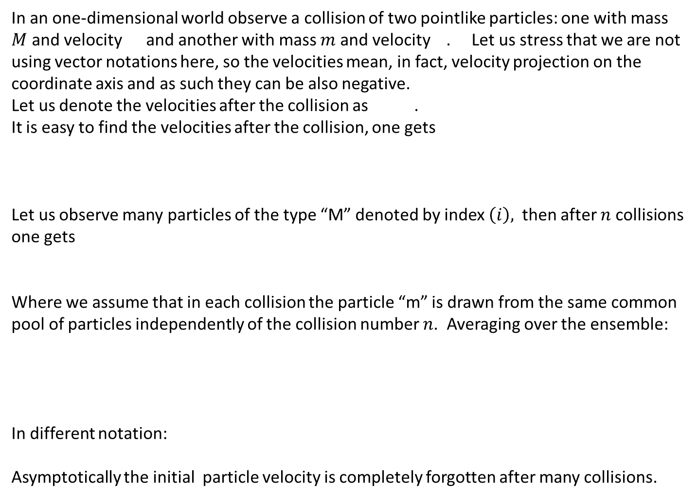
Collisions in an one-dimensional world
In an one-dimensional world observe a collision of two pointlike particles: one with mass $M$ and velocity and another with mass $m$ and velocity . Let us stress that we are not using vector notations here, so the velocities mean, in fact, velocity projection on the coordinate axis and as such they can be also negative.
Let us denote the velocities after the collision as .
It is easy to find the velocities after the collision, one gets
Let us observe many particles of the type “M” denoted by index $\left(i\right),$ then after $n$ collisions one gets
Where we assume that in each collision the particle “m” is drawn from the same common pool of particles independently of the collision number $n$. Averaging over the ensemble:
In different notation:
Asymptotically the initial particle velocity is completely forgotten after many collisions.

Slide 2
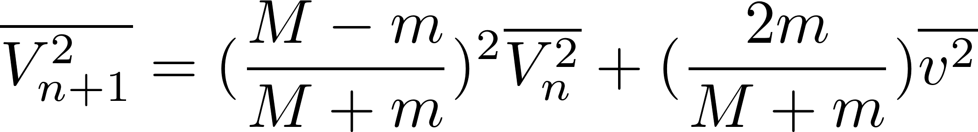
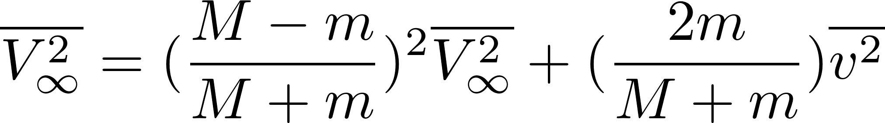
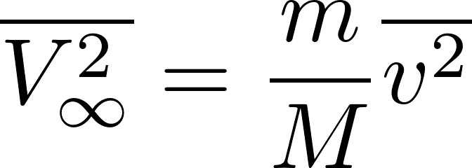
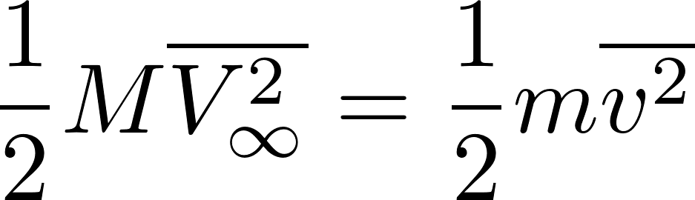
Squaring this equation first and only then making the ensemble average we get:
Asymptotically we get
The meaning oft the asymptotic solution is better understood, after we rewrite it as
We can read it as
“Ensemble-mean kinetic energy is asymptotically the same as the mean energy of the particles from the pool.”

Slide 3
Particle collisions: conclusions based on the demo
A particle randomly bombarded by particles having some mean kinetic energy asymptotically “forgets” its initial velocity and finally reaches (mean) kinetic energy equal to the kinetic energy of the bombarding particles. The word mean here describes a statistical average within an ensemble of similar particles undergoing same random bombardments. To be more precise here we speak about kinetic energies of the translational motion.
Conclusion 1: if we have an equilibrium system consisting of many types of particles (different masses) then the mean kinetic energy of all the particles will be the same.
Conclusion 2: if we start with a system of different types of particles with unequal kinetic energies then after some relaxation time the mean kinetic energies of all the particles will become the same.
Conclusion 3: If we have two physical systems in thermal contact (this means that they cannot exchange particles but the particles on the surface contact can collide with each other) then started from arbitrary macroscopic state the equilibrium will be reached where the mean kinetic energies of particles in the two systems will be equal

Slide 4
Equilibrium macrostate
In statistical physics we deal with macroscopic systems. Is is technically impossible to work with standard physical states (microstates). Technically we have at disposition tremendously reduced information, just values of a few macroscopic quantities, which define the macrostate of the system.
In principle, the values of those macrostate-defining quantities depend on time, thus describing the time development of the corresponding macrostate.
For isolated systems we observe a very interesting phenomenon:
Started from arbitrary (unknown) microstate we usually observe that the macrostate changes with time until after some time, which we call relaxation time, the macrostate does not change any more. Technically it means that all the macrostate-defining quantities are stable, their values do not change any more. We say that the system reached equilibrium state.
This does not mean that the situation is static: the microstates change all the time in macroscopic equilibrium (individual molecules collide, change their positions and velocities etc.) So the macroscopic equilibrium is a dynamical equilibrium. For all practical purposes we, however, can consider the situation as if it was static.
When we said “macroscopic quantities do not change with time” we have meant that no measuring devices are available to measure those quantities with a precision of typically 13 digits. Having such devices we would observe changes at the last digit even for macroscopically defined quantities.

Slide 5
Mutual thermal equilibrium
Consider two separately isolated physical systems. Both of them arrive, after some relaxation time, at the equilibrium state. Since the systems are individually isolated, those two equilibrium states are, a priori, in no relation with each other.
Now, bring those two systems into thermal contact. This means that they cannot exchange particles and neither can perform macroscopically detectable work on each other, but the particles on the contact surface can collide with each other and exchange energy by performing microscopic work.
After establishing the thermal contact, we start, in general, to observe macroscopic changes of states of both systems. The systems are not, in general, in a common equilibrium macrostate. But since the joined system is isolated, we should observe, after some relaxation time a new, common, equilibrium state with no macroscopic quantities changing in time any more. We say the two systems reached mutual thermal equilibrium.
It may happen that initially the two isolated systems are in such (individual) macrostates, that after bringing them to thermal contact we do not observe any macroscopic changes. The systems are immediately in a mutual thermal equilibrium. So we say, that they are in the relation of mutual thermal equilibrium even before the thermal contact is established. The relation “being in mutual equilibrium” can be tested experimentally: no macroscopic changes are to be observed after bringing the two systems into thermal contact.

Slide 6
Thermal equilibrium, temperature.
The relation “being in mutual thermal equilibrium” is experimentally found to be transitive. That means, that if a system A is in equilibrium with B and B is in equilibrium with C, then A is found to be in equilibrium with C as well. This statement is called Zeroth law of thermodynamics.
The relation “being in mutual thermal equilibrium” is trivially also reflexive and symmetrical so the zeroth law of thermodynamics effectively says ”being in thermal equilibrium is equivalence (in mathematical sense). So all the systems can be classified into not overlapping classes of equivalence. The classes can be labeled. The label is called ”the temperature”. Temperature defined in this way is not unique: the only requirement is that different classes have different labels. (For example any function of the temperature will do the job.) We, however, usually require more, we need property of continuity in labeling the classes.
So the temperature is the physical quantity which has the same value for all systems which are in mutual thermal equilibrium.
We need to find some practical (experimental method) to label the classes. To do that we had to choose a suitable ”thermoscope”. By that we mean some system which can be find in many equivalence classes (in each class the system is, of course, in a different (macro)state. Ideally the system should be found in states having the same values of external parameters, differing by the value of some internal parameter (like pressure) in different equivalence classes. The system (and its chosen parameter) can be used as thermoscope: bringing it to thermal contact with any other system and reading the value of “pressure” we can recognize to which equivalence class the measured system belongs.

Slide 7
Thermoscope as a thermometer
We can do more, we can use the readings of our thermoscope to label the classes: so we use it effectively as a thermometer. Most often we first choose some (arbitrary) calibration to define our temperature scale.
Like this: we take the thermoscope of a defined prescribed size, put it into contact with a melt of ice and water and label the pressure reading by zero. Then we put it to contact with boiling water and label the pressure reading as 100. The other pressure readings are simply linearly interpolated or extrapolated.
The temperature defined in this way is rather arbitrary but can serve our purposes and is ”continuously defined”. Topology is introduced into the space of equivalence classes: the two classes are considered to be close to each other if the thermoscope readings are close to each other.

Slide 8
What the temperature really is
We have defined temperature as a label for equivalence classes as defined by the relation “being in mutual thermal equilibrium”.
This “definition” does not allow “theoretically” to assign the temperature value to a system just knowing the values of physical quantities characterizing its (equilibrium) macrostate. Having just an empirical definition of a suitable thermometer we have to find empirically a law how to calculate the “empirical temperature” from given set of macrostate-defining quantities.
What we would like to have is a generally valid “theoretical algorithm” how to define a macroscopic variable which could be used as a temperature in the spirit of the zeroth law of thermodynamics.
Our experience with molecular collisions allows us to formulate a hypothesis that the kinetic energy of the translational motion of molecules can be used as temperature for all systems composed of molecules. The reason is that this kinetic energy is equal for systems in mutual thermal equilibrium, so is the same within the class of equilibrium equivalence.
For systems not composed of molecules this definition cannot be used and we shall look for more general definitions.

Slide 9
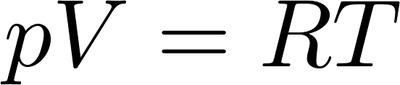
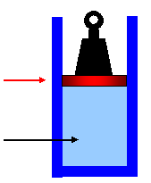


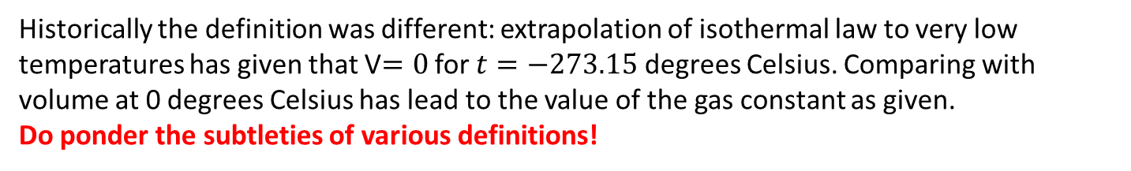

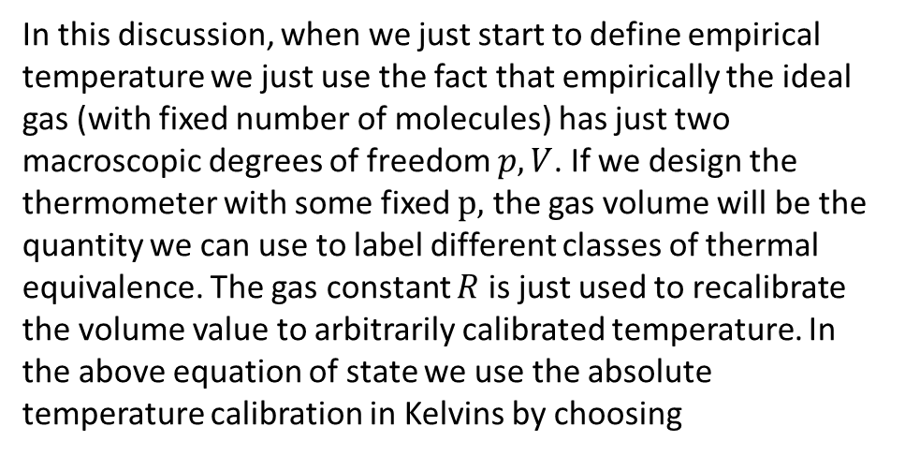
Gas thermometer
As an example of an empirical thermometer we present here an ideal gas at constant external pressure. For one mole of gas we have the equation of state
In this discussion, when we just start to define empirical temperature we just use the fact that empirically the ideal gas (with fixed number of molecules) has just two macroscopic degrees of freedom $p, V$. If we design the thermometer with some fixed $p,$ the gas volume will be the quantity we can use to label different classes of thermal equivalence. The gas constant $R$ is just used to recalibrate the volume value to arbitrarily calibrated temperature. In the above equation of state we use the absolute temperature calibration in Kelvins by choosing
$R=$8.3144598(48) J⋅mol⁻¹⋅K⁻¹
Historically the definition was different: extrapolation of isothermal law to very low temperatures has given that V$=0$ for $t=−273.15$ degrees Celsius. Comparing with volume at 0 degrees Celsius has lead to the value of the gas constant as given.
Do ponder the subtleties of various definitions!

Slide 10
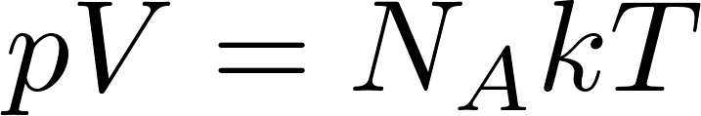
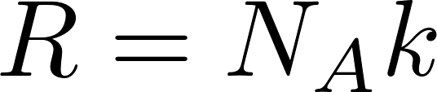
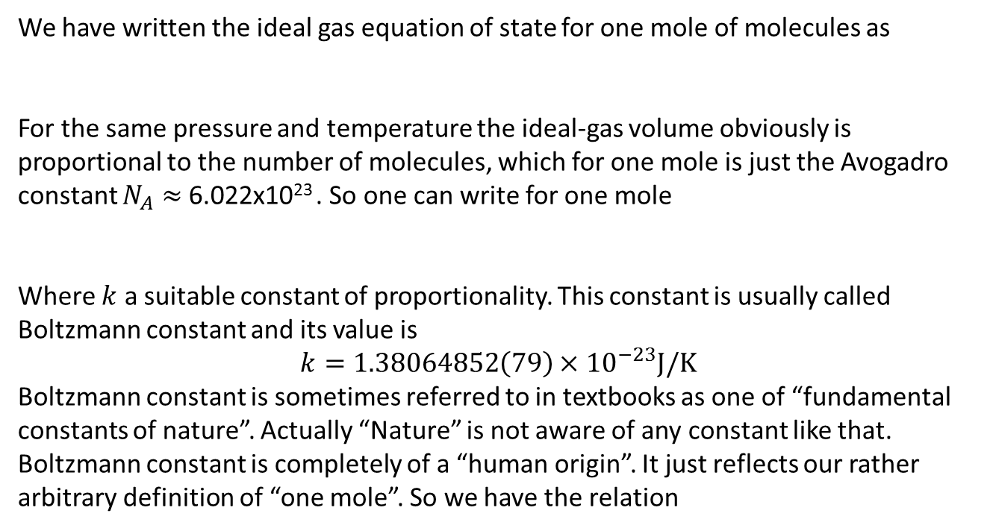
Gas constant, Avogadro constant, Boltzmann constant
We have written the ideal gas equation of state for one mole of molecules as
For the same pressure and temperature the ideal-gas volume obviously is proportional to the number of molecules, which for one mole is just the Avogadro constant $N_{A}≈$ 6.022x10²³ . So one can write for one mole
Where $k$ a suitable constant of proportionality. This constant is usually called Boltzmann constant and its value is
$$k=1.38064852\left(79\right)×{10}^{−23}J/K$$
Boltzmann constant is sometimes referred to in textbooks as one of “fundamental constants of nature”. Actually “Nature” is not aware of any constant like that. Boltzmann constant is completely of a “human origin”. It just reflects our rather arbitrary definition of “one mole”. So we have the relation

Slide 11
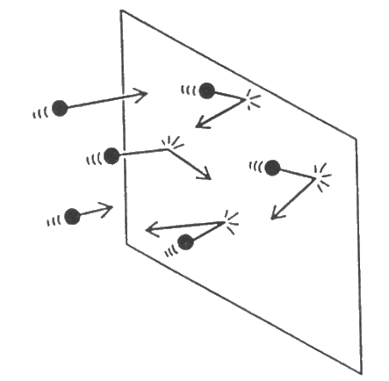
Pressure: kinetic theory of gases
The molecular hypothesis explained where the integer numbers in chemical recipes come from. We have just seen how the molecular hypothesis enhanced our understanding what temperature “is”. Now we shall present the idea how the molecular hypothesis explains the origin of gas pressure. One can find this in textbooks in chapters like “Kinetic theory of gasses”.
The kinetic theory describes a gas as a large number of submicroscopic particles (atoms or molecules), all of which are in constant rapid motion that has randomness arising from their many collisions with each other and with the walls of the container.
Kinetic theory explains macroscopic properties of gases, such as pressure, temperature, viscosity, thermal conductivity, and volume, by considering their molecular composition and motion.
The theory proposes that gas pressure is due to the impacts, on the walls of a container, of molecules or atoms moving with random velocities.

Slide 12
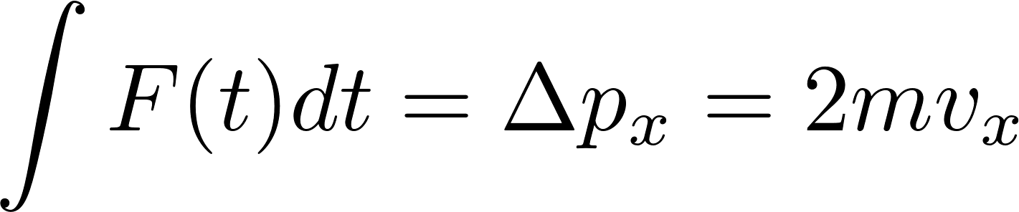

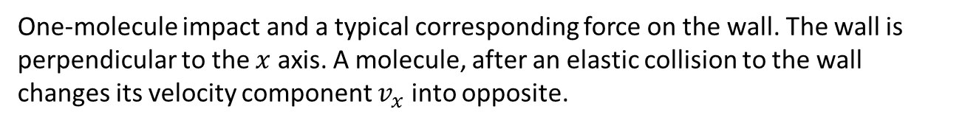
Pressure: kinetic theory of gases
One-molecule impact and a typical corresponding force on the wall. The wall is perpendicular to the $x$ axis. A molecule, after an elastic collision to the wall changes its velocity component $v_{x}$ into opposite.

Slide 13
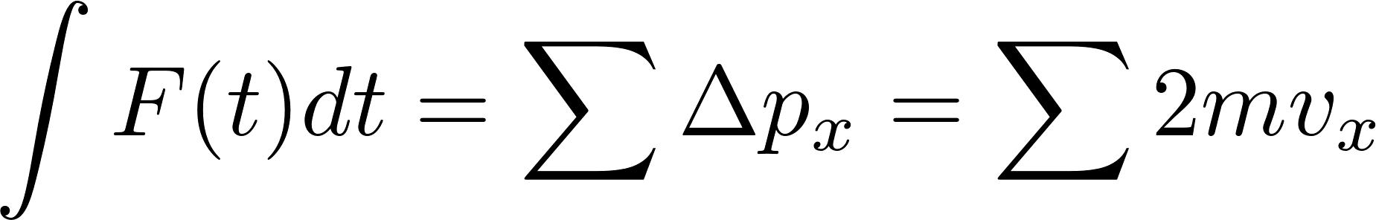
Pressure: kinetic theory of gases
Impact of many molecules and a typical corresponding force on the wall. Since our image is not a video, we cannot visualize that the impacts are not simultaneous but spread in time. In this way the forces due to individual impacts are smeared in time and we observe just an average force fluctuating a little.

Slide 14
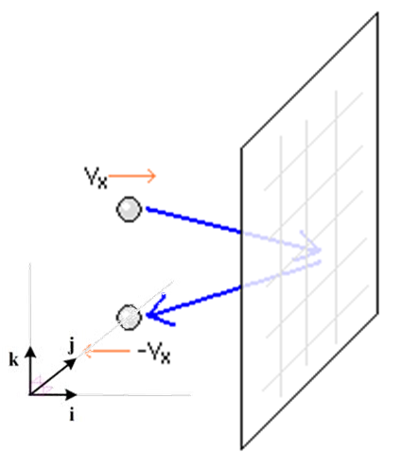
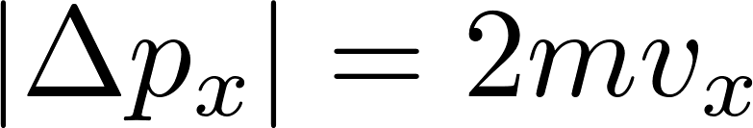
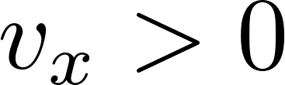
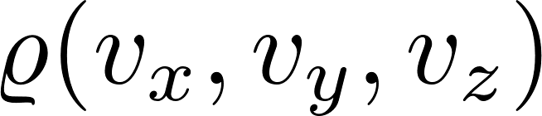

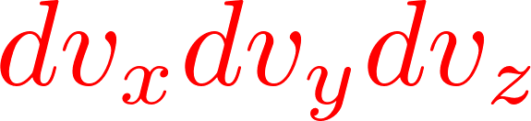



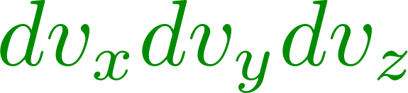
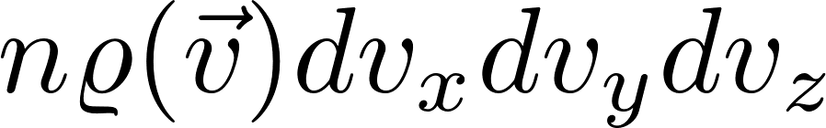


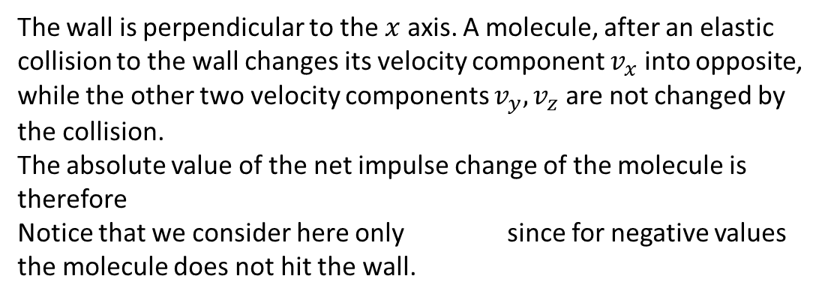
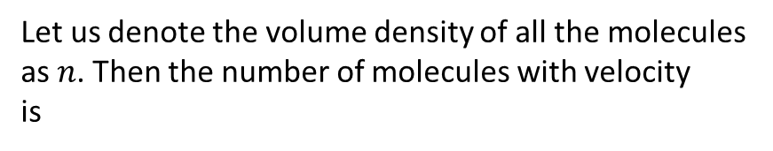
Pressure: kinetic theory of gases
The wall is perpendicular to the $x$ axis. A molecule, after an elastic collision to the wall changes its velocity component $v_{x}$ into opposite, while the other two velocity components $v_{y},v_{z}$ are not changed by the collision.
The absolute value of the net impulse change of the molecule is therefore
Notice that we consider here only since for negative values the molecule does not hit the wall.
The velocity of a molecule is a random vector (random 3-dimensional continuous quantity) with probability density . To simplify our formulation we shall say “a molecule with velocity “ and we shall mean by that “a molecule whose velocity is any vector with the endpoint in a small box around the endpoint of the vector in the abstract velocity space” (see figure).
Let us denote the volume density of all the molecules as $n$. Then the number of molecules with velocity is

Slide 15

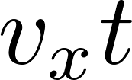
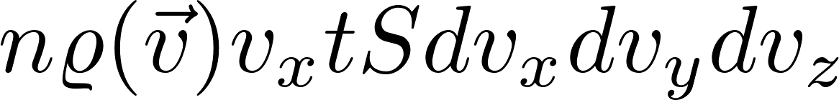

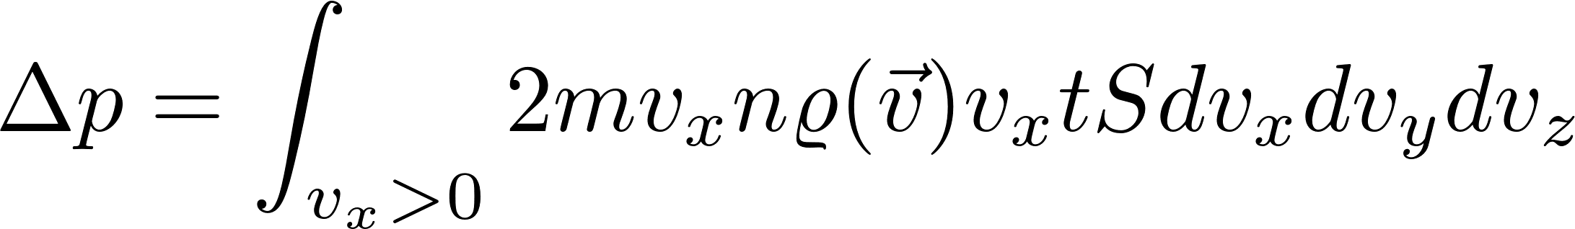
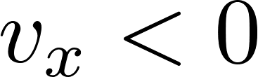
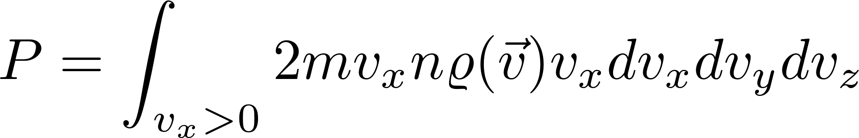
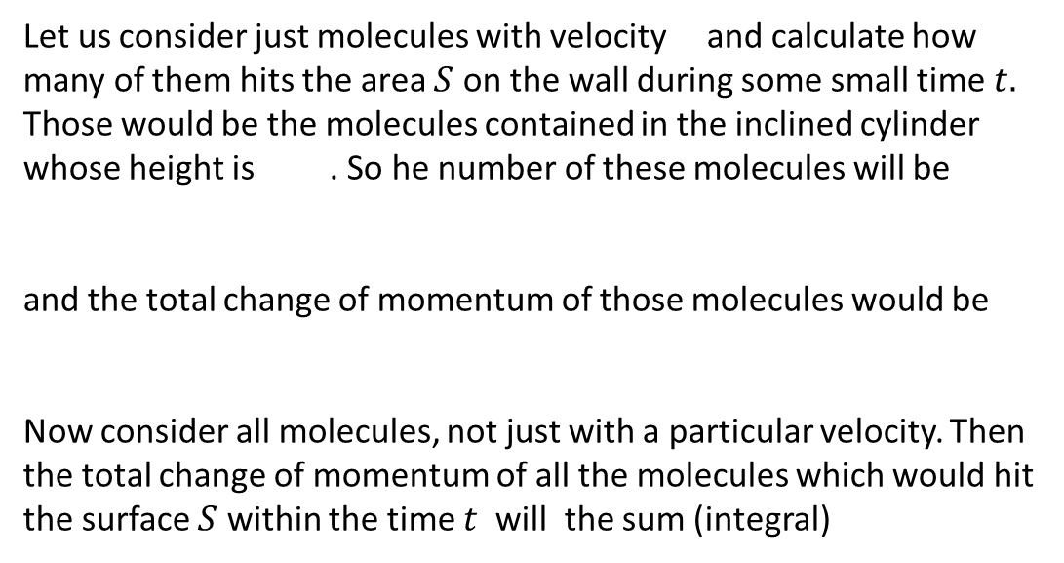
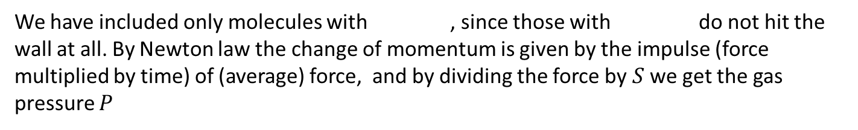
Pressure: kinetic theory of gases
Let us consider just molecules with velocity and calculate how many of them hits the area $S$ on the wall during some small time $t.$
Those would be the molecules contained in the inclined cylinder whose height is . So he number of these molecules will be
and the total change of momentum of those molecules would be
Now consider all molecules, not just with a particular velocity. Then the total change of momentum of all the molecules which would hit the surface $S$ within the time $t$ will the sum (integral)
We have included only molecules with , since those with do not hit the wall at all. By Newton law the change of momentum is given by the impulse (force multiplied by time) of (average) force, and by dividing the force by $S$ we get the gas pressure $P$

Slide 16
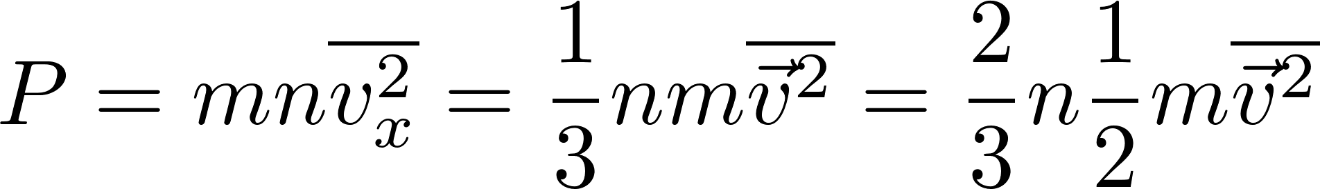
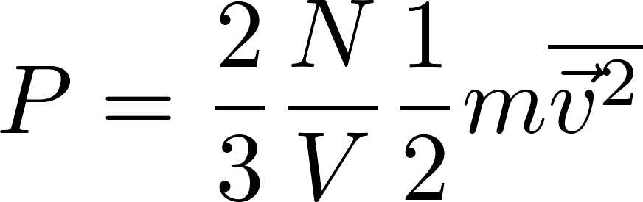

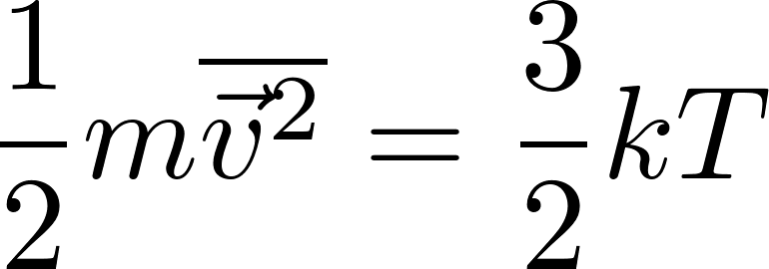
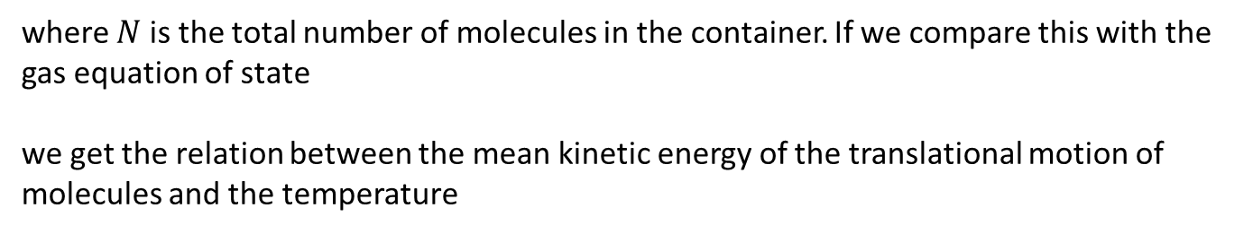
Pressure: kinetic theory of gases
where $N$ is the total number of molecules in the container. If we compare this with the gas equation of state
we get the relation between the mean kinetic energy of the translational motion of molecules and the temperature

Slide 17
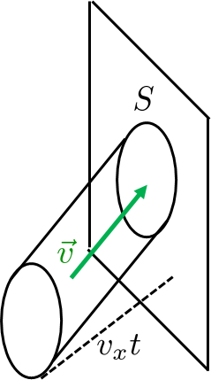
Pressure: kinetic theory of gases
We have, in fact, derived the equation of state for the ideal gas. However, we did not mention, that the gas we have considered, was ideal. Our derivation looked perfectly general. Since real gases do not behave according to the ideal-gas equation, we must have cheated somewhere.
The problem was how we have calculated the number of collisions with the wall. We have assumed that all the molecules in the inclined cylinder hit the wall with the velocity . This is not true.
The reasons are quite complex, let us just present one.
Imagine the molecule, which is just about to hit the wall. There are less molecules in front of that molecule then behind it. So the other molecules from behind attract the molecule more then the molecules in front of it an effectively decelerate it. So the considered molecule hits the wall with slightly different velocity then it had far from the wall.

Slide 18

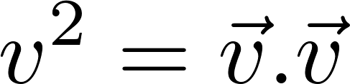
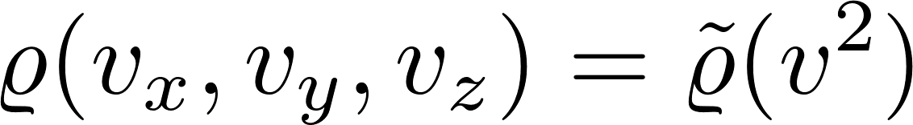
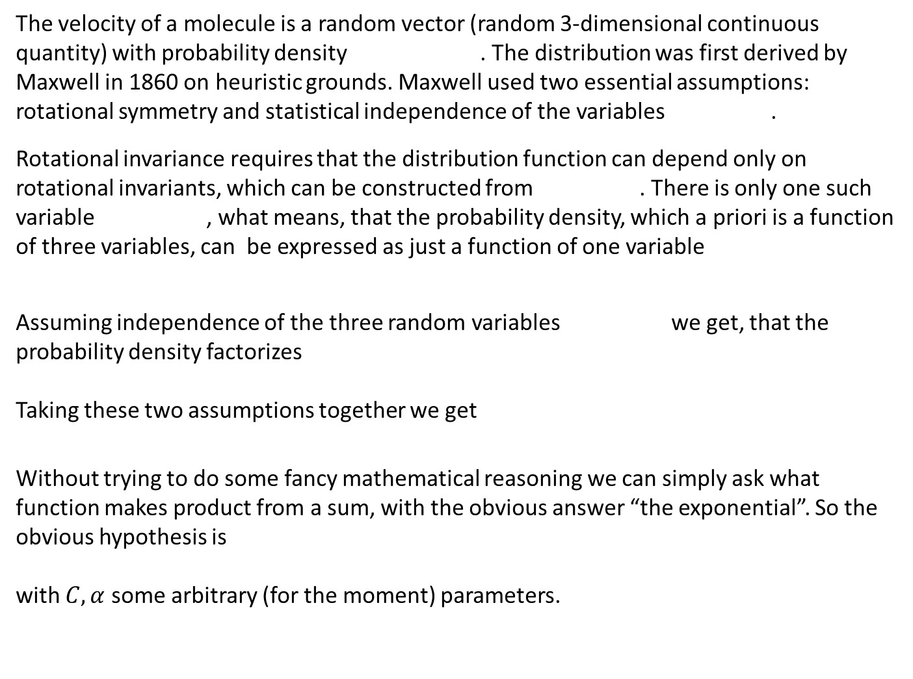
Maxwell velocity distribution
The velocity of a molecule is a random vector (random 3-dimensional continuous quantity) with probability density . The distribution was first derived by Maxwell in 1860 on heuristic grounds. Maxwell used two essential assumptions: rotational symmetry and statistical independence of the variables .
Rotational invariance requires that the distribution function can depend only on rotational invariants, which can be constructed from . There is only one such variable , what means, that the probability density, which a priori is a function of three variables, can be expressed as just a function of one variable
Assuming independence of the three random variables we get, that the probability density factorizes
Taking these two assumptions together we get
Without trying to do some fancy mathematical reasoning we can simply ask what function makes product from a sum, with the obvious answer “the exponential”. So the obvious hypothesis is
with $C, α$ some arbitrary (for the moment) parameters.

Slide 19
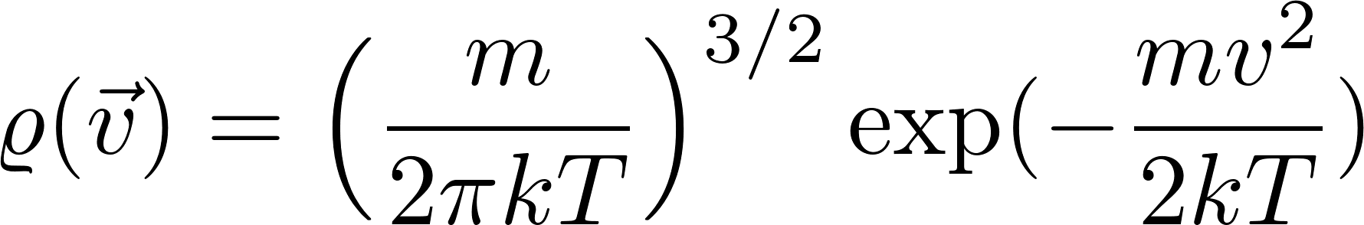
Maxwell velocity distribution
We arrived at a Gaussian distribution. The kinetic theory of pressure has lead to the relation
The Gaussian probability distribution must be consistent with this, so (together with the requirement of a proper normalization) the distribution is uniquely given as
Let us stress that the requirement of spherical symmetry is more-or-less unavoidable. The requirement of statistical independence of the variables is, on the other hand, not forced by any general physics arguments. It was a clever hypothesis justified a posteriori by agreement of many of its consequences with experiment.
We add a note that the Maxwell distribution can be seen as a direct consequence of canonical distribution we shall meet later on, so canonicity leads directly to independence of directions.
For experts we add a note that a careful analysis of physical kinetics (Boltzmann kinetic equation and its collision term in particular) leads to independence of directions directly.

