Slide 1
First law of thermodynamics
The obvious task for a phenomenologist is to find the formula for energy as a function of quantities defining the macrostate.
Obviously, the first law of thermodynamics can determine only the difference of energies of two states, so energy in thermodynamics is defined up to an arbitrary additive constant.
The phenomenologist has to define some arbitrary reference macrostate whose energy is set to 0 by definition. Then he has to measure the sum of work and heat going from the reference state to an arbitrary macrostate. Based on experimental data he has to “guess” a formula for energy.
A theoretician, who already knows that behind the macrostate there is some microstate of molecules can in principle calculate the (mechanical) energy of molecules in the chosen representing microstate and, based on statistical considerations, express the energy of the macrostate through the macroscopic quantities defining the macrostate considered.

Slide 2
First law of thermodynamics
we shall present the statistical analysis later, here we will just quote (without proof) formulas for the energy of ideal gasses.
Gas of $N$ moecules has energy
These formulas are just approximate, more exact quantum mechanical expressions should take into account details of internal structure of atoms and molecules. We introduce a universal notation as
The rationale for this notation will be clear when we shall discuss the isochoric process energy heat balance.

Slide 3
First law of thermodynamics
Let us finally present a formula corresponding to the first law of thermodynamics as it is usually presented in standard textbooks.
Let us consider an infinitesimal change of state between two close macrostates. The energy difference will be $dE$, the mechanical work preformed by the physical system will be $δA$, and heat performed by an external agent (boiler attendand)$δQ$. The first law of thermodynamics then reads
Do notice that the first law of thermodynamics is, in fact, the generalized law of energy conservation: any change of energy has to be balanced by work of external agents. Do notice the negative sign of the mechanical work. This is due to a standard convention that when speaking of the mechanical work we speak about work performed by the system (gas) upon an external agent (piston pusher), while the convention for heat is that it is the (microscopic) work performed by an external agent (boiler attendant) upon the physical system (gas).
Do also notice, that we use the terminology “performed heat” and not “transferred heat”. Heat is a form of work: it is not a form of energy.
A few words to notations. $d$ in $dE$ means the difference of two (infinitesimally close) values of energy. Symbol $δ$ in $δA$ means that it is an infinitesimally small value, but it is not a difference of any two values. The amount of work depends on the trajectory, so it is not a difference of a final and initial values of any state quantity. Similarly for heat.

Slide 4
Heat is a form of work, not of energy
The fact that heat is not a form of energy we consider to be so important, that we devote to it a special slide.
The difference between “work” and “energy” is essential. Energy is a state quantity, work is not. We can say that energy is “stored” in a physical system as are goods in some warehouse. The energy can be “taken out” of this warehouse and transferred to some other object to be stored inside it.
The way, how the energy can be transferred from one object to another is by performing work. Work is the property of some process. Once the process ends, the work is no more there.
If you go with your car to a service, you get an invoice. There are two groups of items mentioned in the invoice: spare parts and work. Spare parts were stored in the service warehouse, were taken out of there and mounted to your car. From then on the spare parts are stored in your car and they are there long after the service operations were finished, you take them to your home with your car.
On the other hand the invoice mentions performed work (usually expressed in man-hours). The work was not stored anywhere in any warehouse. It was just performed during the service operations. You did not take the “performed work” to your home with your car. The work is nowhere after service operations ended.
Well, this is exactly the difference between “energy” and “work”, or “energy” and “heat”. So if you get an invoice saying “we delivered to you 1 GJ of heat” it is nonsense. The invoice should read “we performed for you 1 GJ of heat”. Unfortunately, nobody speaks like that. People just do not follow my lectures.

Slide 5
First law of thermodynamics as a definition of heat
The first law of thermodynamics
is often written as
In this form it can be interpreted as the definition of heat. The point is that we can easily calculate the mechanical work $δA$ for any process (just using the formula $δA=p dV$.
We also often know (either by phenomenological analysis or by theoretical calculation) the formula for energy. What is less obvious is calculation of heat for an arbitrary process. So we easily define that heat is the missing work needed to complete the energy – work balance.
We shall demonstrate the energy – work – heat calculations for standard gas processes.

Slide 6
Energy – work – heat for the isochoric process
Isochoric process means constant volume, $dV=0$. So no mechanical work is performed.
For ideal gas we have the energy formula
so $dE=C_{V}dT$ and from the first law of thermodynamics we get for heat at isochoric process
This is a typical calorimetric formula, so we now know the meaning of the constant $C_{V}:$
it is the heat capacity of ideal gas for isochoric process.
Please, do remember, that the formula $dE=C_{V} dT$is valid for any process with ideal gas, since the energy difference is process independent. So there is always the constant $C_{V}$ in this formula, it is just an “accident” that this constant has a special meaning for isochoric process. So, for example, for isobaric process we still have $dE=C_{V}dT$ and not something like $dE=C_{p}dV$.

Slide 7
Energy – work – heat for the isobaric process
Isobaric process means constant pressure, $p=\text{const}$. Calculation of mechanical work is trivial
For ideal gas we have the energy formula and so
The firs law of thermodynamics then gives
This is a typical calorimetric formula, however, for isobaric process. We have denoted the corresponding heat capacity (at constant pressure) as
$C_{p}=C_{V}+Nk$.
The last relation is called Mayer relation and for one mole it reads

Slide 8
Energy – work – heat for the isothermal process
Isothermal process means constant temperature, $T=\text{const}$. Calculation of mechanical work is not difficult
For ideal gas we have the energy formula and so
The firs law of thermodynamics then gives

Slide 9
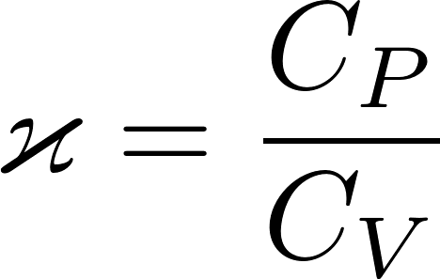
Adiabatic process
Now he have enough knowledge to calculate everything about adiabatic process which is defined as $δQ=0$. From the first law of thermodynamics we get
What we got is a differential equation for an unknown function $T(V)$ describing an adiabatic process on a $VT$ diagram. We are willing top use a $pV$ diagram, so we need a differential equation in $pV$ variables. We swap $VT$ for $pV$ using the equation of state:
Using the Mayer relation $C_{p}=C_{V}+Nk$ we get
where we introduced Poisson constant

Slide 10
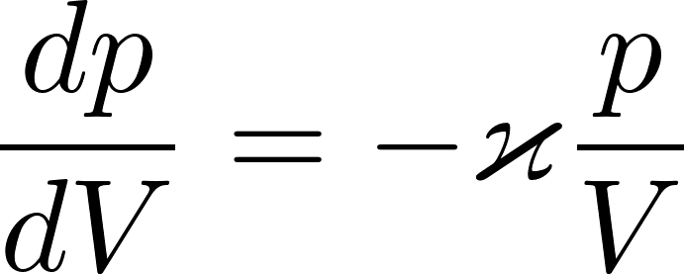
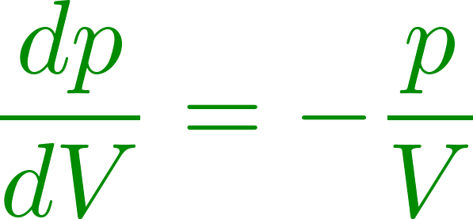
Adiabatic process
What we have got? It is a differential equation for the unknown function $p\left(V\right)$ representing an adiabatic process on a $pV$ diagram. We are looking for a curve, which starts at a given initial state $p_{1}V_{1}$ and in each $pV$ point through which it goes it has the derivative (slope)
There is an infinite number of curves representing different reversible processes going through arbitrary point $pV$. In particular there is an isotherm $pV=\text{const}$, the slope of which is
Since the adiabatic curve is steeper then the isotherm in a common $pV$ point.

Slide 11
Adiabatic process
in principle we can draw in any point in the $pV$ diagram a short line showing the slope of the adiabat curve going through that point as given by the formula
We should get something like this (the figure is just a sketch, not exact drawing)
Now imagine we have a figure with a very dense population of local slope lines. If we choose one point as a starting state for an adiabatic process, we can simply draw a continuous curve going through the points and get the whole adiabat.

Slide 12
Adiabatic process
in principle we can draw in any point in the $pV$ diagram a short line showing the slop of the adiabat curve going through that point as given by the formula
We should get something like this (the figure is just a sketch, not exact drawing)
Now imagine we have a figure with a very dense population of local slope lines. If we choose one point as a starting state for an adiabatic process, we can simply draw a continuous curve going through the points and get the whole adiabat.
The green curve is a smooth curve going through the points and having in each point the slope as given by the short slope line in that point

Slide 13
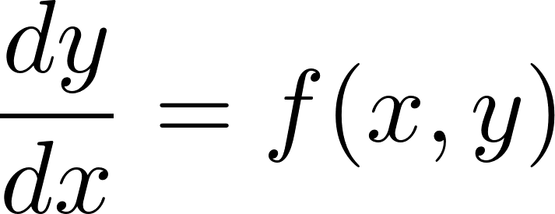
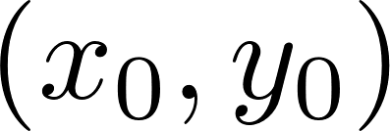
A note on differential equations
Solving a first order differential equation
we are looking for a curve $y(x)$, which starts at the point $(x_{0},y_{0})$ and in each point $(x,y)$ through it goes it has the slope $f(x,y)$. The visualization of this problem in the $x,y$ plane is the same as we have seen when looking for the adiabat curve
Instead of drawing a curve by hand we can use a computer to make many small steps finding a sequence of points $(x_{i},y_{i})$ which approximately lay on the curve we are looking for. A simple recursive stepping algorithm does the job (Euler numerical method for solving differential equations)
A higher order differential equation can be easily rewritten as a first order equation in a higher dimensional space and the Euler method can be used.

Slide 14
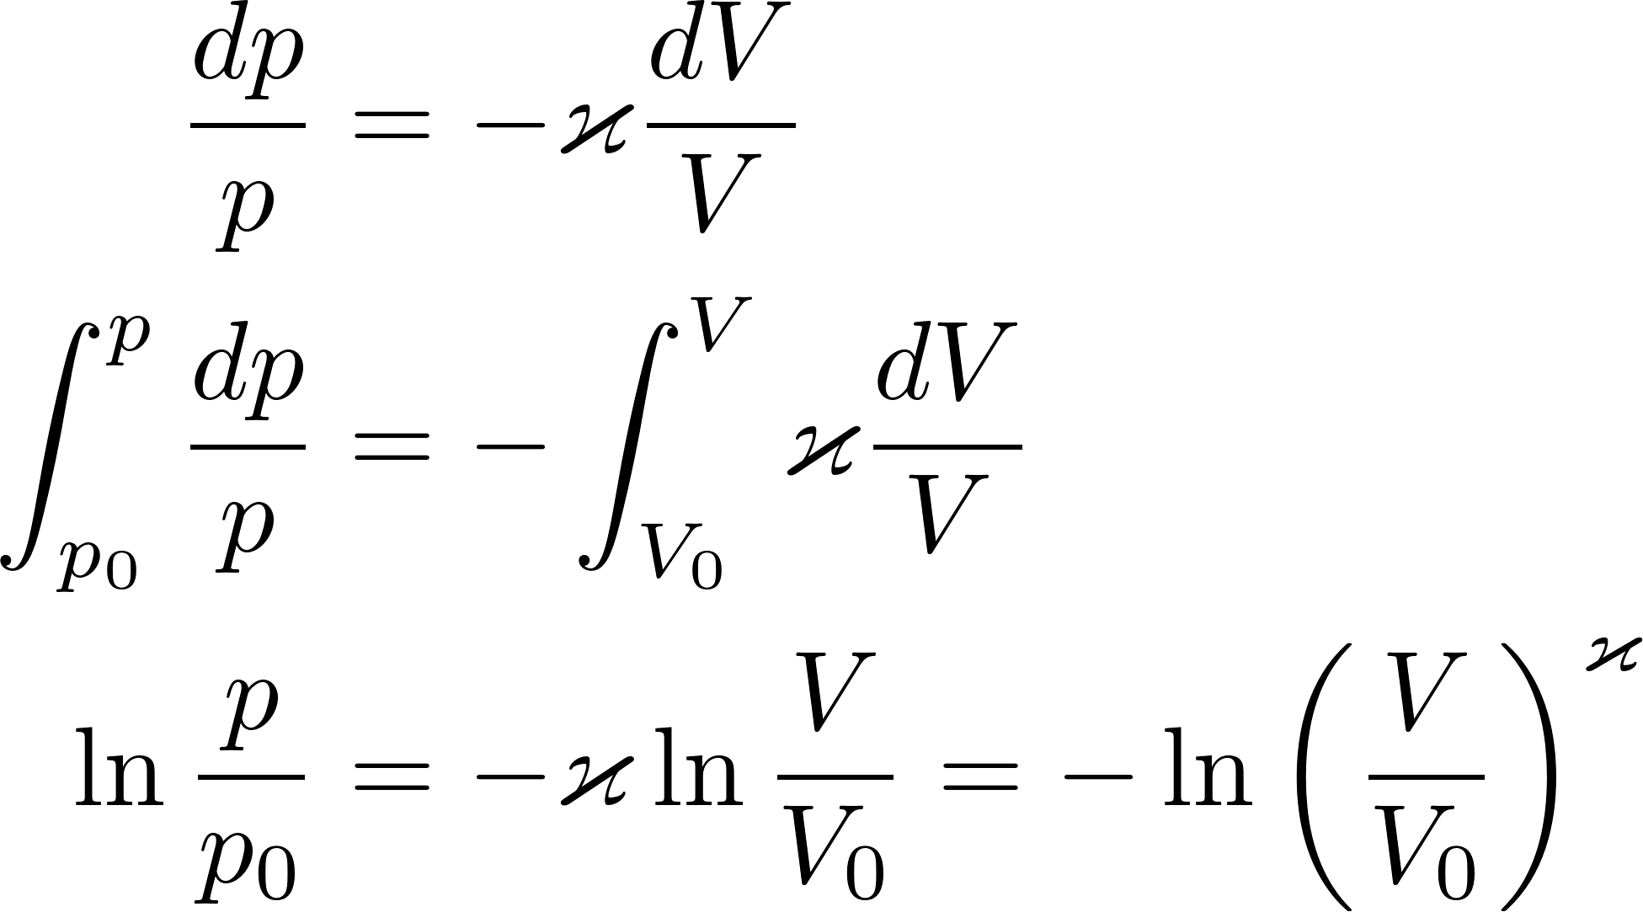
Adiabatic process
The differential equation for the adiabat
can easily be solved analytically.
This is the adiabat curve (for ideal gas) which goes through a given point ${(p}_{0}{,V}_{0})$.

Slide 15
Carnot cycle
The Carnot cycle is a theoretical thermodynamic cycle proposed by French physicist Sadi Carnot in 1824. It provides an upper limit on the efficiency that any classical thermodynamic engine can achieve during the “conversion of heat into work”, or conversely, the efficiency of a refrigeration system in creating a temperature difference (e.g. refrigeration) by the application of work to the system.
The analysis by Carnot is an example of “intellectual beauty”. Using very simple considerations, without any heavy mathematics, Carnot was able to demonstrate, that there is an upper limit for the efficiency of any thermodynamic engine which has access just to two reservoirs: hot at temperature $T_{1}$ and cold at temperature $T_{2}$. What is really striking is that “any engine” means even engines not yet proposed and even engines working on some new (not yet discovered) physical interactions of matter. A demonstration of power of human intellect.
Technical praxis needs a lot of machines able to perform mechanical work: lifting or moving objects, pumping fluids, machining (turning, drilling, milling) materials etc. To perform work, one needs a source of energy. Sometimes it is just a form of mechanical energy like in the watermill. However, sources of mechanical energy (which are simple to use to perform mechanical work) are rare. We have much richer resources of chemical energy, which can simply be used to perform heat but not so easily to perform macroscopic mechanical work.

Slide 16
Thermodynamic cyclic engine
We have used the expression “conversion of heat into work”. This expression is scientifically not quite correct. Heat is not a form of energy, it is a form of (microscopic) work. A heat engine (thermodynamic engine) is a device, which receives work in the form of heat and performs macroscopic mechanical work.
Speaking about the efficiency of such a machine we have in mind how many “Joules of mechanical work” can be produced receiving some amount of Joules of heat work.
Carnot engine is a hypothetical cyclic thermodynamic machine which has access just to two reservoirs: hot at temperature $T_{1}$ and cold at temperature $T_{2}$. Its cycle consists of 4 steps.
It is worth to stress, that the size of the machine (how many moles of working gas is used) is arbitrary. The amount of useful work the machine provides during one cycle depends on its size.

Slide 17
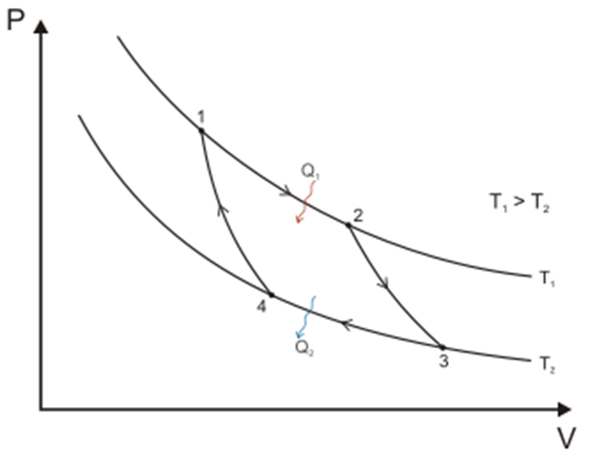
Carnot cycle
The Carnot cycle starts (end ends) in the point $\left(p_{1}, V_{1}, T_{1}\right).$ All three parameters can be chosen arbitrarily. The size of the machine $\left(N\right)$ is then uniquely given by the equation of state $pV=NkT$. The cycle consist of four reversible steps
The isothermal expansion on $T_{1}$to arbitrarily chosen volume $V_{2}$. The Pressure $p_{2}$ is then uniquely determined.
The adiabatic expansion to temperature $T_{2},$ point $(p_{3},V_{3})$ is then uniquely determined.
The isothermal compression on $T_{2}$ to a point $p_{4},V_{4}$ which is uniquely determined by the requirement that from there one can get adiabatically to the initial point $p_{1},V_{1}$.
The adiabatic compression to the point $p_{1},V_{1}$.

