Slide 1
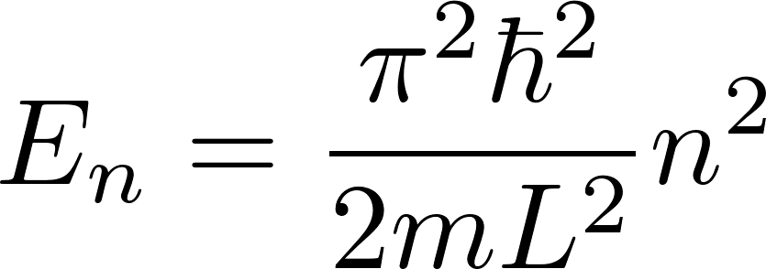
Quantum mechanics
Stationary states of a (spinless point-like) particle confined to a line segment of a length $L$ (model of a gas particle in a box in a one-dimensional world) are labeled by a single quantum number $n$ with possible values $1,2,3,4,…$ with corresponding energies given by the formula
Stationary states of a spinless point-like particle in a 3-dimensional cubic box with the edge size $L$ are labeled by 3 independent integer quantum numbers $n_{1},n_{2},n_{3}$ with energies given by the formula
Stationary states of many non-interacting spinless point-like particles in a box (model of an ideal gas) can be expressed using the one-particle states as described above.

Slide 2
Quantum mechanics
Describing stationary states of a many non-interacting particle system one has to distinguish two cases: distinguishable particles and indistinguishable particles
Indistinguishable particles, also called identical particles or indiscernible particles, are particles that cannot be distinguished from one another, even in principle. We cannot distinguish them from one another physically by “painting a different-color dot on two electrons”. But we cannot distinguish them even virtually by giving them a different name as we do it with human identical twins.
The impossibility of assigning different names to two indistinguishable particles needs a more detailed commentary. When we give different names to human identical twins we can in principle track their movements (trajectories) for whole their lives and so at any moment we can know “who is who”. With two electrons it is not possible. Even if at some initial time moment we observe them well separated in space and therefore we may try to give them two different names, we generally cannot track their trajectories from then on. More precisely, if we keep continuously measuring their positions, we would get “different future” with respect to the case when we do not measure their positions continuously. In microworld one is not able to comply with the requirement of old experimental gurus “good measurement must not influence the measured system”. So since we cannot follow the particle trajectories we loose the initial knowledge of “who is who”.

Slide 3
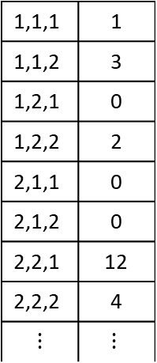
Quantum mechanics
Describing stationary states of $N$non-interacting distinguishable particles is straightforward. We make a numbered list of all particles and assign to each particle its one-particle state $n_{1},n_{2},n_{3}$. So the state is a list of $N$ triplets $n_{1},n_{2},n_{3}$. Do notice that we have effectively gave a name to each particle, its ordering number. This is allowed for distinguishable particles.
Describing stationary states of $N$non-interacting indistinguishable particles is more tricky. Let us assume that we deal with spinless particles, so there is not any additional one-particle state quantum number other than a triplet $n_{1},n_{2},n_{3}$. We start with making a list of all possible one-particle states. It will look like an infinite column
1,1,1
1,1,2
1,2,1
1,2,2
2,1,1
2,1,2
2,2,1
2,2,2
$$⋮$$
The list of one-particle states is infinite, since there are infinitely many integer triplets. Now we add additional column and write there the occupational numbers, that is how many particles are in the corresponding one-particle state
1,1,1 | 1
1,1,2 | 3
1,2,1 | 0
1,2,2 | 2
2,1,1 | 0
2,1,2 | 0
2,2,1 | 12
2,2,2 | 4
$$⋮$$ | $$⋮$$
The sum of occupational numbers is equal to the total number of particles considered.
So the state of indistinguishable spinless non-interacting particles is given by the list of one-particle states each with its occupational number
$$Σ=N$$

Slide 4
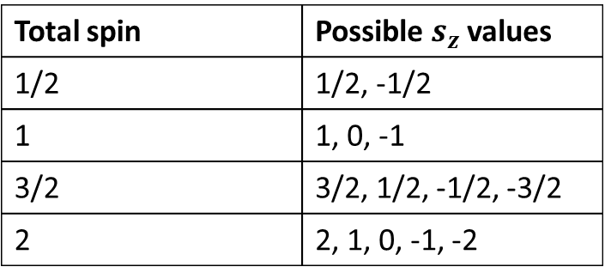
Quantum mechanics: bosons and fermions
Bosons are those particles which have an integer spin (0, 1, 2...). Fermions are those particles that have an odd half-integer (like 1/2, 3/2, …) spin.
One-particle states for spinless (spin=0) bosons are those states we have used so far. Their complete identification is given just by a triplet of integers $n_{1},n_{2},n_{3}$.
For particles with spin their one-particle state is identified with a triplet of integers $n_{1},n_{2},n_{3}$ (this specifies the spatial part of the particle state), but additional specification of the spin state is required as well. Usually a quantum number $s_{z}$ is used for that specification, it gives the projection of the spin to the z-axis. $s_{z}$ can be given using explicit SI definition through $ℏ ($like $s_{z}=\frac{1}{2}ℏ$), but more often we omit $ℏ$ and write something like $s_{z}=\frac{1}{2}$.
Examples of possible values are given in the table:
Total spin | Possible $s_{z}$ values
1/2 | 1/2, -1/2
1 | 1, 0, -1
3/2 | 3/2, 1/2, -1/2, -3/2
2 | 2, 1, 0, -1, -2
For spin 1/2, we often use instead of $s_{z}=\frac{1}{2},−\frac{1}{2}$ the notation $s_{z}=↑, ↓$ .

Slide 5
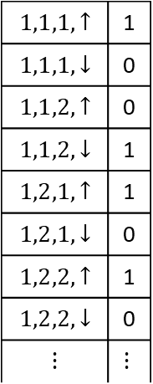
Quantum mechanics: bosons and fermions
Bosons and fermions behave differently what concerns possible values of occupational numbers.
Bosons can have any value as occupational number in an one-particle state
Fermions can have just 0 or 1 as occupational number in an one-particle state. This principle is called Pauli exclusion principle
Do not forget that there are no spinless fermions, so one-particle states of fermions do have also $s_{z}$ quantum number in addition to “spatial” quantum numbers $n_{1},n_{2},n_{3}$. So the table describing a state of spin 1/2 fermions can look like the following
$$1,1,1,↑$$ | 1
$$1,1,1,↓$$ | 0
$$1,1,2,↑$$ | 0
$$1,1,2,↓$$ | 1
$$1,2,1,↑$$ | 1
$$1,2,1,↓$$ | 0
$$1,2,2,↑$$ | 1
$$1,2,2,↓$$ | 0
$$⋮$$ | $$⋮$$
The sum of all occupational numbers is equal to the total number of fermions ion the box.
$$Σ=N$$

Slide 6
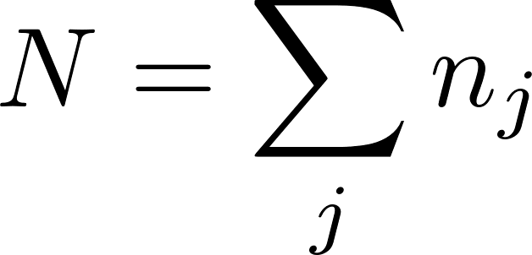
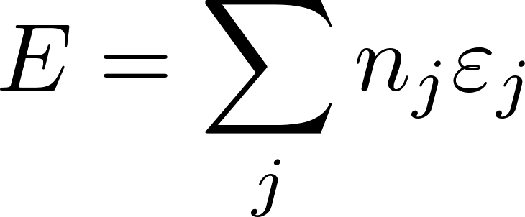
Ideal gas quantum state: shorter notation
Repeating: the quantum state of an ideal gas of point-like particles is given by a table of one-particle states with filled occupational numbers. The one-particle states of point-like particles are fully described as $n_{1},n_{2},n_{3},s_{z}.$ A particle occupying that state would have the energy
We stress that we use the quantum mechanical formula for point-like particles. This means that we can use the formula for ideal gasses consisting of monoatomic molecules (molecules consisting of single atoms like He and not like ${\text{O}}_{2}$. Somebody might disagree with that saying that even a He atom is not “point-like”, since it contains many protons, neutrons and electrons. The complaint would be very relevant for atoms satisfying Newton mechanics. However the real atoms behave according to quantum mechanics. For the usual laboratory conditions the quantum mechanics tells us, that we can handle such atoms as if they were point-like particles. The detailed explanation is behind the scope of this introductory text.
We shall often use a shorter notation, the one particle states will be identified just by one number $j$, understood for example as the line order number in the list of the one particle states. The corresponding occupational number will then be denoted as $n_{j}$ and the state energy as $ε_{j}$. The gas state will then be given as list of the occupational numbers $\{n_{j}\}$ , the total number of particles as
and the total energy as

Slide 7
$$n!$$
We repeat: For indistinguishable particles one has to identify the many-particle-ideal- gas state by a set of occupational numbers.
It is not legal to identify individual particles by naming them by numbers and give the gas state as a list of one particle states of individual numbered particles.
However, it is often possible to simplify some calculation by using such an illegal gas state definition. By that we would get too many gas microstates: two microstates distinguished only by different permutation of particles would be considered as different microstates what is not allowed for indistinguishable particles. We can, however, often rectify this by dividing number of microstates on a proper place by the “Gibbs factor” $N!$. Gibbs found this trick just empirically without knowing the true quantum-mechanical reason. (Quantum mechanics was invented many years later!) He said something like “statistical physics considers many particle states as if the particles were indistinguishable”.
Today, we know, that it is not “as if”. Identical particles are indeed indistinguishable.

Slide 8
Statistical ensemble
This is the central chapter of our lectures on statistical physics. It demonstrates the basic methodological idea: instead of analyzing a single system with very large degrees of freedom in some specific macrostate we shall study an ensemble of identical macroscopic systems each of them being in some (different) microstate representing the macrostate considered. We shall then statistically analyze the ensemble calculating for example some mean macroscopic values of interest and assume that the real macroscopic values of the single system we experimentally observe will be very close to the mean statistical values we have calculated.
The art of statistical physics is hidden in prescripts how to construct the representing statistical ensemble. The prescripts for the construction of the representing statistical ensemble will depend on how the considered macrostate is defined through values of macroscopic variables.
We shall consider here quantum microstates to build the representing ensemble. Actually statistical physics emerged well before quantum mechanics and everything was formulated in terms of classical states (in phase space of the system considered). Since quantum stationary states are discrete, it is conceptually more simple to think in terms of quantum states. Though, in many situations we shall formulate the rules in terms of quantum states but then we shall use continual approximation (and the techniques of calculus) for real calculations.

Slide 9
We shall study in some details three situations:
isolated system: its macrostate will be represented by so called microcanonical ensemble
system in contact with thermal reservoir keeping its temperature constant: its macrostate will be represented by so called canonical ensemble
system in contact with thermal reservoir as well as with particle reservoir which keeps its temperature and chemical potential constant: its macrostate will be represented by so called grand canonical ensemble

Slide 10
Microcanonical ensemble
We start with a macrostate of an isolated system. An isolated system has its energy fixed, so we can consider its energy $E$ as a given macroscopic parameter. In addition to energy all external parameters shall be considered as given and fixed. The external parameters will be generically represented by a macroscopic variable $V$. For better imagination we can think about the volume (of a gas). The statistical ensemble representing an isolated system is called microcanonical ensemble.
Let us stress that the system considered must be large having very big number of degrees of freedom, typically ${10}^{23}$. Only then the number of relevant number of representing microstates will be of the order of ${{10}^{10}}^{23}$. Then the statistical predictions based on evaluating mean values calculated for the representing statistical ensemble will be sharp enough to be useful to represent the observed values of macroscopic physical quantities of the (single!) system we have at hand.
As we stressed several times the role of physics is to provide “good advice” to users. The advice provided by statistical physics is: assume the macroscopic values you meet in reality to be equal to mean values calculated for the representing statistical ensemble. What we just said is that such an advice would be useful if the system considered is large enough.

Slide 11
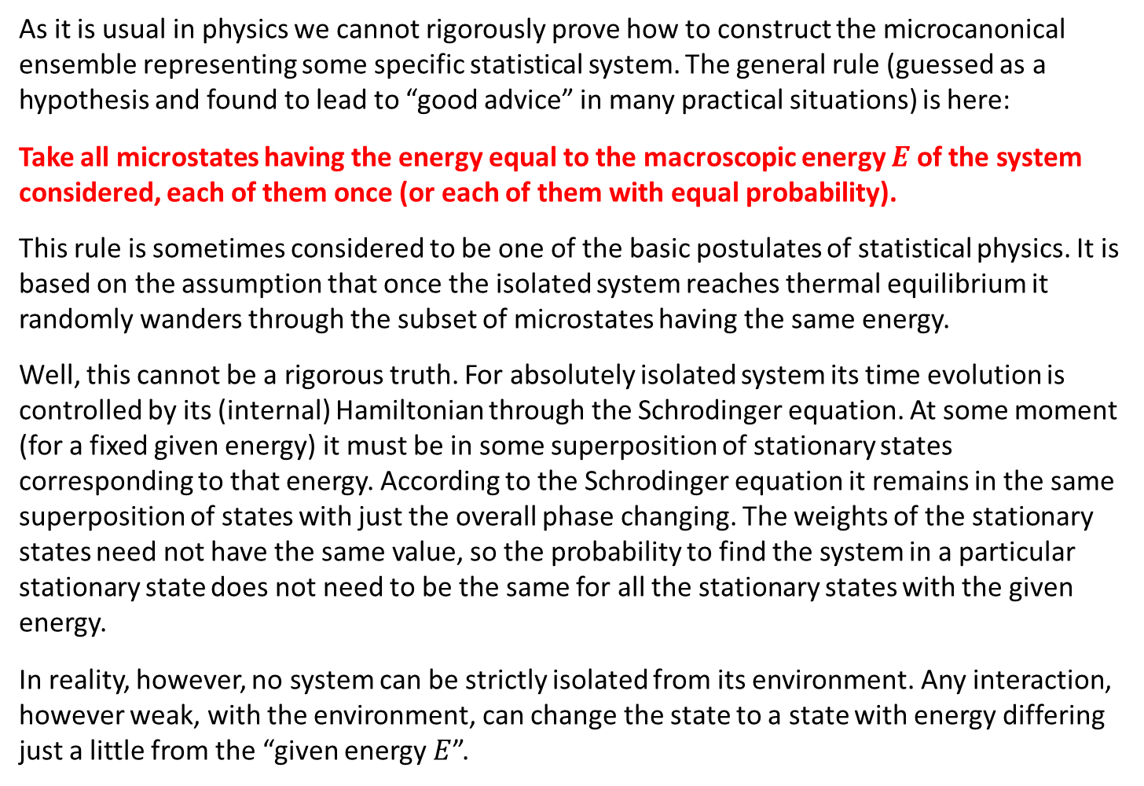
Microcanonical ensemble
As it is usual in physics we cannot rigorously prove how to construct the microcanonical ensemble representing some specific statistical system. The general rule (guessed as a hypothesis and found to lead to “good advice” in many practical situations) is here:
Take all microstates having the energy equal to the macroscopic energy $E$ of the system considered, each of them once (or each of them with equal probability).
This rule is sometimes considered to be one of the basic postulates of statistical physics. It is based on the assumption that once the isolated system reaches thermal equilibrium it randomly wanders through the subset of microstates having the same energy.
Well, this cannot be a rigorous truth. For absolutely isolated system its time evolution is controlled by its (internal) Hamiltonian through the Schrodinger equation. At some moment (for a fixed given energy) it must be in some superposition of stationary states corresponding to that energy. According to the Schrodinger equation it remains in the same superposition of states with just the overall phase changing. The weights of the stationary states need not have the same value, so the probability to find the system in a particular stationary state does not need to be the same for all the stationary states with the given energy.
In reality, however, no system can be strictly isolated from its environment. Any interaction, however weak, with the environment, can change the state to a state with energy differing just a little from the “given energy $E$”.

