Slide 1
Statistical physics manifesto
we have to handle systems with huge number of degrees of freedom $≈{10}^{26}$
exact physical state of such a system ($≈{10}^{26}$ numbers) is called a microstate
a complete information on microstate is experimentally unfeasible
experimentally in any state of a large systems we have just a few values of macroscopically measurable physical quantities
these macroscopic numbers define what we call a macrostate
macrostate is just drastically reduced information on microstate
we have to live with the fact that we just know a macrostate instead of a microstate. Still, we want to “forecast the future” at least on the level of macrostates
the technique how we handle macrostates in physics is statistics
we know the macrostate, but the system is in fact in some unknown microstate
there is tremendously huge number of microstates compatible with our information on macrostate
a particular macrostate can be realized by tremendously huge number of different microstates. This set of compatible microstates is called a statistical ensemble. We shall see that the number of microstates in an ensemble is of the order ${{10}^{10}}^{26}.$
We imagine a procedure which virtually forecast the future of each microstate from the ensemble, then make a virtual average and get the average characteristics of the ensemble which we assume will be useful characteristics of the final macrostate of our particular initial macrostate.

Slide 2
Let’s repeat, the last two points of the “statistical physics manifesto”
A particular macrostate can be realized by tremendously huge number of different microstates. This set of compatible microstates is called a statistical ensemble. We shall see that the number of microstates in an ensemble is of the order ${{10}^{10}}^{26}.$
We imagine a procedure which virtually forecast the future of each microstate from the ensemble, make a virtual average and get the average characteristics of the final macrostate which we assume will be the final macrostate of our particular initial macrostate.
What justifies usage of the meanensemble value as a reliable prediction?
The mean value can be a good strategy if it is very “sharp”. To observe a microstate with value significantly different from the mean ensemble value is in fact highly improbable. So if you want to “survive in the jungle”, the best advice is to “believe to mean values”. If you meet something different, well, it’s just a very bad luck.
We shall argue, that such a bad luck is very, very, very improbable.

Slide 3
We have observed the typical sharpness of the value of a physical quantity when we calculated the probability of finding $n$ molecules out of $N$ in the left half of a box.
Let’s summarize our findings:
mean value of molecules in the left part(as calculated over all the possible microstates) is, as expected $\frac{N}{2}.$
typical deviation is of the order $\sqrt{N}$
What was the reason for getting this result:
Big numbers!
The number of molecules is typically ${N\sim 10}^{23}$, a big number
The number of possible microstates was $2^{N}\sim 2^{{10}^{23}}$ a tremendously big number!
This situation is typical for statistical physics, we meet there three typical numerical values
normal numbers like 1, 4, ${10}^{6}$
big numbers like ${10}^{23}$, typically number of molecules
tremendously big numbers like ${10}^{{10}^{23}}$, typically number of possible microstates

Slide 4
Calculating the number of one-particle states
We have observed that a typical microstate of a large system can be realized by a huge number of possible microstates. The number of microstates is typically ${10}^{N}$, where $N$ is of the order of number of degrees of freedom $N≈{10}^{23}.$ Let us estimate the number of microstates somewhat more precisely for a most simple statistical system: ideal gas of spinless particles.
A microstate of an ideal gas is a list of occupational values for all one-particle states. So to calculate the number of microstates we have to develop a technique for handling numbers of one particle states.
Let us denote as $φ(ε)$ the number of one-particle states in a box which have energies less than $ε$. Let us estimate this number for the case when $ε$ is large. We know that
Let us imagine an abstract space formed by three-dimensional vectors
In this abstract space the one-particle states correspond to points with positive integer coordinates. States with energies less than $ε$are therefore integer-coordinate points inside the “positive octant” of the sphere with the radius

Slide 5
In the abstract $\vec{n}$ space the integer-valued coordinates correspond to vertexes of unit cubes (with volume 1). Each such cube has 8 vertexes, but each vertex is shared by 8 cubes, so on average there is 1 integer-valued point per unit volume cube. So there is one one-particle state per unit volume cube.
States with energies less than $ε$are integer-coordinate points inside the “positive octant” of the sphere with the radius
So for large enough $ε$ (to neglect surface effects) the number of such one-particle states is given by the volume
This is true for spinless particles. For particles with spin their one-particle state is identified not only by with a triplet of integers $n_{1},n_{2},n_{3}$ (this specifies the spatial part of the particle state), but additional specification of the spin state $s_{z}$ is required as well. So each state $n_{1},n_{2},n_{3}$ is $g$-times degenerated where $g$ is the number of possible $s_{z}$ values. $g$ equals 2 for spin 1/2 particles, equals to 3 for spin 1 particles etc. So finally we have

Slide 6
Number of microstates of an ideal gas
We shall estimate the number of microstates which correspond to one macrostate of an ideal monoatomic gas. We shall consider an isolated gas in a box of the volume $V$. Since the gas is isolated its total (internal) energy $E$ is fixed, it is a “given number”.
Actually, however, an absolutely perfect isolation is technically not feasible, so the macroscopic energy is not an absolutely precise real number, it is fixed within some very small (with respect to the value $E$) interval $ΔE$. We shall not specify the interval $ΔE$more precisely, we shall see that the result which would interest us will not depend on the precise value of $ΔE$.
So let us denote as $Ω\left(E\right)$ the number of microstates of an ideal gas with energy $E$ within an unspecified interval $ΔE$. We shall estimate the number of typical (dominating) microstates. We have seen for example, that the macrostate of a gas in a large box is overhelmly dominated by microstates with one half of molecules in the left part of the box and one half in the right part. So we guess that a molecule of our gas will typically occupy a one particle state with energy $\overline{ε}=E/N$, within some interval $Δ\overline{ε}≈α\overline{ε}$, where $α$ is some small constant independent of $\overline{ε}$. The number of one-particle microstates with energy $\overline{ε}$ within the interval $Δ\overline{ε}$ is clearly

Slide 7
A simple combinatorics then tells us that the total number of relevant microstates is
Note that we have used the formula for $φ\left(ε\right)$ derived for monoatomic spinless gas. Actually the spinelessness is not so important, since the spin $g$-factor would get hidden into the constant $C$.
The $N!$ is the Gibbs trick to satisfy indistinguishability of the gas particles. Our estimate was very rough and therefore too unprecise. We shall, however, later see, that if we limit our interests just to the logarithm of this number, then our estimate will be quite reasonable. We get
where we merged some state independent constants into one constant denoted as $C$.
A note concerning physical units is in order. The last equation is wrong what concerns physical units. For example the unit of volume is ${\text{m}}^{3}$ and we certainly do not know what is the logarithm of ${\text{m}}^{3}$. The point is that the constant $C$ also contains some physical units and if we would distribute those units int the two logarithms $\text{ln} V$ and $\text{ln} E$, we would get correct undimensional expressions under all the logarithms.

Slide 8
Entropy for monoatomic spinless ideal gas
For the number of microstates we got the formula
Similar formula was known in phenomenological thermodynamics for monoatomic ideal gas (spin was not known at the time). The corresponding physical quantity was called entropy. The main difference was in physical units, a complete match can be achieved, if we define the entropy in statistical physics adding the Boltzmann constant $k$:
Our formula was derived for ideal gas using crude approximations. That is why it contains unknown constants $α, C$. Later we shall derive exact formula for ideal gas in classical (non-quantum) approximation.
Here we add just a formal definition valid for any isolated physical system:
Entropy for an isolated physical system is defined as k-times the logarithm of the number of microstates corresponding to the macrostate considered.
Since we speak here abut the number of microstates, we are considering a quantum system, where the (discrete, stationary) states can be counted. We also repeat our previous statement: a particular macrostate can be realized by tremendously huge number of different microstates.

Slide 9
The fact, that a microstate can be realized by tremendously huge number of microstates is clear from the above formula. The logarithm of the number of microstates is proportional to number of degrees of freedom $N≈{10}^{23}$. Therefore the number of states $Ω(E)$ itself will really be tremendously huge
Let us also notice, that the entropy for a large system
is additive. That is the entropy of two systems considered as one common system is twice the entropy of one of those systems: for the compound system the number of particles $N$ is doubled, the volume $V$ is doubled and the energy $E$ is doubled. So we see, that the common entropy will be doubled. Actually, it was the requirement of additivity which forced Gibbs to introduce his $"N!$ trick”. It is essential for the additivity that the volume $V$ is divided by $N$ under the logarithm in our formula.

Slide 10
A note about Gibbs’ $N!$ trick
I do not know the exact story how Gibbs invented his $N!$ trick. Most probably he wanted to understand the meaning of the phenomenological entropy within the framework of statistical physics. He derived the formula and found that it does not have the expected additivity property. He must have said to himself something like: “How could I get $N$ into the denominator under the logarithm to make the formula additive?” And he probably realized that the Stirling approximation to $N!$ can put $N$ under the logarithm. So he realized, that putting (artificially) $N!$ to the formula like
will make the entropy formula additive. So he invented the rule “statistical physics considers many particle states as if the particles were indistinguishable”. Later quantum mechanics gave us justification for such artificial empirical rule.

Slide 11
Phenomenological entropy is defined only up to an arbitrary additive constant
Using rather crude approximations we were able to derive the entropy formula
containing unknown constants $α,C$. Actually the phenomenological thermodynamics was not able to specify entropy in an absolute way. It was able only to specify the difference of entropies between two macroscopic states.
Our formula enables us to do exactly the same
Here the arbitrary constants dropped out. Later we will be able to derive the exact formula without any arbitrary constants. In this way we shall show, that the statistical physics is able to get stronger (absolute) formula for entropy in contrast to phenomenological thermodynamics.

Slide 12
A note about “teachers’ tricks”
This note is a warning: do not believe too strongly to “simple derivations” found in textbooks. I cheated a lot deriving entropy formula.
I new the correct formula (derived in a more rigorous way) and so I knew “what I wanted to get”. And I twisted the argumentation to get it right. Be extremely prudent. Logics teaches us that getting the correct result does not validate the arguments leading to that correct results. The main dirty trick used by myself was to write $Δ\overline{ε}≈α\overline{ε}.$ Proportionality to $\overline{ε}$ gave me the required factor 3/2 in front of ln($E$) in the final formula!
So do not be disappointed if reading my text you did not quite understand all the motivations on the way! Writers of textbooks sometimes do such dirty tricks without warning the reader that even they do not quite understand what they do.
On the other hand, not every time when the reader does not understand the text in the textbook he can just say “well, another dirty trick”. He should first try harder to get more deeply inside the story. Because the authors quite often do understand what they write.

Slide 13
Repetition: Equilibrium macrostate
In statistical physics we deal with macroscopic systems for which its is technically impossible to work with microstates. We have at disposition tremendously reduced information, just values of a few macroscopic quantities, which define the macrostate of the system.
In principle, the values of those macrostate-defining quantities depend on time, thus describing the time development of the corresponding macrostate.
For isolated systems we observe a very interesting phenomenon:
Started from arbitrary microstate we usually observe that the corresponding macrostate changes with time until after some time (which we call relaxation time) the macrostate does not change any more. Technically it means that all the macrostate-defining quantities are stable, their values do not change any more. We say that the system reached equilibrium macrostate.
This does not mean that the situation is static: the microstates change all the time in macroscopic equilibrium (individual molecules collide, change their positions and velocities etc.) So the macroscopic equilibrium is a dynamical equilibrium. For all practical purposes we, however, can consider the situation as if it was static.
When we said “macroscopic quantities do not change with time” we have meant that no measuring devices are available to measure those quantities with a precision of typically 13 digits. Having such devices we would observe changes (fluctuations) at the last digit even for macroscopically defined quantities.

Slide 14
Entropy of the equilibrium macrostate
Observing the time development of a microstate we notice irreversible behavior. Once the equilibrium microstate is reached, the microstates continue to change, but never leave the equilibrium macrostate domain of microstates. We may ask why it is so. Starting from a random microstate the changing microstates arrive into the set of equilibrium macrostate domain. A possible “explanation” is that the equilibrium macrostate is so huge, in terms of the number of its realizing microstates, that the probability of leaving this microstate domain by random microstate dynamics is negligible.
Therefore the hypothesis: The equilibrium macrostate of an isolated system is the macrostate realizable by the largest number of available microstates.
The equilibrium macrostate of an isolated system has the largest entropy with respect to the entropies of all non-equilibrium macrostates.
We can use this entropy property to find which macrostate – under given conditions for an isolated system – is the equilibrium macrostate.

Slide 15
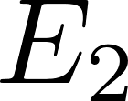
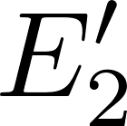
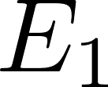
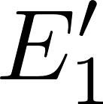
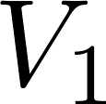
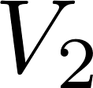
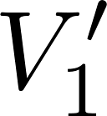
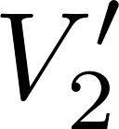
We consider two isolated statistical systems, each of them being individually in equilibrium. Their energies and volumes (representing any general external parameters) are $E_{1}, E_{2}, V_{1}, V_{2}$. We bring them into a thermal contact enabling to redistribute energy between them by performing heat. The new energies will be $E_{1}^{′}, E_{2}^{′}$, satisfying, of course energy conservation $E_{1}^{′}+E_{2}^{′}=E_{1}+E_{2}$. The volumes will be unchanged.
Thermal contact between the two systems is symbolized by the red line

Slide 16
Performing heat the systems exchange energy until new common equilibrium is reached. $So we have a new compund isolated system$ and we would like to calculate the final energies $E_{1}^{′}, E_{2}^{′}$. We do it by finding the maximal entropy of the compound system.
The original systems have their entropy functions $S_{1}\left(E,V\right), S_{2}(E,V)$. Those two system might be very different, one may be for example an ideal gas, the other a box containing free electromagnetic field. So the functions $S_{1}(.,.)$ and $S_{2}(.,.)$ might be different functional prescripts. Our notation suggests that the function prescript expects two variables inserted into the dotted slots. After the values are inserted, the “functional machine” produces the resulting entropy value out of them. It is good to imagine even in “pure mathematics” under the word “function” a computer programming notion “function”: as a program expecting that its formal parameters are substituted by some actual values, than the program starts and returns the resulting value.
We already know how the “entropy program” looks for ideal gas:
For the electromagnetic field it would be something completely different.

Slide 17
Entropy is additive, so the total entropy before the thermal contact is
After the final common equilibrium is established the total entropy will be
We may consider the final entropy as a function of one unknown variable $E_{1}^{′}$, since the other variable $E_{2}^{′}$ is fixed by the energy conservation $E_{2}^{′}=E_{1}+E_{2}−E_{1}^{′}$.
We are looking for the value $E_{1}^{′}$ for which the final entropy will be maximal
Note our (maybe over-prudent) notation. The right hand side means that we differentiate the first entropy function with respect to its first “formal parameter”, the energy, and then we insert for the energy the value $E_{1}^{′}$. Then we differentiate the second entropy function with respect to its first formal. parameter, the energy, and then we insert for the energy the value $E_{1}+E_{2}−E_{1}^{′}$. The minus sign in front of the derivative is due to the “differentiating of a composite function” rule.
In the maximum the total derivative must be zero, so we get

Slide 18
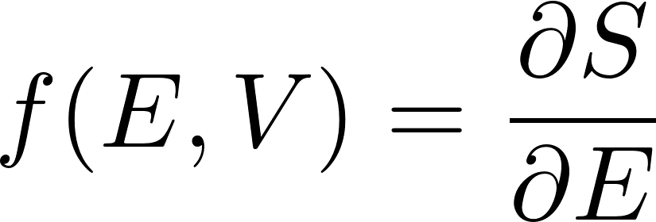
What is the physical meaning of this equation?
Entropy function $S(E,V)$ when differentiated with respect to E gives some other function $f(E,V)$ of the (macro)state variables $E,V$. So it is some state function of the macrostate, it is some physical quantity characterizing the macrostate. The equation says that this state variable has the same value in the two systems in thermal contact in equilibrium. So the two system in mutual equilibrium have the same value of the physical quantity $f(E,V)$.
Discussing the zeroth law of thermodynamics we found that temperature is the physical quantity which has the same value for all systems which are in mutual thermal equilibrium. So the quantity
must be either the temperature itself or some unique function of temperature. We can check what function of temperature it is, since we have explicit entropy function for ideal gas, so we can check the physical meaning of it for ideal gas.

Slide 19
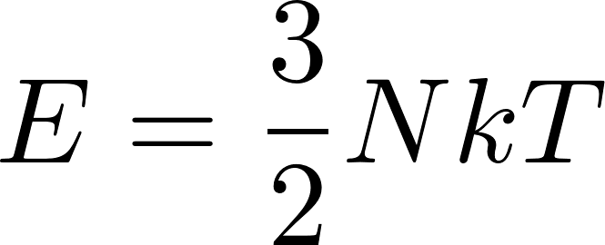
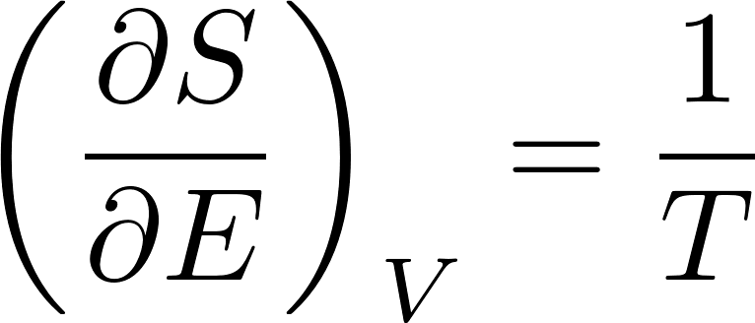
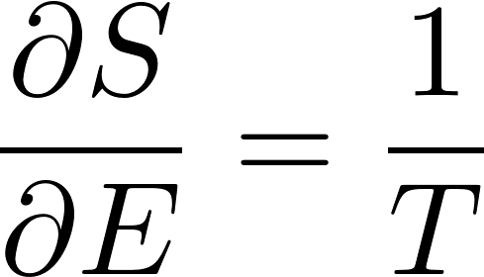
For ideal monoatomic gas we got
For monoatomic ideal gas its energy is given by the formula
and so finally we get
However, the formula
should be true for arbitrary two systems in mutual equilibrium, so the formula
must be true for any physical system.

Slide 20
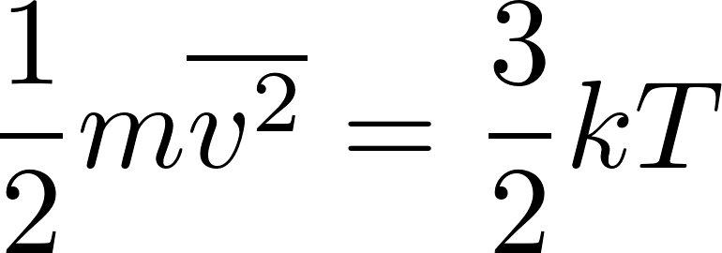
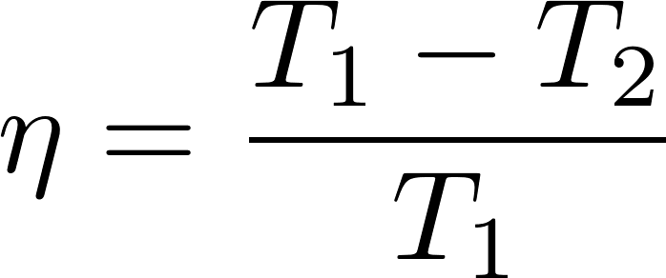
Repetition: Thermodynamic temperature
The second law of thermodynamics allows us to define temperature independently of the medium.
Up to now we had defined the temperature for gas like this:
Temperature of gas in equilibrium is given by the mean kinetic energy of the translational movement of molecules as
This definition of temperature is medium-specific, since it refers to the structure of gas as being composed of molecules. For systems not composed of molecules this definition is not applicable. Of course, we can define in principle the temperature of any system like the temperature of gas which is in equilibrium with the system considered.
We have already seen a medium-independent temperature definition:
The second law of thermodynamics allowed us to define temperature in a medium-independent way. We can use the system whose temperature we want to measure as the hot reservoir with unknown temperature $T_{1}$ and some a system consisting of water at the state of triple point as a cold reservoir with $T_{2}=273.16 K$ and let a Carnot machine work between these two reservoirs. If we were able to measure its efficiency $η$, the unknown temperature $T_{1}$ would be given as the temperature which satisfies the formula

Slide 21
Thermodynamic temperature
Now we have another formula which can serve as a bases for definition of temperature
In this formula the symbol $V$ represents ion general any external parameter. So if for a general system we know its entropy function, we can define what is the temperature of some macrostate: we calculate its entropy and then we have to know the entropy also for a close macrostate at a somewhat different energy. We calculate the difference of entropies, divide by the difference of energies and thus get $\frac{1}{T}.$
This definition is also often called “thermodynamic temperature” and is completely equivalent to the definition using efficiency of an ideal heat engine we have already discussed in these lectures.

Slide 22
We consider two isolated statistical systems, each of them being individually in equilibrium. Their energies and volumes (representing any general external parameters) are $E_{1}, E_{2}, V_{1}, V_{2}$. This time we bring them into a contact realized by a piston what enables to redistribute volume between them. The piston, of course, provides (by microscopic movements) also a heat contact. The new energies will be $E_{1}^{′}, E_{2}^{′}$, satisfying, of course energy conservation $E_{1}^{′}+E_{2}^{′}=E_{1}+E_{2}$. The new volumes will be $V_{1}^{′}, V_{2}^{′}$ with the total volume unchanged $V_{1}^{′}+V_{2}^{′}=V_{1}+V_{2}$.
After the final common equilibrium is established the total entropy will be
the final values of energies will be the same as in the case when we have considered just a thermal contact. The only unknown value in this relation is $V_{1}^{′}$, since $V_{2}^{′}$ is given by the total volume conservation $V_{2}^{′}=V_{1}+V_{2}−V_{1}^{′}$.

Slide 23
We get the final value $V_{1}^{′}$ by maximizing the entropy
Finally we get
What is the physical meaning of this equation?
Entropy function $S(E,V)$ when differentiated with respect to V gives some other function $\tilde{f}(E,V)$ of the (macro)state variables $E,V$. So it is some state function of the macrostate, it is some physical quantity characterizing the macrostate. The equation says that this state variable has the same value in the two subsystems for the final position of the piston. But we know when the piston stops moving: when the pressure on both its sides will be the same. So the physical quantity $\tilde{f}$ must be somehow related to pressure. However, since the piston provides also a heat contact, the temperatures will also be equal, so the function $\tilde{f}$ may be some combination of temperature and pressure.

Slide 24
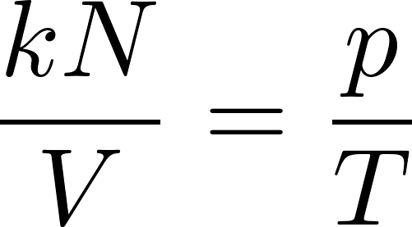
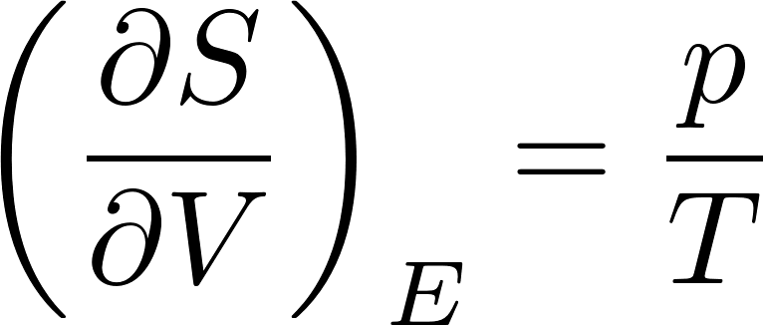
For ideal monoatomic gas we got
From the equation of state for ideal gas we have
So finally we get
This formula must be true for any system, which can have a “piston contact” with ideal gas system. By knowing for example the entropy function for electromagnetic field in a box, this formula gives us the pressure in the box provided by the electromagnetic field inside.

Slide 25
System and state variables
We shall include here notes from the methodology (or philosophy, if you want) of physics.
Physics does not have the ambition to study the entire world in one complex attempt. It rather tries to focus on some smaller part of the world, called a physical system, which is well identified and can be meaningfully studied how it behaves due to its internal functioning and due to its interactions with the rest of the world, which is not included into the system studied.
So the first task of any physical study is to define (identify) the physical system of interest. Just a very specific example: let the system of interest will be the hydrogen gas of $N$ molecules contained in a box of the volume $V.$
Now the key point of physics is that even if we identified sharply the system of interest which “keeps its identity constant” during the time we observe it, the system can be found in different states in different times.
This is philosophically not a simple assumption. How a system which we considered to be identical system in two instants of time can be “in different states”? What is then the meaning of “identical”? The problem was already recognized by the antique philosophy. There is the famous quote by Heraclitus: You could not step twice into the same river. I do not have satisfying solution to this problem. Anyhow, every physicist just intuitively uses the notion “same system in different states”.

Slide 26
System and state variables
Let us come back to the notion of “physical system”. How the system is characterized, identified? It is by defining the values of a set of “system variables”. This set of values should be unique, so that the system is well defined. Those values must be constant in time so that the system “keeps its identity”. (Let me note that the notion of “system variables” you would hardly find in physics textbooks. People usually are satisfied with intuitive interpretation of “system” and “state”. I do not want to pretend that I have something beyond the intuitive approach. This discussion just wanted to point that there is a problem.)
In addition to system variables there are the “state variables”. These variables define a specific “state of the system” considered. If the state is changed, we recognize it by the change of some of the state variables.
So an example: let the system of interest will be the hydrogen gas of $N$ molecules contained in a box of the volume $V$. Here “hydrogen”, “$N$” and “$V$” are the system variables, considered to be fixed. The state variables mat be the temperature $T$ and pressure $p$.
However, we have already studied the changes of gas state due to changing volume. This just shows that the division into sets of “system” and “state” variables is somewhat arbitrary. Some originally system variables can be reconsidered to be state variables and their change then considered as the change of state of the (more mutable) system.

Slide 27
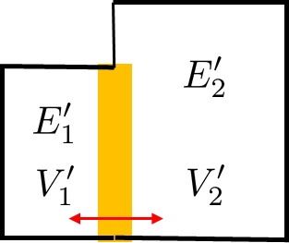
System and state variables
We have already met the situation, where the volume of the box with gas started to be considered as mutable. So instead of system definition “$N$ molecules of hydrogen gas in a box of the volume $V$”. we can redefine the system as “$N$molecules of hydrogen gas in a box”. The volume of the box is not considered to be fixed, so if the volume is changed we say “it is the same system”. Then the state variables might be temperature $T$, pressure $p$ and volume $V$. This is what we implicitly did when discussing common equilibrium of two systems in contact allowing to redistribute volumes between them

Slide 28
Variable number of particles
Let us now be even more flexible and consider the number of particles $N$ of gas not as a system variable but as a state variable. The system will be “hydrogen gas in a box” and the state variables will be temperature $T$, pressure $p$, volume $V$ and the number of particles $N$.
Experimentally such a system may be realized as a box with a small hole through which it is connected to some reservoir of particles. Another possibility is a chemical reaction. For example system (artificially) prepared as system of $N$ molecules of water $H_{2}O$. You will find that that is not an equilibrium macrostate. Water molecules can dissociate
so the number of water molecules in the equilibrium will be smaller then the initial number due to dissociation. Even more: the number of molecules of some type is not constant and (microscopically) fluctuates even in an equilibrium macrostate.

Slide 29
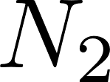
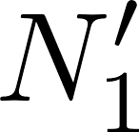
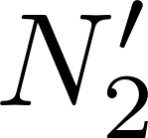
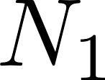
We consider two isolated statistical systems, each of them being individually in equilibrium. Their energies, volumes and particle numbers are $E_{1}, E_{2}, V_{1}, V_{2}$, $N_{1}$, $N_{2}$. We bring them into a contact enabling to redistribute particles between them through some hole. Of course redistributing particles also redistributes energy. The new energies will be $E_{1}^{′}, E_{2}^{′}$, the new particle numbers will be $N_{1}^{′}, N_{2}^{′}$.The volumes will be unchanged. We shall consider a case when the total number of particles will be fixed (no chemical reactions), so $N_{1}+N_{2}=N_{1}^{′}+N_{2}^{′}$.
After the final common equilibrium is established the total entropy will be
The final values of energies will be the same as in the case when we have considered just a thermal contact. The only unknown value in this relation is $N_{1}^{′}$, since $N_{2}^{′}$ is given by the total number of particles conservation $N_{2}^{′}=N_{1}+N_{2}−N_{1}^{′}$.

Slide 30
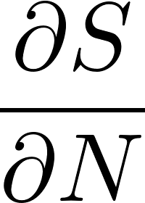
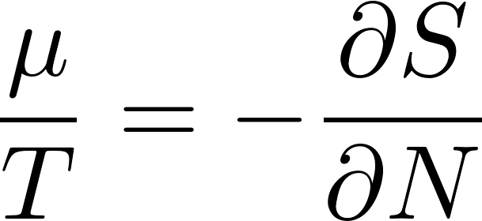
Chemical potential
We get the final value $N_{1}^{′}$ by maximizing the entropy
Finally we get
What is the physical meaning of this equation?
Entropy function $S(E,V,N)$ when differentiated with respect to $N$ gives some other function $\tilde{f}(E,V,N)$ of the (macro)state variables $E,V,N$. So it is some state function of the macrostate, it is some physical quantity characterizing the macrostate. The equation says that this state variable has the same value for the two systems in contact. The problem is that in cases of energy and volume redistributions we had an intuitive feeling what are the relevant physical quantities which emerge to be the same after reaching common equilibrium. Here we normally (unless we are constructors of chemical reactors) do not have everyday experience what is the particle-redistribution-controlling quantity.
At this moment we accept that it is the quantity which can be defined using the formula
and we define the name chemical potential $μ$ for the relevant quantity by the formula

Slide 31
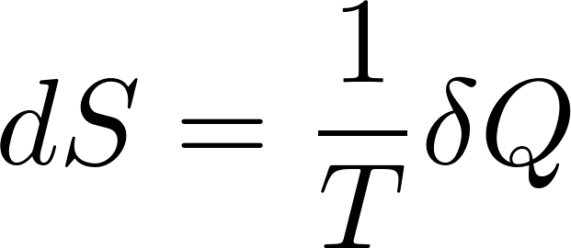
Equilibrium entropy changes
Equilibrium entropy of an isolated system is naturally a function of energy and external parameters. As an external parameter we shall generically consider volume.
We can easily express the total differential of equilibrium entropy $S\left(E,V\right).$ For fixed number of particles we get
We have just expressed the partial derivatives in equilibrium, so we get
Rearranging this equation a bit we get
we compare this to the first law of thermodynamics
and get
and also
both equations are valid for reversible processes only

