Slide 1
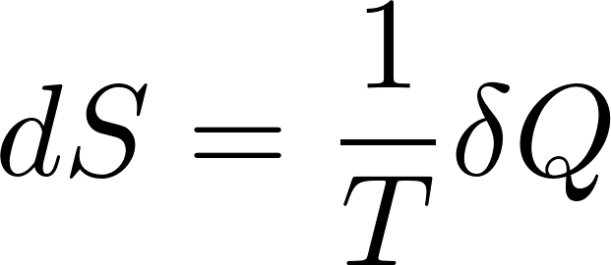
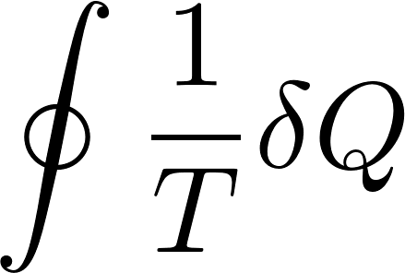
$1/T$ as an integrating factor
The relation
deserves more detailed discussion. The symbol $d$ in $dS$ means that $dS$ is a total differential. Physically it means that it is a difference of entropies of two close equilibrium states. (Entropy is a state variable). On the other hand the symbol $δ$ in $δQ$ means that here we do not have a differential. Heat is not a state variable! $δQ$ is the small amount of microscopic work performed in a (here reversible) process!
Temperature has a magic property: multiplying by $1/T$ a non-differential $δQ$ we get a differential $dS$!
The other way how to express the same thing is to say that $δQ$ is non-integrable, so that
but $dS$ is integrable
This is why $1/T$ is called “integrating factor”. The trivial consequence is that the integral around a closed curve is zero

Slide 2
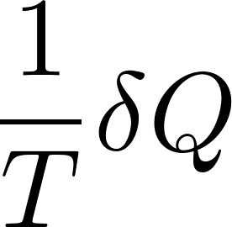
Still another definition of thermodynamic temperature
We can use the above formula to alternatively define temperature. Like this: temperature is the physical quantity which one has to put into the denominator like
to get full differential (for a reversible process) d{something} from $δQ$ which is not a full differential.

Slide 3
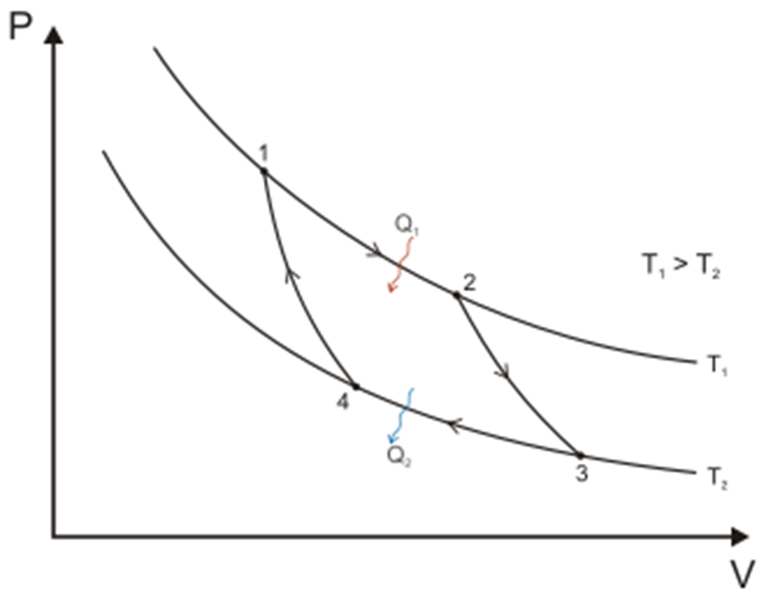
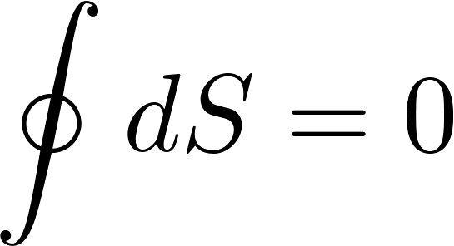
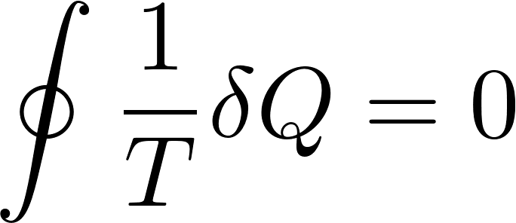
Carnot engine again using entropy
Carnot machine is a cyclic device, so after one cycle we get
W have omitted contribution from the adiabats 23 and 41, since heat is zero on adiabat. On isotherms the temperature is constants, so integrals are trivial
Do not forget that $Q_{2}<0$ .
So we have trivially derived the formula for the efficiency (without the need to calculate volumes and pressures).

Slide 4
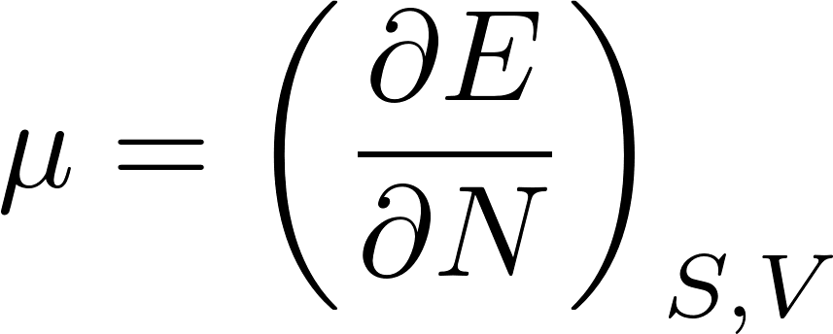
Equilibrium entropy changes
Equilibrium entropy of an isolated system is naturally a function of energy and external parameters. As an external parameter we shall generically consider volume.
We can easily express the total differential of equilibrium entropy $S\left(E,V,N\right).$ For variable number of particles we get
Substituting for the partial derivatives in equilibrium, we get
Rearranging this equation a bit we get
Looking at this equation we can formally define the chemical potential as the energy change required to increase the number of particles by $dN=1$ for fixed volume and fixed entropy on the system:
The problem is in magic words “fixed entropy”. Fixed entropy usually means just $δQ=0$, what means thermally isolated system. But if we want to add particles into the system, we have to push particles through some hole in the wall and this means that some microscopic work is to be performed and a part of it might be $δQ!$ So it is not easy to experimentally secure both constant entropy and variable number of particles. We shall come back to this question later.

Slide 5
We shall study in some details three situations:
isolated system: its macrostate will be represented by so called microcanonical ensemble
system in contact with thermal reservoir keeping its temperature constant: its macrostate will be represented by so called canonical ensemble
system in contact with thermal reservoir as well as with particle reservoir which keeps its temperature and chemical potential constant: its macrostate will be represented by so called grand canonical ensemble

Slide 6
Microcanonical ensemble
We start with a macrostate of an isolated system. An isolated system has its energy fixed, so we can consider its energy $E$ as a given macroscopic parameter. In addition to energy all external parameters shall be considered as given and fixed. The external parameters will be generically represented by a macroscopic variable $V$. For better imagination we can think about the volume (of a gas). The statistical ensemble representing an isolated system is called microcanonical ensemble.
Let us stress that the system considered must be large having very big number of degrees of freedom, typically ${10}^{23}$. Only then the number of relevant number of representing microstates will be of the order of ${{10}^{10}}^{23}$. Then the statistical predictions based on evaluating mean values calculated for the representing statistical ensemble will be sharp enough to be useful to represent the observed values of macroscopic physical quantities of the (single!) system we have at hand.
As we stressed several times the role of physics is to provide “good advice” to users. The advice provided by statistical physics is: assume the macroscopic values you meet in reality to be equal to mean values calculated for the representing statistical ensemble. What we just said is that such an advice would be useful if the system considered is large enough.

Slide 7
Microcanonical ensemble
As it is usual in physics we cannot rigorously prove how to construct the microcanonical ensemble representing some specific statistical system. The general rule (guessed as a hypothesis and found to lead to “good advice” in many practical situations) is here:
Take all microstates having the energy equal to the macroscopic energy $E$ of the system considered, each of them once (or each of them with equal probability).
This rule is sometimes considered to be one of the basic postulates of statistical physics. It is based on the assumption that once the isolated system reaches thermal equilibrium it randomly wanders through the subset of microstates having the same energy.
Well, this cannot be a rigorous truth. For absolutely isolated system its time evolution is controlled by its (internal) Hamiltonian through the Schrodinger equation. At some moment (for a fixed given energy) it must be in some superposition of stationary states corresponding to that energy. According to the Schrodinger equation it remains in the same superposition of states with just the overall phase changing. The weights of the stationary states need not have the same value, so the probability to find the system in a particular stationary state does not need to be the same for all the stationary states with the given energy.
In reality, however, no system can be strictly isolated from its environment. Any interaction, however weak, with the environment, can change the state to a state with energy differing just a little from the “given energy $E$”.

Slide 8
Microcanonical ensemble
So some weak interaction with the environment can in principle make the “isolated system in equilibrium” wander through all the microstates with energy equal or very close to the ”given energy” $E$.
However, the interaction with environment we usually do not have under control. The interaction Hamiltonian in special situations may not be able to guarantee that the system considered would visit all the microstates having the “given energy”.
A typical example is a magnetized ferromagnet. Its macrostate is realized by microstates where almost all the local magnetic moments are oriented in a fixed direction. However to each such microstate there exist a complementary microstate where the local magnetic moments are oriented in exactly the opposite direction. These complementary microstates have the same energy, but they are certainly not representing the same macrostate. Normally we do not observe that a piece of magnetized material becomes spontaneously magnetized in an opposite direction.
The reason is, that the interaction with environment is not able to simultaneously flip all the local magnetic moments. To do that the interaction Hamiltonian would have to be highly non-local. The interaction with environment is usually able to flip just a few local magnetic moments. So the complete flip of all the moments would have to be achieved by many local consecutive flips. This is highly improbable, because “on the way” the system would have to go through states with very high energies: something like half of the moments “up” and the other half “down”.

Slide 9
Microcanonical ensemble
If we form the microcanonical ensemble for a ferromagnet according to the rule “each microstate with the given energy”, there will be microstates with exactly opposite magnetization and the mean magnetization calculated for the ensemble would be zero. Contrary to the experimental experience: we know there are magnetized materials in equilibrium.
So using microcanonical ensembles might be tricky and in some situations good physical intuition is required. We shall not dwell on it more here, this was just a warning.
We may be, however, suspicious of general rule “each microstate with the given energy” because of other reasons as well.
For example we know that for a gas macrostate in equilibrium the distribution of molecules in the container is uniform. However, there are microstates with all the molecules having the same energy as they have in a typical microstate but by chance they occupy just one half of the container. Such microstate will enter the microcanonical ensemble, although they do not represent the studied macrostate properly. They are even macroscopically distinguishable from the “typical: microstate: they in fact represent other, highly non-equilibrium macrostate. We have however seen, that the number of such untypical microstate is negligibly small: we can safely calculate the mean values through the ensemble containing such non-typical microstates and get the correct typical values.
Our notes in the last few slides are conceptually beyond the level of these lectures. We just presented them as a warning that the world is often more complex then it is described in basic textbooks. It is here, where the intuition of physics gurus is vitally important.

Slide 10
Microcanonical ensemble
Well, let us forget about exceptional situations and show that the basic hypothesis of equal probabilities of all available microstates for isolated system can be used as an extremely valuable tool to obtain “good advice” when dealing with systems with huge amount of degrees of freedom.
We have already introduced the function $Ω(E)$ as the number of microstates having its energy within some small not exactly specified interval around the value E.
It is typical for statistical physics, that it operates with not precisely defined approximations.
However one has to be sure that the inaccuracies do cancel in resulting values.
Suppose for example we want to calculate the mean value of some physical quantity $A$, which in the microstate $i$ has the value $A_{i}$. The mean value is for the microcanonical ensemble given as
Here the summation is restricted over microstates whose energy $E_{i}=E$. However this condition is not to be taken rigorously. We rather mean the states having its energy within some small not exactly specified interval around the value E. The same inaccuracy of definition is hidden in the function $Ω(E)$. But if we consider $Ω(E)$ to be the number of terms in the sum, everything is consistent. But is it also useful? Well, experience show that yes. The point is, that for real situations we find that the result does not depend on how large the “interval around $E$” is, provided it is “reasonably small”.

Slide 11
Microcanonical ensemble - entropy
We have defined the entropy of an isolated macroscopic system as
Entropy for an isolated physical system is defined as k-times the logarithm of the number of microstates corresponding to the macrostate considered.
Here we use the imprecisely defined function $Ω(E)$ alone, so one would naively say that the inaccuracy cannot get canceled against some other inaccuracy in the formula.
The mystery is hidden in the use of logarithm. For huge numbers the logarithm is a very very slowly increasing function. Here is an example. Let us have two huge numbers ${\text{e}}^{{10}^{23}}$ and $1000 {\text{e}}^{{10}^{23}}$ These two numbers are obviously grossly unequal. But look:
So with a very good precision we get that the logarithms of these two grossly unequal numbers are practically equal!
So the logarithm in the definition of entropy is blind to the inaccuracy in the definition of $Ω(E)$.

Slide 12
Approximations in statistical physics
In mechanics we have worked with exact equations, like $s=vt$. This is an equation in space of real numbers and is perceived as exact. We normally are not aware of the fact that this equation is not about the real world, it is an equation in some mathematical model. The mathematical model in mechanics is rigorous and exact. What is not exact is the mapping of the mathematical model to some real-world situation.
The equation $s=vt$ is by no means about a real-world train: the position of the train cannot be given with arbitrary precision, the train never moves exactly uniformly etc. So even the mathematical-mode equations are exact, the results interpreted in terms of the real world are just approximate.
In statistical physics where we deal with systems of many degrees of freedom even the mathematical equations are often just approximate. The definition of entropy $S=k \text{ln}Ω(E)$ is not strictly exact since its right hand side is not rigorously defined. We do not mind, because the logarithm is blind enough to this inaccuracy. But if we naively do exponentiation like
we have to be very careful about the interpretation (validity) of the resulting equation. When we know experimentally the entropy to a good precision it does not mean that we do know precisely “the number of relevant microstates”. The equations of statistical physics are usually valid only in logarithmic approximation.

Slide 13
Microcanonical ensemble - calculations
So let us do some calculations with microcanonical ensemble.
N number of microstates in the ensemble can clearly be expressed as
This formula is not used for practical calculations, it is useful for theoretical manipulations.
Mean energy through the ensemble is
We got a consistent result.
Now to less trivial quantity. Let us consider an ideal gas of monoatomic spinless particles and calculate the (mean) pressure. Just formally
where $p_{i}$ is the pressure of gas in a specific microstate $i$. So first we have to learn, how to calculate $p_{i}$.

Slide 14
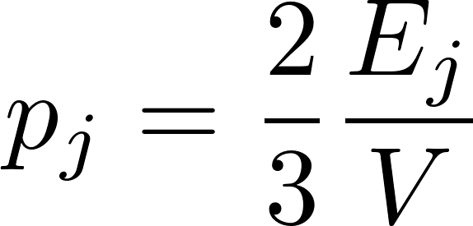
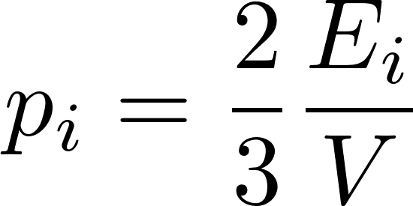
Gas in a microstate, calculating its pressure
This is an exercise of elementary quantum mechanics.
We start with calculating the pressure of a gas in a box consisting of just a single molecule in the state $j=(n_{1},n_{2},n_{3})$. To calculate the pressure we use the trick from elementary mechanics: to calculate force it is often easier to calculate the work the force performs during an infinitesimal change of state using the energy conservation principle.
The energy in the considered state is
Now consider our piston-pusher dwarf changing reversibly the volume a bit. He has to perform an infinitesimal work $δA=−p_{j}dV, where$ $p_{j}$ is the pressure in the one-particle microstate j. The energy of the gas is changed by
The relation $dE_{j}=−p_{i}dV$ gives
For gas containing many molecules the energy of a (total) specific microstate $i$ is given by the sum over all one-particle states. Repeating the above procedure it is obvious that the pressure in the total microstate $i$ will be again given by the formula

Slide 15
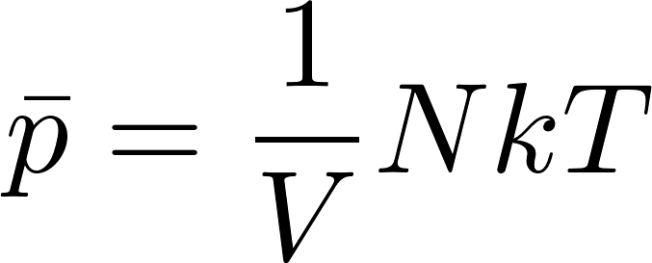
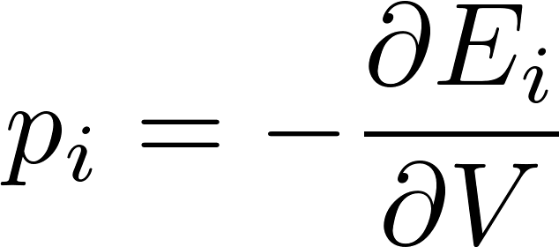
Microcanonical ensemble - calculations
For gas in the microstate $i$ we got
so the mean pressure will be
Even if we have not yet calculated the temperature for microcanonical gas we know that for monoatomic gas we expect $E=\frac{3}{2}NkT$ so for the pressure we get the equation of state
We have done the calculation for ideal gas. In general, for arbitrary external parameter $V$ we shall find that changing its value requires to do work. (Remember, an external parameter is a parameter which is contained in the formula for energies of the stationary states!). So for infinitesimal changes we get something like $dE_{i}=−p_{i}dV$ where $p_{i}$ is conjugated force parameter to the external parameter $V$ so in general we get
and so

