Slide 1
Canonical ensemble – partition function
We have defined the statistical sum as a “normalization constant”
This evokes impression that $Z$ is a constant. It is to some extent true. However, a canonical system has a given temperature $T$ and volume (external parameter) $V$. If we evaluate $Z$ for arbitrary values T$,V$, we get a function $Z\left(T,V\right)$. $Z$ as a function is called partition function. We shall show that this function carries a lot of useful information about the canonical system considered. Let us start with calculating the mean energy:
So the information on the mean energy “is coded” in the partition function. The above formula is the instruction how to decode it. In the same way one can easily prove that even higher moments are coded in the partition function. For variance one gets

Slide 2
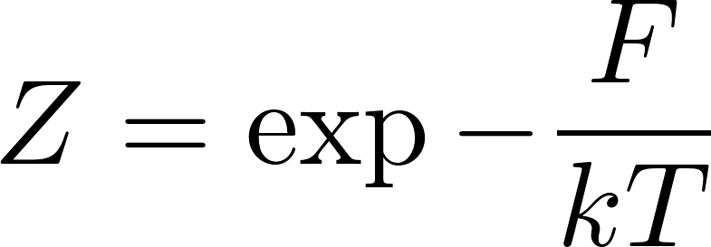
Canonical ensemble – free energy
Similarly for the mean pressure we get
We see that the logarithm of the partition function carries a lot of useful information. Therefore it was given a special name: free energy. More precisely
free energy $F$ is defined by the expression
Similarly all higher moments of probability distribution of $p$ can be obtained by derivatives of $Z$ and its logarithm. If we expand $\text{ln} Z$ as a Taylor series in $V$, the coefficients of the expansion will be so called cumulants (find in Wikipedia, how cumulants are related to moments) of $p$. Therefore $\text{ln} Z$ is called generating function of the cumulants of $p$. Remember the term generating function, you will meet it often in theoretical physics.

Slide 3
Canonical ensemble – free energy
Free energy is closely related to the entropy. We have expressed entropy of the canonical system as
Substituting for $\text{ln} Z$ from the definition of free energy
we get
Actually the free energy was defined already in phenomenological thermodynamics as
Since for macroscopic systems (entropy is defined only for macroscopic systems!) there is no practical experimental difference between $\overline{E}$ and $E$, the statistical and thermodynamical expressions are equivalent.

Slide 4
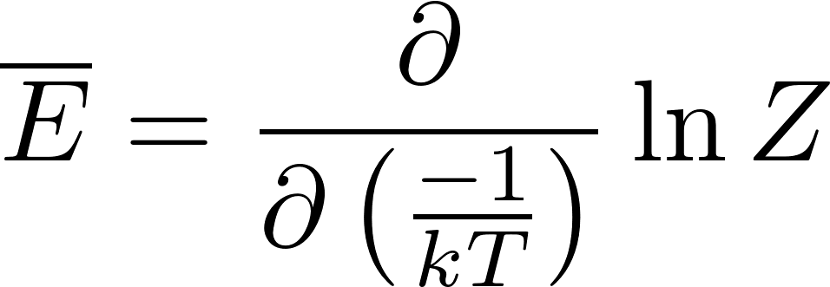
Canonical ensemble – quantum harmonic oscillator
Stationary states of a quantum harmonic oscillator can be labeled by integers $n$ and the energies are
Now we consider one quantum harmonic oscillator in thermostat at temperature $T$. The calculation of the statistical sum is easy
The mean energy is
After a bit tedious calculations we get
In the classical limit $ℏ→0$ we get $\overline{E}≈kT$, the same value as we got using Boltzmann distribution for a classical harmonic oscillator.

Slide 5
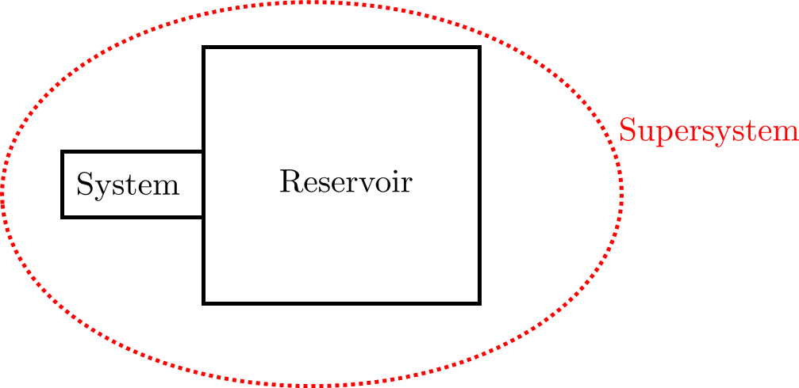
Grand canonical ensemble
We shall now consider a system with variable number of particles $N.$ The system will be in thermal and diffusion contact with a very large system called reservoir. The thermal contact means energy exchange and the diffusion contact particle exchange between the system and the reservoir. Since the reservoir is considered to be much larger than the system, we can assume the temperature and the chemical potential of the reservoir to be constant and given. The system and the reservoir together form “supersystem”. The supersystem can be considered as isolated, the total energy of the supersystem $E_{super}$is considered to be fixed as well as the total number of particles $N_{super}$of the supersystem to be fixed, so we can represent the supersystem by a microcanonical ensemble.
The energy of the system will be denoted as $E$, of the reservoir as $E_{res}$ and of the supersystem as $E_{super}$, the number of particles of the system will be denoted by $N$, of the reservoir by $N_{res}$ and of the supersystem $N_{super}$.
Our discussion will be a close parallel to our derivation of the canonical distribution.
The microstate of the supersystem is composed by the state of the system $i$ and by the state of the reservoir $I$. So the supersystem state is a pair $(i,I)$.

Slide 6
Grand canonical ensemble
We are interested in a quantity, which is defined for the system alone. That is its value depends only on the system state $i$ and not on the reservoir state $I$. Still, we can calculate its mean value using a the microcanonical ensemble for the whole supersystem:
We can group the terms to groups having the same value of $i$ and express the mean $A$ value as
Here $Ω_{res}\left(E_{super}−E_{i}, N_{super}−N_i\right)$ is the number of states of the reservoir such that combined with the system state $i$ they have the right total energy $E_{super}$ and the right total number of particles $N_{super}$. So it is the number of terms in the original sum containing the system state $i$. So the rewritten sum is correct.
Now we rewrite $Ω_{res}$ through the entropy $S_{res}$ and get

Slide 7
Grand canonical ensemble
Since the reservoir is much larger than the system $E_{i}≪E_{super}$ and $N_{i}≪N_{super}$ we expand the function in the exponent to the first order in Taylor series:
Using the formulas $\frac{∂S}{∂E}=\frac{1}{T}$ , $\frac{∂S}{∂N}=−\frac{μ}{T}$ we get
The factor in front of the sum “does not feel” the system at all neither it feels what quantity $A$ we are interested in, it is just a constant. It is in fact a normalization constant.

Slide 8
Grand canonical ensemble
So what have we got? In the formula $T$ is the temperature of the reservoir and $μ$ is the chemical potential of the reservoir. Because of the equilibrium through the thermal and diffusion contact these are also the temperature and the chemical potential of the system. So we can calculate any mean value concerning the system by forgetting about the reservoir: there is no more any mentioning of the reservoir in the above formula.
The formula looks like a standard formula for calculating the mean values if we interpret the factor
as a probability of the system microstate $i$. So the rule:
The ensemble representing a macrostate of a system with a given temperature and chemical potential (kept constant by a suitable external reservoir) can be constructed taking all the possible microstates (with arbitrary energy $E_{i}$ and arbitrary number of particles $N_{i}$), each with the probability
such an ensemble is called grand canonical ensemble.

Slide 9
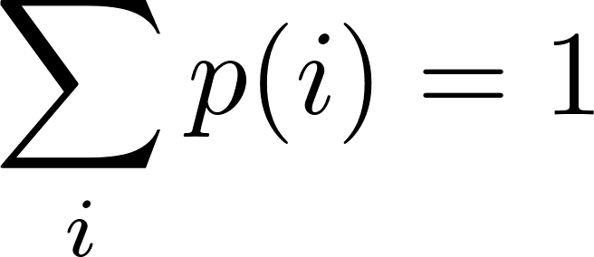
Grand canonical ensemble – grand partition function
The normalization constant can be calculated from the condition
From there we get
is sometimes called the grand statistical sum. As a function of $T, V, μ$ it is called grand partition function and it is the first thing one has to calculate when one wants to use the grand canonical ensemble.
A short summary of the grand canonical ensemble usage:
grand canonical ensemble is to be used when the given quantities for the system are temperature $T$ volume (or external parameter) $V$m and chemical potential $μ$
the first step is to calculate the grand partition function
then the mean value of any quantity $A$ is calculated as

Slide 10
Grand canonical ensemble – practical usage
We have said that we use the grand canonical ensemble when we have a macrostate with given $T, V, μ$. This is somewhat a symbolic statement. We usually do not have direct knowledge about the value of the chemical potential for a given system. (Try to buy a $μ$-meter in a laboratory-equipment shop!).
Normally we know the number of particles $N$together with $T,V$. So we should use the canonical ensemble. However for technical reasons we might prefer the grand canonical ensemble. The reason is the following: compare the two expressions
Technically it is usually easier to calculate the grand canonical sum over all the states without any restriction than the canonical sum with the states restricted by the condition $N_{i}=N$. The way how we use the grand canonical ensemble even for systems with given $N$ and not $μ$is the following. We just pretend that $μ$ is given (without knowing its numerical value) and do the calculations with the parameter $μ$ as a symbolic number. Then calculate the mean number of particles as a function of (pretended given but unknown) $μ$
and find the “good” value of $μ$ by inverting the equation . This value of $μ$ we then insert to all other results obtained by the grand-canonical calculation and we get the correct answer. The reason is that for macroscopic system $\overline{N}$ is undistinguishable from fixed $N$.

Slide 11
How to measure chemical potential
We can in principle experimentally determine the chemical potential for some type of particles for a system for which we are able to do the grand-canonical calculation. From the equation
we can in principle get the value of $μ$ if we can measure (for example by suitable electrochemical method like by the lambda sensor) the concentration of the relevant particles to obtain $N.$
One may argue that “this is not a direct measurement of $μ!“$ since we need the theoretical formula connecting $μ$ and $N$. Well, actually most of the measurements (and measuring devices) do not “measure directly” the required physical quantity. Directly measurable are for example length and angle. Even the old-fashioned ammeter does not measure the electric current directly: it measures the angle of the pointing needle and we have some theory to connect the measured angle and the current going through the ammeter. In a standard thermometer we do not directly measure temperature but rather the length of the mercury column in a glass tube. And we have some phenomenological formula connecting the temperature and the length of the mercury column.

Slide 12
Grand partition function
Similarly to the partition function of the canonical distribution useful information on moments of physical quantities is coded in the grand partition function. For example the mean number of particles can be calculated as follows
The grand partition function can be expressed thorough the canonical partition function:
Using again the argument on domination of mean values for the logarithm of the sum:

Slide 13
Grand canonical potential
Similarly to the definition of free energy through the logarithm of canonical partition function we define the grand canonical potential $Ω$ as
There is an inconsistency in the notation (overall in the statistical physics books): symbol $Ω$ was already used to denote the number of microstates in the microcanonical ensemble. The reader has to resolve from the context the two omegas from each other.

Slide 14
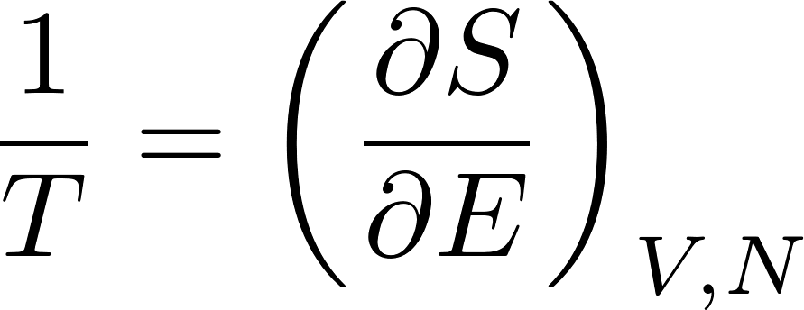
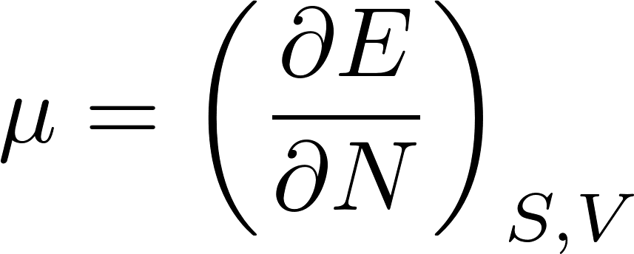
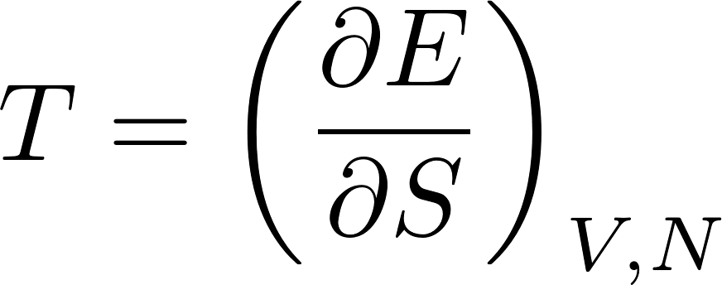
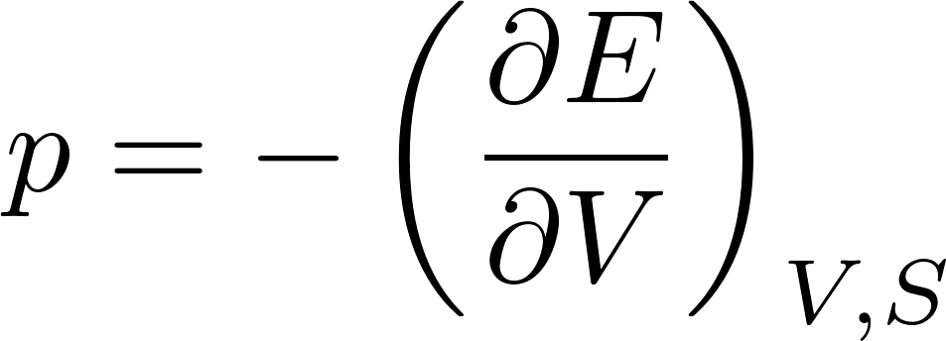
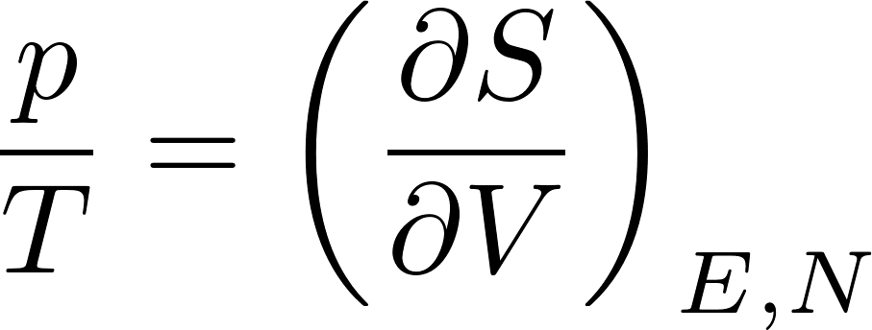
Thermodynamic potentials
In the preceding lectures we have met several functions of the state like energy $E$, entropy $S$, free energy $F$ and canonical potential $Ω$ with the property that their partial derivatives with respect to their natural variables gave us the possibility to calculate various macroscopic physical quantities. For example we have met the following relations:
Now we shall discuss various thermodynamic potentials more systematically. We start with the first law of thermodynamics written for reversible processes.
These relations suggest, that the “native” variables for energy are $S,V,N$ and for entropy $E,V,N$. In this context energy and entropy are called thermodynamic potentials.
If the thermodynamic potentials are expressed through their “native” variables, we get the following relations

Slide 15
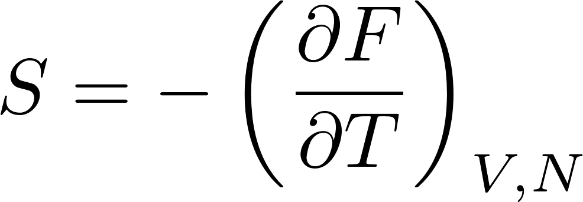
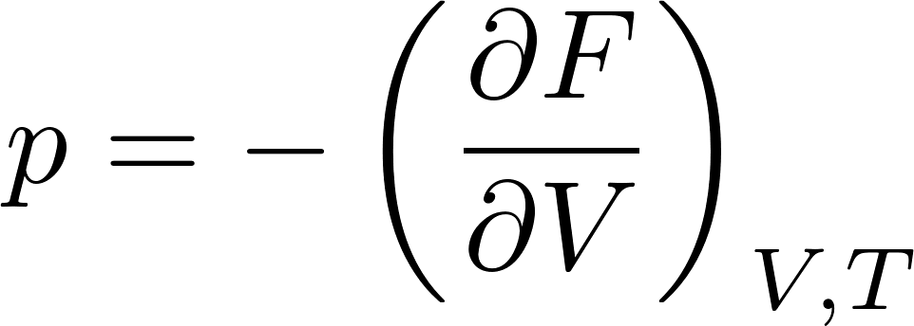
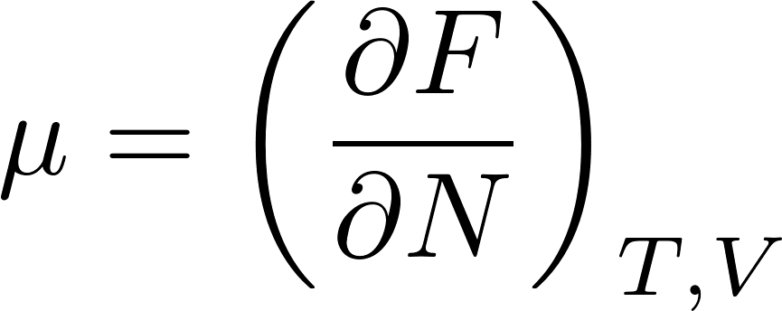
Thermodynamic potentials
Energy as and thermodynamic potential has intuitively clear meaning, but its “native” variables are not nice: the entropy is experimentally inaccessible. One would prefer to replace entropy to something experimentally comfortable like temperature.
There is a general mathematical tool to manage such replacement: the Legendre transform (remember how one does that in theoretical mechanics: Lagrangian as a function of $q,\dot{q}$, is replaced by Hamiltonian as a function of $q,p$). The Legendre transform to swap $S$ for $T:$
We have already seen such function, it is called free energy. Do not be confused: it looks there are 4 variables on the right but only 3 on the left! $S$ on the right is not a variable, it should be written as a function of $T,V,N$by inverting the relation
One has to solve this for $S$ as a function of $T,V,N$ and insert it to the Legendre transform. Let us calculate the differential of $F:$
The native variables of $F$ are $T,V,N$ and we get relations

Slide 16
Free energy
For isothermal processes with fixed $N$ get
So for isothermal process infinitesimal pieces of work can be easily integrate to get
Free energy can be understood as the isothermal potential of work. It says how much mechanical work can be extracted from a device in an isothermal process. This is perhaps the motivation for its name “free energy”.

Slide 17
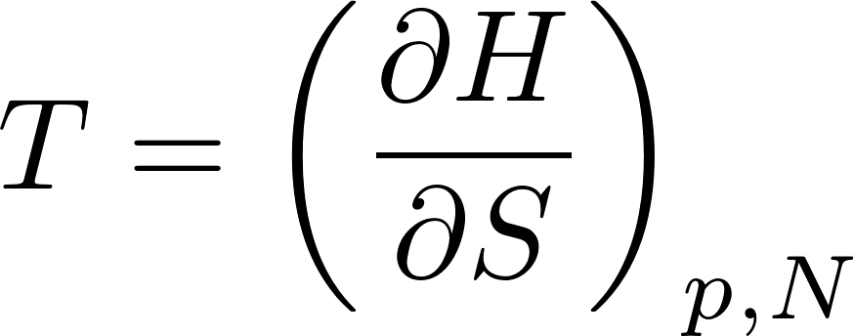
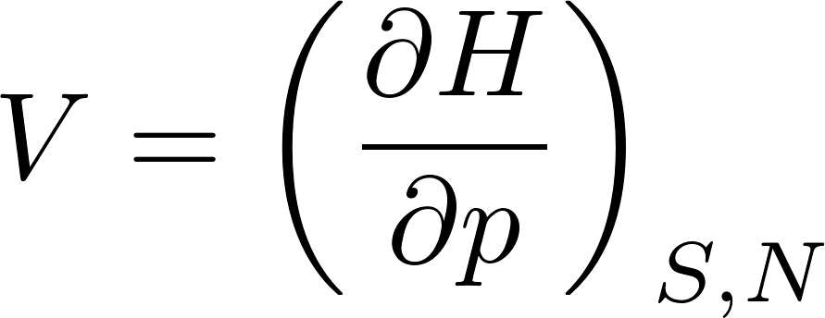
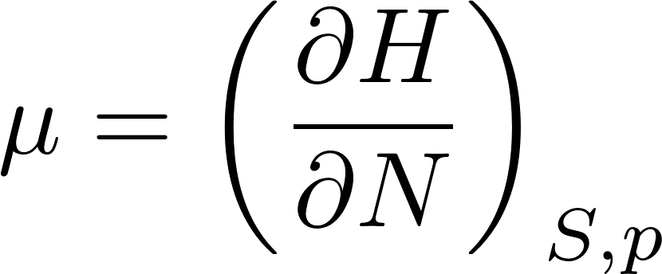
Further thermodynamic potentials
Free energy is a useful thermodynamic potential if we need the native parameters to be $T,V,N$. For other purposes we might need other native parameters. For example if we require S$,p,N$, we can do the following Legendre transformation
$H$ is called enthalpy (actually $H$ is the capital Greek letter eta, not our Latin H) and we get
For isobaric processes with fixed $N$ we get
So for isobaric processes infinitesimal pieces of performed heat can easily be integrated to get

Slide 18
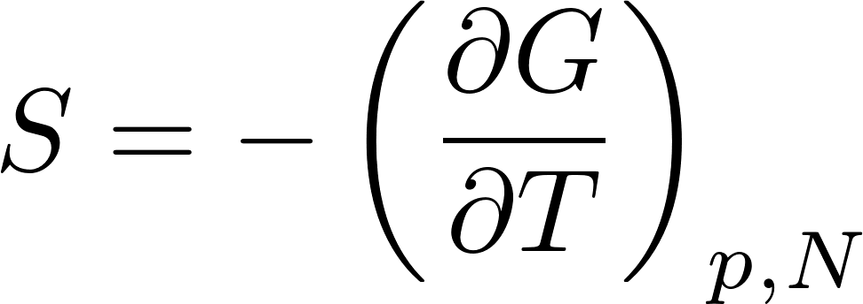
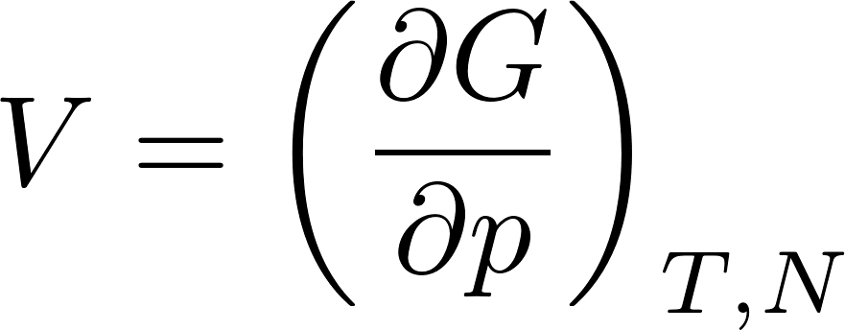
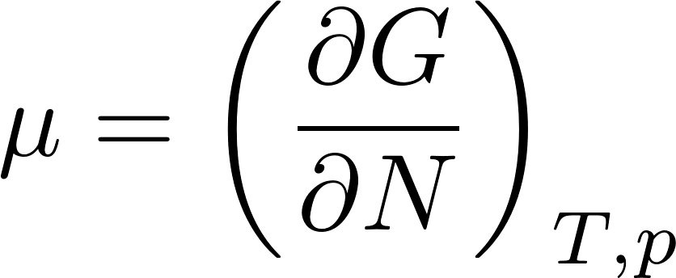
Further thermodynamic potentials
The thermodynamic potential with native parameters $T,P,N$ is the Gibbs potential (sometimes called free enthalpy)
$G$ as any thermodynamic potential is an extensive variable. But its only extensive parameter is $N$, its two other native parameters $p,T$ are intensive, so $G$ must be proportional to $N$. So it must look like $G=N f(p,T)$, where $f$ is some suitable function of $p,T$. However from the relation
we get $f=μ$, so we see, that $G$ can be expressed as

Slide 19
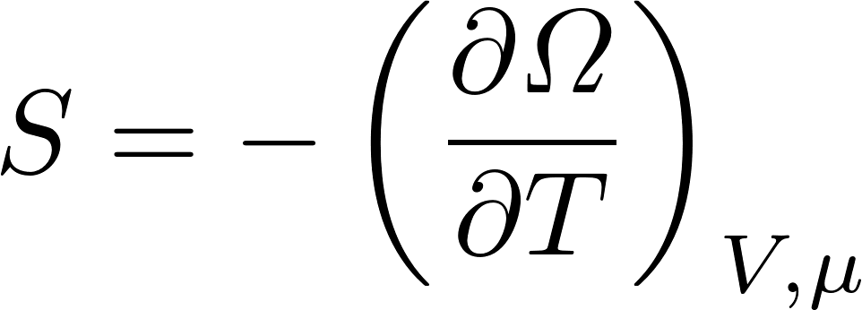
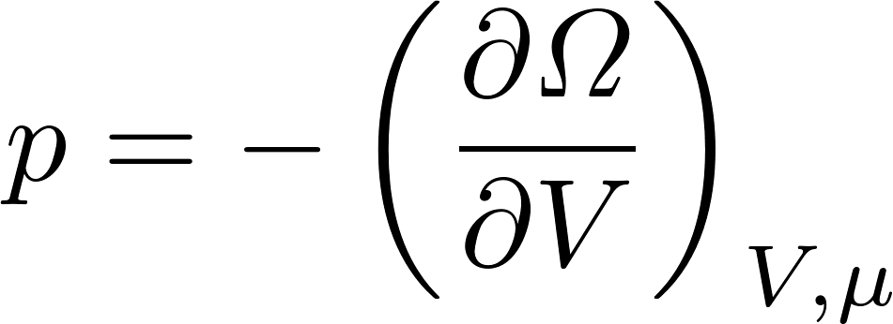
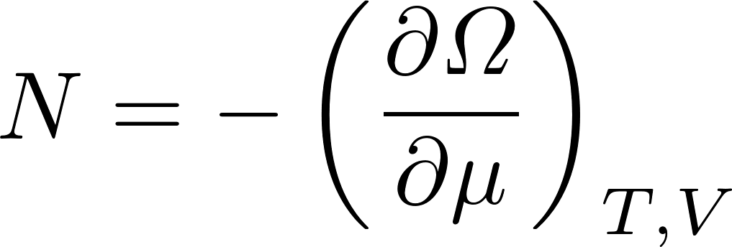
Further thermodynamic potentials
The thermodynamic potential with native variables $T,V,μ$ is the grand canonical potential
Comparing the Legendre transformation defining $Ω$ with the expression we got for the logarithm of the grand canonical partition function
we see that the grand canonical potential is related to the grand canonical partition function similarly as the free energy is related to the canonical partition:
There are other ways how to express $Ω:$
Now we understand why we have got for the ideal gas in the classical approximation
It is due to the ideal gas equation of state $pV=NkT$.

