Slide 1
Ideal gas – classical limit – grand partition function
We shall demonstrate now the calculation of the grand partition function for an ideal gas in the classical limit. The gas microstate is given by the list of the occupational numbers, which we shall denote as
The grand partition function is the sum over all gas microstates (over all possible lists}:
Be careful and understand well what the symbols mean! The overall sum is over all possible infinite lists of occupational numbers. The sums in the exponent are over the occupational numbers in one specific list. Now exponent of a sum is a product of exponents:
Now the most difficult (for understanding) rearrangement according to the distributive law. Symbolically but imprecisely: “sum of products is the product of sums”.
Observe the difference: in the original expression the sum is over lists of numbers, in the transformed expression the sum is over all possible number values for the specific state $j$. So for fermions it is the sum of just two numbers 0, 1. You can understand that this is correct by inspecting small specific examples for the distributive law. Try hard, finally you will get it!

Slide 2
Ideal gas – classical limit – grand partition function
So far our calculations were exact. Now we will do approximations of the classical limit.
Firstly, in the classical limit there is no difference between bosons and fermions because the mean occupational numbers are very low. So we continue the calculations with fermions, where the sums are only over $n_{j}=0,1$.
The classical limit also means so we approximate the logarithms
We got just the sum over mean occupational numbers, what gives the total number of particles. So in the classical limit
We have calculated the grand partition function! We were able to do it because of the classical limit but also because in the grand statistical sum there is no restriction for the one-particle states we sum over. For the canonical sum the restriction $N_{j}=N$ would make a similar calculation more difficult. (Later we shall see that in classical (non-quantum) statistics the calculation of the canonical sum for ideal gas is easy!)

Slide 3
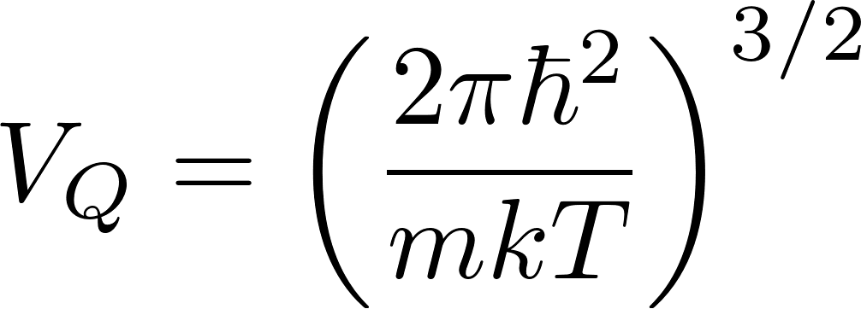
Ideal gas – classical limit – entropy
Summarizing the results we have obtained
we continue by calculating the entropy of an ideal gas in the classical limit. We start with the relation
After substitution for $μ$ and we get
This formula is called Sackur-Tetrode equation for the entropy of monoatomic classical ideal gas. It demonstrates that the statistical physics is able to calculate the entropy absolutely: there is no arbitrary additive constants, while the phenomenological thermodynamics is able to determine entropy only up to an additive constant.

Slide 4
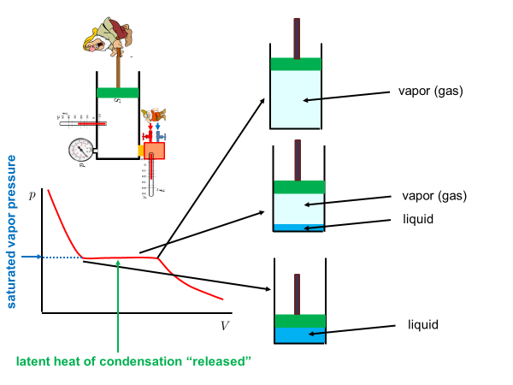
Real gases, condensation
Real gases do not satisfy the ideal gas equation of state $pV=NkT$. Real isotherms are not simple hyperbolas. For sufficiently small temperatures the real isotherm has a flat horizontal segment corresponding to condensation. The piston pusher dwarf will observe
a strange phenomenon: he will be able to decrease the volume of the container without at a constant pressure. The reason is that a new phase will appear at the bottom of the container: a liquid phase. When pushing the piston more an more molecules from the gas phase above the liquid enter the liquid phase thus decreasing the number of molecules in the gas phase. The gas phase having smaller number of molecules keeps constant pressure in the decreasing gas volume in the container.

Slide 5
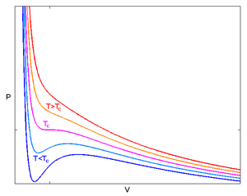
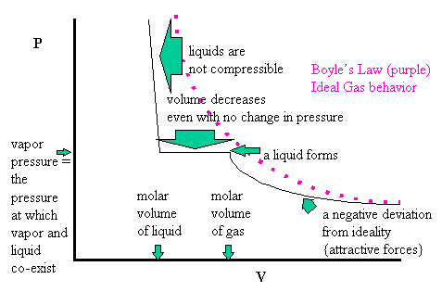
van der Waals equation
here were several attempts to “invent formulas” for the real gas equation of states. The most popular in the textbooks is the van der Waals equation
where $a,b$ are empirical constants characterizing the specific gas. The equation is of the third order in $V$ and for the temperatures below certain critical temperature $T_{c}$ does not have a flat horizontal segment ibn the region where condensation is expected. Instead an upward rise and a downward dip is “predicted” by the formula. This region in the isotherm is usually interpreted as corresponding to a metastable equilibrium of
overheated liquid or overcooled vapor which can be observed for very clean samples of the substance. Usually, however a flat horizontal segment of isotherm is observed.

Slide 6
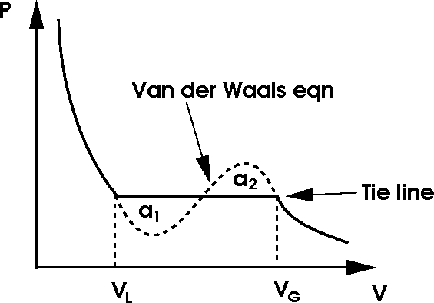
Van der Waals equation: Maxwell construction
It is possible to predict the position of the horizontal flat segment on the isotherm using the Van der Waals curve with the rise and dip. Maxwell construction says: substitute the rise-dip area with a horizontal line in such a way, that the areas above and below the horizontal line are equal.
The pressure as given by the position of the flat horizontal line is called saturated vapor pressure. If we artificially prepare an non-equilibrium state such that the pressure of vapor is less than the saturated pressure, then during the relaxation molecules from the liquid phase will escape into the vapor phase more often then from the vapor phase into the liquid phase. This causes increasing the vapor pressure until it reaches the saturated vapor pressure, that is equilibrium. The equilibrium is dynamical: macroscopically we do not observe and changes, but on the molecular level the molecules continue to migrate between the liquid and the vapor phase in equal amounts.

Slide 7
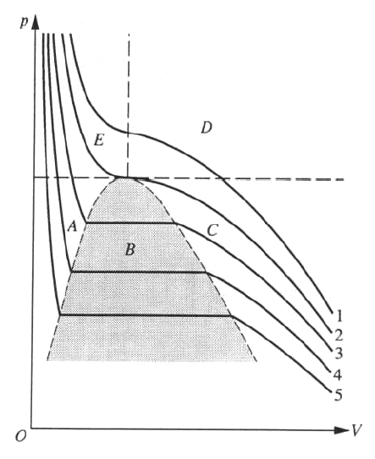
Van der Waals equation: critical isotherm
If we draw several isotherms as given by the van der Waals equation (with Maxwell modification) we observe that the higher the temperature the shorter is the flat horizontal segment and for certain temperature the flat segment is degenerated to a point. It is the isotherm marked as “2” it the figure below. This isotherm is called the critical isotherm and corresponds to the critical temperature $T_{c}$. For the critical isotherm there is no need to do the Maxwell construction, since the rise-dip area degenerates to just a point: it is an inflex point on the isotherm. The point corresponds to the critical volume $V_{c}$ and critical pressure $p_{c}.$ For still higher temperatures is no rise-dip area, therefore no coexistence of
liquid-vapor phases. For temperatures higher than critical it is not possible to liquify the gas just by decreasing volume and increasing pressure: one must first lower the temperature below critical value.
The position of the critical point $T_{c},V_{c},p_{c}$ can be calculated from the van der Waals equation. One can for example look for temperature $T_{c}$ for which the isotherm has an inflex point. Technically easier way is to rewrite the van der Waals equation to a third order equation for the variable $V$ with $p,T$ as parameters and find the values of these parameters for which this third order equation has a triple (real) root $V_{c}$ .
critical isotherm

Slide 8
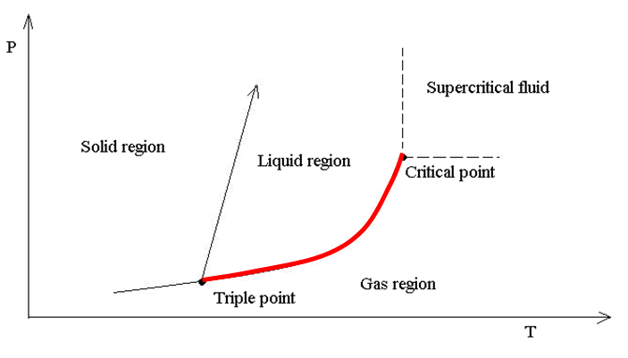
Phase diagram
It is clear that the saturated vapor pressure is uniquely determined by the temperature. The equilibrium between the liquid and gas phase is determined by just one macroscopic parameter, temperature or pressure. Therefore one can visualize the liquid-gas coexistence equilibrium states by a curve in a $pT$ diagram, called phase diagram . The liquid-gas coexistence curve is visualized in the figure below by the red curve. The curve is at high temperatures
ended by the critical point. There is no liquid-gas coexistence above the critical temperature. At the critical point itself there is already no difference in physical properties between the liquid and the gas phase. The point is that there are no absolute differences between the liquid and the gas phase, only relative. So if I have liquid and gas next to each other, I can tell for
example that the liquid phase is the one with higher mass density. When common people say that gas has low mass density it has just comparative meaning “lower than liquid”. That is why I can reversibly go from the gas phase to the liquid phase without seeing any discontinuity: it is enough to go around the critical point (the green path in the figure).
Similarly to the liquid-gas coexistence curve, there are liquid-solid and gas-solid coexistence curves. The three curves meet at the triple point with $p,V,T$ uniquely determined

Slide 9
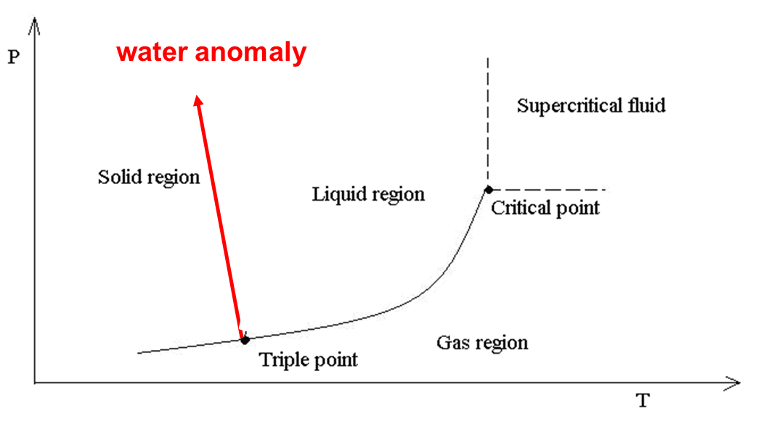
Phase diagram for water
On the above figure showing water phase diagram we can see the water anomaly: the solid – liquid (ice – water) coexistence curve has a negative slope. This means that the ice melting temperature decreases with increasing pressure. The reason is that the ice mass density is lower than the liquid water density at the same temperature (ice is floating on water). We shall see it in the next slide with Clausius Clapeyron equation.

Slide 10
Clausius - Clapeyron equation
Imagin a Carnot cycle working between two gas liquid coexistence temperatures $T, T−dT,$ that is at saturated vapor pressures $p, p−dp$. The cycle is represented by the green cyclic path in the figure. The mechanical work produced is equal to the area inside the cycle $A=dp(V_{G}−V_{L})$. The heat obtained at the higher temperature $T$ is equal to the latent heat $l$. From the efficiency formula for the Carnot cycle we get
This is the Clausius Clapeyron equation giving the slope of the coexistence curve in the phase diagram. Similar equation holds for the liquid solid curve. For water where the solid volume is larger than the liquid volume we get negative slope: the water anomaly.

