Slide 1
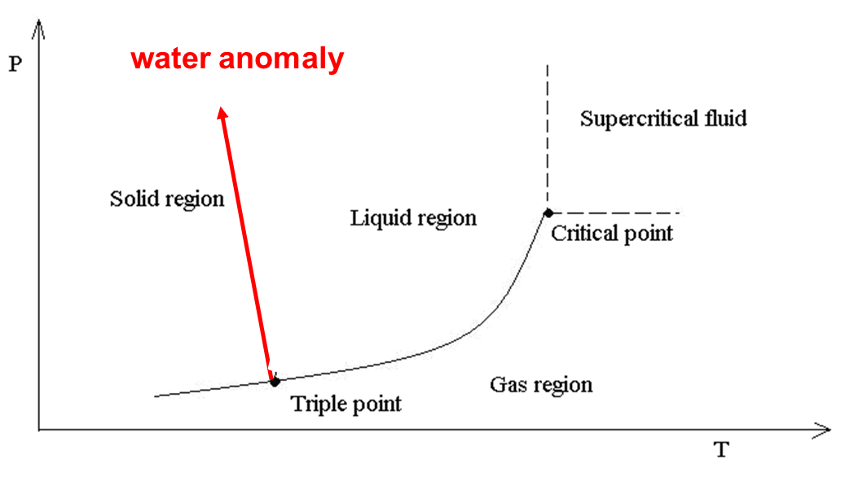
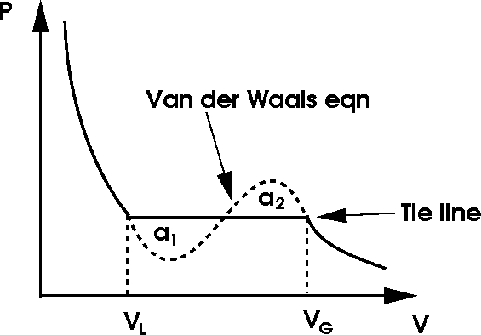
Clausius - Clapeyron equation
Imagin a Carnot cycle working between two gas liquid coexistence temperatures $T, T−dT,$ that is at saturated vapor pressures $p, p−dp$. The cycle is represented by the green cyclic path in the figure. The mechanical work produced is equal to the area inside the cycle $A=dp(V_{G}−V_{L})$. The heat obtained at the higher temperature $T$ is equal to the latent heat $l$. From the efficiency formula for the Carnot cycle we get
This is the Clausius Clapeyron equation giving the slope of the coexistence curve in the phase diagram. Similar equation holds for the liquid solid curve. For water where the solid volume is larger than the liquid volume we get negative slope: the water anomaly.

Slide 2
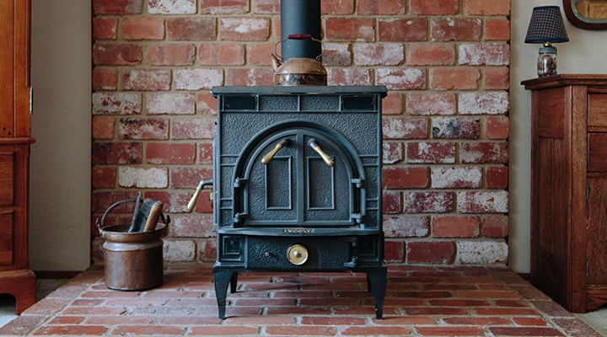
Electromagnetic radiation in a hot cavity
Heating stove: even if the fuel is burned out, no fire there, if you open the door you see red light. There is electromagnetic field inside heated to temperature $T$. This is all we know about the field inside. We do not know the detailed state (microstate). We just have very reduced information:
There is radiation in the box of volume $V$, having temperature $T$. This sentence describes the current macrostate. We assume that some relaxation time has already passed, so it is an equilibrium macrostate. A priori we do not know if $V,T$ specify the equilibrium macrostate sufficiently, so that we can start statistical physics machinery. Just assume that yes and we shall see later that $V,T$ is really enough.

Slide 3
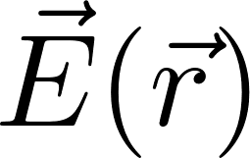
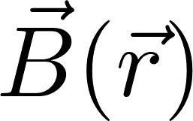
Physics manifesto
Select some part of the outer world, call it the system
Find how to describe state of the system
Find the equation of motion
Predict future states
Now we go to work with a new physical system: electromagnetic field. It is a new animal in the physics ZOO. So we have to show how the physics manifesto works for this new animal.
System: electromagnetic field
State of electromagnetic field: two vector fields
What are the equations of motion, how to predict future? (This is something which is usually not much discussed in the course “Theory of electromagnetic field”.)
Let us try our standard strategy: starting from the current state find the new state after infinitesimal time interval $dt$.
Suggestion: try to use Maxwell equations.

Slide 4
Maxwell equations
The first two equations do not contain derivatives with respect to time. They must be true in each time instant. Therefore they pose a condition on state of the electromagnetic field which must be satisfied in each time instant (in particular in “initial state”).
This means that the six functions describing the state
cannot be chosen arbitrarily at will at each spatial point. Very imprecisely it means that because of two conditions only four of the six functions are independent. To work wit six functions of state are just technically practical in applications. In theoretical physics we, however, often describe the state by just four other functions (potentials).

Slide 5
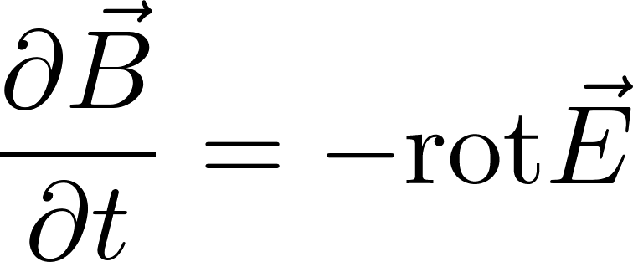
Electromagnetic field – time development
The second pair of the Maxwell equations contains time derivatives, so let us try to rewrite those equations to use them to determine a new state after infinitesimal time interval $dt$.
Suppose we know the state $\vec{E}\left(t,\vec{r}\right), \vec{B}(t,\vec{r})$. The state after time $dt$ should be
The right hand sides concern only the “current time” $t$. Therefore they can be evaluated just knowing the current (initial) state. So we are happy: we can move forward in time. We should just check whether the first pair of the Maxwell equations will be satisfied after the time shift if they were satisfied in the initial state. One can easily check that it is true provided the charges and currents satisfy the continuity equation (which is the consequence of the charge conservation). Notice that we have considered the currents to be “external entities”, their time and space dependence are considered here “to be given”.
By the way: do notice that when we want to make the time shift we have to do it simultaneously for both electric field and magnetic field. So these two fields are not “individual entities” they form together a common “electromagnetic field”.

Slide 6
Note: boundary conditions
These equations can in principle be used to predict the state after a small time interval $dt$ knowing the current state at the time $t.$ And then iterate to further future, next $dt$, and next $dt$ an d so on. We can try to do it at least numerically on a computer. However, we meet two problems:
numerical instabilities. We either have be very careful with the choice of steps in time and space or we have to choose more sophisticated numerical methods. This is not a sign of some essential problem
we will not be able to numerically approximate the rotations in points at the boundaries. We have to use boundary conditions for the boundary points instead. This is essential and it helps us to understand why the partial differential equations force us to specify the boundary conditions. To know the initial state is not enough to predict the future.

Slide 7
Statistical physics of a new physical object: electromagnetic field
So we have described a new physical object: the electromagnetic field. We know how to define its state and we know how to predict its time development.
So far there was no need of statistical methods.
A new situation arises when the electromagnetic field interacts with some thermal reservoir: we can imagine a stow with hot walls and the red light inside. This red light is just electromagnetic field in statistical equilibrium with the hot walls. We expect to use the technology of the canonical ensemble.
It is not, however, straightforward: we were not told how to create the canonical ensemble for object whose state is described by a field theory. Fortunately there is a way how to describe the state of the free electromagnetic field in a cavity by discrete mathematical objects similar to harmonic oscillators (even if there are infinitely many oscillators required) and for such objects the application of statistical physics is well understood.

Slide 8
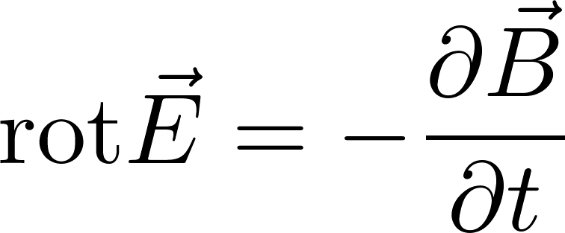
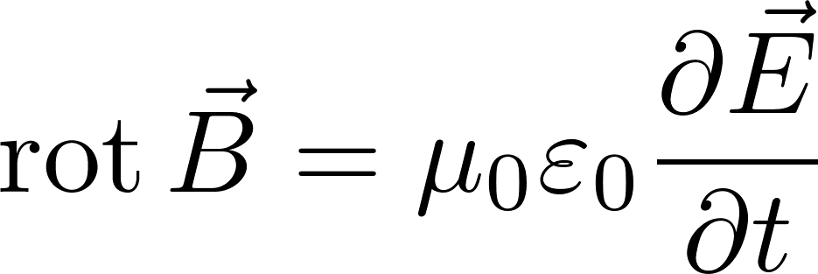
Free electromagnetic field
Let us now consider some area of space where there are neither charges nor currents. Still, electromagnetic field may be there. It is true, that the field had to be created somewhere sometimes by some charges but this is not interesting for us for the moment. An example might be light moving through the empty space which originated far away by a distant star. Another example is the electromagnetic field in a microwave cavity. The field was created by a magnetron outside the cavity and injected into the cavity through a wave guide. But from then on it can be considered as a free electromagnetic field inside a cavity within brass (conducting) walls. The Maxwell equations for a free field read
Since the spatial are is limited, we need to consider the physical conditions on the border of the area. These border conditions are necessary supplement to the Maxwell equations, without them the equations themselves are useless.

Slide 9
Free electromagnetic field – wave equation
For completeness we show, that the Maxwell equations of a free field can be rewritten to the form of a wave equation.
we apply another rotation:
Now the well know relation
For those who are not familiar with nablas, here is the derivation in coordinate formalism (if you still do not recognize some formulas, consult web)

Slide 10
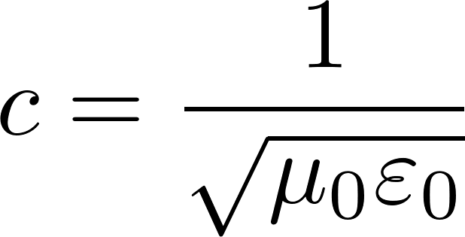
Free electromagnetic field – wave equation
since we get
So finally
So the free field satisfies the wave equation. The phase velocity is
$c$= 299 792 458 m/s, what is the velocity of light
Deriving the wave equations we have used only two of the four Maxwell equations, so in addition to the wave equation there are additional constrains for the electromagnetic wave to be fulfilled!

Slide 11
Free electromagnetic field in a conducting box
Free electromagnetic field in a conducting box (like microwave) satisfies wave equation inside the box. The more difficult part of the problem are the boundary condition.
Let us investigate the $x$-component of the electric field $E_{x}(x,y,z)$ in a cube-like conducting box $a×a×a$.
Tangential components on the boundary have to be zero
According to Fourier: function $E_{x}(x,y,z)$ satisfying such conditions can be constructed from the set of functions (cyclically for other components)
where $f$-s are so far unknown functions
The electric field has to satisfy the condition $\text{div} \vec{E}=0$ also in points with $x=0, x=a$. There the $y$ and $z$ field components do not contribute since their sinuses are 0 there, therefore we get the condition for the derivative of $f$
so the derivatives of $f$ can be constructed from sinuses, so $f$from cosines.

Slide 12
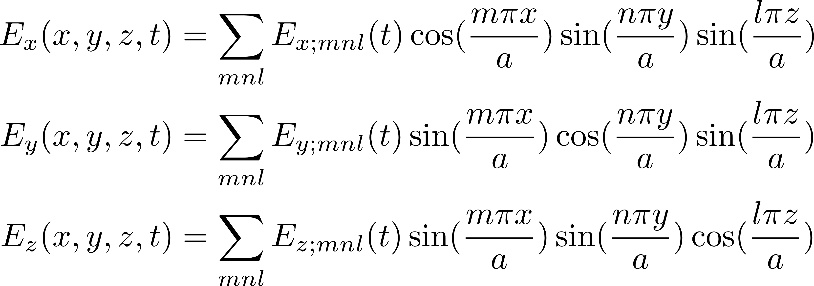
Free electromagnetic field in a conducting box
We have found that the electric field automatically satisfying the boundary conditions can be looked for in the form
where $E_{x;mnl}\left(t\right), E_{y;mnl}\left(t\right), E_{z;mnl}(t)$ are so far unknown functions. Actually not all these functions are independent, because of the zero divergence condition, which gives the conditions
so for any $mnl$ only two of these functions are independent (for example the $x$ and $y$ component). The third one can be expressed from the other two.
What have we got? We have found that in each time $t$the state of the electric field in the boxed is uniquely given by two infinite discrete sets of functions $E_(x;mnl)(t)$ and $E_{y;mnl}(t)$ where $mnl$ are triplets of arbitrary integers.
Originally we have described the state of an electric field as a field: a vector in each spatial point $xyz$ in the given time $t.$ Now we have discrete sets of functions of time.

Slide 13
Free electromagnetic field in a conducting box
What are the equations of motion for the state functions $E_{x;mnl}\left(t\right), E_{y;mnl}\left(t\right)$ ? The electric field has to satisfy the wave equation
and similarly for the $y$ component. (The $z$ component is expressed through the other two components and will satisfy the wave equation automatically.) After substituting the fields by the discrete sums containing the $E_{x;mnl}\left(t\right), E_{y;mnl}\left(t\right)$ into the wave equations we get the equations
where
These are equations of motions for harmonic oscillators!
The time dependence will be
What have we got? The electric field in a box is mathematically equivalent to two sets of independent harmonic oscillators, labeled by integer triplets $mnl$. We shell show that magnetic part of the electromagnetic filed is fully determined by the “electric” functions $E_{x;mnl}\left(t\right), E_{y;mnl}\left(t\right)$ so the oscillators describe the state of field completely!

Slide 14
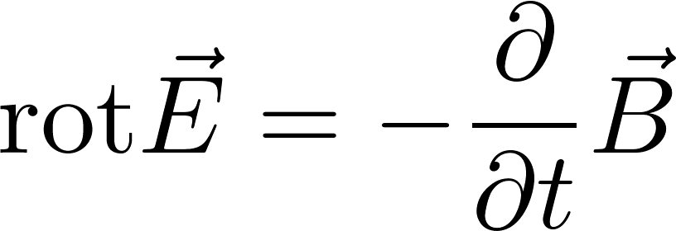
Free electromagnetic field in a conducting box
We have the solution for the electric field in a box. Now we show very briefly that the magnetic field is fully given by the electric field. From the Maxwell equation
We get for the $mnl$ term in the sums and for the expected time dependence
The $x,y$ components of the magnetic field we get by the cyclic permutation.
So we have shown that the electric field solution generates the magnetic field solution.

Slide 15
Free electromagnetic field in a conducting box
Why did we do the rewriting of the field into sets of harmonic oscillators? Because we want to study what kind of field is formed in the box, if the box walls are heated to temperature $T$ and so we have the electromagnetic field in thermal contact with thermostat. We would like to use canonical ensemble technology, bat we do not know how to do that if the microstates of the electromagnetic field are described as fields in space.
On the other hand we know how to do statistics of independent harmonic oscillators in contact with the thermal reservoir taking the oscillator as either classical or quantum objects. Since the oscillators are independent, they do not feel each other and we can do the canonical calculation for just one harmonic oscillator (an easy task) and then do the summation through the set (infinitely large) of all the harmonic oscillators. Here are the results for one oscillator labeled as $mnl$
Classical result for the mean energy at temperature $T:$ $\overline{E}=kT$
Quantum result for the mean energy at temperature $T:$
Observe the difference: all classical oscillators have the same mean energy not dependent on their $ω_{mnl}$. Quantum oscillators mean energies do depend on $ω_{mnl}$.

Slide 16
Free electromagnetic field in a conducting box:
canonical ensemble
Since the microstate of the free electromagnetic field is the same as the microstate of (an infinite) set of harmonic oscillators the statistical physics of the field in contact with the thermal reservoir is straightforward: one just uses the canonical ensemble for independent harmonic oscillators. But we immediately see some problems.
If the oscillators are considered to be classical, then the mean energy for each of them is $kT$, independently of $ω_{mnl}$. Since there is an infinite number of these oscillators, we get infinite mean energy of the electromagnetic field in a hot box. Even worse: this infinite value is not a constant but depends on $T.$ So to increase the temperature in a stove would need to add infinite amount of energy. Even more worse: since the mean energy of the oscillators does not depend on $ω_{mnl}$, even the very high frequencies of the electromagnetic field will be highly excited even at moderate temperatures. Very high frequencies mean ultraviolet, roentgen, gamma frequencies. It would mean “open the window to a stove” and you get irradiated by deadly radiation. Disaster, which got the name “ultraviolet catastrophe”. It means that either the statistical physics is completely wrong or that the electromagnetic field is not a classical but a quantum object and quantum version of oscillators should be used.

Slide 17
Free electromagnetic field in a conducting box:
canonical ensemble
Even considering the oscillators to be quantum objects is not without problems! The mean energy of a quantum oscillator is
The problem is the constant additive term $ℏω/2$. Which again gives infinite contribution to the total energy. However, this term is a constant net depending on any state characteristics like the temperature, so can be considered as a meaningless energetical additive constant. Well, this is a rather cheap solution to an essential problem, it is more like sweeping the problem under the carpet. We shall omit this constant term in what follows in this formula and in the formula for energy of a harmonic oscillator.
Historically the problem with the classical statistics was found by Max Planck around 1900. Curiously enough it was not the youngest theory to be blamed for the disaster (statistical physics) but older and well established theories: Newton mechanics and Maxwell theory of electromagnetism, which had to be replaced by their quantum versions. Max Planck was the first who “quantized” the old theory for black body radiation. It started the quantum era of physics.

Slide 18
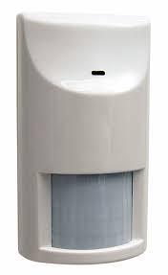
Black body radiation
After all the preparatory work let us study the electromagnetic field in a box in contact with thermal reservoir. In physics the problem is known under the name “black body radiation”.
The experiment shows, that all bodies heated to some temperature emit electromagnetic waves. Our sun emits visible light from its surface having some 6000 K. Our own bodies emit infrared radiation corresponding to our temperature of 37 Celsius. This radiation is detected by mosquito sensors which then recognize us as the object to attack. This radiation is also detected by motion detector in the alarm systems.
The spectral characteristics of radiation emitted by a hot body is theoretically simplest if it is so called black body. A black body is an idealized physical body that absorbs all incident electromagnetic radiation, not reflecting any part of it. In thermal equilibrium it emits radiation called black body radiation. An approximate realization of a black surface is a hole in the wall of a large cavity. Any light entering the hole is reflected within the internal surface of the body indefinitely or absorbed within the body and is unlikely to re-emerge, making the hole a nearly perfect absorber. In thermal equilibrium radiation is emitted from such hole equivalent to black body radiation. If the electromagnetic field inside a cavity is in thermal equilibrium with its walls the spectral characteristic of the electromagnetic field inside are equal to the black body radiation.
Motion detector

Slide 19
Quantum states of a free electromagnetic field in a box
We have shown that the electromagnetic field states are equivalently described as states of a set of harmonic oscillators. So we know, how to make a quantum theory of electromagnetic field in a box: we just take those oscillators to be quantum oscillators and the general state of the field will be some general quantum state of those oscillators.
We know that a quantum state of a harmonic oscillator is given by a single integer $n$ (called excitation number) and its energy in the state $n$ is $E_{n}=nℏω$. (We have omitted the $ℏω/2$ term). A quantum state of electromagnetic field can be therefore given as the list of all the equivalent oscillators together with the excitation number of each of them.
One particular (micro)state of the electromagnetic field in a box is given by the table like this.
The table is an infinite list of oscillators. Each raw contains the label of a particular oscillator and its quantum excitation number.
The total energy of the field in such state is given by the sum
mnl,s | excit.number
111,x | $$n_{111x}$$
111,y | $$n_{111y}$$
112,x | $$n_{112x}$$
112,y | $$n_{112y}$$
121,x | $$n_{121x}$$
121,y | $$n_{121y}$$
$$…$$ | $$…$$
In the sum $mnl$ are integers, $s$ runs through just two values $x,y$.
We know what are all possible microstates and what are their energies, so we can use canonical ensemble technology.
We have quantized the electromagnetic field !!! Very advanced physics !!!

Slide 20
Thermal radiation in a cavity - energy
Thermal radiation is equivalent to a set of independent oscillators. We can calculate the mean energy of each one separately, we get
By the way the energy of an oscillator in the state with excitation number $n$ is $ℏω$, therefore we see that the mean excitation number at the temperature $T$ is
The total energy of all the oscillators (the total energy of radiation in the cavity) is
The sum runs over all triplets $mnl$ of integers and over two values of $s$: $x, y$. Now we do a standard trick: we approximate the sum by an integral over $ω.$ To do this we have to know how many oscillators have the frequency less than some value $ω$. We see that the various $ω$ values correspond to points in the abstract $mnl$ space with integer coordinates. The trick is the same as we used when calculating the number of one-particle states. So we get (the factor 2 is for two states $x,y$ for each $mnl$).

Slide 21
Thermal radiation in a cavity - energy
The total energy of the thermal radiation in a cavity is
$a^{3}$ is the cavity volume, so we get for the energy density of the thermal radiation in the cavity
The energy density is expressed as an integral (a sum) over frequencies $ω.$ So the function under the integral can be interpreted as the spectral energy density $u(ω)$, that means the energy per unit volume per frequency interval $dω$ around the frequency $ω is$

Slide 22
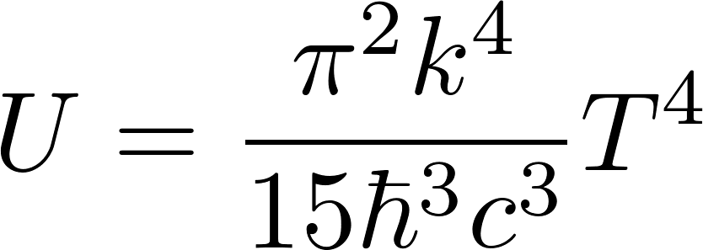
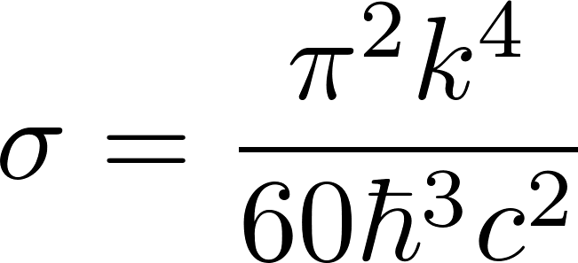
Thermal radiation in a cavity - energy
After integration over $ω$ we get for the total energy density
If we make a small hole into the cavity with equilibrium thermal radiation, the radiation will be emitted through that hole. The energy density flow peer unit of time will be
We derived the formula in a rather hand-waiving way: the energy with density $U$ flows out of the hole with the velocity of light $c$. The factor 1/4 we got by averaging over angles of the outgoing radiation.
The formula is called Stefan’s low and is usually written in the form
$σ$ is called Stefan-Boltzmann constant

Slide 23
Free electromagnetic field:
alternative description of the state
We found that the electromagnetic field in a box is mathematically equivalent to two sets of independent harmonic oscillators, labeled by integer triplets $mnl$and an additional label $x$ or $y$.
and similarly for $y,z$
We called the “items” oscillators due to the fact that we have concentrated on the time dependence of the coefficients $E_{x;mnl}(t)$ not giving too much meaning to the “spatial” sinuses and cosines. But equally well we could call the “defining items” as stationary waves, when we include the spatial dependence into the “state”. We see stationary waves
with frequencies and wave vectors
We see the relation

Slide 24
Free electromagnetic field:
alternative description of the state
Se we have two alternative description of electromagnetic field state
The electromagnetic field in a box is mathematically equivalent to two sets of independent harmonic oscillators, labeled by integer triplets $mnl$and an additional label $x$ or $y$ with frequencies
Alternatively
The electromagnetic field in a box is mathematically equivalent to two sets of independent stationary waves, labeled by integer triplets $mnl$and an additional label $x$ or $y$ with frequencies and wave vectors
What concerns the creation of the canonical ensemble both the alternatives are the same. The oscillators and the stationary waves are considered here as individual objects, individual independent subsystems. The quantum states of individual oscillators as well as individual stationary waves are given identically by the excitation number $n.$ The energy of the state $n$ is $ε_{n}=ℏω_{mnl}$. So the alternative descriptions of the states of the electromagnetic field give the same statistical physics results.

Slide 25
Free electromagnetic field:
still another alternative description - photons
The complete (micro)state of the electromagnetic field we have represented by the table where the excitation numbers are any integers. If you see the table do you recall
that you have already met a similar table in a very different context? Here it is: The state of non-interacting indistinguishable spinless bosons was given by the list of one-
mnl,s | excit.number
111,x | $$n_{111x}$$
111,y | $$n_{111y}$$
112,x | $$n_{112x}$$
112,y | $$n_{112y}$$
121,x | $$n_{121x}$$
121,y | $$n_{121y}$$
$$…$$ | $$…$$
one particle state | occup. number
1,1,1 | 1
1,1,2 | 3
1,2,1 | 0
1,2,2 | 2
2,1,1 | 0
2,1,2 | 0
2,2,1 | 12
2,2,2 | 4
$$⋮$$ | $$⋮$$
particle states each with its occupational number which could be any integer. The total energy was
For the electromagnetic field the total energy is
The same (almost) description of the states, the same formula for the energy.

Slide 26
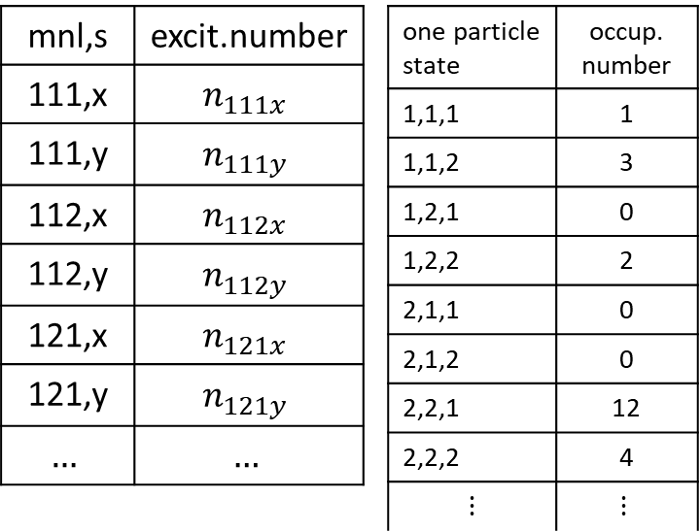
Free electromagnetic field:
still another alternative description - photons
The table giving the state of the electromagnetic field via the states of stationary waves is very similar to the table giving some state of a ideal spinless boson gas. However there are some dissimilarities as well:
Each row in the stationary wave table represents a different stationary wave. Different stationary waves are considered as different objects, different physical systems. The rows in the boson table represents different one particle states of one physical object: the bosonic particle
the rows in the stationary waves table have additional label $s∈\left\{x,y\right\}.$ We can have additional label for bosons with spins. But the closest to spin zero boson is a spin 1 boson which should have 3 spin states, not just 2.
To disclose our aim: we want to show that there is another alternative description of the electromagnetic field in a box: ideal bosonic gas of particles called photons. To do that we have to handle the above mentioned dissimilarities of the two tables.

Slide 27
Free electromagnetic field:
still another alternative description - photons
First to the problem “different objects versus different states”. Here is the reminder of the slide where we discussed the freedom of reconsidering what are the “system variables” and what are the “state variables”. It was about chemical potential and considering the number of particles $N$ not as a fixed system characteristics but rather as a state variable.
We can do a similar trick with the $mnl$ labels of the stationary waves. We considered different $mnl$ labels as “names” for different physical objects, different oscillators or different stationary waves. We can consider all the stationary waves “in the box” as instances of one type of “physical animal” – a stationary wave – in different states $mnl$. Similarly to gas particles being same “physical animals” in different one-particle state.
So this dissimilarity disappeared.

Slide 28
Free electromagnetic field:
still another alternative description - photons
Now to the problem of “spin labels”. The particles we want to “invent and introduce” must be bosons, since the excitation numbers interpreted as occupational numbers are any integers. The bosons should not be spinless since we have to interpret the labels $x,y$ as some spin-state labels. So far we do not know any bosons which would have just two spin states. Spin 1 bosons should have 3 “spin projections”. Two spin
projections suggest spin 1/2, but spin 1/2 particles are fermions!
However, the above mentioned classification is valid if we consider only nonrelativistic particles. Relativistic particles with the mass equal to zero with the total spin 1 have only two spin-projection states +1 and -1. Projection 0 is not possible. The reason is hidden deeply in relativistic quantum mechanics (better: field theory). We skip the detailed argumentation, just take it as a fact.
So there is a chance for a particle-like alternative description of the states of the electromagnetic field introducing relativistic mass=0 particles with spin 1 named photons. The “spin-projection labels” for photons do not necessarily mean true spin projections: other quantum mechanical base of “spin states” can be used equally well. For photons we most other use the “polarization basis”.

Slide 29
Free electromagnetic field:
alternative descriptions of the state
Se here are now three alternative description of electromagnetic field state
The electromagnetic field in a box is mathematically equivalent to two sets of independent harmonic oscillators, labeled by integer triplets $mnl$and an additional label $x$ or $y$ with frequencies
The electromagnetic field in a box is mathematically equivalent to two sets of independent stationary waves, labeled by integer triplets $mnl$and an additional label $x$ or $y$ with frequencies and wave vectors
The electromagnetic field in a box is mathematically equivalent to an ideal gas of relativistic mass=0 bosons. Their one-particle states are labeled as $mnls$ where the $mnl$ are integers and $s$ can have two values describing two possible polarizations. The frequencies and the wave vectors are interpreted using the de’Broglie relations as the energy and the momentum of particles. A boson in the one-particle-state $mnls$ would have the energy and momentum

Slide 30
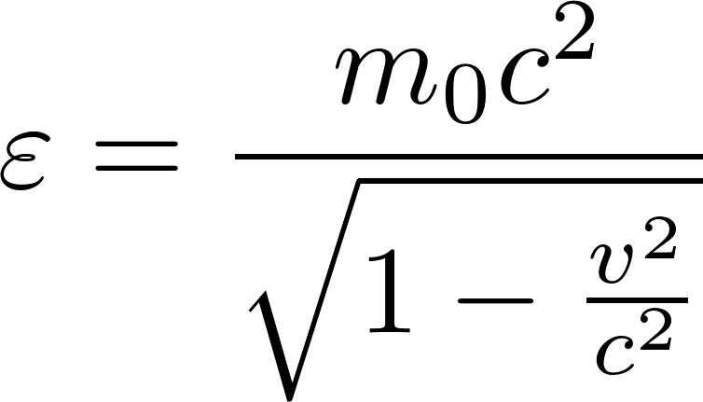
Free electromagnetic field: photons
We found that the energy and momentum formulas for photons should be
This gives us the following relation between energy and momentum
Such a relation is expected for relativistic massless particle because of the general relativistic formula for the particle rest mass
For photons this gives the rest mass 0. The general formula for the relation between the
energy, rest mass and velocity of a particle is
To get non-zero energy, the zero-mass particle velocity must always be $\text{v} =c$. So photons always move with the velocity $c$.
We have discovered photons !!!

Slide 31
Thermal radiation in a cavity as a photon gas
We have arrived at a conclusion that we can consider the electromagnetic field in a cavity as a photon gas. So we can try to calculate the properties of the thermal radiation by calculating the properties of a photon gas in equilibrium with the cavity walls at the temperature $T.$
How to do that? we certainly do not know a priori the total number of photons in the cavity so we try to work within the grand canonical technology pretending to know the chemical potential of photons, calculate with it as with a symbolical abstract number $μ$ and finally find the correct value of it by adjusting this value to get the correct thermal radiation results which we already know.
So we have a the photon gas with one-particle-states $mnl$s. The mean occupational number a one-particle-state will be
The total energy of the photon gas will be

Slide 32
Thermal radiation in a cavity as a photon gas
Let us compare the formula we have just got with the formula we have got for “equivalent oscillators” where we had “mean excitation numbers” instead of “mean occupational numbers”
The formula for $ω_{mnl}$ is the same in both cases, the only difference is that there is $μ$ in the formula on the left. The conclusion is: we get exactly the same results for the thermal radiation if calculated as for oscillators and if calculated as for photons if we set $μ=0.$
We discovered a new law of nature: chemical potential of photons is (always) zero.
Putting $μ=0$ we continue in exactly the same way as we did for the “equivalent oscillators”: we replace the sum by an integral using formula for the density of one-particle-states which would be for photons the same as was the formula for the density of oscillators and we will get the same result

