Slide 1
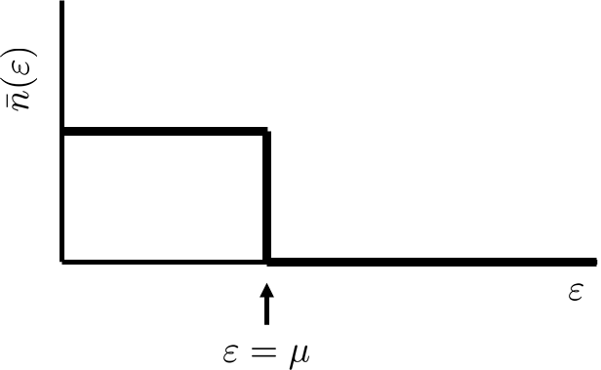
Fermi ideal gas at low temperatures
Fermi-Dirac distribution
in the limit $T→0$gives
At $T=0$ all one-particle states below $ε=μ$ are occupied, all states above $μ$ are empty.
So at $T=0$ chemical potential $μ$ is equal to the energy of the highest occupied one-particle state. This energy is called the Fermi energy $ε_{F}$.
The Fermi energy can easily be calculated if we realize that the number of one-particle states below $ε_{F}$ must be equal to the total number of particles. (Do not forget $g=2$ for spin 1/2 particles.)

Slide 2
Fermi ideal gas at low temperatures
or temperatures slightly above $T=0$ the chemical potential will be slightly higher then $ε_{F}$ so the occupation numbers will be only slightly different from their values at $T=0$ for $ε$ around $ε_{F}$ in the interval with a width $≈kT$. (Red curve.)
This qualitative picture will not change until the temperature reaches Fermi temperature $T≈T_{F}=ε_{F}/k$.
Fermi gas below the Fermi temperature is called degenerate Fermi gas.
As an example of degenerate fermi gas we can consider conduction electrons in metal. Of course, the electron gas is not ideal, the electron feel each other. We use this example only to demonstrate some features qualitatively.
For metal potassium the electron density in the lattice is $1.34×{10}^{22}$ ${\text{cm}}^{−3}$ and for the Fermi temperature we get $T_{F}≈$ 24000 K.

Slide 3
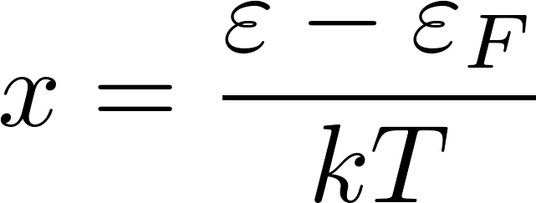
Fermi ideal gas at low temperatures
We shall calculate the degenerate fermion gas heat capacity work in the approximation $μ=ε_{F}$.
We have intelligently written zero as
this trick enables us to use the substitution
For temperatures much lower then $T_{F}$ Fermi-Dirac function is constant (either 1 or 0) almost everywhere except around $ε_{F}$. So the derivative of the Fermi-Dirac function is nonzero only around $ε_{F}$.Therefore the slowly varying function $φ′(ε)$ can be replaced by the constant value $φ^{′}(ε_{F})$ and we get
For $T≪T_{F}$ we can replace the lower bound by $−∞$

Slide 4
Fermi ideal gas at low temperatures
The obtained result
shows that the heat capacity of the conduction electron gas is negligible for $T≪T_{F}.$
This is how quantum mechanics (which was not yet known) saved the statistical physics from being thrown away. The heat capacity of electrons (which were not yet known) did not influenced the heat capacity of the metal as given by the lattice of atoms and everything was ok with the predictions of statistical physics at normal temperatures.

Slide 5
Bose condensation
Bosons are particles which can have any occupation numbers of the one-particle states. It means that at very low temperatures practically all bosons of an ideal bose gas can occupy the lowest-energy one particle state.
It is, however, not a priori clear whether at low but finite temperatures like 1K still a majority of particles would occupy the lowest-energy one-particle state.
We shall estimate what happens for liquid helium which we shall very roughly consider to be an ideal gas in a box 1 cm³ containing 10²² particles.
The energy of the lowest one-particle states will be $ε_{0}={10}^{−18}$ eV, the first higher state will have energy twice that big $ε_{1}=2ε_{0}$.
The mean occupation number of the lowest state is
Let us assume that a significant number of particles $≈{10}^{22}$ is in the lowest state, then

