Slide 1
Smuggling the energy
We want to study the energy transfer through the virtual border represented by the dashed line. Molecules randomly cross the border. At the stationary state there is no net flow of the molecules, the number of molecules crossing from left to right is the same as the number crossing in the opposite direction. It is the same as for real smugglers on a real border. All the smugglers crossing the border return (with emptied backpacks) back. (Unless they are caught and jailed by the finance police .) The flow of molecules from left to right (per second per unit of area) is where $n_{left}$ is a typical density of molecules and ${\text{v}}_{left}$ is the typical velocity of molecules left from the border. The net flow through the border is zero if
Now the smuggler-molecules crossing from the left carry “backpacks” filled by the energy $ε_left$. Those crossing from the right carry the energy $ε_{right}$. So the net flow of energy through the border taken as positive from left to right and expressed in units $\text{J} {\text{s}}^{−1}{\text{m}}^{−2}$ is

Slide 2
Smuggling the energy
The question is where the backpacks of the smuggler-molecules are filled with energy. The energy we are speaking about is, of course, the kinetic energy of the molecule as it was “obtained” in the last collision before crossing the border. This means that $ε_{letf}$ is typically the mean kinetic energy of molecules at a distance of the mean free molecular path to the left from the border.
Warning: you have certainly noticed that we always used the word “typical” characterizing various physical quantities. We stress by that that our reasoning is an “order-of-magnitude” reasoning. We do not care to distinguish between for example mean absolute velocities or square roots of mean quadratic velocities or whatever. Therefore our results will not contain such factors as $\sqrt{2},π$ you will find in some textbooks. The authors of those books do not often present more rigorous arguments than we do here, but they know more exact results and do some cheating to get “better results”.
So to continue with our reasoning we have to repeat basic facts about molecular mean free path. Next we present some slides from the course of mechanics

Slide 3
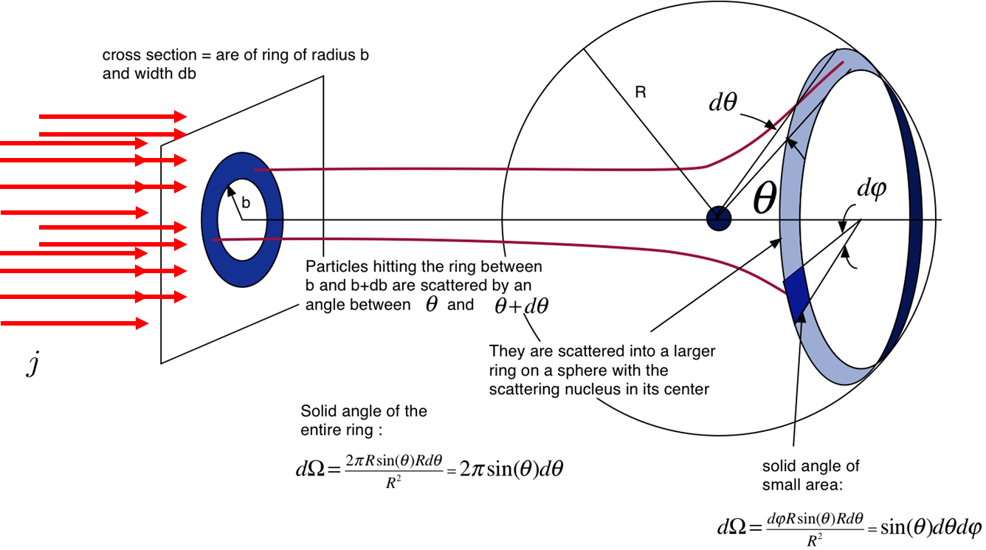
Scattering cross section
If the whole $4π$ spatial angle around the target is covered by detectors, then the number of detector “clicks” per second $n$ can be expressed as
where $j$ is the incoming particle beam flow density (in particles per second per area unit) and $σ_{tot}$ (in area units) is so called total cross section which one can imagine as the area in the plane perpendicular to the beam: beam particles going through this area induce detector clicks, beam particles which miss this area do not induce clicks in the detectors.

Slide 4
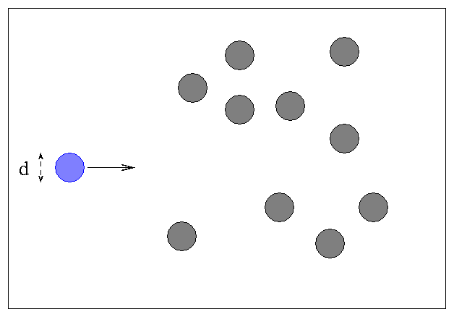
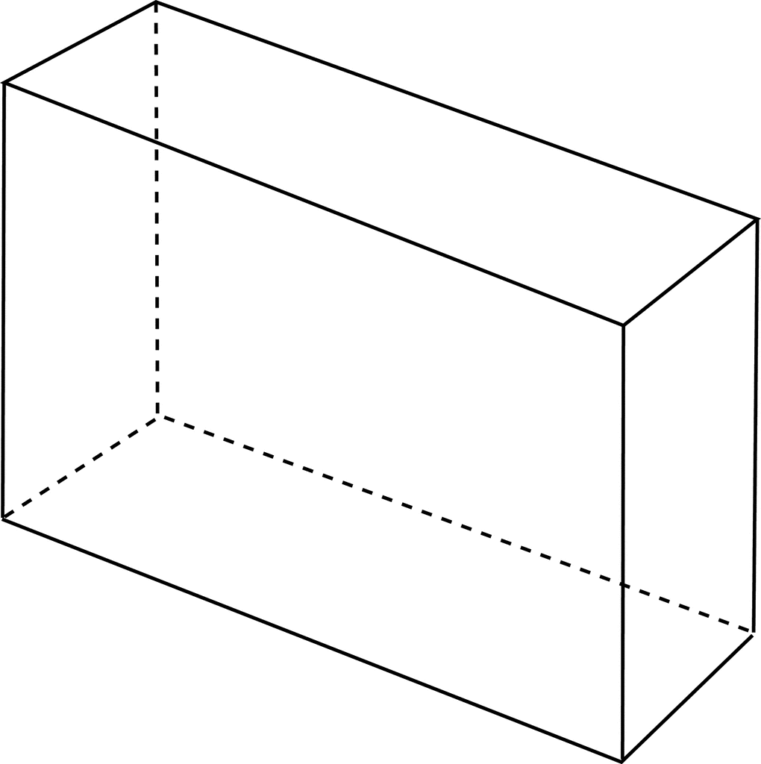
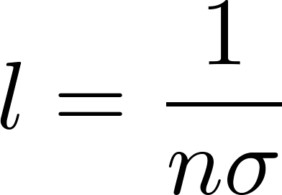
Mean free path estimate from the total cross section
Imagine the following experiment. A particle (the blue one in the figure) is shot into a gas of randomly moving particles (the grey ones in the figure).
Each gas particle represents a target of area $σ$. Gas particle density is $n$.
The total area of targets on the path of the length $l$ is
The projectile will not get out of the gas container if the total area covered by the targets will cover the area of the back wall $S$. (We have neglected mutual concealing of targets.)
For shorter containers it will get out. So what we have crudely estimated is the typical mean free path of a particle in gas

