Slide 1
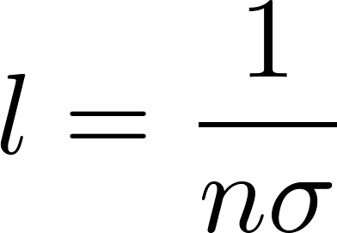
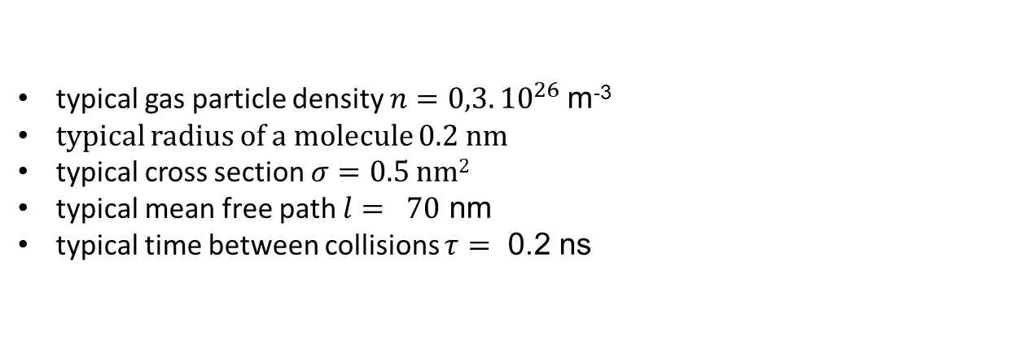
Typical mean free path
typical gas particle density $n=0,3.{10}^{26}$m⁻³
typical radius of a molecule 0.2 nm
typical cross section $σ=0.5$ nm²
typical mean free path $l= 70$ nm
typical time between collisions $τ=$ 0.2 ns

Slide 2
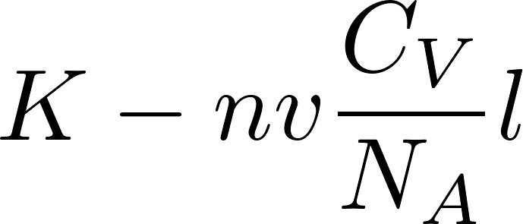
Energy (“heat”) transfer
The two temperatures are the temperatures at two locations at a mean free path distance from each other
So the heat transfer coefficient is
Note: everybody calls it “heat transfer coefficient” even if it better should be thermal energy transfer coefficient.

Slide 3
Viscosity
Let us consider gas laminar flow. Viscous gas will not flow homogeneously. We shall observe that its flow velocity ${\text{v}}_{x}$ is zero just above the bed and then increases with increasing coordinate $y$. So there is a flow velocity gradient.
The flow velocity is a drift velocity superimposed on the random thermal movement of the molecules. The drift velocity might be of the order of a few ${\text{ms}}^{−1}$ the chaotic thermal velocity might be of the order 500 ${\text{ms}}^{−1}$. The drift velocity is in the direction $x,$ the chaotic velocity has random direction. That means, that slow molecules from the bottom layers can by their random movement infiltrate the top layers and decelerate the molecules there and the fast molecules from the top layers can infiltrate the bottom layers and accelerate the molecules there. The random chaotic movement of the molecules leads to the transfer of $x$-direction momentum through the virtual boundary (represented by the dashed line) between the flowing layers. Transfer of momentum per time means the force acting between the layers in the $x$-direction what leads to tangential tension between the layers manifested as the viscosity.

Slide 4
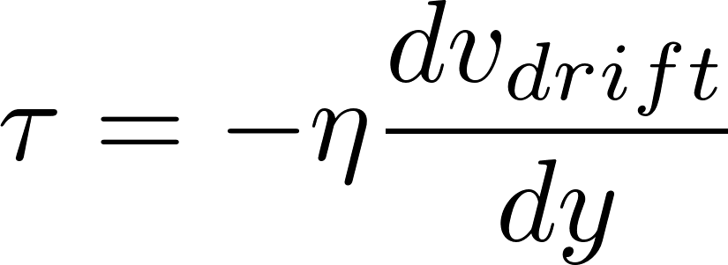
Smuggling the momentum: viscosity
Not relating the detailed discussion we had on energy transfer we just write the expression for the momentum flow density (in ${\text{kgms}}^{−1}$ per unit of time per unit of the border area)
Phenomenologically we define the coefficient of viscosity $η$ by the relation for the tangential tension between the layers in the form
So we got for the coefficient of gas viscosity

Slide 5
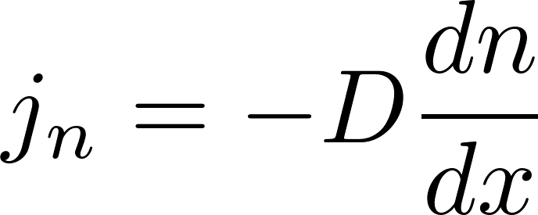
Smuggling themselves: diffusion
Let us consider a rather artificial situation. We have two types of molecules in the container. They are not uniformly distributed but in such a way, that the pressure is homogenous, therefore there is no “blow of the wind” in the container. We prepared such a thought experiment to be able to observe diffusion in a pure form free of a molecular transport by a macroscopic flow of gas.
We shall monitor just one type of molecules (for example the red ones) how they randomly move through the virtual border represented by the dashed line.
“The smugglers” do not carry anything in their backpacks, they smuggle themselves: there is a non-zero net flow of the smugglers through the border what leads to gradual homogenization of the concentration of the red molecules in the container.
We can directly write the formula for the net molecular diffusion current density (in units of molecules per the time unit per the area unit):
So the diffusion current is
$D$ is called the diffusion coefficient.

