Slide 1
Continuous random events
Continuous random event:
throwing a dart
The difference with respect to the discrete case is that the random events cannot be enumerated or listed (the set is not countable).
Having in mind that we cannot define the probabilities to individual random events, we have to introduce probabilities in some other way.
We can consider not individual events but some subset of events (with non zero measure) and assign probability to the “compound events” that any of the points from the subset was hit.
Let us discuss it more specifically for the one dimensional case. As the subsets we shall consider just intervals on the real line.

Slide 2
So suppose we can (for example experimentally) to assign probabilities that an arbitrary interval $(a, b)$ was hit. Let is denote as the probability, that the coordinate (name of the event) $ξ$ is within the interval $(a, b)$
So to have the complete probabilistic information about the process, we need to collect the probabilities for arbitrary values of $a, b$. But if we think a bit more, we do not need a two dimensional set of probability data, what is enough to collect is just one dimensional function
since then, of course
$F(x)$ is, obviously, a non-decreasing function, since
Also:

Slide 3
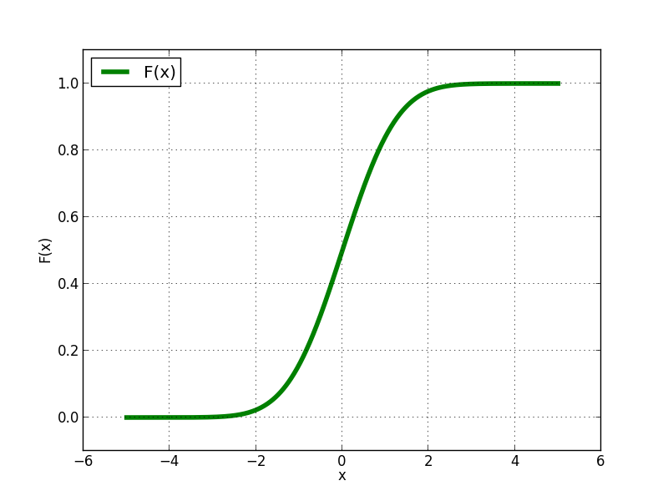
Function
is called cumulative distribution function (CDF). Other names like probability distribution function, cumulative probability distribution function are also used. Typically it looks like a “sigmoid curve”

Slide 4
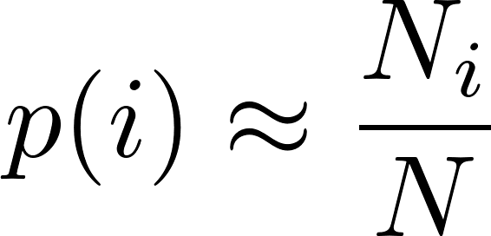
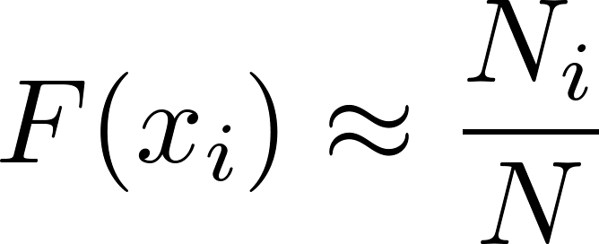
For discrete events we could approximately determine the event probabilities experimentally. We perform $N$ experiments and observe how many times $\left(N_{i}\right)$ the event $i$ happens. Then
How we can determine the distribution function experimentally? We have to discretize the space $x$ of the “event names”. Typically we define $n$ discrete values
We perform $N$ “dart throws”, recording the coordinates of individual hits and calculate the numbers $N_{i}$ defined as the number of hits with coordinates less than $x_{i}$. Than

Slide 5
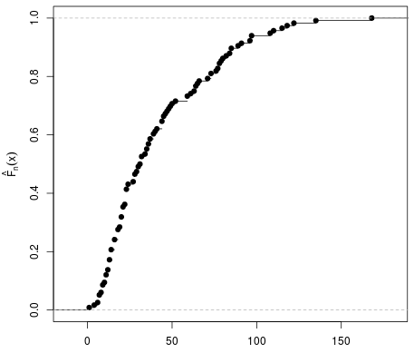
Experimentally we get something like this
The true (theoretical) distribution function should somehow “smoothly interpolate” the experimental points. In the particular case represented by the figure the smooth interpolation is not easy to be drawn, due to experimental errors.
The error to our formula
is easy to estimate from binomial distribution and can be symbolically written as (see also http://en.wikipedia.org/wiki/Empirical_distribution_function)
Having data values and errors we can do “curve fitting” described on the next slide.

Slide 6
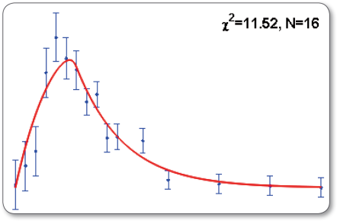
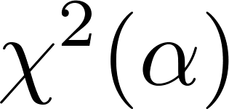
Supplement: curve fitting
Suppose we have some experimental data, a set of triplets
where $ε_{i}$ are experimental errors of $y_{i}$, so that the measured values are
Now we have a hypothesis, that the data points are to be described by a smooth curve
where $α$ is a set of parameters to be determined so that the data is optimally described. We do it like this. For any given value of $α$ we calculate the test value
and we let the computer find optimal set of parameter values so that is minimal. Without going into the theory, the rule of thumb is that the fit is good when
where $n$ is the number of experimental points and $p$ is the number of fitting parameters $α$.

Slide 7
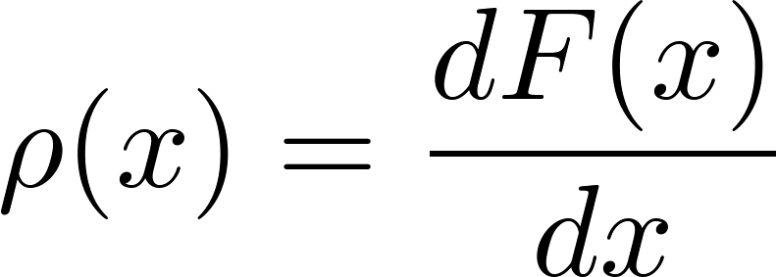
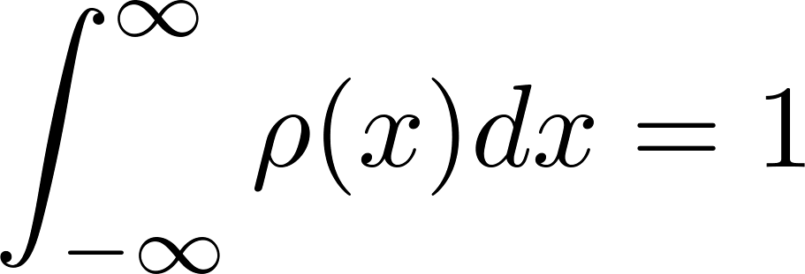
Probability density
The formula suggest by its notation to play with the derivative of the cumulative probability distribution function. So let us define
It is clear, that the information contained in the function $ρ(x)$ enables to calculate any probability we need, in particular
Since $F(x)$ is a non-decreasing function, $ρ(x)$ is non-negative. Having in mind the analogy with mass density function for which the mass of any volume within a body is calculated as the integral of (non-negative) mass density over that volume, we call the function $ρ(x)$ “probability density function”. It is clear, that instead of the cumulative distribution function we can consider the probability density function as a primary carrier of the information on probability of the process considered. Actually, in many textbooks, the authors start the discussion of continuous random variables with introducing probability density and then derive the cumulative distribution function as a secondary concept. The normalization is obvious:

Slide 8
Probability density
Having the formula
we can calculate the probability to hit a small interval around the value $x$ as
This is the closest analogy to the discrete-random-variable notion “probability of $x$” we have for the case of continuous random variables. This is how the proponents of the “priority of probability density over cumulative distribution” intuitively define the probability density. The argumentation is: for an infinitesimal interval dx the probability to hit that interval is “obviously” proportional to its length dx, so
with the “factor of proportionality” possibly depending on the position $x$. Denoting this factor of proportionality as $ρ(x)$, we get

Slide 9
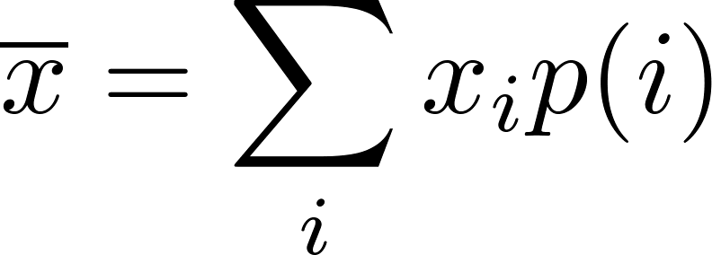
Mean and variance
In analogy with the discrete case, where we have defined the mean value of a random variable $x$ as
we define the mean value of any variable $f(x)$ (depending on the random event $x$ as
in particular for the random variable $x$ (used to give a name to random events considered) we get
We define the variance of $f$ as
and for “the name” $x$

Slide 10
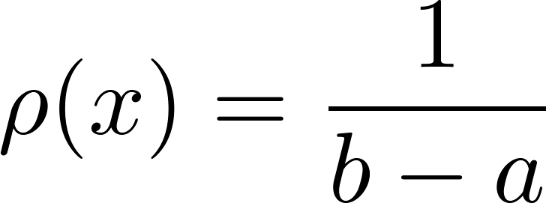
Examples
Uniform distribution
can be defined only on a finite interval $\left(a,b\right)$:
We use this probability if we want to describe the situation when “no x is preferred with respect to others”. So something like “no bias”, “maximal democracy”, “equal chance”.
However, one should be very careful here. For discrete random events, it is obvious what is meant under “no bias”:
Naively one would say that generalization to a continuous case is
But one should be careful: generally there is no canonical naming of continuous events! We can use in principle any variable as “a name” for random events, but the probability density which is constant with respect to a certain variable is not constant with respect to an arbitrary other variable.

Slide 11
Supplement: probability density, change of variables
Suppose we have same probability density function $ρ(x)$ defined with respect to a variable $x$. Let us define a new variable $y$ by the transformation formula.
Since we are going to use the new variable $y$ as a new “name” for the event $x$, the transformation should be one-to-one. Let us assume it is a rising function. Our task is to find the probability density with respect to the variable $y$, which we denote as $\tilde{ρ}(y)$. It is easy, by definition:
Now we make a substitution in the integral and get
we should get, however

Slide 12
Supplement: probability density, change of variables
Comparing the two formulas, we get
So the “new” probability density is not obtained just by inserting the inverse transformation as an argument to the “old” probability density: the Jacobian of the transformation plays a role as well!
So even if the original probability density was a constant function, the Jacobian need not be constant and so the “new” probability density will not be constant in general.
Conclusion:
“No-bias probability density” cannot be canonically defined for a general case of continuous random events!

Slide 13
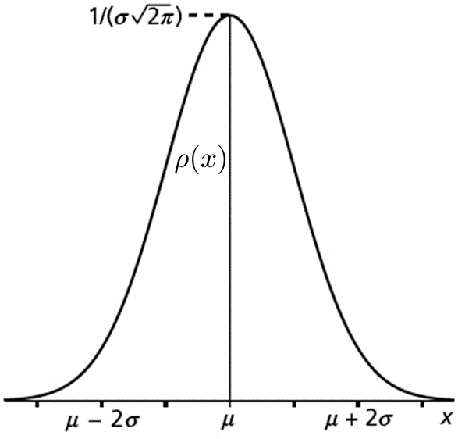
Examples
Gauss (normal) distribution
is defined by the formula
we see, that it is a whole “family” of probability distributions, differing by the choice of two parameters $μ$ and $σ$. The meaning of these parameters is almost obvious:
A typical shape is presented in the figure.

Slide 14
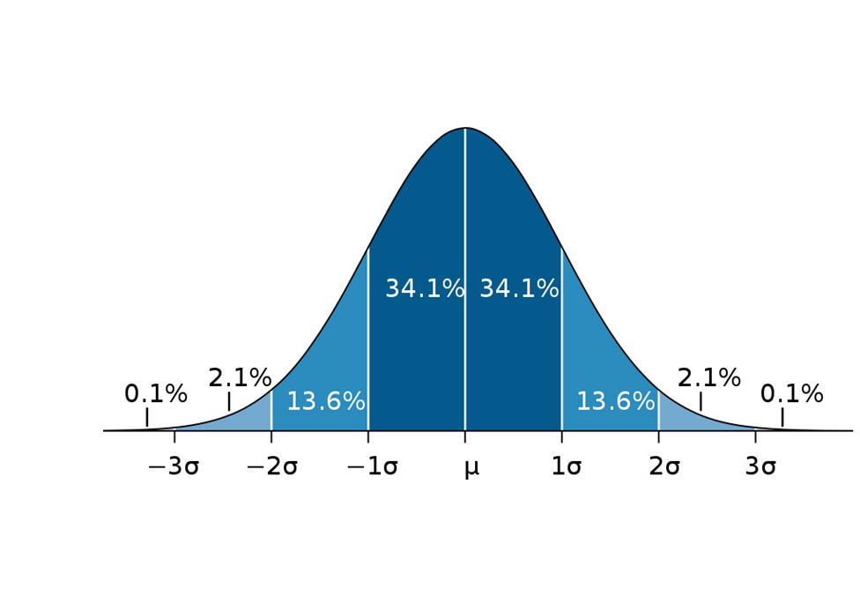
Examples: Gauss distribution
The following figure is instructive. It is worth to remember how often can one meet the deviation larger than a few standard deviations (assuming Gauss distribution)

Slide 15
Examples: Gauss distribution
Gauss (normal) distribution is frequently used in physics and generally in any science discipline.
Sometimes we use Gauss distribution because we have good theoretical reasons that the probability density describing the random process we consider is a Gauss distribution
Sometimes we use Gauss distribution because of a lack of any theoretical reasons. We just have a rough feeling about the mean and variance and the Gauss probability density is a nice bell-like shape corresponding to a simple analytical formula. Moreover, it is practically the only elementary formula known to a good high school student corresponding to a bell-like curve. Moreover, it is fully specified by just two parameters: mean and variance. So we use it having nothing better in the pocket.

Slide 16
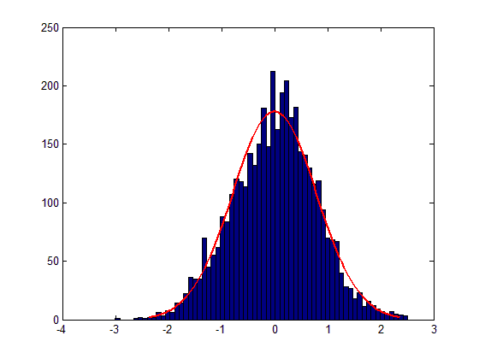
Probability density: experimental determination
We have already discussed how to estimate experimentally the cumulative distribution function. We can estimate directly the probability density using essentially the same technique.
discretize the space defining “bins” (intervals)
The bins are usually called “underflow bin” and “overflow bin”, the bins in-between are usually (but not necessarily) chosen as equal-sized.
Perform $N$ experiments to obtain $N$ random events and record the numbers $N_{i}$ of how many times the event falls into the bin . (For simplicity we neglect underflows and overflows.)
You can visualize the results in the form of a histogram
Then let the computer to find a smooth curve describing the histogram

Slide 17
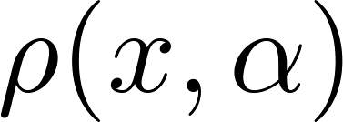
Probability density: experimental determination
Then let the computer to find a smooth curve describing the histogram. To do this properly, wee need experimental errors of the number of hits in every bin.
If the bins are reasonably small, we can estimate the errors as
and the expected values are
Assuming some formula for the probability density having a few free parameters $α$,
we write the test function (to be minimalized) as
and find the optimal parameters $α$, thus estimating the probability density.

Slide 18
Continuous random events: more dimensions
Quite often the events from the event space considered cannot be properly named using just one real number. The event space might have more dimensions. We do not want to discuss here what is exactly meant by the dimensionality of the space considered. An intuitive feeling is enough to accept, that a good naming scheme requires n-tuples of real numbers like
Those who want to know more about dimensionality and related things should read some textbook on manifolds, for example
M.Fecko, Differential Geometry and Lie Groups for Physicists, http://www.amazon.com/Differential-Geometry-Lie-Groups-Physicists/dp/0521187966
The generalization of the probability machinery for more dimensions is straightforward. We use many-dimensional probability density function in the event space
and the probability to observe a random event within a subset $S$ of the whole space is
In some cases the volume element in the event space might be given by a more complicated formula instead of a simple .

Slide 19
Continuous random events: more dimensions
Example
A typical example is a multidimensional Gauss distribution as one finds, for example, in Maxwell distribution of the velocities of molecules in gas.
If I randomly select a molecule in gas and ask: “What is currently your velocity” I get an answer containing three numbers: projects of the velocity vector on three orthogonal axes.
So I have a three-dimensional random variable: a velocity vector. Maxwell has derived a simple formula for the probability density in three-dimensional velocity space

Slide 20
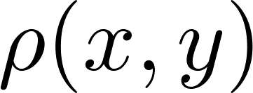
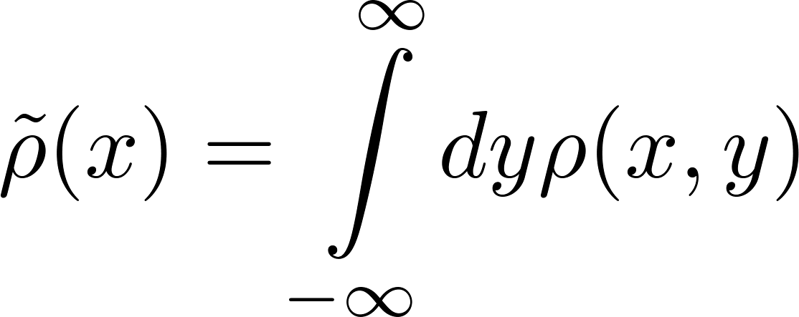
Continuous random events: more dimensions
Marginal distribution
Sometimes I have a many-dimensional probability distribution and I am interested just for a subset of events having smaller dimension. For example having a two-dimensional probability density
I want to now only how the variable$x$ is distributed, so I need to find, what is the probability $p(x,x+dx)$ to find the coordinate $x$ in the interval $(x, x+dx)$ irrespective of what is the value of $y$. Graphically it means, that the two-dimensional event hits the shadowed area below.
We are searching for the probability density $\tilde{ρ}\left(x\right)$ defined as
Comparing the two expressions we get
$\tilde{ρ}\left(x\right)$ is called a marginal distribution derived from the more-dimensional distribution

Slide 21
Continuous random events: more dimensions
Conditional probability
Suppose we have a two-dimensional distribution
Suppose we have an interval $X$ on the axis $x$, and an interval $Y$ on the axis $y$. Then the joint probability to find $x∈X$ and $y∈Y$ is
The probability to find $y∈Y$ with $x$ being anywhere is
The conditional probability to find $x∈X$ given that $y∈Y$ is defined as
Experimentally what we speak about is to observe $(x,y)$ events but record only those values of $x$which were accompanied by $y∈Y$. Then we analyze the probability distribution of the recorded values of $x$. What we get is the conditional probability.

