Slide 1
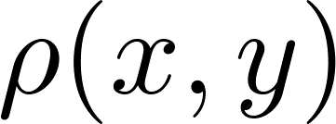
Podmienená pravdepodobnosť
Majme teraz dvojrozmerné eventy, ktoré žijú v dvojrozmernom priestore $x,y$. Ich rozloženie pravdepodobnosti je dané dvojrozmernou hustotou .
Ako sa tá dvojrozmerná hustota experimentálne získa. Vyberiem sa do roviny $x,y$ na „lov eventov“. Ulovím $N$, urobím dvojrozmerný histogram a nafitujem ho hladkou funkciou .
Predpokladajme teraz, že nás zaujíma len $x$-rozdelenie eventov takých, ktorých hodnota $y$ padne do nejakej zvolenej množiny $Y$ na osi $y$. Ako to získam? Zoberiem si „sieťku na eventy“ a potulujem sa s ňou len po podoblasti roviny $x,y$, takej kde $y∈Y$ a chytám eventy. Všetky eventy, ktoré tak chytím budú mať hodnotu $y∈Y$ a nejaké dopredu neurčené $x.$ Zoberiem si takto ulovené eventy a analyzujem v tejto množine rozdelenie premennej $x$. To čo dostanem je podmienená pravdepodobnosť premennej $x$ za predpokladu, že $y∈Y$ .
Teraz si uvedomím, že nemusím vždy nanovo loviť eventy v záujmovej oblasti $Y$. Stačí, ak z pôvodne nalovených $N$ eventov, ktoré som lovil náhodne v celej rovine $x,y$ vyberiem také, pre ktoré $y∈Y$ . Označme počet takých eventov $N_{Y}$. Z týchto $N_{Y}$eventov bude istý počet takých, ktorých súradnica $x$ bude v oblasti $X$, teda $x∈X$. Označme tento počet ako $N_{XY}$. Potom by už malo byť akceptovateľné nazvať číslo
že to je podmienená pravdepodobnosť $x∈X$ ak už vieme (alebo „za predpokladu“), že $y∈Y$.

Slide 2
Podmienená pravdepodobnosť
Vypočítame teraz $N_{Y}, N_{XY}$.
Ak všetkých pokusov je $N$, potom z nich takých, kde $y∈Y$ je zrejme
Z týchto eventov sme potom vyberali také, kde súčasne bolo aj $x∈X$. Ich počet sme označili $N_{XY}$. Uvedomme si ale, že tie eventy nemusíme vyberať z tých $N_{Y}$ eventov, rovnaké eventy dostaneme ak ich budeme vyberať rovno zo všetkých $N$ eventov, ak budeme vyberať eventy pre ktoré $x∈X$ a súčasne $Y∈Y$. Bude ich
Potom pre podmienenú pravdepodobnosť, ktorú sme (dúfam že s plným pochopením) definovali ako
dostaneme
a to je presne ten vzorec, ktorý sa nám možno zdal málo pochopiteľným

Slide 3
Continuous random events: more dimensions
Independent variables
Variable $x$ is independent of $y$ if the conditional probability
does not depend on $Y$ for any $X$. It means that knowing information about $y$ does not change our expectation about $x$. We shall prove that $x$ is independent of $y$ if and only if the two dimensional probability density factorizes, that is if it can be written as
where on the right side we have the marginal distributions. First we prove the sufficient condition. Suppose $ρ(x,y)$ factorizes. Then
and the result obviously does not depend on $Y$.

Slide 4
Continuous random events: more dimensions
Independent variables
Now we prove the necessary condition. Let us choose the regions $X,Y$ to be very small intervals around specific (but arbitrary) values $x_{0}{,y}_{0}$. Let us denote those small intervals as $dx_{0},dy_{0}$. We get
Since the conditional probability is independent of $Y$, we can write
Comparing the two results, we get
since the values $x_{0}{,y}_{0}$ are arbitrary, we have proven the factorization.

Slide 5
Continuous random events: more dimensions
Mean values
We have two random variables $x, y$ with probability density $ρ(x,y)$. Then the following is true in general
Proof:
We have two independent random variables $x, y$ with probability density Then the following is true

Slide 6
Continuous random events: more dimensions
Mean values
Proof: for independent variables
and we get
Note: if holds, it does not necessarily mean that the variables are independent, even if it often considered as a strong hint for independence.

Slide 7
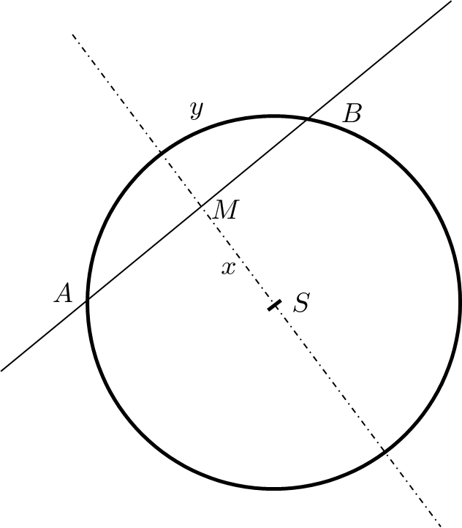
Continuous random events: no bias distribution counterexample
Consider the following problem. A thin long rigid rod is randomly thrown onto a circle and intersect the circle in two points A,B forming a chord (segment AB). Denote the length of the chord as $ξ$. Find the probability density for the random variable $ξ$.
“Solution” 1:
Without loss of generality we can assume that all the thrown rods are parallel, perpendicular to the dash-dotted line in the figure. So the random event is fully specified by the size of the segment SB denoted as $x$. Using “non-biased” uniform distribution of $x∈\left(−r,r\right)$ we get

Slide 8
Continuous random events: no bias distribution counterexample
Consider the following problem. A thin long rigid rod is randomly thrown onto a circle and intersect the circle in two points A,B forming a chord (segment AB). Denote the length of the chord as $ξ$. Find the probability density for the random variable $ξ$.
“Solution” 2:
Without loss of generality we can assume that all the thrown rods intersect the circle in the specific point A. So the random event is fully specified by the angle ASB denoted as $φ$. Using “non-biased” uniform distribution of $φ∈(0,2π)$ we get
So two equally plausible “solutions”, two different results!

Slide 9
Demo random processes

Slide 10
Random walk in one dimension: Drunken sailor
Consider one-dimensional world, a line with a coordinate denoted by $x$.
In the point $x=0$ there is a pub. At time $n=0$ (we use discrete time) a sailor gets out of the pub and starts to make random steps of equal size $Δ$ but random direction (with equal probability either to the left or to the right).
Suppose that after making $n$ steps he has got into the point with the coordinate $x_{n}$. Then after making the next step he would be in the point
The equation describes the dynamics of what is called a random process. If we observe one sailor during his motion, we observe one particular realization of the random process. This means, that for this particular realization in each time step a particular sign (plus or minus) is randomly chosen (for example by tossing a coin) and a particular position history is realized. Observing another sailor, the random choices in each time step would be different and we get a different realization of the random process. Each realization is described by the same dynamical equation as presented above.

Slide 11
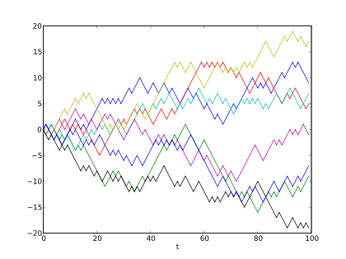
Random walk in one dimension: Drunken sailor
In the figure, there are 8 different realizations of the drunken sailor random process denoted by different colors. The plot shows the current position on the line (vertical axis) versus the time steps (horizontal axis).

Slide 12
Random walk in one dimension: Drunken sailor
We have observed in the figure that with increasing time (number of steps) there is a tendency that the sailors typically get to increasing distances from the origin.
Very often our primary interest is just one realization of the random process (one drunken sailor) and we would like to understand how his distance from the origin changes in time. We, of course, know, that for one sailor his particular distance from the origin is not a monotonic function of time. It might happen quite often that he would appear in the pub (at zero distance). Analyzing one particular trajectory with the aim to understand qualitatively its characteristics might be fairly complicated.
Instead of that we often switch to a different problem: to understand a typical behavior within a statistical ensemble of many realizations of the same random process (as it was visualized in the figure).
So we write dynamic equations for an ensemble of $N$ sailors performing random walk synchronously in parallel (making their n-th step in the same time instant). We get a set of equations

Slide 13
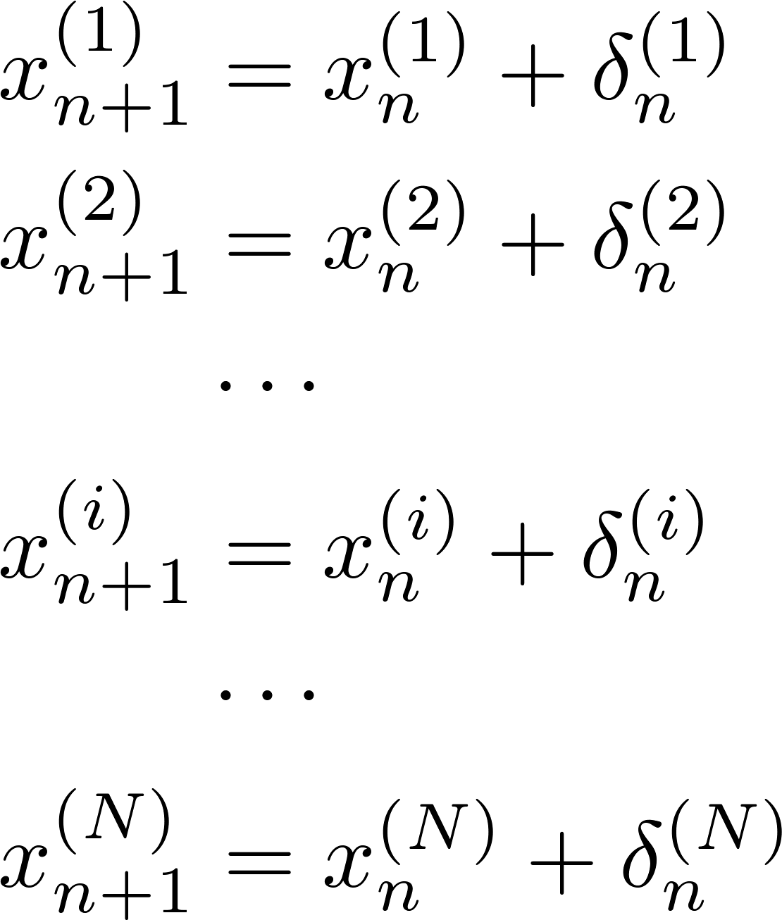
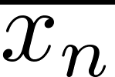
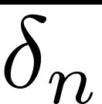
Random walk in one dimension: Drunken sailor
the superscript in the parenthesis is the index denoting individual sailors in the ensemble
Now we sum the equations and we get
The overlines denote the average values over the ensemble, that is denotes the mean coordinate of the sailor ensemble after $n$ steps. For very large $N$ the mean step is zero, since the random signs cancel.
The last recurrent equation is easily solved as

Slide 14
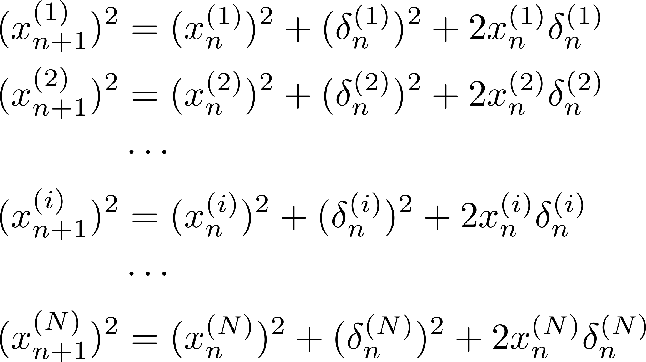
Random walk in one dimension: Drunken sailor
This results can be qualitatively expressed as: In the mean the sailor is to be found in the pub in each time instance. The statement is almost obvious due to the left-right symmetry of the problem.
However this “first law of a drunken sailor” does not characterize the observed fact that with increasing time the probability to find a sailor in a distance larger than something increases. To investigate this effect it is useful to square all the ensemble equations before calculating the averages.

Slide 15
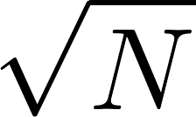
Random walk in one dimension: Drunken sailor
Averaging over the ensemble we get
The last recurrent equation is easily solved as
The “second law of the drunken sailor” therefore reads:
Mean square of the distance of the sailor from the pub increases proportionally to the number of steps. Said alternatively the typical distance of a drunken sailor from the pub increases as the square root of the number of steps.
This contrasts with the “law of non-random (directional) walk”: the distance (and not the square of it) increases proportionally to the number of steps.
So the characterizing logo of the drunken sailor is

Slide 16
Drunken sailor application: Standard error of an arithmetic mean
In mathematics and statistics, the arithmetic mean is the sum of a collection of numbers divided by the number of numbers in the collection.
It is often use to decrease the measurement error of some quantity by performing the measurement several times and taking the arithmetic mean as a better estimate of the true value of the measured quantity compared to the result of a single measurement.
Let the statistical error of a single measurement be (symbolically) expressed by the formula
Let us make $N$ individual independent measurements, denoted as
and calculate the arithmetic mean
then the typical statistical error of the average can be estimated as

Slide 17
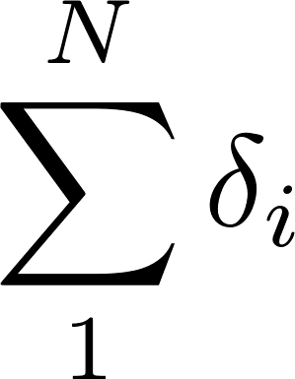
Drunken sailor application: Standard error of an arithmetic mean - proof
Let us investigate the outcome of the i-th measurement, it differs from the true value by a random error
where $δ_{i}$ is the (individual) measurement error, usually assumed to be Gaussian-distributed with mean $\overline{δ}=0$ and variance $\overline{δ^{2}}=Δ^{2}$. Then
The difference between the true value and the arithmetic mean is expressed through the sum of independent individual errors
this expression is the same as that giving the coordinate of a drunken sailor after $N$ random steps

Slide 18
Drunken sailor application: Standard error of an arithmetic mean - proof
In the final formula we clearly recognize the “drunken sailor $\sqrt{N}$rule”.

Slide 19
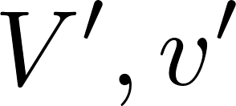
Collisions in a one-dimensional world
In a one-dimensional world observe a collision of two pointlike particles: one with mass $M$ and velocity and another with mass $m$ and velocity . Let us stress that we are not using vector notations here, so the velocities mean, in fact, velocity projection on the coordinate axis and as such they can be also negative.
Let us denote the velocities after the collision as .
It is easy to find the velocities after the collision, one gets
Let us observe many particles of the type “M” denoted by index $\left(i\right),$ then after $n$ collisions one gets
Where we assume that in each collision the particle “m” is drawn from the same common pool of particles independently of the collision number $n$. Averaging over the ensemble:
In different notation:
Asymptotically the initial particle velocity is completely forgotten after many collisions.

Slide 20
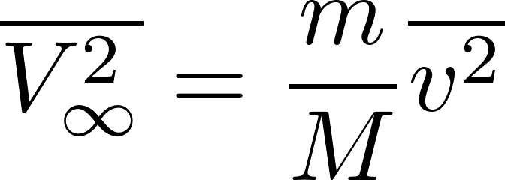
Squaring this equation first and only then making the ensemble average we get:
Asymptotically we get
The meaning oft the asymptotic solution is better understood, after we rewrite it as
We can read it as
“Ensemble-mean kinetic energy is asymptotically the same as the mean energy of the particles from the pool.”

Slide 21
Particle collisions: conclusions based on the demo
A particle randomly bombarded by particles having some mean kinetic energy asymptotically “forgets” its initial velocity and finally reaches (mean) kinetic energy equal to the kinetic energy of the bombarding particles. The word mean here describes a statistical average within an ensemble of similar particles undergoing same random bombardments. To be more precise here we speak about kinetic energies of the translational motion.
Conclusion 1: if we have an equilibrium system consisting of many types of particles (different masses) then the mean kinetic energy of all the particles will be the same.
Conclusion 2: if we start with a system of different types of particles with unequal kinetic energies then after some relaxation time the mean kinetic energies of all the particles will become the same.
Conclusion 3: If we have two physical systems in thermal contact (this means that they cannot exchange particles but the particles on the surface contact can collide with each other) then started from arbitrary macroscopic state the equilibrium will be reached where the mean kinetic energies of particles in the two systems will be equal

