Slide 1
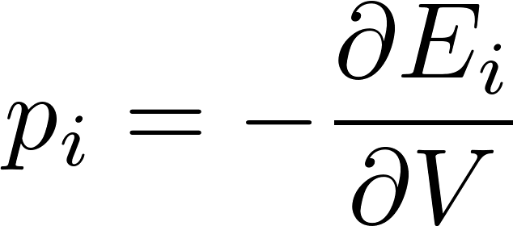
Macroscopic work in general
Studying the work related to piston-pusher dwarf we have studied one specific example of macroscopically performed work.
In general the term macroscopic work is used for any work required to change a (macroscopic) external parameter (like volume of gas).
What is called external parameter was never quite clear to me on a phenomenological level in thermodynamics. In statistical physics, and in particular in quantum statistical physics, it is more clearly defined. We have a system with very large degree of freedom (like ${10}^{26}$) We consider its stationary states and the corresponding energy spectrum. The energy values might depend on some macroscopic parameters (like volume, magnetic field etc.). Those parameters are, by definition , called external parameters. If an external agent (dwarf) changes the value of an external parameter, it leads to changes of the energy spectrum, and therefore it changes the total energy of the system. Therefore work has to be performed to change the external parameter value. Since the external parameter ($V)$ is a macroscopic parameter, the change of its value $(dV)$ is also macroscopic and the corresponding work $(δA=pdV)$ is “macroscopically observable”. In the formula $p$ denotes a force parameter conjugated to the external parameter $V$. In particular: if the system is in its $i$-th stationary state with energy $E_{i}$, the conjugated force value (in the state $i$) is defined as

Slide 2
Microscopic work: heat
There is, however, also a different way how to change the energy of a system, not by changing the external parameters values.
If we bring the system considered to a thermal contact with some external objects, then the interaction of molecules (collisions) of the two systems can lead to a change of the energy of the system being considered. How it is done? Of course by performing work on the molecular level. It is a simple mechanical work as known from the courses of mechanics, but typically this work is performed on a microscopic level and is not directly observable macroscopically.
According to present-day knowledge this work performed on a microscopic molecular level is called heat. However, there was a complicated historical development until the physicist arrived at the knowledge, that what they phenomenologically called heat is not a sort of (kind of) energy, it is rather a sort of work.
The difference between “the work” and “the energy” is principal. Common people still speak about heat as a kind of energy. So some more notes about the history of “heat” are necessary now.

Slide 3
Historical notes
We have at least intuitive feeling about temperature. So it was in the history. People learned how to measure temperature without properly understanding what “temperature really is”. The invention of a thermometer was not a single act. Various thermoscopes were known by old Greeks. But only much later people introduced some arbitrary scales to thermoscope leading gradually to the development of thermometer. Our practical scale was introduced by Celsius at the first half of the 18 century.
The invention of thermometer opened the way to gather empirical facts related to temperature an how it can be changed.
It was obvious, that temperature of some object could be changed by heating it or cooling it, what essentially meant to bring it into a thermal contact with something hotter (with higher temperature) or something cooler (with lower temperature). Again what physical process is hidden behind the heating or cooling was not understood at all.

Slide 4
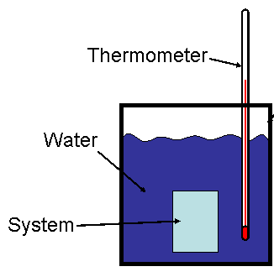
Calorimetry
Quantitative experiments about heating or cooling were done using calorimeters.
A calorimeter is a thermally isolated vessel. Inside the vessel we bring into contact two physical objects having initially different temperatures. Typically one object is a liquid like water, the other may be some solid body.
After some time the thermal equilibrium is established, both object having the same temperature which we measure.
So the experiment looks like this
Water: mass $m_{1}$, initial temperature $t_{1}$. Solid body: mass $m_{2},$ initial temperature $t_{2}>t_{1}.$
The final temperature is $t$.
Empirical facts show that there is a material constant for water $c_{1}$ and for the body $c_{2}$, so that a following calorimetric equation holds
The material constants$c_{1}, c_{2}$ are called specific heat constants.

Slide 5
Calorimetric equation as a conservation law
Calorimetric equation can be rewritten as:
Inspecting that equation it looks like a conservation law. Some quantity calculated like $mct$ is the same at the beginning an at the end of the process. This something looks like to be hidden inside the objects but distributed differently between the two objects during the process, the total sum being conserved.
We certainly cannot resist the temptation to introduce a new physical quantity: the heat. The heat is hidden inside the objects, can be transferred between the objects, the total amount of heat is conserved. More heat inside the object means higher temperature. It lead to terminology like heat transfer, loss of heat, “heat is transferred through conduction, flow or radiation”. All this was found to be wrong!
The crucial point was, that the first calorimetric measurements were done using fluids or solid bodies both having the property that they change their volumes with temperature only slightly. The situation is dramatically different with gases.
We have seen during a qualitative discussion of an adiabatic process that we can change the temperature of some gas just by changing its volume by the “piston pusher” who is acting by force on a moving piston therefore performing mechanical work.
So the lesson is simple, to change the temperature, we do not need to increase the “heat content” of the body, we can just perform mechanical work.

Slide 6
Phenomenological units of heat
Historically, when people defined heat as “something that is conserved according to the calorimetric equation
it was obvious, that there is not any “natural” physical unit of heat, The content of heat in a body defined as $mct$ is not well defined until we define the physical unit for the heat capacity.
It is obvious, that if we multiply the heat capacities of all materials by the same constant, the calorimetric equation would still hold, That means the unit for heat capacity can be arbitrary, since the heat capacity and/or heat itself is (at this level of physics knowledge) not directly connected to any other physical quantity (with already defined physical unit).
So the unit of heat was chosen arbitrarily to be one calorie “cal” defined as the amount of heat needed to increase the temperature of one gram of water by one degree.
Therefore the specific heat of water was defined as 1 cal/g/K. The specific heat of any other material can then be measured by a suitable calorimetric measurement.

Slide 7
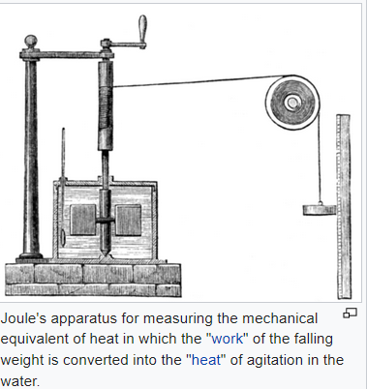
Mechanical equivalent of heat
Benjamin Thompson, Count Rumford, had observed the frictional heat generated by boring cannon at the arsenal in Munich, Germany circa 1797. More precise measurements were done by James Prescott Joule in the 1840s.
Finally it was found that the same increase of temperature of some object as achieved by “transfer of heat” of 1 kcal can be achieved by performing a mechanical work of
4186 J.
So it was found that the “amount od heat” can be more naturally measured by the units of work, Joules. In this way a “mechanical equivalent of heat” was found. Calories can be universally converted to Joules by the conversion constant 4186 J/kcal.

Slide 8
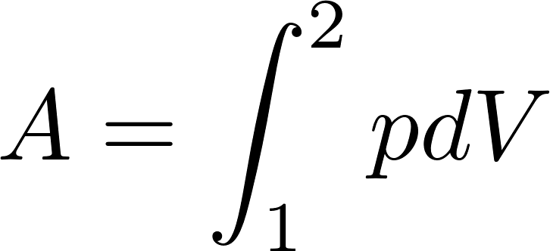
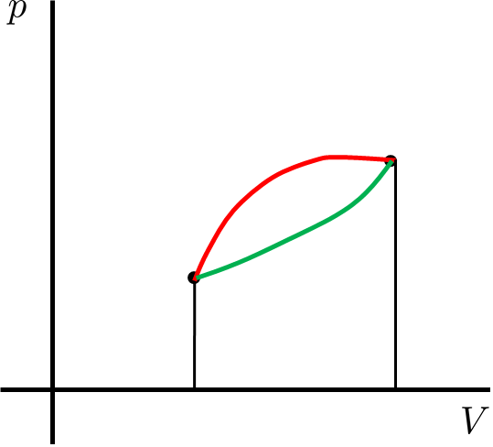
Work and heat for reversible processes in gas
We have found that the work performed by the “piston-pusher” during a reversible process changing the state of gas from the state “1” to the state “2” can be calculated as
and this work depends on “the trajectory” of the process between the initial and final states, as it is clearly seen from the figure below.
The obvious question is how much heat is to be provided by the boiler attendant on a particular process (trajectory). A careful investigation of this problem has lead to precise specification of the concept of energy formulating the law called “first law of thermodynamics”.

Slide 9
First law of thermodynamics
For any process between the two states “1” and “2” we can calculate the work performed by the piston pusher
and we can measure the heat “transferred” to the gas by calorimetric consideration of the actions performed by the boiler attendant. The following empirical law was established.
The sum of mechanical work and heat (converted to Joules) depends only on the initial and final states of the system and so this sum is the same for any (reversible) process (trajectory) between those two states.
Let us stress again: the work by itself and the heat by itself depend on the specific trajectory, their sum does not.
This means that the sum of work and heat must be calculable from the characteristics of the initial and final states only.
This means that we can define a physical quantity of state in such a way, that the difference of this quantity between the two states is equal to the sum of work and heat performed during (any reversible) process between the two states.

Slide 10
First law of thermodynamics
Repeating: the first law of thermodynamics says, that there must be a physical quantity of state such that the sum of work and heat is calculable as a difference of this quantity between the final and initial state.
This quantity was given a name: energy. More precisely, the phenomenological thermodynamics used the name internal energy. The reason perhaps was, that it was not obvious that the state function “energy” as found by thermodynamical considerations has anything common with the quantity “energy” as found in the studies of Newtonian mechanics of particles.
Of course, there was a connection: the internal energy can be changed at the expense of mechanical work, the same work as found in classical mechanics.
Only after molecules were discovered, it was clear that the “internal energy” is a “standard” mechanical energy of molecules, just macroscopically “not directly visible”.
In what follows we shall use the terminology “energy”, without the attribute internal.

Slide 11
First law of thermodynamics
The obvious task for a phenomenologist is to find the formula for energy as a function of quantities defining the macrostate.
Obviously, the first law of thermodynamics can determine only the difference of energies of two states, so energy in thermodynamics is defined up to an arbitrary additive constant.
The phenomenologist has to define some arbitrary reference macrostate whose energy is set to 0 by definition. Then he has to measure the sum of work and heat going from the reference state to an arbitrary macrostate. Based on experimental data he has to “guess” a formula for energy.
A theoretician, who already knows that behind the macrostate there is some microstate of molecules can in principle calculate the (mechanical) energy of molecules in the chosen representing microstate and, based on statistical considerations, express the energy of the macrostate through the macroscopic quantities defining the macrostate considered.

Slide 12
First law of thermodynamics
we shall present the statistical analysis later, here we will just quote (without proof) formulas for the energy of ideal gasses.
Gas of $N$ moecules has energy
These formulas are just approximate, more exact quantum mechanical expressions should take into account details of internal structure of atoms and molecules. We introduce a universal notation as
The rationale for this notation will be clear when we shall discuss the isochoric process energy heat balance.

Slide 13
First law of thermodynamics
Let us finally present a formula corresponding to the first law of thermodynamics as it is usually presented in standard textbooks.
Let us consider an infinitesimal change of state between two close macrostates. The energy difference will be $dE$, the mechanical work preformed by the physical system will be $δA$, and heat performed by an external agent (boiler attendand)$δQ$. The first law of thermodynamics then reads
Do notice that the first law of thermodynamics is, in fact, the generalized law of energy conservation: any change of energy has to be balanced by work of external agents. Do notice the negative sign of the mechanical work. This is due to a standard convention that when speaking of the mechanical work we speak about work performed by the system (gas) upon an external agent (piston pusher), while the convention for heat is that it is the (microscopic) work performed by an external agent (boiler attendant) upon the physical system (gas).
Do also notice, that we use the terminology “performed heat” and not “transferred heat”. Heat is a form of work: it is not a form of energy.
A few words to notations. $d$ in $dE$ means the difference of two (infinitesimally close) values of energy. Symbol $δ$ in $δA$ means that it is an infinitesimally small value, but it is not a difference of any two values. The amount of work depends on the trajectory, so it is not a difference of a final and initial values of any state quantity. Similarly for heat.

Slide 14
Heat is a form of work, not of energy
The fact that heat is not a form of energy we consider to be so important, that we devote to it a special slide.
The difference between “work” and “energy” is essential. Energy is a state quantity, work is not. We can say that energy is “stored” in a physical system as are goods in some warehouse. The energy can be “taken out” of this warehouse and transferred to some other object to be stored inside it.
The way, how the energy can be transferred from one object to another is by performing work. Work is the property of some process. Once the process ends, the work is no more there.
If you go with your car to a service, you get an invoice. There are two groups of items mentioned in the invoice: spare parts and work. Spare parts were stored in the service warehouse, were taken out of there and mounted to your car. From then on the spare parts are stored in your car and they are there long after the service operations were finished, you take them to your home with your car.
On the other hand the invoice mentions performed work (usually expressed in man-hours). The work was not stored anywhere in any warehouse. It was just performed during the service operations. You did not take the “performed work” to your home with your car. The work is nowhere after service operations ended.
Well, this is exactly the difference between “energy” and “work”, or “energy” and “heat”. So if you get an invoice saying “we delivered to you 1 GJ of heat” it is nonsense. The invoice should read “we performed for you 1 GJ of heat”. Unfortunately, nobody speaks like that. People just do not follow my lectures.

Slide 15
First law of thermodynamics as a definition of heat
The first law of thermodynamics
is often written as
In this form it can be interpreted as the definition of heat. The point is that we can easily calculate the mechanical work $δA$ for any process (just using the formula $δA=p dV$.
We also often know (either by phenomenological analysis or by theoretical calculation) the formula for energy. What is less obvious is calculation of heat for an arbitrary process. So we easily define that heat is the missing work needed to complete the energy – work balance.
We shall demonstrate the energy – work – heat calculations for standard gas processes.

Slide 16
Energy – work – heat for the isochoric process
Isochoric process means constant volume, $dV=0$. So no mechanical work is performed.
For ideal gas we have the energy formula
so $dE=C_{V}dT$ and from the first law of thermodynamics we get for heat at isochoric process
This is a typical calorimetric formula, so we now know the meaning of the constant $C_{V}:$
it is the heat capacity of ideal gas for isochoric process.
Please, do remember, that the formula $dE=C_{V} dT$is valid for any process with ideal gas, since the energy difference is process independent. So there is always the constant $C_{V}$ in this formula, it is just an “accident” that this constant has a special meaning for isochoric process. So, for example, for isobaric process we still have $dE=C_{V}dT$ and not something like $dE=C_{p}dV$.

Slide 17
Energy – work – heat for the isobaric process
Isobaric process means constant pressure, $p=\text{const}$. Calculation of mechanical work is trivial
For ideal gas we have the energy formula and so
The firs law of thermodynamics then gives
This is a typical calorimetric formula, however, for isobaric process. We have denoted the corresponding heat capacity (at constant pressure) as
$C_{p}=C_{V}+Nk$.
The last relation is called Mayer relation and for one mole it reads

Slide 18
Energy – work – heat for the isothermal process
Isothermal process means constant temperature, $T=\text{const}$. Calculation of mechanical work is not difficult
For ideal gas we have the energy formula and so
The firs law of thermodynamics then gives

