Slide 1
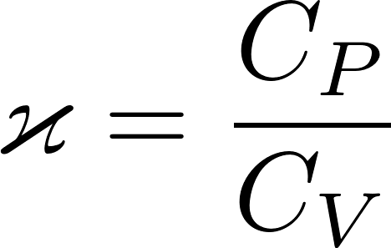
Adiabatic process
Now he have enough knowledge to calculate everything about adiabatic process which is defined as $δQ=0$. From the first law of thermodynamics we get
What we got is a differential equation for an unknown function $T(V)$ describing an adiabatic process on a $VT$ diagram. We are willing to use a $pV$ diagram, so we need a differential equation in $pV$ variables. We swap $VT$ for $pV$ using the equation of state:
Using the Mayer relation $C_{p}=C_{V}+Nk$ we get
where we introduced Poisson constant

Slide 2
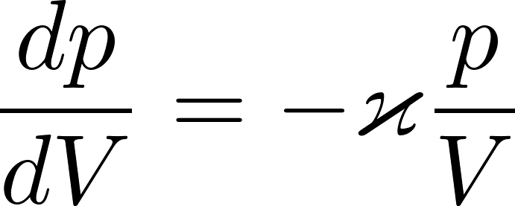
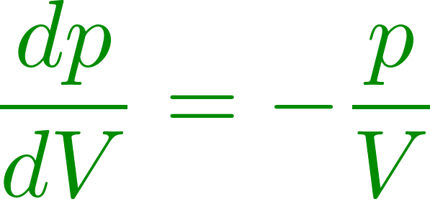
Adiabatic process
What we have got? It is a differential equation for the unknown function $p\left(V\right)$ representing an adiabatic process on a $pV$ diagram. We are looking for a curve, which starts at a given initial state $p_{1}V_{1}$ and in each $pV$ point through which it goes it has the derivative (slope)
There is an infinite number of curves representing different reversible processes going through arbitrary point $pV$. In particular there is an isotherm $pV=\text{const}$, the slope of which is
Since the adiabatic curve is steeper than the isotherm in a common $pV$ point.

Slide 3
Adiabatic process
in principle we can draw in any point in the $pV$ diagram a short line showing the slope of the adiabat curve going through that point as given by the formula
We should get something like this (the figure is just a sketch, not exact drawing)
Now imagine we have a figure with a very dense population of local slope lines. If we choose one point as a starting state for an adiabatic process, we can simply draw a continuous curve going through the points and get the whole adiabat.

Slide 4
Adiabatic process
in principle we can draw in any point in the $pV$ diagram a short line showing the slop of the adiabat curve going through that point as given by the formula
We should get something like this (the figure is just a sketch, not exact drawing)
Now imagine we have a figure with a very dense population of local slope lines. If we choose one point as a starting state for an adiabatic process, we can simply draw a continuous curve going through the points and get the whole adiabat.
The green curve is a smooth curve going through the points and having in each point the slope as given by the short slope line in that point

Slide 5
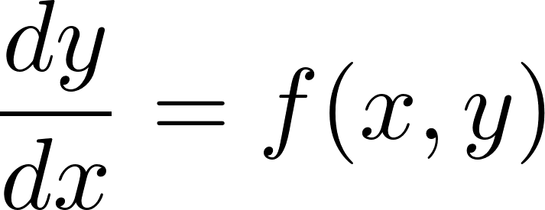
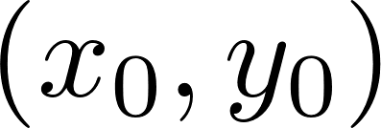
A note on differential equations
Solving a first order differential equation
we are looking for a curve $y(x)$, which starts at the point $(x_{0},y_{0})$ and in each point $(x,y)$ through it goes it has the slope $f(x,y)$. The visualization of this problem in the $x,y$ plane is the same as we have seen when looking for the adiabat curve
Instead of drawing a curve by hand we can use a computer to make many small steps finding a sequence of points $(x_{i},y_{i})$ which approximately lay on the curve we are looking for. A simple recursive stepping algorithm does the job (Euler numerical method for solving differential equations)
A higher order differential equation can be easily rewritten as a first order equation in a higher dimensional space and the Euler method can be used.

Slide 6
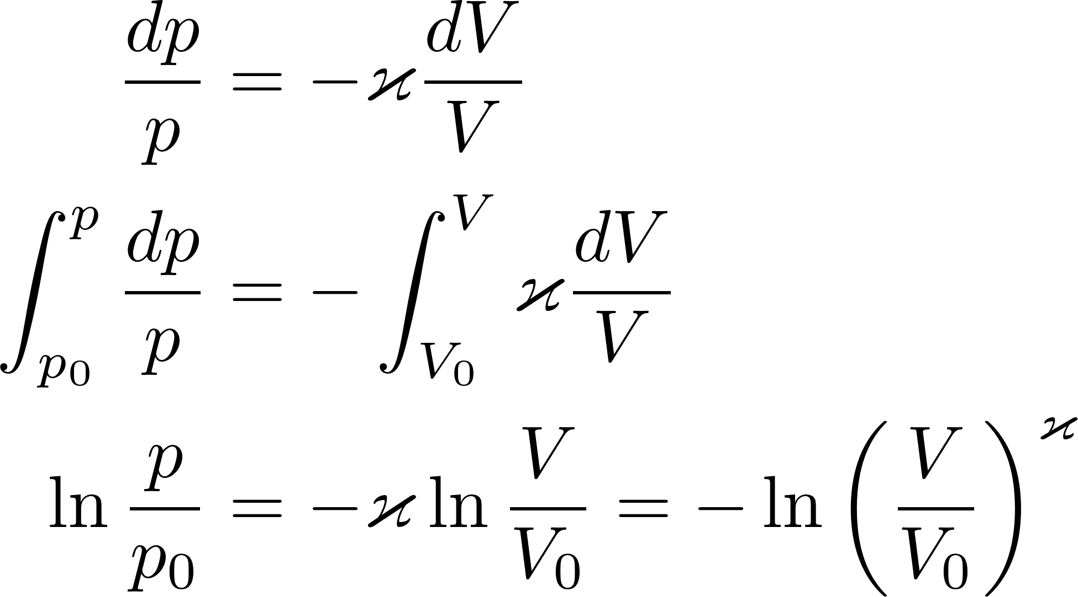
Adiabatic process
The differential equation for the adiabat
can easily be solved analytically.
This is the adiabat curve (for ideal gas) which goes through a given point ${(p}_{0}{,V}_{0})$.

Slide 7
Carnot cycle
The Carnot cycle is a theoretical thermodynamic cycle proposed by French physicist Sadi Carnot in 1824. It provides an upper limit on the efficiency that any classical thermodynamic engine can achieve during the “conversion of heat into work”, or conversely, the efficiency of a refrigeration system in creating a temperature difference (e.g. refrigeration) by the application of work to the system.
The analysis by Carnot is an example of “intellectual beauty”. Using very simple considerations, without any heavy mathematics, Carnot was able to demonstrate, that there is an upper limit for the efficiency of any thermodynamic engine which has access just to two reservoirs: hot at temperature $T_{1}$ and cold at temperature $T_{2}$. What is really striking is that “any engine” means even engines not yet proposed and even engines working on some new (not yet discovered) physical interactions of matter. A demonstration of power of human intellect.
Technical praxis needs a lot of machines able to perform mechanical work: lifting or moving objects, pumping fluids, machining (turning, drilling, milling) materials etc. To perform work, one needs a source of energy. Sometimes it is just a form of mechanical energy like in the watermill. However, sources of mechanical energy (which are simple to use to perform mechanical work) are rare. We have much richer resources of chemical energy, which can simply be used to perform heat but not so easily to perform macroscopic mechanical work.

Slide 8
Thermodynamic cyclic engine
We have used the expression “conversion of heat into work”. This expression is scientifically not quite correct. Heat is not a form of energy; it is a form of (microscopic) work. A heat engine (thermodynamic engine) is a device, which receives work in the form of heat and performs macroscopic mechanical work.
Speaking about the efficiency of such a machine we have in mind how many “Joules of mechanical work” can be produced receiving some amount of Joules of heat work.
Carnot engine is a hypothetical cyclic thermodynamic machine which has access just to two reservoirs: hot at temperature $T_{1}$ and cold at temperature $T_{2}$. Its cycle consists of 4 steps.
It is worth to stress, that the size of the machine (how many moles of working gas is used) is arbitrary. The amount of useful work the machine provides during one cycle depends on its size.

Slide 9
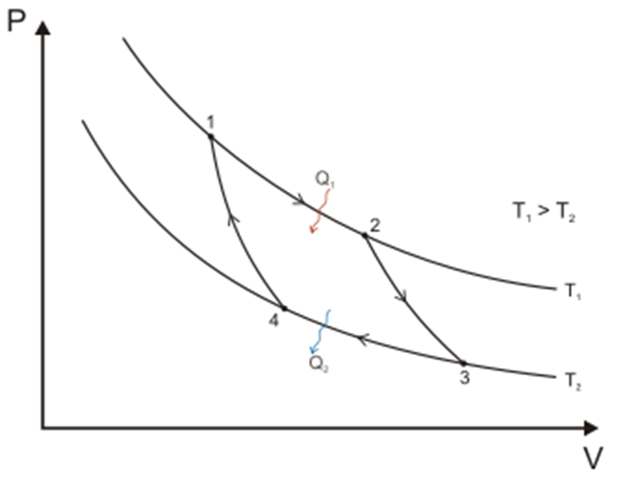
Carnot cycle
The Carnot cycle starts (end ends) in the point $\left(p_{1}, V_{1}, T_{1}\right).$ All three parameters can be chosen arbitrarily. The size of the machine $\left(N\right)$ is then uniquely given by the equation of state $pV=NkT$. The cycle consist of four reversible steps
The isothermal expansion on $T_{1}$to arbitrarily chosen volume $V_{2}$. The Pressure $p_{2}$ is then uniquely determined.
The adiabatic expansion to temperature $T_{2},$ point $(p_{3},V_{3})$ is then uniquely determined.
The isothermal compression on $T_{2}$ to a point $p_{4},V_{4}$ which is uniquely determined by the requirement that from there one can get adiabatically to the initial point $p_{1},V_{1}$.
The adiabatic compression to the point $p_{1},V_{1}$.

Slide 10
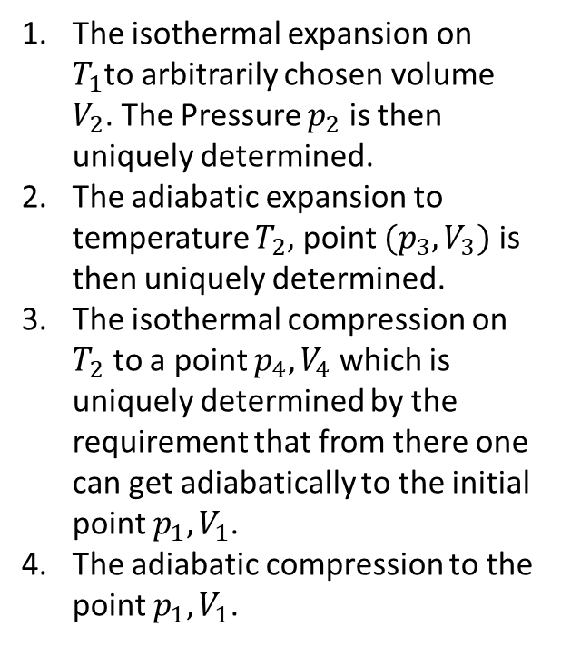
Carnot cycle
The machine performs positive mechanical work during the expansion steps 1 and 2 and negative mechanical work during the compression steps 3 and 4.
It is an easy but a bit tedious work to calculate all the state parameters $p_{2},p_{3},V_{3},p_{4},V_{4}$ from a given set $p_{1},V_{1},T_{1},T_{2},V_{2}$. Once we have those values it is easy to calculate heat and work for each step of the Carnot cycle.

Slide 11
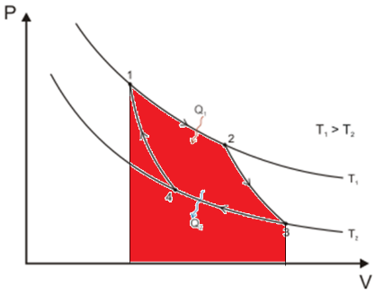
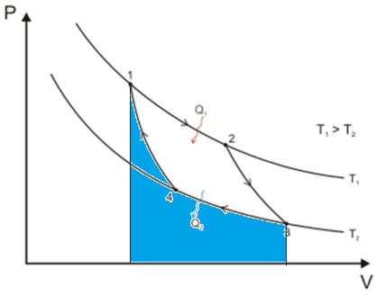
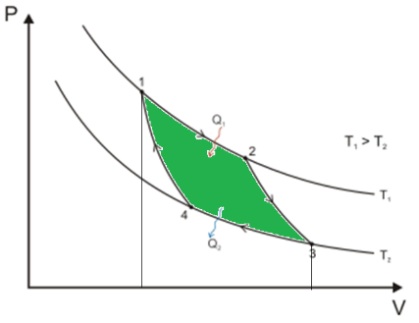
Carnot cycle
The machine performs positive mechanical work during the expansion steps 1 and 2, the total amount of the positive work is given by the area marked as red in the figure.
The machine performs negative mechanical work during the compression steps 3 and 4, the total amount of the negative work is given by the area marked as blue in the figure.
The net amount of work ($A)$, which can be used during one cycle is given by the area marked as green in the figure.
There is a positive heat $Q_{1}>0,$ performed by the thermostat keeping the temperature $T_{1}$ during the step 1 and a negative heat $Q_{2}<0$ at temperature $T_{2}$ during the step 3. Heat is zero during the adiabatic steps 2 and 4.
Since the machine gets to the initial state after performing the cycle, the useful work $A$ can be calculated as $A=Q_{1}−|Q_{2}|$.

Slide 12
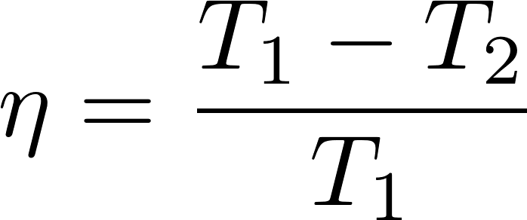
Carnot cycle: efficiency
Carnot main motivation to study heat engines was the problem how to increase the efficiency of real thermodynamic machines. He designed the Carnot cycle to study the efficiency in general.
The efficiency of the Carnot machine is defined as
Once we calculate all the state parameters relevant to the Carnot cycle it is easy to calculate the efficiency. One gets a simple formula

Slide 13
Note on efficiencies
There are frequent misconceptions concerning the notion efficiency:
that it is a physics notion defined like (power output)/(power input)
that efficiency is always less than 100 %
There is no unique technical definition of efficiency: it is more an economics notion than a physics notion. The idea can perhaps be symbolically defined as
To be mathematically consistent one has to quantitatively express both “performance” and “price” in same units. It may be dollars, watts, amount of water (like amount of water pumped out of a mine compared to the amount of water needed to turn the water wheel driving the pump), etc.
The efficiency can easily be much larger than 100%. A drastic example might be a picklock priced 100 $ to steel a luxury car priced 1 million $. The efficiency is 10000 % (until you get caught by the police).

Slide 14
Carnot cycle: efficiency
We have defined the efficiency of the Carnot machine as
The reason for this definition is simple. The purpose for the thermodynamic engine is to get useful mechanical work $A.$ And we have to pay cost for burning some fuel to provide heat $Q_{1}$.
At the time being the cooling ${(Q}_{2})$ is free of charge, we use the atmosphere as heat absorber. It may happen in future that we will have to pay charges for “heat pollution”, then the definition of the engine efficiency would be something like
where $α$ would be a “penalty price factor” for heat pollution determined by the state government.

Slide 15
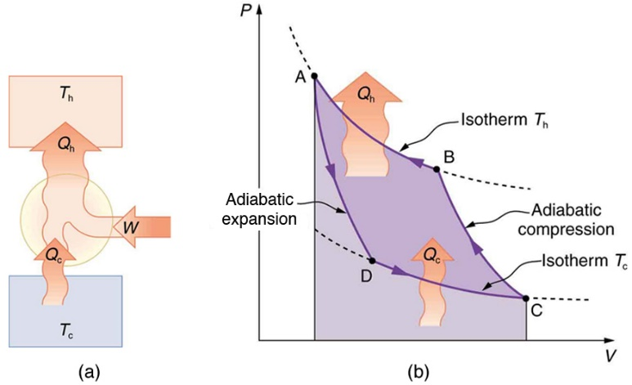
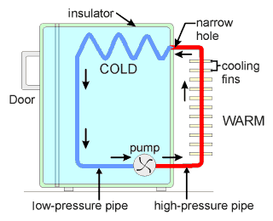
Carnot engine as a refrigerator
Carnot cycle is reversible so the engine can run in the opposite direction. Instead of producing useful work it consumes mechanical work, “receives” heat from the cold body
and heats the hot body. So it works as a refrigerator: the cold body becomes even colder, the hot body (“kitchen environment”) gets even hotter. You have certainly noticed the heat radiator on the back of a kitchen refrigerator.
Since the Carnot cycle is run exactly in the opposite way, all the quantities have the same absolute value, jut opposite signs ( $Q_{1}<0, Q_{2}>0, A<0$).
Think about the efficiency of a refrigerator. The purpose is the heat $Q_{2}$ “pumped out” from inside and the cost is the mechanical work (we pay for the electricity to drive the compressor). So we get

Slide 16
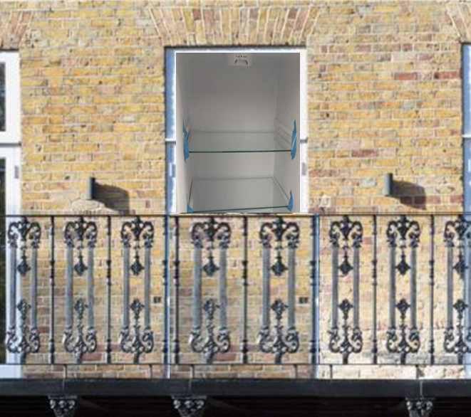
Carnot engine as a heat pump
Carnot engine run in the reverse direction can be used not only as a refrigerator to cool the cold but also as a heater to heat the hot.
To get a heat pump for heating you can in principle take a standard refrigerator, throw away its door, open the balcony and insert the refrigerator into the balcony door so that the interior of the refrigerator is seen from outside the building like here in the picture.
If you look from inside the room, you will see the backward side of the refrigerator with the (black) heat exchanger replacing the balcony door.
If you switch on the refrigerator it will start to cool the outside atmosphere and heat the room by the hot heat exchanger

Slide 17
Carnot engine as a heat pump
A heat pump works exactly as a refrigerator: it “takes out” heat $Q_{2}$ from outside, consumes the mechanical work $|A|$ and “injects” heat ${|Q}_{1}|$ into the room. What is its efficiency?
The purpose is $|Q_{1}|$ and the cost is $\left|A\right|$.
The efficiency of a heat pump is larger than 100% ! We get more Joules into the room than we pay for the Joules of $A$ !

Slide 18
Carnot theorem
The Carnot theorem states: No engine operating between two heat reservoirs can be more efficient than a Carnot engine operating between the same reservoirs.
The Carnot theorem has to be read carefully. It says, that the Carnot engine is a winner of a competition between all possible heat engines. However, one has to read carefully the rules for that competition.
The rules to be observed by all engines willing to take part in the competition are here:
the heat engine must be a cyclically working machine, each cycle starting and ending in the same state
the machine is allowed to interact only with two outer systems: two heat reservoirs, one having temperature $T_{1}$, the other temperature $T_{2},$ or be thermally isolated during some parts of its cycle.
The proof of the Carnot theorem is by reductio ad absurdum. That means that we assume that a better machine exist and then we show that we can derive from that some physically unacceptable consequence. The key is in the words physically unacceptable: we do not get any logical contradiction. We just get a consequence which we believe not to be true in the world around us. This kind of belief is based on our historical experience, limited as it is. Limited experience does not mean absolute knowledge. Keep in mind: maybe we are wrong.
You have been warned, so we can continue with the proof of the Carnot theorem.

Slide 19
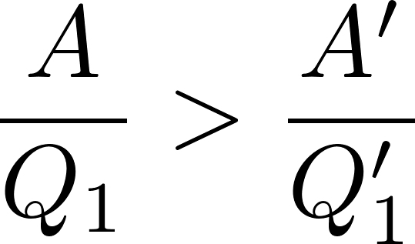
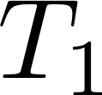
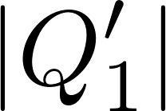
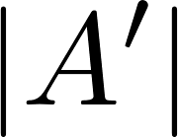
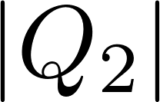
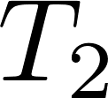
Carnot theorem: “proof”
Suppose somebody claims that his (hypothetical) machine is better than Carnot machine. His parameters are $Q_{1}>0$ (heat “taken out from the hot reservoir) and $Q_{2}<0$ ($|Q_{2}|$ is returned to the cold reservoir) and performs useful work $A$.
We take a Carnot engine of such a size, that when operated as a heat engine its parameters are $Q_{1}^{′}>0$ and $Q_{2}^{′}=Q_{2}<0$. We run the Carnot engine as a heat pump (reversed run) consuming mechanical work $A^{′}=Q_{1}^{′}−|Q_{2}|$ per cycle.
We shall prove that $A>A′$ if the hypothetical machine is indeed more efficient. Here is the proof:
according to the assumption:
So we can use the hypothetical efficient machine to feed the Carnot heat pump and we still can use the work access $A−A′$ to for some useful purpose like pumping out water from a mine.

Slide 20
Carnot theorem: “proof”
So we have shown that if the hypothetical machine is indeed more efficient than the Carnot machine, we can combine the hypothetical machine with a Carnot heat pump to form a compound heat machine (framed by green in the figure) that produces useful mechanical work $A−A′$ just by “consuming “ heat $Q_{1}−|Q_{2}|$ from the hot reservoir but does not “return” any heat to the cold reservoir, since the same heat which is returned by the hypothetical machine is taken out by the Carnot heat pump. The cold reservoir is, in fact, not needed for the work of such a compound machine.
By that we would be able to construct a perpetuum mobile of the second kind. This is defined as a heat machine which “converts” heat into mechanical work without the need to “return” some heat into outer environment. This is believed to be a physical contradiction.

Slide 21
Second law of thermodynamics
We arrived at the statement that it is not possible to construct perpetuum mobile of the second kind. Notice that we did not prove it. We just said we believe it cannot be constructed. We believe it so strongly that we have promoted this statement to be a deep principle of physics: the second law of thermodynamics. All our experience suggest, that perpetuum mobile of the second kind is not possible. As anything in physics, we cannot prove it. Just saying “it would be too good to be true” is just a cliché, not a proof.
Impossibility of perpetuum mobile of the second kind is just one possible formulation of the second law of thermodynamics. There are many other, physically equivalent, formulations. Like this one:
Heat cannot spontaneously “flow” from cold system to hot system without external work being performed.
This can be reformulated as: It is not possible to construct absolute refrigerator, which would be a device able to “pump heat” from cold region to hot region without need “to pay” for some mechanical work. Refrigerators are possible, we have one at home. But we have to pay for the electricity. It is easy to demonstrate the connection to the Carnot theorem.

Slide 22
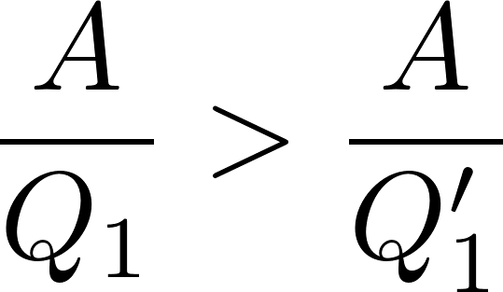
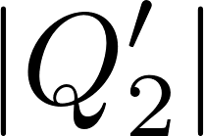
Carnot theorem: absolute refrigerator is impossible
Suppose somebody claims that his (hypothetical) machine is better than Carnot machine. His parameters are $Q_{1}>0$ (heat “taken out from the hot reservoir) and $Q_{2}<0$ ($|Q_{2}|$ is returned to the cold reservoir). We take a Carnot engine of such a size, that when operated as a heat engine its parameters are $Q_{1}^{′}>0$ and $Q_{2}^{′}<0$ such that $A^{′}=A.$ We run the Carnot engine as a heat pump (reversed run) consuming mechanical work $A^{′}=A$ per cycle Here is the proof that if the hypothetical machine is more efficient, we would be able to construct absolute refrigerator:
according to the assumption:
The framed statement says that the net heat is “pumped out” from the cold reservoir by the green framed compound machine without need of external work, so we have got absolute refrigerator.

Slide 23
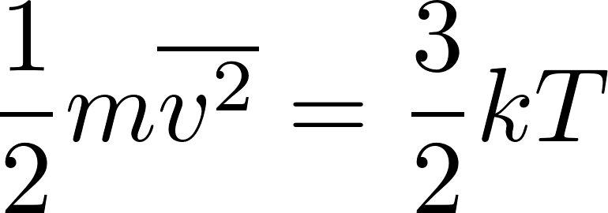
Thermodynamic temperature
The second law of thermodynamics allows us to define temperature independently of the medium.
Up to now we had defined the temperature for gas like this:
Temperature of gas in equilibrium is given by the mean kinetic energy of the translational movement of molecules as
This definition of temperature is medium-specific, since it refers to the structure of gas as being composed of molecules. For systems not composed of molecules this definition is not applicable. Of course, we can define in principle the temperature of any system like the temperature of gas which is in equilibrium with the system considered.
The second law of thermodynamics allows us to define temperature in a medium-independent way. We can use the system whose temperature we want to measure as the hot reservoir with unknown temperature $T_{1}$, a system consisting of water at the state of triple point as a cold reservoir with $T_{2}=273.16 K$ and let a Carnot machine work between these two reservoirs. If we were able to measure its efficiency $η$, the unknown temperature $T_{1}$ would be given as the temperature which satisfies the formula

Slide 24
Thermodynamic temperature
The definition of the thermodynamic temperature through the efficiency of Carnot machine is perhaps not directly usable for practical metrology. It serves as a unique theoretical definition and for practical purposes we have to use some device (perhaps different devices for different temperature regions) for which we have a reasonable statistical theory which can be directly related to the thermodynamic definition of temperature.
Actually the term “thermodynamic temperature” is not uniquely defined in physics literature. During our lectures we shall meet several other definitions also referred to as “thermodynamic temperature”. All of them are theoretically equivalent. Strangely enough even the official legal document defining SI units by International Bureau of Weights and Measures (French: Bureau international des poids et mesures, BIPM) is of no help to uniquely identify the notion of “thermodynamic temperature. In the old official definition of Kelvin it just says (https://www.bipm.org/en/measurement-units/):
The Kelvin (K) is the fraction 1/273.16 of the thermodynamic temperature of the triple point of water.
There is no further specification of what the notion thermodynamic temperature means. It is implicitly assumed that “it is explained somewhere” in the physics literature.
The notion of temperature is abstract enough that one feels rather unsure like “what they speak about”.

Slide 25
On the other hand, BIPM uses the same strategy in defining other, more common, units like meter
The meter is the length of the path travelled by light in vacuum during a time interval of 1/299 792 458 of a second.
Here one first does not feel unsafe, what is meant under the definition “length of the path”, which seems to be intuitively clear. However, anyone interested in more careful thinking will recognize that the precise definition is not simple at all and soon he will be trapped in the labyrinth of general relativity.

Slide 26
Quantum mechanics: some postulates
We shall need basic knowledge of quantum mechanics. Here we shall present a few elementary facts about quantum mechanics. In principle you will be able to follow our statistical physics course if you accept these facts.
Microworld is discrete in the following sense: there exist special stationary states of a quantum system which are discrete. These states are usually identified by a set of (a few) discrete “quantum numbers”.
Quantum mechanics usually predicts experimental results only probabilistically. This is not due to some incompleteness of the quantum theory; it is fundamental property of the microworld. However, if a system is in one of its stationary states, then its energy is precisely predictable. Since the stationary states are discrete this means that the energy spectrum (set of possible energy values) is discrete.
The stationary states are not the only possible states of a quantum system. There are so called superposition states not having uniquely predictable energy. However, it can be proved that for the purpose of describing statistical physics equilibrium states it is enough to consider only stationary states.
There may be different stationary states having the same energy. This is called energy degeneration. The energy level belonging to several different stationary states is called degenerated.

Slide 27
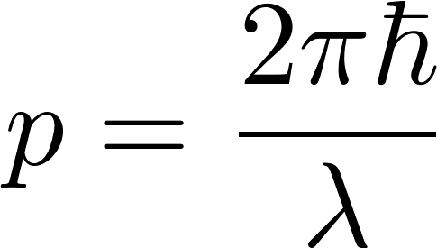
Quantum mechanics
One of the first attempts to understand the discrete character of stationary states was de’Broglie’s hypothesis of describing particles as localized packets of some (de’Broglie’s) waves. Today, we do not think that particles are waves. The waves which appear in quantum theory are just mathematical tools to arrive at prediction of outcomes of physical experiments by solving Schrodinger wave equation and decoding by well defined operations those predictions from the wave function found. The details are not necessary to be able to follow our statistical physics explanations. It is however useful to remember the relation between the energy of a free moving particle and the frequency of the corresponding de’Broglie’s wave
and the relation between the particle momentum and the wavelength of the
corresponding wave
$ℏ$ is the Planck constant . The new SI defines: $h$ =6.62607015×10⁻³⁴ Js

Slide 28
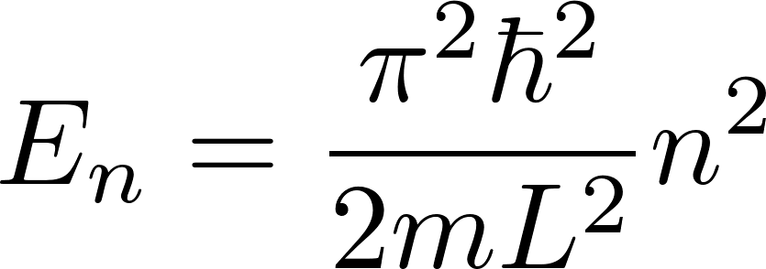
Quantum mechanics
Stationary states of a (spinless point-like) particle confined to a line segment of a length $L$ (model of a gas particle in a box in a one-dimensional world) are labeled by a single quantum number $n$ with possible values $1,2,3,4,…$ with corresponding energies given by the formula
Stationary states of a spinless point-like particle in a 3-dimensional cubic box with the edge size $L$ are labeled by 3 independent integer quantum numbers $n_{1},n_{2},n_{3}$ with energies given by the formula
Stationary states of many non-interacting spinless point-like particles in a box (model of an ideal gas) can be expressed using the one-particle states as described above.

