Slide 1
Repetition: Equilibrium macrostate
In statistical physics we deal with macroscopic systems for which its is technically impossible to work with microstates. We have at disposition tremendously reduced information, just values of a few macroscopic quantities, which define the macrostate of the system.
In principle, the values of those macrostate-defining quantities depend on time, thus describing the time development of the corresponding macrostate.
For isolated systems we observe a very interesting phenomenon:
Started from arbitrary microstate we usually observe that the corresponding macrostate changes with time until after some time (which we call relaxation time) the macrostate does not change any more. Technically it means that all the macrostate-defining quantities are stable, their values do not change any more. We say that the system reached equilibrium macrostate.
This does not mean that the situation is static: the microstates change all the time in macroscopic equilibrium (individual molecules collide, change their positions and velocities etc.) So the macroscopic equilibrium is a dynamical equilibrium. For all practical purposes we, however, can consider the situation as if it was static.
When we said “macroscopic quantities do not change with time” we have meant that no measuring devices are available to measure those quantities with a precision of typically 13 digits. Having such devices we would observe changes (fluctuations) at the last digit even for macroscopically defined quantities.

Slide 2
Entropy of the equilibrium macrostate
Observing the time development of a microstate we notice irreversible behavior. Once the equilibrium microstate is reached, the microstates continue to change, but never leave the equilibrium macrostate domain of microstates. We may ask why it is so. Starting from a random microstate the changing microstates arrive at the set of equilibrium macrostate domain. A possible “explanation” is that the equilibrium macrostate is so huge, in terms of the number of its realizing microstates, that the probability of leaving this microstate domain by random microstate dynamics is negligible.
Therefore the hypothesis: The equilibrium macrostate of an isolated system is the macrostate realizable by the largest number of available microstates.
The equilibrium macrostate of an isolated system has the largest entropy with respect to the entropies of all non-equilibrium macrostates.
We can use this entropy property to find which macrostate – under given conditions for an isolated system – is the equilibrium macrostate.

Slide 3
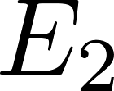
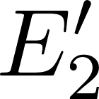
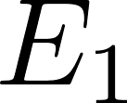
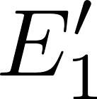
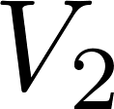
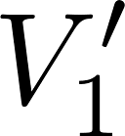
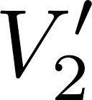
We consider two isolated statistical systems, each of them being individually in equilibrium. Their energies and volumes (representing any general external parameters) are $E_{1}, E_{2}, V_{1}, V_{2}$. We bring them into a thermal contact enabling to redistribute energy between them by performing heat. The new energies will be $E_{1}^{′}, E_{2}^{′}$, satisfying, of course energy conservation $E_{1}^{′}+E_{2}^{′}=E_{1}+E_{2}$. The volumes will be unchanged.
Thermal contact between the two systems is symbolized by the red line

Slide 4
Performing heat the systems exchange energy until new common equilibrium is reached. $So we have a new compund isolated system$ and we would like to calculate the final energies $E_{1}^{′}, E_{2}^{′}$. We do it by finding the maximal entropy of the compound system.
The original systems have their entropy functions $S_{1}\left(E,V\right), S_{2}(E,V)$. Those two system might be very different, one may be for example an ideal gas, the other a box containing free electromagnetic field. So the functions $S_{1}(.,.)$ and $S_{2}(.,.)$ might be different functional prescripts. Our notation suggests that the function prescript expects two variables inserted into the dotted slots. After the values are inserted, the “functional machine” produces the resulting entropy value out of them. It is good to imagine even in “pure mathematics” under the word “function” a computer programming notion “function”: as a program expecting that its formal parameters are substituted by some actual values, then the program starts and returns the resulting value.
We already know how the “entropy program” looks for ideal gas:
For the electromagnetic field it would be something completely different.

Slide 5
Entropy is additive, so the total entropy before the thermal contact is
After the final common equilibrium is established the total entropy will be
We may consider the final entropy as a function of one unknown variable $E_{1}^{′}$, since the other variable $E_{2}^{′}$ is fixed by the energy conservation $E_{2}^{′}=E_{1}+E_{2}−E_{1}^{′}$.
We are looking for the value $E_{1}^{′}$ for which the final entropy will be maximal
Note our (maybe over-prudent) notation. The right-hand side means that we differentiate the first entropy function with respect to its first “formal parameter”, the energy, and then we insert for the energy the value $E_{1}^{′}$. Then we differentiate the second entropy function with respect to its first formal parameter, the energy, and then we insert for the energy the value $E_{1}+E_{2}−E_{1}^{′}$. The minus sign in front of the derivative is due to the “differentiating of a composite function” rule.
In the maximum the total derivative must be zero, so we get

Slide 6
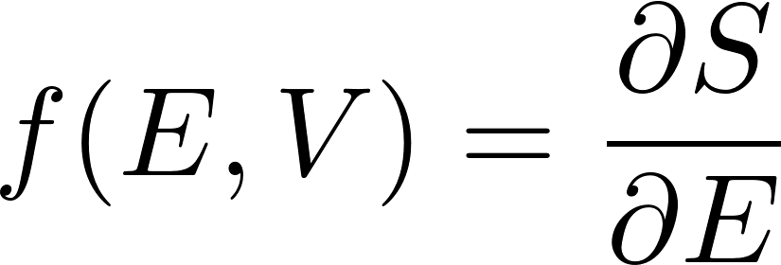
What is the physical meaning of this equation?
Entropy function $S(E,V)$ when differentiated with respect to E gives some other function $f(E,V)$ of the (macro)state variables $E,V$. So it is some state function of the macrostate, it is some physical quantity characterizing the macrostate. The equation says that this state variable has the same value in the two systems in thermal contact in equilibrium. So the two system in mutual equilibrium have the same value of the physical quantity $f(E,V)$.
Discussing the zeroth law of thermodynamics we found that temperature is the physical quantity which has the same value for all systems which are in mutual thermal equilibrium. So the quantity
must be either the temperature itself or some unique function of temperature. We can check what function of temperature it is, since we have explicit entropy function for ideal gas, so we can check the physical meaning of it for ideal gas.

Slide 7
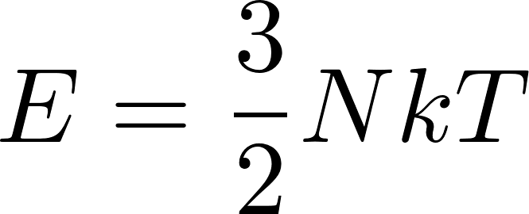
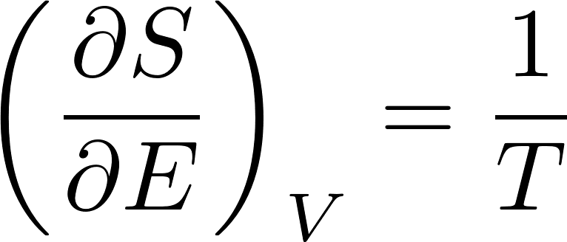
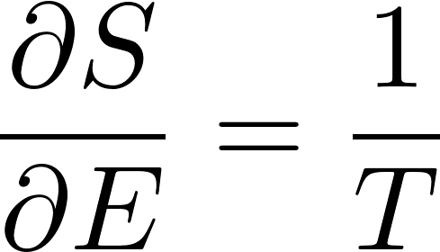
For ideal monoatomic gas we got
For monoatomic ideal gas its energy is given by the formula
and so finally we get
However, the formula
should be true for arbitrary two systems in mutual equilibrium, so the formula
must be true for any physical system.

Slide 8
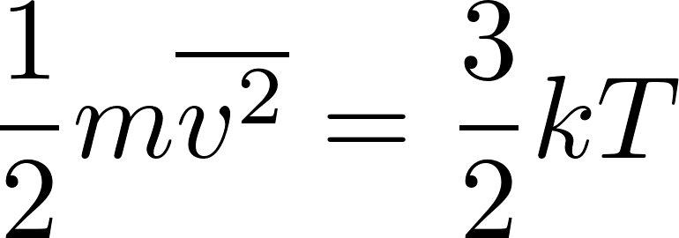
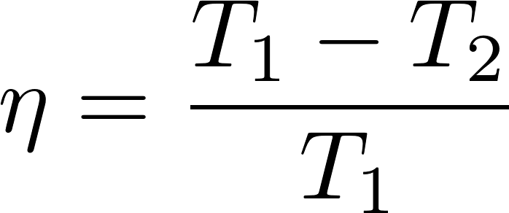
Repetition: Thermodynamic temperature
The second law of thermodynamics allows us to define temperature independently of the medium.
Up to now we had defined the temperature for gas like this:
Temperature of gas in equilibrium is given by the mean kinetic energy of the translational movement of molecules as
This definition of temperature is medium-specific, since it refers to the structure of gas as being composed of molecules. For systems not composed of molecules this definition is not applicable. Of course, we can define in principle the temperature of any system like the temperature of gas which is in equilibrium with the system considered.
We have already seen a medium-independent temperature definition:
The second law of thermodynamics allowed us to define temperature in a medium-independent way. We can use the system whose temperature we want to measure as the hot reservoir with unknown temperature $T_{1}$ and some a system consisting of water at the state of triple point as a cold reservoir with $T_{2}=273.16 K$ and let a Carnot machine work between these two reservoirs. If we were able to measure its efficiency $η$, the unknown temperature $T_{1}$ would be given as the temperature which satisfies the formula

Slide 9
Thermodynamic temperature
Now we have another formula which can serve as a bases for definition of temperature
In this formula the symbol $V$ represents in general any external parameter. So if for a general system we know its entropy function, we can define what is the temperature of some macrostate: we calculate its entropy and then we have to know the entropy also for a close macrostate at a somewhat different energy. We calculate the difference of entropies, divide by the difference of energies and thus get $\frac{1}{T}.$
This definition is also often called “thermodynamic temperature” and is completely equivalent to the definition using efficiency of an ideal heat engine we have already discussed in these lectures.

Slide 10
Another example of entropy maximization. We consider two isolated statistical systems, each of them being individually in equilibrium. Their energies and volumes (representing any general external parameters) are $E_{1}, E_{2}, V_{1}, V_{2}$. This time we bring them into a contact realized by a piston what enables to redistribute volume between them. The piston, of course, provides (by microscopic movements) also a heat contact. The new energies will be $E_{1}^{′}, E_{2}^{′}$, satisfying, of course energy conservation $E_{1}^{′}+E_{2}^{′}=E_{1}+E_{2}$. The new volumes will be $V_{1}^{′}, V_{2}^{′}$ with the total volume unchanged $V_{1}^{′}+V_{2}^{′}=V_{1}+V_{2}$.
After the final common equilibrium is established the total entropy will be
the final values of energies will be the same as in the case when we have considered just a thermal contact. The only unknown value in this relation is $V_{1}^{′}$, since $V_{2}^{′}$ is given by the total volume conservation $V_{2}^{′}=V_{1}+V_{2}−V_{1}^{′}$.

Slide 11
We get the final value $V_{1}^{′}$ by maximizing the entropy
Finally we get
What is the physical meaning of this equation?
Entropy function $S(E,V)$ when differentiated with respect to V gives some other function $\tilde{f}(E,V)$ of the (macro)state variables $E,V$. So it is some state function of the macrostate, it is some physical quantity characterizing the macrostate. The equation says that this state variable has the same value in the two subsystems for the final position of the piston. But we know when the piston stops moving. It is when the pressure on both its sides will be the same. So the physical quantity $\tilde{f}$ must be somehow related to pressure. However, since the piston provides also a heat contact, the temperatures will also be equal, so the function $\tilde{f}$ may be some combination of temperature and pressure.

Slide 12
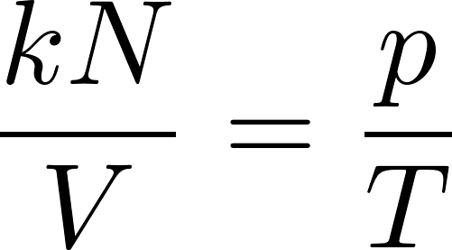
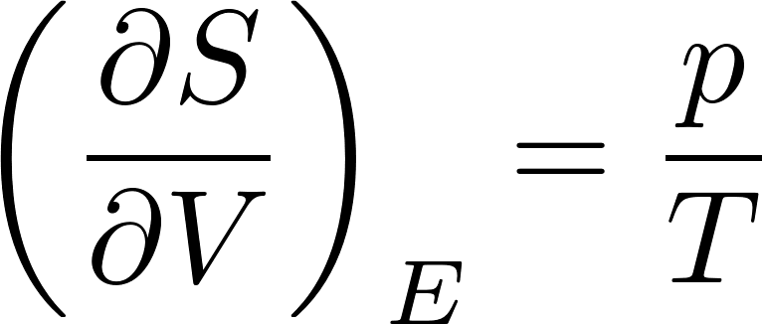
For ideal monoatomic gas we got
From the equation of state for ideal gas we have
So finally we get
This formula must be true for any system, which can have a “piston contact” with ideal gas system. By knowing for example the entropy function for electromagnetic field in a box, this formula gives us the pressure in the box provided by the electromagnetic field inside.

Slide 13
System and state variables
We shall include here notes from the methodology (or philosophy, if you want) of physics.
Physics does not have the ambition to study the entire world in one complex attempt. It rather tries to focus on some smaller part of the world, called a physical system, which is well identified and can be meaningfully studied how it behaves due to its internal functioning and due to its interactions with the rest of the world, which is not included into the system studied.
So the first task of any physical study is to define (identify) the physical system of interest. Just a very specific example: let the system of interest will be the hydrogen gas of $N$ molecules contained in a box of the volume $V.$
Now the key point of physics is that even if we identified sharply the system of interest which “keeps its identity constant” during the time we observe it, the system can be found in different states in different times.
This is philosophically not a simple assumption. How a system which we considered to be identical system in two instants of time can be “in different states”? What is then the meaning of “identical”? The problem was already recognized by the antique philosophy. There is the famous quote by Heraclitus: You could not step twice into the same river. I do not have satisfying solution to this problem. Anyhow, every physicist just intuitively uses the notion “same system in different states”.

Slide 14
System and state variables
Let us come back to the notion of “physical system”. How the system is characterized, identified? It is by defining the values of a set of “system variables”. This set of values should be unique, so that the system is well defined. Those values must be constant in time so that the system “keeps its identity”. (Let me note that the notion of “system variables” you would hardly find in physics textbooks. People usually are satisfied with intuitive interpretation of “system” and “state”. I do not want to pretend that I have something beyond the intuitive approach. This discussion just wanted to point that there is a problem.)
In addition to system variables there are the “state variables”. These variables define a specific “state of the system” considered. If the state is changed, we recognize it by the change of some of the state variables.
So an example: let the system of interest will be the hydrogen gas of $N$ molecules contained in a box of the volume $V$. Here “hydrogen”, “$N$” and “$V$” are the system variables, considered to be fixed. The state variables mat be the temperature $T$ and pressure $p$.
However, we have already studied the changes of gas state due to changing volume. This just shows that the division into sets of “system” and “state” variables is somewhat arbitrary. Some originally system variables can be reconsidered to be state variables and their change then considered as the change of state of the (more mutable) system.

Slide 15
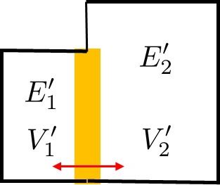
System and state variables
We have already met the situation, where the volume of the box with gas started to be considered as mutable. So instead of system definition “$N$ molecules of hydrogen gas in a box of the volume $V$”. we can redefine the system as “$N$molecules of hydrogen gas in a box”. The volume of the box is not considered to be fixed, so if the volume is changed, we say “it is the same system”. Then the state variables might be temperature $T$, pressure $p$ and volume $V$. This is what we implicitly did when discussing common equilibrium of two systems in contact allowing to redistribute volumes between them

Slide 16
Variable number of particles
Let us now be even more flexible and consider the number of particles $N$ of gas not as a system variable but as a state variable. The system will be “hydrogen gas in a box” and the state variables will be temperature $T$, pressure $p$, volume $V$ and the number of particles $N$.
Experimentally such a system may be realized as a box with a small hole through which it is connected to some reservoir of particles. Another possibility is a chemical reaction. For example system (artificially) prepared as system of $N$ molecules of water $H_{2}O$. You will find that that is not an equilibrium macrostate. Water molecules can dissociate
so the number of water molecules in the equilibrium will be smaller than the initial number due to dissociation. Even more: the number of molecules of some type is not constant and (microscopically) fluctuates even in an equilibrium macrostate.

Slide 17
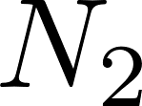
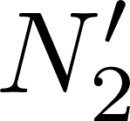
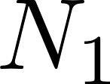
We consider two isolated statistical systems, each of them being individually in equilibrium. Their energies, volumes and particle numbers are $E_{1}, E_{2}, V_{1}, V_{2}$, $N_{1}$, $N_{2}$. We bring them into a contact enabling to redistribute particles between them through some hole. Of course redistributing particles also redistributes energy. The new energies will be $E_{1}^{′}, E_{2}^{′}$, the new particle numbers will be $N_{1}^{′}, N_{2}^{′}$.The volumes will be unchanged. We shall consider a case when the total number of particles will be fixed (no chemical reactions), so $N_{1}+N_{2}=N_{1}^{′}+N_{2}^{′}$.
After the final common equilibrium is established the total entropy will be
The final values of energies will be the same as in the case when we have considered just a thermal contact. The only unknown value in this relation is $N_{1}^{′}$, since $N_{2}^{′}$ is given by the total number of particles conservation $N_{2}^{′}=N_{1}+N_{2}−N_{1}^{′}$.

Slide 18
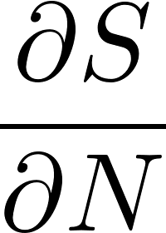
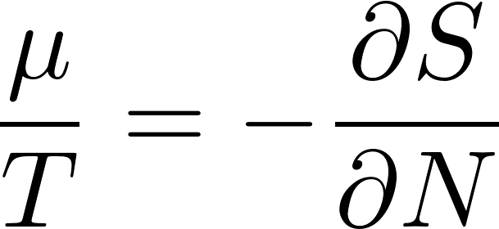
Chemical potential
We get the final value $N_{1}^{′}$ by maximizing the entropy
Finally we get
What is the physical meaning of this equation?
Entropy function $S(E,V,N)$ when differentiated with respect to $N$ gives some other function $\tilde{f}(E,V,N)$ of the (macro)state variables $E,V,N$. So it is some state function of the macrostate, it is some physical quantity characterizing the macrostate. The equation says that this state variable has the same value for the two systems in contact. The problem is that in cases of energy and volume redistributions we had an intuitive feeling what are the relevant physical quantities which emerge to be the same after reaching common equilibrium. Here we normally (unless we are constructors of chemical reactors) do not have everyday experience what is the particle-redistribution-controlling quantity.
At this moment we accept that it is the quantity which can be defined using the formula
and we define the name chemical potential $μ$ for the relevant quantity by the formula

Slide 19
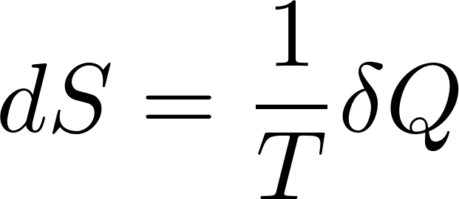
Equilibrium entropy changes
Equilibrium entropy of an isolated system is naturally a function of energy and external parameters. As an external parameter we shall generically consider volume.
We can easily express the total differential of equilibrium entropy $S\left(E,V\right).$ For fixed number of particles we get
We have just expressed the partial derivatives in equilibrium, so we get
Rearranging this equation a bit we get
we compare this to the first law of thermodynamics
and get
and also
both equations are valid for reversible processes only

Slide 20
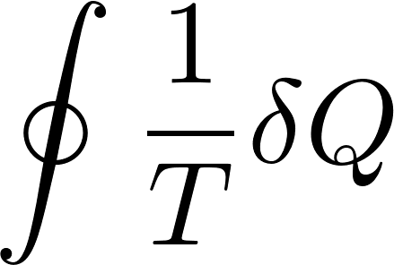
$1/T$ as an integrating factor
The relation
deserves more detailed discussion. The symbol $d$ in $dS$ means that $dS$ is a total differential. Physically it means that it is a difference of entropies of two close equilibrium states. (Entropy is a state variable). On the other hand the symbol $δ$ in $δQ$ means that here we do not have a differential. Heat is not a state variable! $δQ$ is the small amount of microscopic work performed in a (here reversible) process!
Temperature has a magic property: multiplying by $1/T$ a non-differential $δQ$ we get a differential $dS$!
The other way how to express the same thing is to say that $δQ$ is non-integrable, so that
but $dS$ is integrable
This is why $1/T$ is called “integrating factor”. The trivial consequence is that the integral around a closed curve is zero

Slide 21
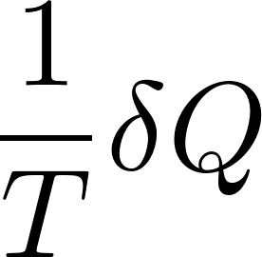
Still another definition of thermodynamic temperature
We can use the above formula to alternatively define temperature. Like this: temperature is the physical quantity which one has to put into the denominator like
to get full differential (for a reversible process) d{something} from $δQ$ which is not a full differential.

Slide 22
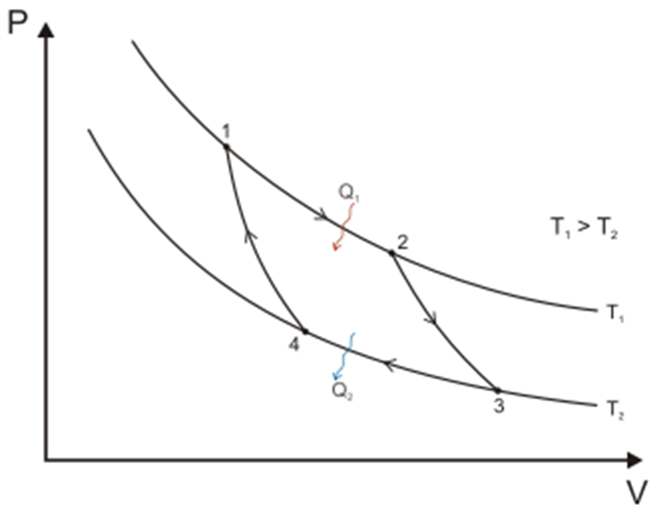
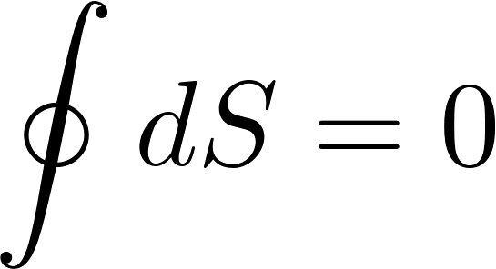
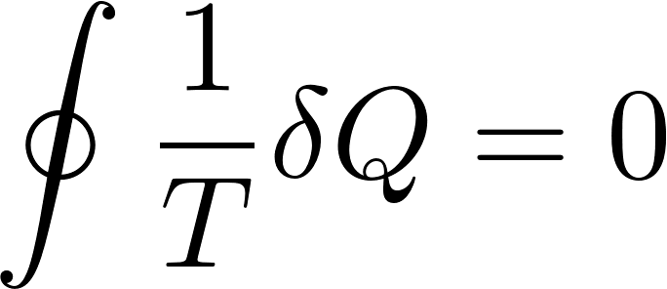
Carnot engine again using entropy
Carnot machine is a cyclic device, so after one cycle we get
W have omitted contribution from the adiabats 23 and 41, since heat is zero on adiabat. On isotherms the temperature is constants, so integrals are trivial
Do not forget that $Q_{2}<0$ .
So we have trivially derived the formula for the efficiency (without the need to calculate volumes and pressures).

Slide 23
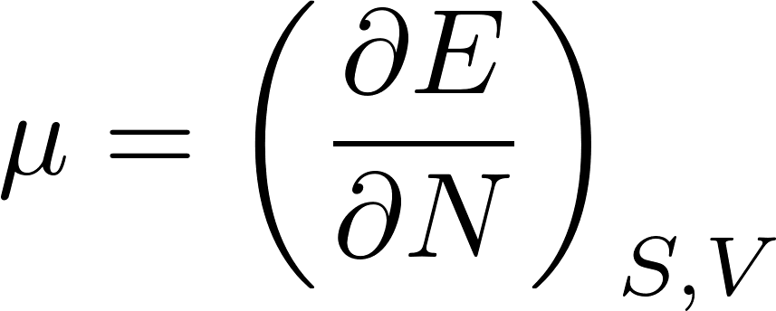
Equilibrium entropy changes
Equilibrium entropy of an isolated system is naturally a function of energy and external parameters. As an external parameter we shall generically consider volume.
We can easily express the total differential of equilibrium entropy $S\left(E,V,N\right).$ For variable number of particles we get
Substituting for the partial derivatives in equilibrium, we get
Rearranging this equation a bit we get
Looking at this equation we can formally define the chemical potential as the energy change required to increase the number of particles by $dN=1$ for fixed volume and fixed entropy on the system:
The problem is in magic words “fixed entropy”. Fixed entropy usually means just $δQ=0$, what means thermally isolated system. But if we want to add particles into the system, we have to push particles through some hole in the wall and this means that some microscopic work is to be performed and a part of it might be $δQ!$ So it is not easy to experimentally secure both constant entropy and variable number of particles. We shall come back to this question later.

