Slide 1
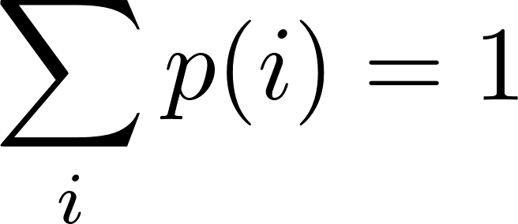
Canonical ensemble – Statistical sum
The normalization constant can be calculated from the condition
From there we get where
$Z$ is sometimes called the statistical sum and it is the first thing one has to calculate when one wants to use the canonical ensemble. We have explicitly written the condition that the sum is taken only over the states with fixed $N_{i}=N$. Usually one writes just and the condition $N_{i}=N$ is understood implicitly.
A short summary of the canonical ensemble usage:
canonical ensemble is to be used when the given quantities for the system are temperature $T$ and volume (or external parameter) $V$
the first step is to calculate the statistical sum $Z$
then the mean value of any quantity $A$ is calculated as

Slide 2
Canonical ensemble – mean values
In particular the mean energy of a canonical system is given as
The mean pressure (more generally the man value of the canonical force quantity conjugated to the external parameter $V$ is given as

Slide 3
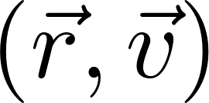
Canonical ensemble – Boltzmann distribution
In external field the gas particle distribution is no more uniform in space, the microstate of the particle is given by its position and velocity. So for one classical particle we get the probability density in the space
This is called the Boltzmann distribution. The normalization constant is to be obtained from the condition
If we are not interested by the velocity distribution, we can integrate over velocities and get the marginal spatial probability density

Slide 4
Canonical ensemble – entropy
We have defined entropy for isolated system as k-times the logarithm of the number of microstates corresponding to the macrostate considered (equivalently the number of states in the corresponding microcanonical ensemble).
This definition cannot be extrapolated to the system in contact with the thermal reservoir: the corresponding ensemble is the canonical ensemble which is formed by all - that is an infinite number - of microstates. We have to look for some alternative definition of entropy.
The notion of entropy is conceptually relevant only for macrostates of systems with very large degrees of freedom. The canonical distribution can be used also for small systems in contact with reservoir, but we need to define entropy only for very large systems.
For very large systems the macroscopic values are very sharp: the values fluctuate but typically on the level of 13-th decimal place.
In particular: the energy of a large canonical system is practically constant. We are unable to observe fluctuations on the 13-th decimal place. Experimentally we cannot just by measurements distinguish a canonical system with fixed given temperature from a microcanonical system with a given fixed energy. Therefore the idea:
The entropy for a canonical system can be defined in two consecutive steps
Determine the mean energy $\overline{E}$ of the canonical system considered.
Imagine the same system as if an isolated system with a fixed energy $E=\overline{E }$ and determine what would be its entropy $S(E=\overline{E})$. This is to be called the entropy of the original canonical system.

Slide 5
Canonical ensemble – entropy
The above mentioned two-step process for calculating the canonical entropy can be rewritten by a single compact formula. Its derivation is a bit tricky. Here it is.
We start with the definition of the statistical sum
where the summation is over the states. We can regroup the terms in this sum according to the energy of states and rewrite the sum as a sum over energies as
In this sum the function $Ω(E)$ is a sharply rising function of $E$ while the exponent is a sharply decreasing function of $E$. Therefore the main contribution to the whole sum comes from the terms with $E≈\overline{E}$. The domination of the terms around $\overline{E}$ is such, that in the logarithmic precision the logarithm of the sum is given by a single term (we write just $=$ instead of $≈$ as it is usual in statistical physics where most of the equations are only approximate anyhow).
From there we get
This formula could be used as the definition of entropy of a canonical system. But we will derive still a nicer formula.

Slide 6
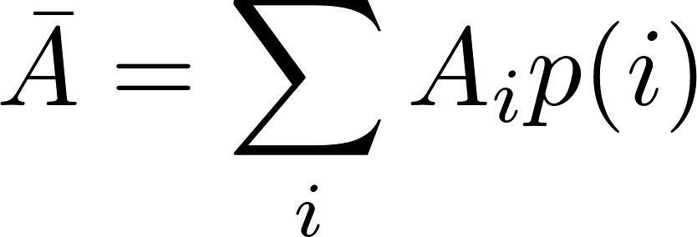
General ensemble – entropy
The formula for entropy we have derived for the canonical ensemble can be used as a general definition of entropy for any macroscopic state, represented by a suitable statistical ensemble.
Statistical ensemble in general is a set of microstates $i$ with assigned probability $p(i)$. Then the man value of any physical quantity $A$ which has a well-defined value $A_{i}$ for any microstate $i$ from the ensemble is defined as
and the entropy of that macrostate is defined as
It looks as if it was a mean value of some physical quantity (entropy?) of individual microstates. This is not true. The probability $p(i)$ is not a state variable of an individual microstate. It cannot be calculated just from microstate-defining variables. The probability $p(i)$ is given by the weight of the microstate $i$ in the ensemble characterizing the macrostate. So one has to know the macrostate before assigning the probabilities $p(i)$.
Actually, many textbooks basically start the introduction to statistical physics with something like the above framed text as “the basic postulate”. The general formula for entropy which looks a priori like a miraculous guess is in fact very natural for anyone who is familiar with the theory of information, where it is called “the information entropy”. The interested reader may find more in my text on advanced statistical physics.

Slide 7
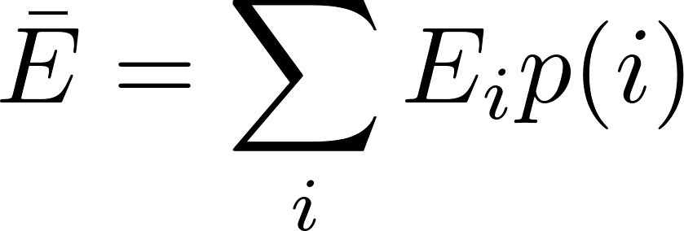
Canonical ensemble – first law of thermodynamics
We start with the formula for the mean energy:
Now suppose our “external dwarfs” infinitesimally change the macrostate in a general way. The corresponding ensemble will be changed, that is the probabilities of the microstates will be changed by $dp(i)$ and the energies of the microstates will also be changed in general by $dE_{i}$ due to some changes of external parameters (like $V$). The mean energy of the macrostate will be changed by
The physical interpretation of the first sum is clear: energies $E_{i}$ are changed due to the change of the external parameter $dV$, so we can write
We know the first term; it is the mechanical work (extracted e.g. by the dwarf piston-pusher). So the second term must be heat (performed by the boiler attendant)

Slide 8
Canonical ensemble – first law of thermodynamics
Now for a canonical system we perform an ingenious trick writing
Using this in the just derived formula for heat we get
The first term is 0 since
The second term needs another ingenious insight:
indeed:
So we have got, as expected

Slide 9
Canonical ensemble – partition function
We have defined the statistical sum as a “normalization constant”
This evokes impression that $Z$ is a constant. It is to some extent true. However, a canonical system has a given temperature $T$ and volume (external parameter) $V$. If we evaluate $Z$ for arbitrary values T$,V$, we get a function $Z\left(T,V\right)$. $Z$ as a function is called partition function. We shall show that this function carries a lot of useful information about the canonical system considered. Let us start with calculating the mean energy:
So the information on the mean energy “is coded” in the partition function. The above formula is the instruction how to decode it. In the same way one can easily prove that even higher moments are coded in the partition function. For variance one gets

Slide 10
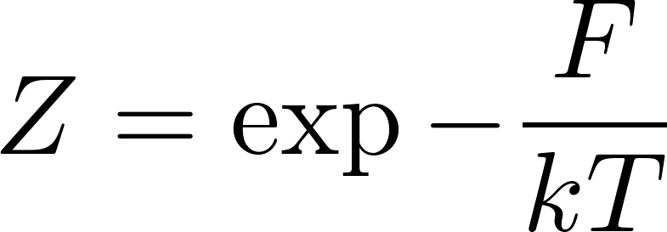
Canonical ensemble – free energy
Similarly for the mean pressure we get
We see that the logarithm of the partition function carries a lot of useful information. Therefore it was given a special name: free energy. More precisely
free energy $F$ is defined by the expression
Similarly all higher moments of probability distribution of $p$ can be obtained by derivatives of $Z$ and its logarithm. If we expand $\text{ln} Z$ as a Taylor series in $V$, the coefficients of the expansion will be so called cumulants (find in Wikipedia, how cumulants are related to moments) of $p$. Therefore $\text{ln} Z$ is called generating function of the cumulants of $p$. Remember the term generating function, you will meet it often in theoretical physics.

Slide 11
Canonical ensemble – free energy
Free energy is closely related to the entropy. We have expressed entropy of the canonical system as
Substituting for $\text{ln} Z$ from the definition of free energy
we get
Actually the free energy was defined already in phenomenological thermodynamics as
Since for macroscopic systems (entropy is defined only for macroscopic systems!) there is no practical experimental difference between $\overline{E}$ and $E$, the statistical and thermodynamical expressions are equivalent.

Slide 12
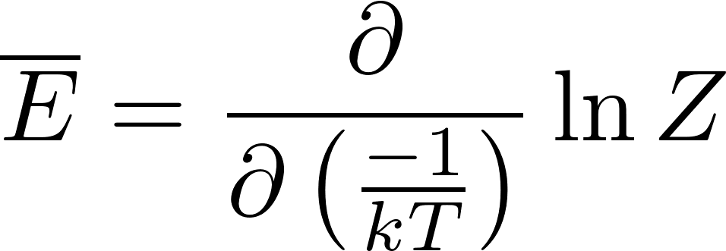
Canonical ensemble – quantum harmonic oscillator
Stationary states of a quantum harmonic oscillator can be labeled by integers $n$ and the energies are
Now we consider one quantum harmonic oscillator in thermostat at temperature $T$. The calculation of the statistical sum is easy
The mean energy is
After a bit tedious calculations we get
In the classical limit $ℏ→0$ we get $\overline{E}≈kT$, the same value as we got using Boltzmann distribution for a classical harmonic oscillator.

Slide 13
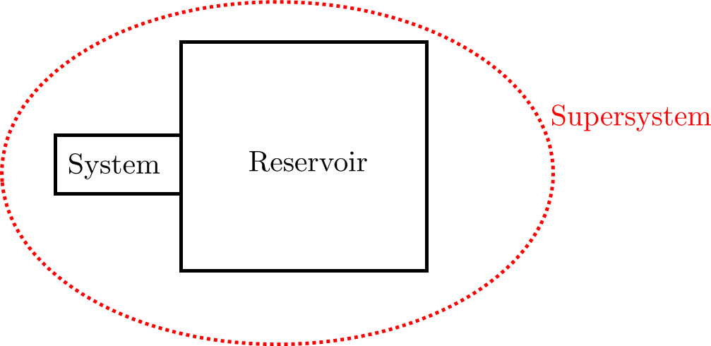
Grand canonical ensemble
We shall now consider a system with variable number of particles $N.$ The system will be in thermal and diffusion contact with a very large system called reservoir. The thermal contact means energy exchange and the diffusion contact particle exchange between the system and the reservoir. Since the reservoir is considered to be much larger than the system, we can assume the temperature and the chemical potential of the reservoir to be constant and given. The system and the reservoir together form “supersystem”. The supersystem can be considered as isolated, the total energy of the supersystem $E_{super}$is considered to be fixed as well as the total number of particles $N_{super}$of the supersystem to be fixed, so we can represent the supersystem by a microcanonical ensemble.
The energy of the system will be denoted as $E$, of the reservoir as $E_{res}$ and of the supersystem as $E_{super}$, the number of particles of the system will be denoted by $N$, of the reservoir by $N_{res}$ and of the supersystem $N_{super}$.
Our discussion will be a close parallel to our derivation of the canonical distribution.
The microstate of the supersystem is composed by the state of the system $i$ and by the state of the reservoir $I$. So the supersystem state is a pair $(i,I)$.

Slide 14
Grand canonical ensemble
We are interested in a quantity, which is defined for the system alone. That is its value depends only on the system state $i$ and not on the reservoir state $I$. Still, we can calculate its mean value using a the microcanonical ensemble for the whole supersystem:
We can group the terms to groups having the same value of $i$ and express the mean $A$ value as
Here $Ω_{res}\left(E_{super}−E_{i}, N_{super}−N_i\right)$ is the number of states of the reservoir such that combined with the system state $i$ they have the right total energy $E_{super}$ and the right total number of particles $N_{super}$. So it is the number of terms in the original sum containing the system state $i$. So the rewritten sum is correct.
Now we rewrite $Ω_{res}$ through the entropy $S_{res}$ and get

Slide 15
Grand canonical ensemble
Since the reservoir is much larger than the system $E_{i}≪E_{super}$ and $N_{i}≪N_{super}$ we expand the function in the exponent to the first order in Taylor series:
Using the formulas $\frac{∂S}{∂E}=\frac{1}{T}$ , $\frac{∂S}{∂N}=−\frac{μ}{T}$ we get
The factor in front of the sum “does not feel” the system at all neither it feels what quantity $A$ we are interested in; it is just a constant. It is in fact a normalization constant.

Slide 16
Grand canonical ensemble
So what have we got? In the formula $T$ is the temperature of the reservoir and $μ$ is the chemical potential of the reservoir. Because of the equilibrium through the thermal and diffusion contact these are also the temperature and the chemical potential of the system. So we can calculate any mean value concerning the system by forgetting about the reservoir: there is no more any mentioning of the reservoir in the above formula.
The formula looks like a standard formula for calculating the mean values if we interpret the factor
as a probability of the system microstate $i$. So the rule:
The ensemble representing a macrostate of a system with a given temperature and chemical potential (kept constant by a suitable external reservoir) can be constructed taking all the possible microstates (with arbitrary energy $E_{i}$ and arbitrary number of particles $N_{i}$), each with the probability
such an ensemble is called grand canonical ensemble.

Slide 17
Grand canonical ensemble – grand partition function
The normalization constant can be calculated from the condition
From there we get
is sometimes called the grand statistical sum. As a function of $T, V, μ$ it is called grand partition function and it is the first thing one has to calculate when one wants to use the grand canonical ensemble.
A short summary of the grand canonical ensemble usage:
grand canonical ensemble is to be used when the given quantities for the system are temperature $T$ volume (or external parameter) $V$m and chemical potential $μ$
the first step is to calculate the grand partition function
then the mean value of any quantity $A$ is calculated as

Slide 18
Grand canonical ensemble – practical usage
We have said that we use the grand canonical ensemble when we have a macrostate with given $T, V, μ$. This is somewhat a symbolic statement. We usually do not have direct knowledge about the value of the chemical potential for a given system. (Try to buy a $μ$-meter in a laboratory-equipment shop!).
Normally we know the number of particles $N$together with $T,V$. So we should use the canonical ensemble. However for technical reasons we might prefer the grand canonical ensemble. The reason is the following: compare the two expressions
Technically it is usually easier to calculate the grand canonical sum over all the states without any restriction than the canonical sum with the states restricted by the condition $N_{i}=N$. The way how we use the grand canonical ensemble even for systems with given $N$ and not $μ$is the following. We just pretend that $μ$ is given (without knowing its numerical value) and do the calculations with the parameter $μ$ as a symbolic number. Then calculate the mean number of particles as a function of (pretended given but unknown) $μ$
and find the “good” value of $μ$ by inverting the equation . This value of $μ$ we then insert to all other results obtained by the grand-canonical calculation and we get the correct answer. The reason is that for macroscopic system $\overline{N}$ is undistinguishable from fixed $N$.

Slide 19
How to measure chemical potential
We can in principle experimentally determine the chemical potential for some type of particles for a system for which we are able to do the grand-canonical calculation. From the equation
we can in principle get the value of $μ$ if we can measure (for example by suitable electrochemical method like by the lambda sensor) the concentration of the relevant particles to obtain $N.$
One may argue that “this is not a direct measurement of $μ!“$ since we need the theoretical formula connecting $μ$ and $N$. Well, actually most of the measurements (and measuring devices) do not “measure directly” the required physical quantity. Directly measurable are for example length and angle. Even the old-fashioned ammeter does not measure the electric current directly: it measures the angle of the pointing needle and we have some theory to connect the measured angle and the current going through the ammeter. In a standard thermometer we do not directly measure temperature but rather the length of the mercury column in a glass tube. And we have some phenomenological formula connecting the temperature and the length of the mercury column.

Slide 20
Grand partition function
Similarly to the partition function of the canonical distribution useful information on moments of physical quantities is coded in the grand partition function. For example, the mean number of particles can be calculated as follows
The grand partition function can be expressed thorough the canonical partition function:
Using again the argument on domination of mean values for the logarithm of the sum:

Slide 21
Grand canonical potential
Similarly to the definition of free energy through the logarithm of canonical partition function we define the grand canonical potential $Ω$ as
There is an inconsistency in the notation (overall in the statistical physics books): symbol $Ω$ was already used to denote the number of microstates in the microcanonical ensemble. The reader has to resolve from the context the two omegas from each other.

