Slide 1
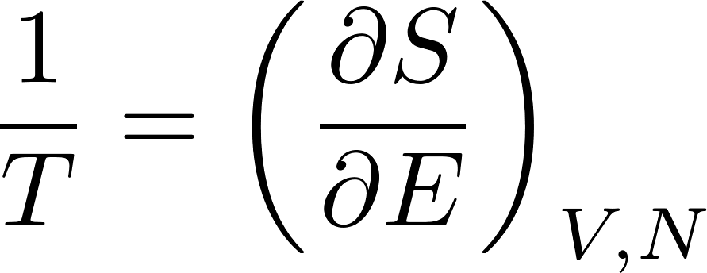
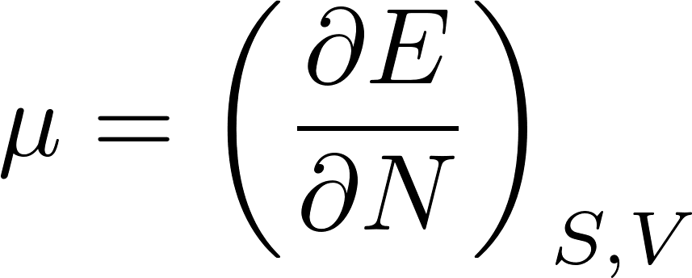
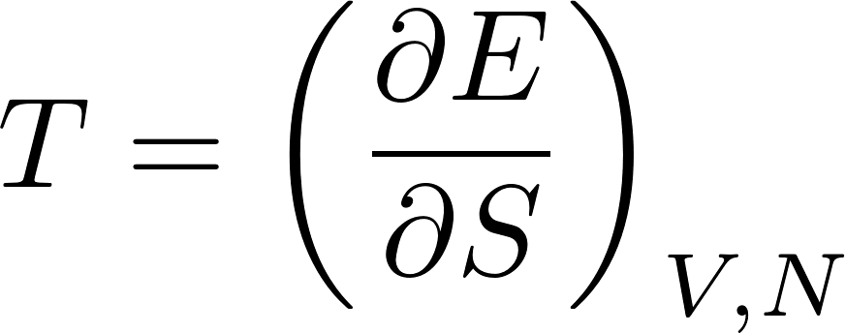
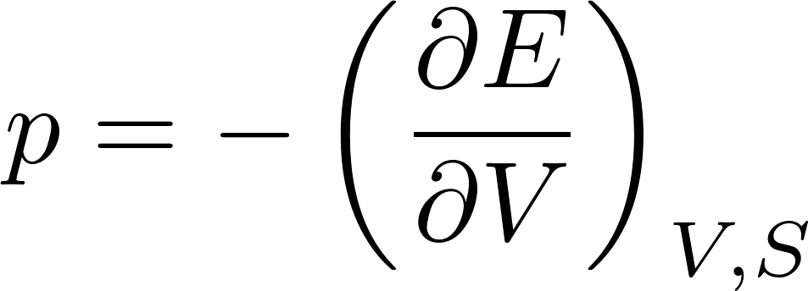
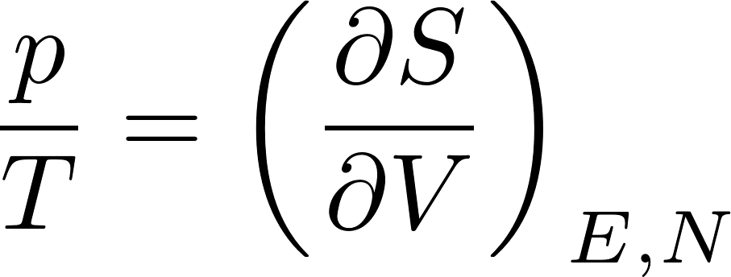
Thermodynamic potentials
In the preceding lectures we have met several functions of the state like energy $E$, entropy $S$, free energy $F$ and canonical potential $Ω$ with the property that their partial derivatives with respect to their natural variables gave us the possibility to calculate various macroscopic physical quantities. For example we have met the following relations:
Now we shall discuss various thermodynamic potentials more systematically. We start with the first law of thermodynamics written for reversible processes.
These relations suggest, that the “native” variables for energy are $S,V,N$ and for entropy $E,V,N$. In this context energy and entropy are called thermodynamic potentials.
If the thermodynamic potentials are expressed through their “native” variables, we get the following relations

Slide 2
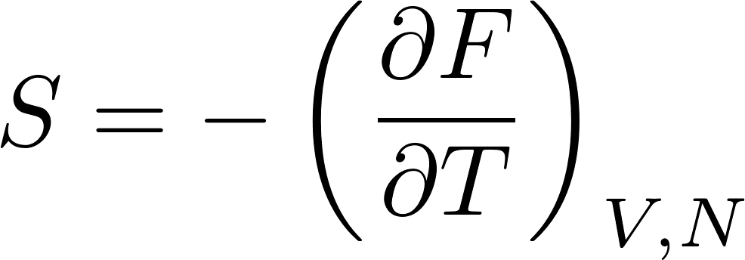
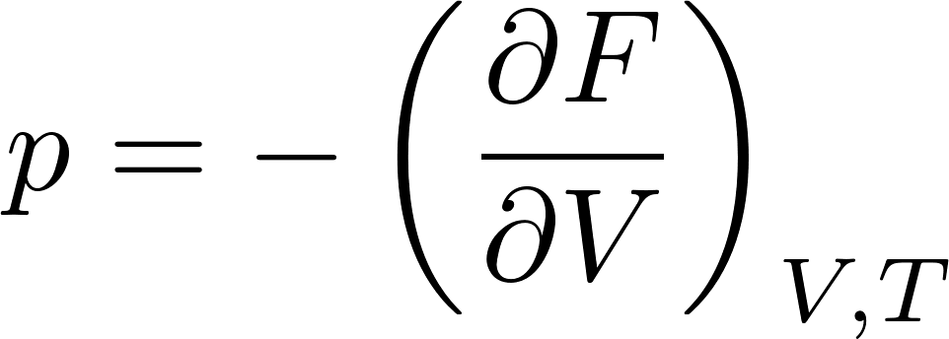
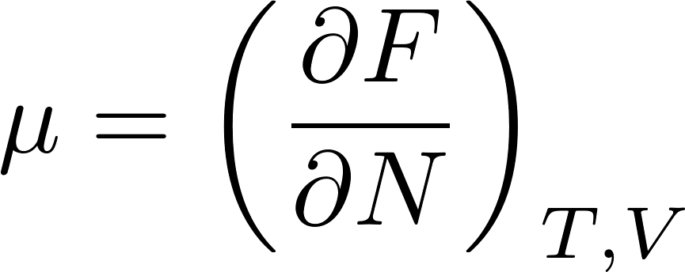
Thermodynamic potentials
Energy as and thermodynamic potential has intuitively clear meaning, but its “native” variables are not nice: the entropy is experimentally inaccessible. One would prefer to replace entropy to something experimentally comfortable like temperature.
There is a general mathematical tool to manage such replacements: the Legendre transform (remember how one does that in theoretical mechanics: Lagrangian as a function of $q,\dot{q}$, is replaced by Hamiltonian as a function of $q,p$). The Legendre transform to swap $S$ for $T:$
We have already seen such function; it is called free energy. Do not be confused: it looks there are 4 variables on the right but only 3 on the left! $S$ on the right is not a variable, it should be written as a function of $T,V,N$by inverting the relation
One has to solve this for $S$ as a function of $T,V,N$ and insert it to the Legendre transform. Let us calculate the differential of $F:$
The native variables of $F$ are $T,V,N$ and we get relations

Slide 3
Free energy
For isothermal processes with fixed $N$ get
So for isothermal process infinitesimal pieces of work can be easily integrate to get
Free energy can be understood as the isothermal potential of work. It says how much mechanical work can be extracted from a device in an isothermal process. This is perhaps the motivation for its name “free energy”.

Slide 4
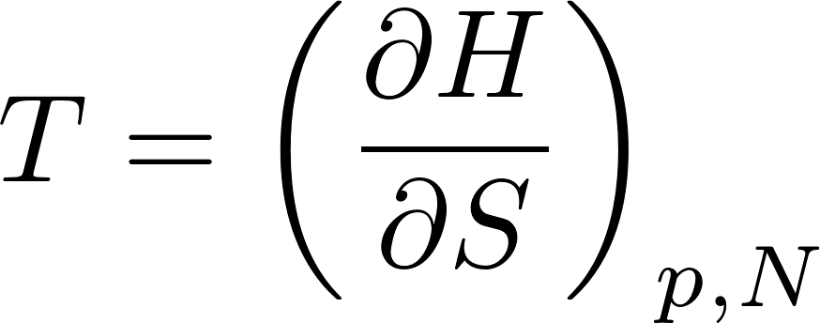
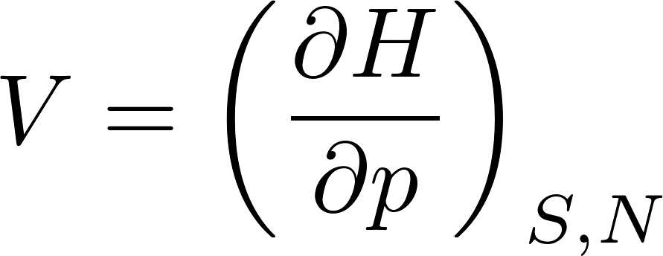
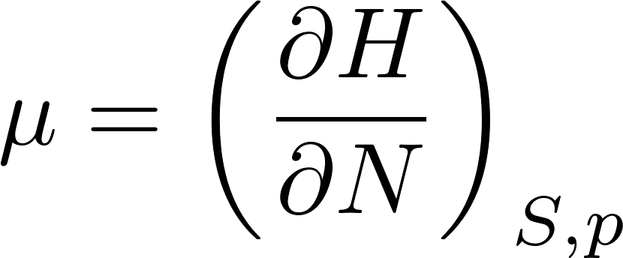
Further thermodynamic potentials
Free energy is a useful thermodynamic potential if we need the native parameters to be $T,V,N$. For other purposes we might need other native parameters. For example if we require S$,p,N$, we can do the following Legendre transformation
$H$ is called enthalpy (actually $H$ is the capital Greek letter eta, not our Latin H) and we get
For isobaric processes with fixed $N$ we get
So for isobaric processes infinitesimal pieces of performed heat can easily be integrated to get

Slide 5
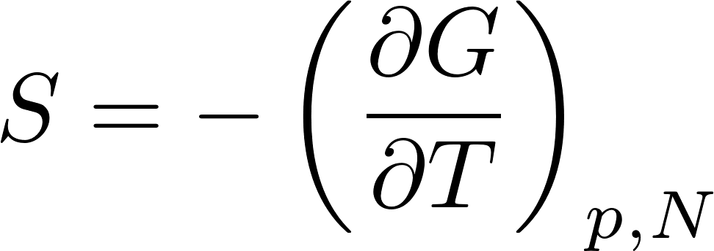
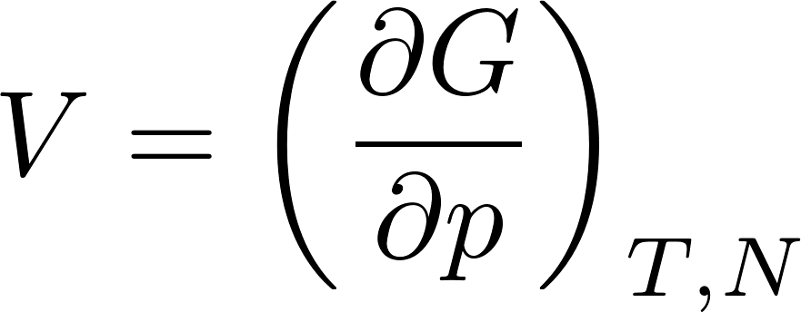
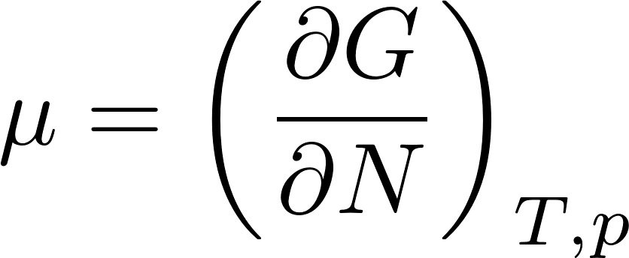
Further thermodynamic potentials
The thermodynamic potential with native parameters $T,P,N$ is the Gibbs potential (sometimes called free enthalpy)
$G$ as any thermodynamic potential is an extensive variable. But its only extensive parameter is $N$, its two other native parameters $p,T$ are intensive, so $G$ must be proportional to $N$. So it must look like $G=N f(p,T)$, where $f$ is some suitable function of $p,T$. However from the relation
we get $f=μ$, so we see, that $G$ can be expressed as

Slide 6
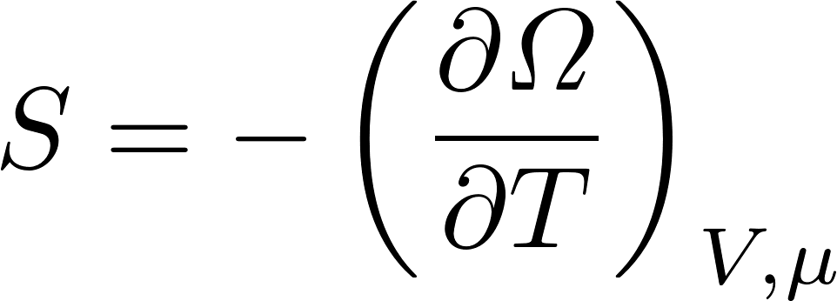
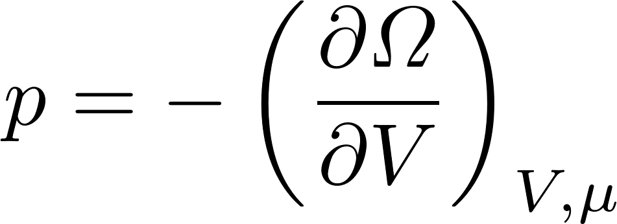
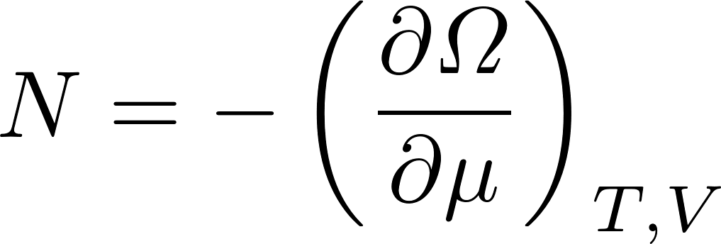
Further thermodynamic potentials
The thermodynamic potential with native variables $T,V,μ$ is the grand canonical potential
Comparing the Legendre transformation defining $Ω$ with the expression we got for the logarithm of the grand canonical partition function
we see that the grand canonical potential is related to the grand canonical partition function similarly as the free energy is related to the canonical partition:
There are other ways how to express $Ω:$
Later we shall be able to calculate the grand canonical function for ideal gas in classical approximation and we shall get . It is due to the ideal gas equation of state $pV=NkT$.

Slide 7
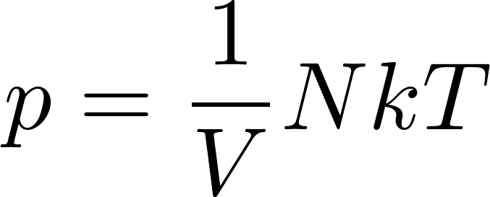
Non-equilibrium macrostates - entropy
So far, we have discussed equilibrium thermodynamic potentials. These potentials can be defined even for non-equilibrium macrostates.
We have already defined the entropy for arbitrary (equilibrium as well as non-equilibrium) macrostates of an isolated system. The definition was universal:
Entropy for an isolated physical system is defined as k-times the logarithm of the number of microstates corresponding to the macrostate considered.
We have used this definition to study evolution towards equilibrium of two systems after
putting into contact.
More generally entropy for arbitrary macrostate can be defined, when we define a statistical ensemble of microstates representing the macrostate considered (equilibrium or non-equilibrium). The statistical ensemble is defined by assigning the probabilities $p(i)$ to arbitrary microstate $i$. (In general some probabilities might be 0.) We defined the entropy as
The difference between the equilibrium and non equilibrium macrostates is manifested by the fact that we need more macroscopic variables to define a non-equilibrium macrostate than for the equilibrium macrostate. For example the macrostate of a gas in equilibrium is given by three variables like $N,T,V$. Any other macroscopic variable in equilibrium can be calculated as a function of the equilibrium variables. Like pressure

Slide 8
Non-equilibrium macrostates
Non equilibrium macrostate of a gas needs more variables for its specification. These additional variables characterize how the non-equilibrium state differs from the equilibrium. Consider gas in an isolated container having two compartments separated by a non-penetrable diaphragm. The temperature is the same in both compartments, but the number of molecules and therefore the pressure might be prepared as different.
Free expansion:
If we suddenly remove the diaphragm, the gas in the container will get into a non-equilibrium state which (immediately after the diaphragm removal) will be given by 5 parameters $N,T,V,p_{1},p_{2}$, where $p_{1}, p_{2}$ give pressure in the left half and the right half of the container. Then an irreversible process starts. Finally a common equilibrium state is achieved, which is characterized by just 3 parameters $N,T,V$. The resulting $p$ is given by the equation of state.
By the way the final temperature $T$ will be the same as the initial temperature: neither heat nor mechanical work is performed (the diaphragm is removed by pulling it down, in the direction perpendicular to the gas pressure, so no work is needed for the removal). Therefore the final energy of the gas will be the same as the initial energy. There is no potential energy of interaction for ideal gas, so the kinetic energy of the molecules is not changed, so the final temperature for an ideal gas free expansion is the same as the initial temperature.

Slide 9
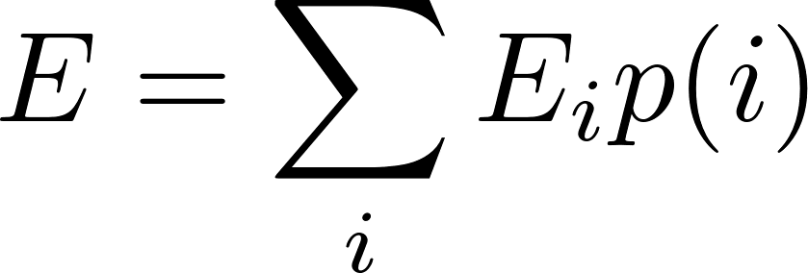
Non-equilibrium macrostates – thermodynamic potentials
We have defined entropy for arbitrary macrostate, equilibrium or non-equilibrium. It is trivial to define the energy for a non-equilibrium macrostate characterized by an ensemble of microstates with probabilities $p(i)$. The mean non-equilibrium macrostate energy is then
All other non-equilibrium thermodynamic potentials are defined by the appropriate Legendre transformations from energy and entropy.
Now what about the differentials (potential changes during infinitesimal processes). For reversible (equilibrium) processers we had for example
This cannot be a correct expression for the differential of a non-equilibrium entropy, since there are more independent (non-equilibrium) parameters and their differential are missing in the above expression. So the correct formula has to look like this
Even this formula is debatable for states far from equilibrium: it is not clear what is the meaning of $T,p,μ$ for such states.

Slide 10
Non-equilibrium macrostates – extremal entropy
Now consider isolated system in fixed volume with fixed number of particles. This means $dE=0, dV=0,dN=0$. For nonequilibrium processes for such system we get from
We know, however, that an isolated system spontaneously increases its entropy, so we expect $dS≥0,$ so for isolated system
Therefore we formulate the hypothesis, that for arbitrary infinitesimal processes the following inequality holds
The equality holds for equilibrium (reversible) processes. The above inequality express our starting hypothesis that the isolated system increases its entropy during its approach to equilibrium and the entropy of an isolated system is maximal for the equilibrium macrostate.

Slide 11
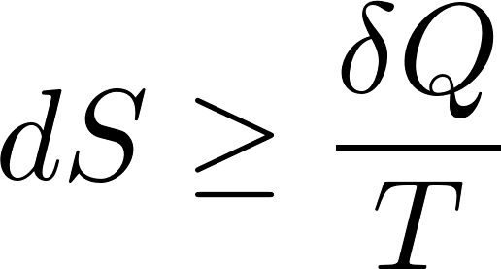
Non-equilibrium macrostates – Clausius inequality
First law of thermodynamics (energy conservation) says
So we get for a general (reversible or irreversible) process the Clausius inequality
Actually the Clausius inequality can be proven from the second law of thermodynamics, we shall not present the proof here.

Slide 12
Thermodynamic potentials – irreversible processes
The Clausius inequality for entropy
can be rearranged for the inequality for differential of energy for reversible and irreversible processes
Remainder: $TdS≠δQ$ for irreversible processes! The other thermodynamic potentials we get from energy by Legendre transformations and from there one can easily derive the corresponding inequalities
From there we directly see the extremal properties
$F$ is minimal in equilibrium for a system with given $T,V,N$
$H$ is minimal in equilibrium for a system with given $S,p,N$
$G$ is minimal in equilibrium for a system with given $T,V,N$
$Ω$ is minimal in equilibrium for a system with given $T,V,μ$
$S$ is maximal in equilibrium for a system with given $E,V,N$
$E$ is minimal in equilibrium for a system with given $S,V,N$

Slide 13
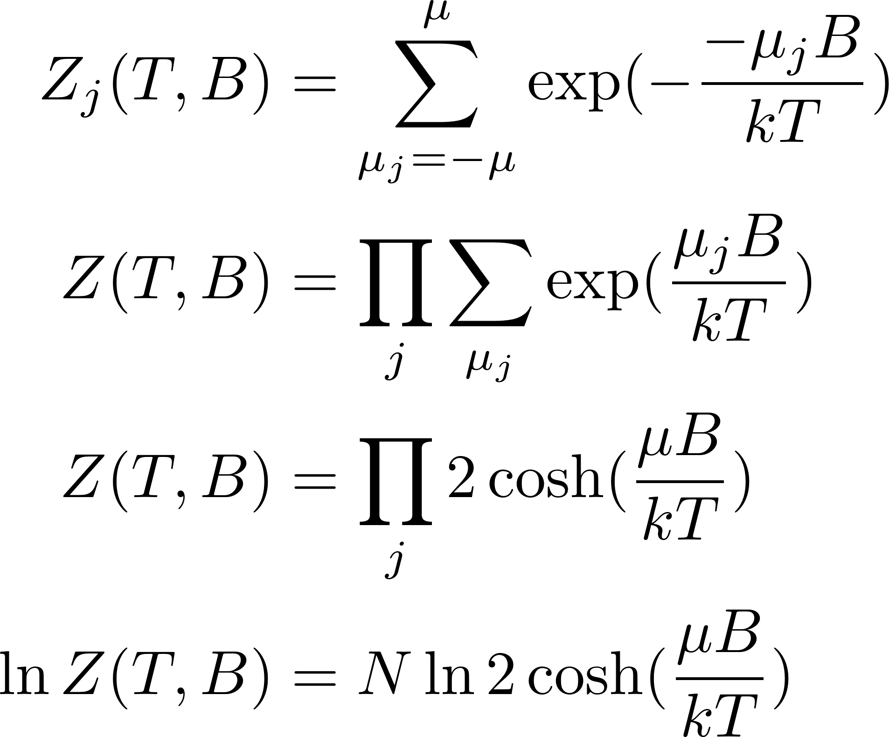
Finding equilibrium by minimizing the free energy
Let us demonstrate how we can use the non-equilibrium free energy to find equilibrium state for a system in contact with a heat reservoir (thermostat). We first start using standard canonical technique and then proceed to minimizing the non-equilibrium free energy to see that we get equivalent results.
Consider a system of mutually non-interacting spins in external magnetic field $B$, in thermostat with temperature $T$. Each spin has just two states $−μ,μ$ with energies $−μB, μB .$ (Here $μ$ is the spin magnetic moment, not some chemical potential!). Since the spins are noninteracting (independent) we can first consider just one spin $j$, calculate its statistical sum and then the statistical sum of the whole system of spins is a product of individual sums
The total magnetic moment in equilibrium we get as a generalized force conjugated to the external fields $B$

Slide 14
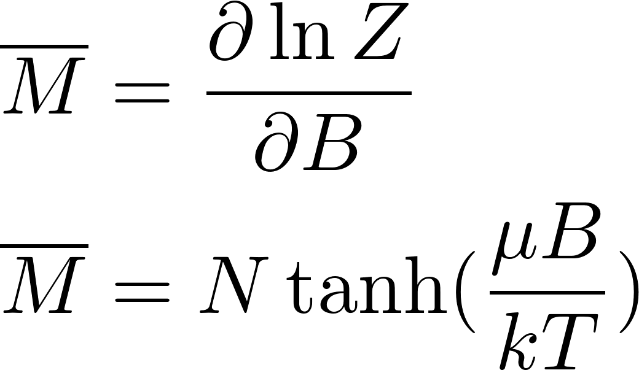
Finding equilibrium by minimizing the free energy
Now let us consider the same system in an artificially maintained non-equilibrium state. The non-equilibrium parameter will be magnetization $M$, different from its equilibrium value $\overline{M}$. How this could be achieved? We can just virtually imagine little dwarfs each controlling one of the spins. They observe their spins, permanently collectively evaluate the total magnetization and if they find that in the time instant the magnetization value is different from the prescribed non-equilibrium value $M,$ they randomly choose some dwarfs and order them to flip the spins they control to restore the magnetization to the prescribed value. By this dwarf mechanism the system is maintained in the non-equilibrium macrostate without being forced to be in a fixed microstate. The microstates dynamically change (by interaction with the reservoir) without relaxation to the equilibrium macrostate.
Now the hypothesis: we shall calculate the statistics of the described non-equilibrium macrostate by as if a canonical technique, but all the sums will be not over all the microstates but only over the microstates having the prescribed total magnetization $M_{i}=M$.

Slide 15
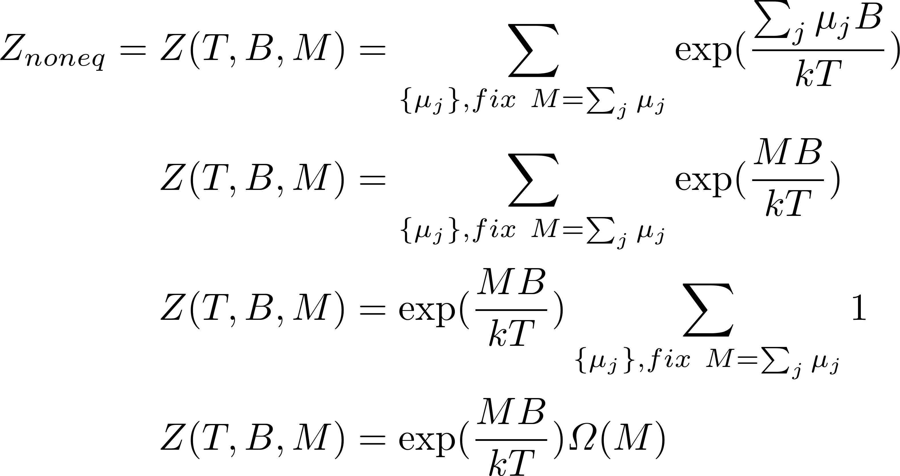
Finding equilibrium by minimizing the free energy
individual spin states will be denoted as $μ_{j}∈\{−μ,μ\}$. Then the microstate of the whole system will be given by the list $\left\{μ_{j}\right\}≡\{μ_{1},μ_{2},μ_{3},…{,μ}_{j},…\}$.
where $Ω\left(M\right)$is the number of states (number of lists $\{μ_{j}\}$) with the total magnetization equal to the prescribed value $M$. When $n$ denotes the number of “up” spins (that is $μ_{j}=μ$) then the total magnetization will be

Slide 16
Finding equilibrium by minimizing the free energy
The nonequilibrium free energy will be
differentiating with respect to M we find the value $\overline{M}$, which minimizes $F_{noneq}$. After some work we get
This is exactly the same as we got using standard “canonical mean” technique.

Slide 17
Quantum ideal gas
For classical (non-quantum) ideal gas we could use canonical distribution for just one particle (Maxwell-Boltzmann distribution). The reason is that molecules do not interact (except for very short time during collisions) and so they are statistically independent. Classical particle is well identifiable, so we can use one-particle distribution.
For quantum particles we have a problem even for non-interacting particles: particles are usually undistinguishable. So we cannot well identify just one particle, therefore one-particle distributions are meaningless.
Still, classical one-particle distributions are very useful, so we would be happy to have some quantum analogue. Some small one-particle-like gas subsystem.
The key idea is this: take as a subsystem one one-particle state. The one particle states are well identifiable as $(n_{1}, n_{2}, n_{3},s_{z})$. We can speak about the “state of the one-particle state”: it is given by the occupational number of the one-particle state considered.
Different one-particle states are statistically independent of each other, that is their occupational numbers are independent.
In different microstates of the whole gas the occupational number of one specifically chosen one-particle states are generally different: we can speak about the occupational-number-probability distribution for a specific one-particle state for a particular gas macrostate.
The occupational number is the number of particles in that chosen state. We can consider the chosen one-particle state as a small system in thermal and diffusion contact with the rest of the gas and use grand canonical distribution as the relevant probability distribution.

Slide 18
Quantum ideal gas
One-particle states will be denoted in brief as $j$. It can be understood as the order number in a sorted list of all one-particle states as shown in the table below for fermions with spin 1/2.
j | $$n_{1},n_{2},n_{3},s_{z}$$
1 | $$1,1,1,↑$$
2 | $$1,1,1,↓$$
3 | $$1,1,2,↑$$
4 | $$1,1,2,↓$$
5 | $$1,2,1,↑$$
6 | $$1,2,1,↓$$
7 | $$1,2,2,↑$$
8 | $$1,2,2,↓$$
$$⋮$$ | $$⋮$$
The energy of a particle in the state $n_{1},n_{2},n_{3},s_{z}$ is

Slide 19
Fermi gas: Fermi-Dirac distribution
We shall now consider Fermi gas at the temperature $T$ with the chemical potential $μ.$ We apply the grand canonical distribution to a particular one-particle state $j$, its energy will be denoted as $ε_{j}$. The allowed occupational numbers are so there are just two possible “states of the one particle state”. The total energy of $n_{j}$ particles in the state $j$ is, of course $n_{j}ε_{j}$, and the sum will have just two terms for $n_{j}=0$ and $n_{j}=1$. The grand statistical sum for the chosen one one-particle state $j$ will be:
The probabilities for the two values of $n_{j}$ will be
The mean value of the occupational number will be
This formula is called Fermi-Dirac distribution. To repeat: it gives the mean occupational number of the one-particle state $j$of Fermi gas.

Slide 20
Bose gas: Bose-Einstein distribution
We shall now consider Bose gas at the temperature $T$ with the chemical potential $μ.$ We apply the grand canonical distribution to a particular one-particle state $j$. The allowed occupational numbers are so there is an infinite number of possible “states of the one particle state”. The grand canonical statistical sum is an infinite series. Fortunately it is geometric series, so it can easily be calculated. We get
This result is, of course, valid only for convergent series, so the following must be true
For increasing $j$ the $ε_{j}$ are increasing, so it is enough if $μ<ε_{0}$.
So the chemical potential for any Bose gas must satisfy the condition $μ<ε_{0}$. Since $ε_{0}$ is almost 0, we practically get the condition $μ<0$.

Slide 21
Bose gas: Bose-Einstein distribution
The probabilities of occupational numbers will be
The mean value of the occupational number will be
We did a clever trick with the derivative after which we got a geometrical series. The rest of the calculation is trivial. Finally we get
This formula is called Bose-Einstein distribution. To repeat: it gives the mean occupational number of the one-particle state $j$of Bose gas.

Slide 22
Quantum ideal gas – classical limit
we shall now investigate the situation, when the mean occupancy of all one-particle states is much less than 1. We expect that then the quantum effects can be neglected and get results as for classical particles with the exception of the Gibbs paradox: indistinguishability is manifested even in the classical limit.
So we look for situations where
This requirement leads to the same condition for bosons and fermions
If this condition holds for $j=0$, then it holds for all $j$, so the classical limit is good when
As usual, we just pretend to know $μ$. The mean number of all particles in the considered gas is
The sum is over all the one-particle states. It can be rewritten as a sum over energies of the one particle states using the degeneracy $Ω(ε)$
The sum is over all the (discrete) values of the energies of the one-particle states.

Slide 23
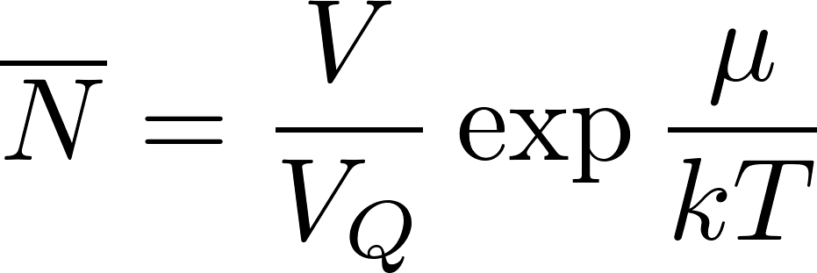
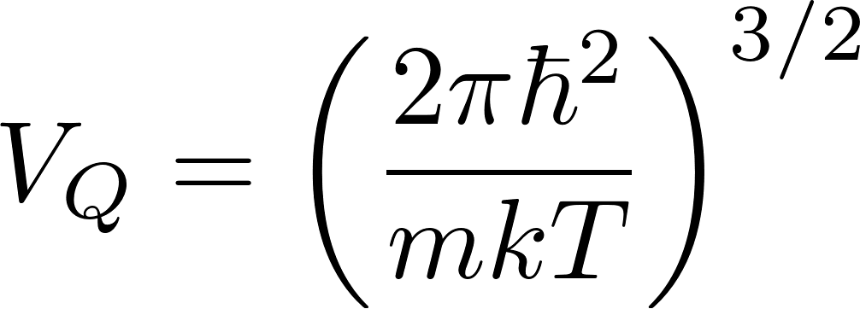
Quantum ideal gas – classical limit
The discrete summation
can be approximate by integrating over almost continuous spectrum of energies as
where $φ(ε)$ is our standard notation for the number of one-particle states with energies less than $ε$. For spinless particles we have ($m$ is the mass of the particles $L=V^{2/3}).$
Let us note that the spin degeneracy survives the classical limit so for particles with spin we should include also the spin degeneracy factor $g$ (2 for the spin 1/2, 3 for the spin 1 etc.). The integration is trivial, we get
where we have denoted
The index Q in the notation suggests “quantum volume”. $V_{Q}$ is the volume corresponding to the de’Broglie’s wavelength of a particle having the energy by the order of magnitude equal to $kT$. It is roughly a minimum volume required so that the particle can have such energy. Restricting to a smaller volume would lead (by uncertainty principle) to larger energy.

Slide 24
Quantum ideal gas – classical limit
The relation we more often use in the inverse form: to calculate $μ$
when we know $N:$
We have calculated the chemical potential! Of course, the result is valid only in the classical limit, what requires
or
Intuitively we understand why this is the condition of classicality. $NV_{Q}$ is the minimal volume required by quantum mechanics for the gas so that its temperature (roughly kinetic energy per molecule) can be $T$. If the available total volume is much larger than that, the de’Broglie’s waves “are not squeezed” by the gas container and particles behave as classical. Of course, this is a “hand-waving” argument, but perhaps there is a piece of truth in it.

Slide 25
Ideal gas – classical limit – grand partition function
We shall demonstrate now the calculation of the grand partition function for an ideal gas in the classical limit. The gas microstate is given by the list of the occupational numbers, which we shall denote as
The grand partition function is the sum over all gas microstates (over all possible lists}:
Be careful and understand well what the symbols mean! The overall sum is over all possible infinite lists of occupational numbers. The sums in the exponent are over the occupational numbers in one specific list. Now exponent of a sum is a product of exponents:
Now the most difficult (for understanding) rearrangement according to the distributive law. Symbolically but imprecisely: “sum of products is the product of sums”.
Observe the difference: in the original expression the sum is over lists of numbers, in the transformed expression the sum is over all possible occupational number values for the specific state $j$. So for fermions it is the sum of just two numbers 0, 1. You can understand that this is correct by inspecting small specific examples for the distributive law. Try hard, finally you will understand the distributive law!

Slide 26
Ideal gas – classical limit – grand partition function
So far, our calculations were exact. Now we will do approximations of the classical limit.
Firstly, in the classical limit there is no difference between bosons and fermions because the mean occupational numbers are very low. So we continue the calculations with fermions, where the sums are only over $n_{j}=0,1$.
The classical limit also means so we approximate the logarithms
We got just the sum over mean occupational numbers, what gives the total number of particles. So in the classical limit
We have calculated the grand partition function! We were able to do it because of the classical limit but also because in the grand statistical sum there is no restriction for the one-particle states we sum over. For the canonical sum the restriction $N_{j}=N$ would make a similar calculation more difficult. (Later we shall see that in classical (non-quantum) statistics the calculation of the canonical sum for ideal gas is easy!)

Slide 27
Ideal gas – classical limit – entropy
Summarizing the results we have obtained
we continue by calculating the entropy of an ideal gas in the classical limit. We start with the relation
After substitution for $μ$ and we get
This formula is called Sackur-Tetrode equation for the entropy of monoatomic classical ideal gas. It demonstrates that the statistical physics is able to calculate the entropy absolutely: there is no arbitrary additive constants, while the phenomenological thermodynamics is able to determine entropy only up to an additive constant.

