Slide 1
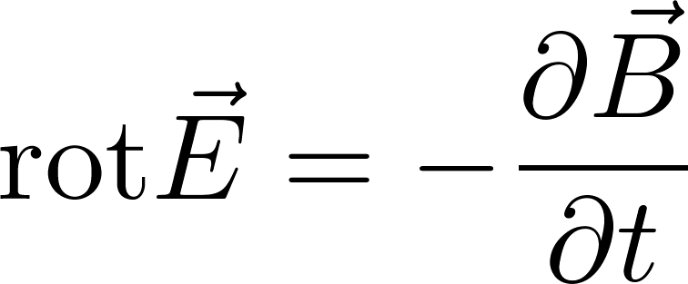
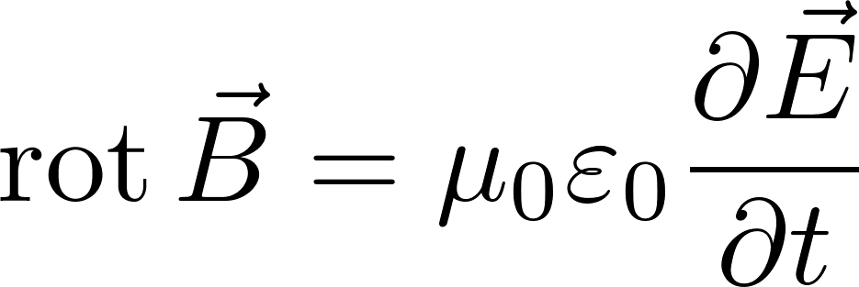
Free electromagnetic field
Let us now consider some area of space where there are neither charges nor currents. Still, electromagnetic field may be there. It is true, that the field had to be created somewhere sometimes by some charges, but this is not interesting for us for the moment. An example might be light moving through the empty space which originated far away by a distant star. Another example is the electromagnetic field in a microwave cavity. The field was created by a magnetron outside the cavity and injected into the cavity through a wave guide. But from then on it can be considered as a free electromagnetic field inside a cavity within brass (conducting) walls. The Maxwell equations for a free field read
Since the spatial area is limited, we need to consider the physical conditions on the border of the area. These border conditions are necessary supplement to the Maxwell equations, without them the equations themselves are useless.

Slide 2
Free electromagnetic field – wave equation
For completeness we show, that the Maxwell equations of a free field can be rewritten to the form of a wave equation.
we apply another rotation:
Now the well know relation
For those who are not familiar with nablas, here is the derivation in coordinate formalism (if you still do not recognize some formulas, consult web)

Slide 3
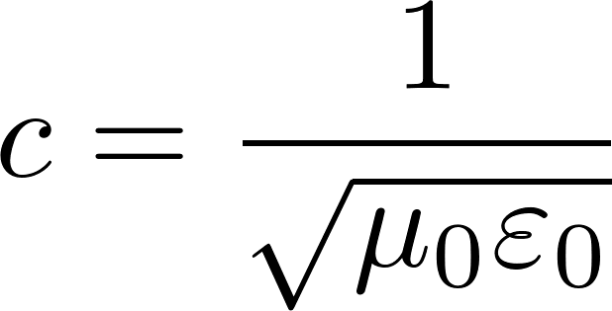
Free electromagnetic field – wave equation
since we get
So finally
So the free field satisfies the wave equation. The phase velocity is
$c$= 299 792 458 m/s, what is the velocity of light
Deriving the wave equations we have used only two of the four Maxwell equations, so in addition to the wave equation there are additional constrains for the electromagnetic wave to be fulfilled!

Slide 4
Free electromagnetic field in a conducting box
Free electromagnetic field in a conducting box (like microwave) satisfies wave equation inside the box. The more difficult part of the problem are the boundary condition.
Let us investigate the $x$-component of the electric field $E_{x}(x,y,z)$ in a cube-like conducting box $a×a×a$.
Tangential components on the boundary have to be zero
According to Fourier: function $E_{x}(x,y,z)$ satisfying such conditions can be constructed from the set of functions (cyclically for other components)
where $f$-s are so far unknown functions
The electric field has to satisfy the condition $\text{div} \vec{E}=0$ also in points with $x=0, x=a$. There the $y$ and $z$ field components do not contribute since their sinuses are 0 there, therefore we get the condition for the derivative of $f$
so the derivatives of $f$ can be constructed from sinuses, so $f$from cosines.

Slide 5
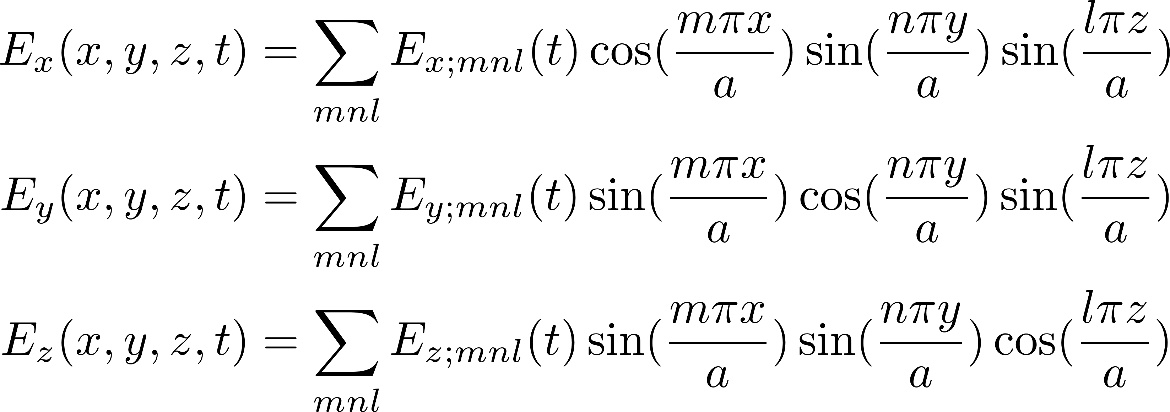
Free electromagnetic field in a conducting box
We have found that the electric field automatically satisfying the boundary conditions can be looked for in the form
where $E_{x;mnl}\left(t\right), E_{y;mnl}\left(t\right), E_{z;mnl}(t)$ are so far unknown functions. Actually not all these functions are independent, because of the zero-divergence condition, which gives the conditions
so for any $mnl$ only two of these functions are independent (for example the $x$ and $y$ component). The third one can be expressed from the other two.
What have we got? We have found that in each time $t$the state of the electric field in the boxed is uniquely given by two infinite discrete sets of functions $E_{x;mnl}(t)$ and $E_{y;mnl}(t)$ where $mnl$ are triplets of arbitrary integers.
Originally, we have described the state of an electric field as a field: a vector in each spatial point $xyz$ in the given time $t.$ Now we have discrete sets of functions of time.

Slide 6
Free electromagnetic field in a conducting box
What are the equations of motion for the state functions $E_{x;mnl}\left(t\right), E_{y;mnl}\left(t\right)$ ? The electric field has to satisfy the wave equation
and similarly for the $y$ component. (The $z$ component is expressed through the other two components and will satisfy the wave equation automatically.) After substituting the fields by the discrete sums containing the $E_{x;mnl}\left(t\right), E_{y;mnl}\left(t\right)$ into the wave equations we get the equations
where
These are equations of motions for harmonic oscillators!
The time dependence will be
What have we got? The electric field in a box is mathematically equivalent to two sets of independent harmonic oscillators, labeled by integer triplets $mnl$. We shell show that magnetic part of the electromagnetic filed is fully determined by the “electric” functions $E_{x;mnl}\left(t\right), E_{y;mnl}\left(t\right)$ so the oscillators describe the state of field completely!

Slide 7
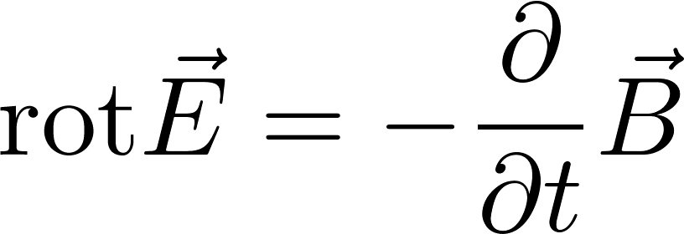
Free electromagnetic field in a conducting box
We have the solution for the electric field in a box. Now we show very briefly that the magnetic field is fully given by the electric field. From the Maxwell equation
We get for the $mnl$ term in the sums and for the expected time dependence
The $x,y$ components of the magnetic field we get by the cyclic permutation.
So we have shown that the electric field solution generates the magnetic field solution.

Slide 8
Free electromagnetic field in a conducting box
Why did we do the rewriting of the field into sets of harmonic oscillators? Because we want to study what kind of field is formed in the box, if the box walls are heated to temperature $T$ and so we have the electromagnetic field in thermal contact with thermostat. We would like to use canonical ensemble technology, bat we do not know how to do that if the microstates of the electromagnetic field are described as fields in space.
On the other hand we know how to do statistics of independent harmonic oscillators in contact with the thermal reservoir taking the oscillator as either classical or quantum objects. Since the oscillators are independent, they do not feel each other and we can do the canonical calculation for just one harmonic oscillator (an easy task) and then do the summation through the set (infinitely large) of all the harmonic oscillators. Here are the results for one oscillator labeled as $mnl$
Classical result for the mean energy at temperature $T:$ $\overline{E}=kT$
Quantum result for the mean energy at temperature $T:$
Observe the difference: all classical oscillators have the same mean energy not dependent on their $ω_{mnl}$. Quantum oscillators mean energies do depend on $ω_{mnl}$.

Slide 9
Free electromagnetic field in a conducting box:
canonical ensemble
Since the microstate of the free electromagnetic field is the same as the microstate of (an infinite) set of harmonic oscillators the statistical physics of the field in contact with the thermal reservoir is straightforward: one just uses the canonical ensemble for independent harmonic oscillators. But we immediately see some problems.
If the oscillators are considered to be classical, then the mean energy for each of them is $kT$, independently of $ω_{mnl}$. Since there is an infinite number of these oscillators, we get infinite mean energy of the electromagnetic field in a hot box. Even worse: this infinite value is not a constant but depends on $T.$ So to increase the temperature in a stove would need to add infinite amount of energy. Even worse: since the mean energy of the oscillators does not depend on $ω_{mnl}$, even the very high frequencies of the electromagnetic field will be highly excited even at moderate temperatures. Very high frequencies mean ultraviolet, roentgen, gamma frequencies. It would mean “open the window to a stove” and you get irradiated by deadly radiation. Disaster, which got the name “ultraviolet catastrophe”. It means that either the statistical physics is completely wrong or that the electromagnetic field is not a classical, but a quantum object and quantum version of oscillators should be used.

Slide 10
Free electromagnetic field in a conducting box:
canonical ensemble
Even considering the oscillators to be quantum objects is not without problems! The mean energy of a quantum oscillator is
The problem is the constant additive term $ℏω/2$. Which again gives infinite contribution to the total energy. However, this term is a constant not depending on any state characteristics like the temperature, so can be considered as a meaningless energetical additive constant. Well, this is a rather cheap solution to an essential problem, it is more like sweeping the problem under the carpet. We shall omit this constant term in what follows in this formula and in the formula for energy of a harmonic oscillator.
Historically the problem with the classical statistics was found by Max Planck around 1900. Curiously enough it was not the youngest theory to be blamed for the disaster (statistical physics) but older and well-established theories: Newton mechanics and Maxwell theory of electromagnetism, which had to be replaced by their quantum versions. Max Planck was the first who “quantized” the old theory for black body radiation. It started the quantum era of physics.

Slide 11
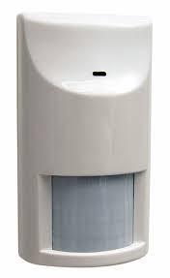
Black body radiation
After all the preparatory work let us study the electromagnetic field in a box in contact with thermal reservoir. In physics the problem is known under the name “black body radiation”.
The experiment shows, that all bodies heated to some temperature emit electromagnetic waves. Our sun emits visible light from its surface having some 6000 K. Our own bodies emit infrared radiation corresponding to our temperature of 37 Celsius. This radiation is detected by mosquito sensors which then recognize us as the object to attack. This radiation is also detected by motion detector in the alarm systems.
The spectral characteristics of radiation emitted by a hot body is theoretically simplest if it is so called black body. A black body is an idealized physical body that absorbs all incident electromagnetic radiation, not reflecting any part of it. In thermal equilibrium it emits radiation called black body radiation. An approximate realization of a black surface is a hole in the wall of a large cavity. Any light entering the hole is reflected within the internal surface of the body indefinitely or absorbed within the body and is unlikely to re-emerge, making the hole a nearly perfect absorber. In thermal equilibrium radiation is emitted from such hole equivalent to black body radiation. If the electromagnetic field inside a cavity is in thermal equilibrium with its walls the spectral characteristic of the electromagnetic field inside are equal to the black body radiation.
Motion detector

Slide 12
Quantum states of a free electromagnetic field in a box
We have shown that the electromagnetic field states are equivalently described as states of a set of harmonic oscillators. So we know, how to make a quantum theory of electromagnetic field in a box: we just take those oscillators to be quantum oscillators and the general state of the field will be some general quantum state of those oscillators.
We know that a quantum state of a harmonic oscillator is given by a single integer $n$ (called excitation number) and its energy in the state $n$ is $E_{n}=nℏω$. (We have omitted the $ℏω/2$ term). A quantum state of electromagnetic field can be therefore given as the list of all the equivalent oscillators together with the excitation number of each of them.
One particular (micro)state of the electromagnetic field in a box is given by the table like this.
The table is an infinite list of oscillators. Each raw contains the label of a particular oscillator and its quantum excitation number.
The total energy of the field in such state is given by the sum
mnl,s | excit.number
111,x | $$n_{111x}$$
111,y | $$n_{111y}$$
112,x | $$n_{112x}$$
112,y | $$n_{112y}$$
121,x | $$n_{121x}$$
121,y | $$n_{121y}$$
$$…$$ | $$…$$
In the sum $mnl$ are integers, $s$ runs through just two values $x,y$.
We know what are all possible microstates and what are their energies, so we can use canonical ensemble technology.
We have quantized the electromagnetic field !!! Very advanced physics !!!

Slide 13
Thermal radiation in a cavity - energy
Thermal radiation is equivalent to a set of independent oscillators. We can calculate the mean energy of each one separately, we get
By the way the energy of an oscillator in the state with excitation number $n$ is $ℏω$, therefore we see that the mean excitation number at the temperature $T$ is
The total energy of all the oscillators (the total energy of radiation in the cavity) is
The sum runs over all triplets $mnl$ of integers and over two values of $s$: $x, y$. Now we do a standard trick: we approximate the sum by an integral over $ω.$ To do this we have to know how many oscillators have the frequency less than some value $ω$. We see that the various $ω$ values correspond to points in the abstract $mnl$ space with integer coordinates. The trick is the same as we used when calculating the number of one-particle states. So we get (the factor 2 is for two states $x,y$ for each $mnl$).

Slide 14
Thermal radiation in a cavity - energy
The total energy of the thermal radiation in a cavity is
$a^{3}$ is the cavity volume, so we get for the energy density of the thermal radiation in the cavity
The energy density is expressed as an integral (a sum) over frequencies $ω.$ So the function under the integral can be interpreted as the spectral energy density $u(ω)$, that means the energy per unit volume per frequency interval $dω$ around the frequency $ω is$

Slide 15
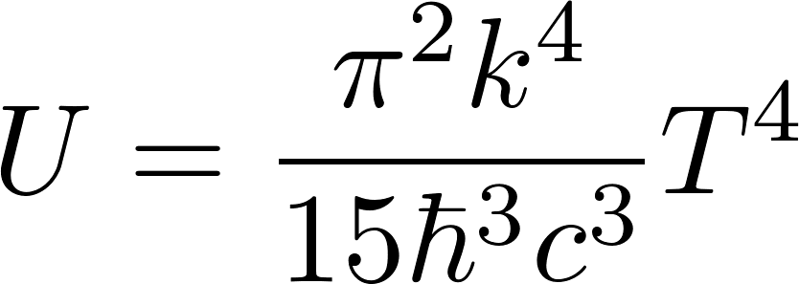
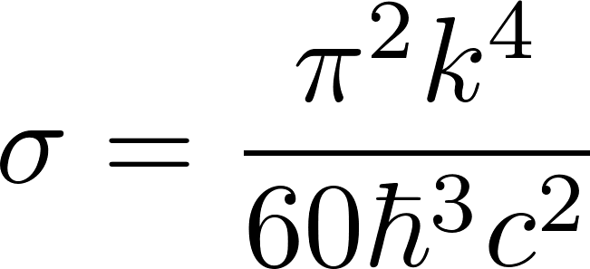
Thermal radiation in a cavity - energy
After integration over $ω$ we get for the total energy density
If we make a small hole into the cavity with equilibrium thermal radiation, the radiation will be emitted through that hole. The energy density flow peer unit of time will be
We derived the formula in a rather hand-waving way: the energy with density $U$ flows out of the hole with the velocity of light $c$. The factor 1/4 we got by averaging over angles of the outgoing radiation.
The formula is called Stefan’s low and is usually written in the form
$σ$ is called Stefan-Boltzmann constant

Slide 16
Free electromagnetic field:
alternative description of the state
We found that the electromagnetic field in a box is mathematically equivalent to two sets of independent harmonic oscillators, labeled by integer triplets $mnl$and an additional label $x$ or $y$.
and similarly for $y,z$
We called the “items” oscillators due to the fact that we have concentrated on the time dependence of the coefficients $E_{x;mnl}(t)$ not giving too much meaning to the “spatial” sinuses and cosines. But equally well we could call the “defining items” as stationary waves, when we include the spatial dependence into the “state”. We see stationary waves
with frequencies and wave vectors
We see the relation

Slide 17
Free electromagnetic field:
alternative description of the state
Se we have two alternative description of electromagnetic field state
The electromagnetic field in a box is mathematically equivalent to two sets of independent harmonic oscillators, labeled by integer triplets $mnl$and an additional label $x$ or $y$ with frequencies
Alternatively
The electromagnetic field in a box is mathematically equivalent to two sets of independent stationary waves, labeled by integer triplets $mnl$and an additional label $x$ or $y$ with frequencies and wave vectors
What concerns the creation of the canonical ensemble both the alternatives are the same. The oscillators and the stationary waves are considered here as individual objects, individual independent subsystems. The quantum states of individual oscillators as well as individual stationary waves are given identically by the excitation number $n.$ The energy of the state $n$ is $ε_{n}=ℏω_{mnl}$. So the alternative descriptions of the states of the electromagnetic field give the same statistical physics results.

