Slide 1
Free electromagnetic field:
still another alternative description - photons
The complete (micro)state of the electromagnetic field we have represented by the table where the excitation numbers are any integers. If you see the table do you recall
that you have already met a similar table in a very different context? Here it is: The state of non-interacting indistinguishable spinless bosons was given by the list of one-
mnl,s | excit.number
111,x | $$n_{111x}$$
111,y | $$n_{111y}$$
112,x | $$n_{112x}$$
112,y | $$n_{112y}$$
121,x | $$n_{121x}$$
121,y | $$n_{121y}$$
$$…$$ | $$…$$
one particle state | occup. number
1,1,1 | 1
1,1,2 | 3
1,2,1 | 0
1,2,2 | 2
2,1,1 | 0
2,1,2 | 0
2,2,1 | 12
2,2,2 | 4
$$⋮$$ | $$⋮$$
particle states each with its occupational number which could be any integer. The total energy was
For the electromagnetic field the total energy is
The same (almost) description of the states, the same formula for the energy.

Slide 2
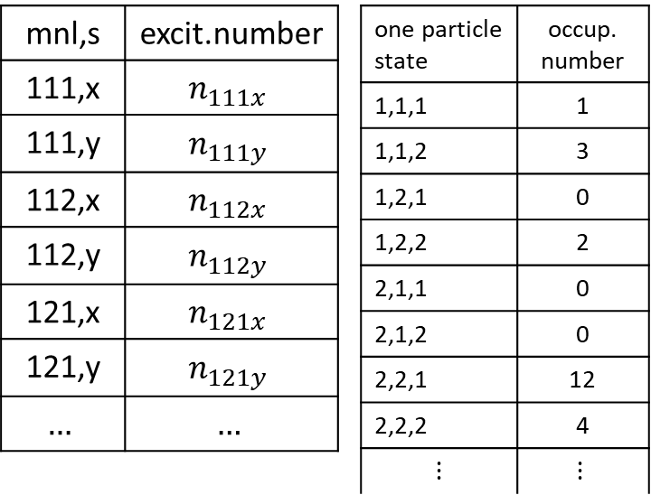
Free electromagnetic field:
still another alternative description - photons
The table giving the state of the electromagnetic field via the states of stationary waves is very similar to the table giving some state of a ideal spinless boson gas. However there are some dissimilarities as well:
Each row in the stationary wave table represents a different stationary wave. Different stationary waves are considered as different objects, different physical systems. The rows in the boson table represents different one particle states of one physical object: the bosonic particle
the rows in the stationary waves table have additional label $s∈\left\{x,y\right\}.$ We can have additional label for bosons with spins. But the closest to spin zero boson is a spin 1 boson which should have 3 spin states, not just 2.
To disclose our aim: we want to show that there is another alternative description of the electromagnetic field in a box: ideal bosonic gas of particles called photons. To do that we have to handle the above-mentioned dissimilarities of the two tables.

Slide 3
Free electromagnetic field:
still another alternative description - photons
First to the problem “different objects versus different states”. Here is the reminder of the slide where we discussed the freedom of reconsidering what are the “system variables” and what are the “state variables”. It was about chemical potential and considering the number of particles $N$ not as a fixed system characteristics but rather as a state variable.
We can do a similar trick with the $mnl$ labels of the stationary waves. We considered different $mnl$ labels as “names” for different physical objects, different oscillators or different stationary waves. We can consider all the stationary waves “in the box” as instances of one type of “physical animal” – a stationary wave – in different states $mnl$. Similarly to gas particles being same “physical animals” in different one-particle state.
So this dissimilarity disappeared.

Slide 4
Free electromagnetic field:
still another alternative description - photons
Now to the problem of “spin labels”. The particles we want to “invent and introduce” must be bosons, since the excitation numbers interpreted as occupational numbers are any integers. The bosons should not be spinless since we have to interpret the labels $x,y$ as some spin-state labels. So far, we do not know any bosons which would have just two spin states. Spin 1 bosons should have 3 “spin projections”. Two spin
projections suggest spin 1/2, but spin 1/2 particles are fermions!
However, the above-mentioned classification is valid if we consider only nonrelativistic particles. Relativistic particles with the mass equal to zero with the total spin 1 have only two spin-projection states +1 and -1. Projection 0 is not possible. The reason is hidden deeply in relativistic quantum mechanics (better: field theory). We skip the detailed argumentation, just take it as a fact.
So there is a chance for a particle-like alternative description of the states of the electromagnetic field introducing relativistic mass=0 particles with spin 1 named photons. The “spin-projection labels” for photons do not necessarily mean true spin projections: other quantum mechanical base of “spin states” can be used equally well. For photons we most ly use the “polarization basis”.

Slide 5
Free electromagnetic field:
alternative descriptions of the state
Se here are now three alternative description of electromagnetic field state
The electromagnetic field in a box is mathematically equivalent to two sets of independent harmonic oscillators, labeled by integer triplets $mnl$and an additional label $x$ or $y$ with frequencies
The electromagnetic field in a box is mathematically equivalent to two sets of independent stationary waves, labeled by integer triplets $mnl$and an additional label $x$ or $y$ with frequencies and wave vectors
The electromagnetic field in a box is mathematically equivalent to an ideal gas of relativistic mass=0 bosons. Their one-particle states are labeled as $mnls$ where the $mnl$ are integers and $s$ can have two values describing two possible polarizations. The frequencies and the wave vectors are interpreted using the de’Broglie relations as the energy and the momentum of particles. A boson in the one-particle-state $mnls$ would have the energy and momentum

Slide 6
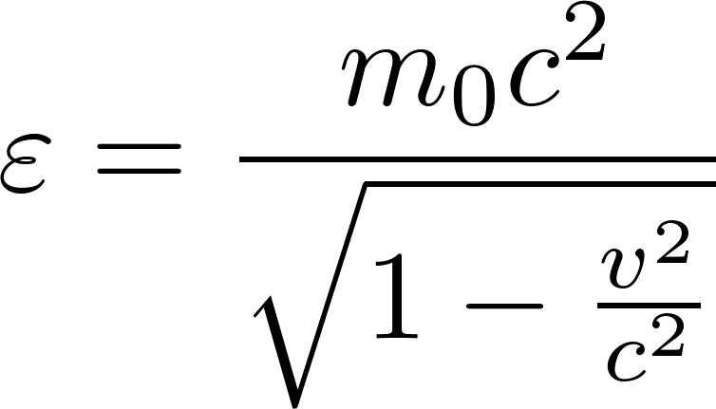
Free electromagnetic field: photons
We found that the energy and momentum formulas for photons should be
This gives us the following relation between energy and momentum
Such a relation is expected for relativistic massless particle because of the general relativistic formula for the particle rest mass
For photons this gives the rest mass 0. The general formula for the relation between the
energy, rest mass and velocity of a particle is
To get non-zero energy, the zero-mass particle velocity must always be $\text{v} =c$. So photons always move with the velocity $c$.
We have discovered photons !!!

Slide 7
Thermal radiation in a cavity as a photon gas
We have arrived at a conclusion that we can consider the electromagnetic field in a cavity as a photon gas. So we can try to calculate the properties of the thermal radiation by calculating the properties of a photon gas in equilibrium with the cavity walls at the temperature $T.$
How to do that? we certainly do not know a priori the total number of photons in the cavity so we try to work within the grand canonical technology pretending to know the chemical potential of photons, calculate with it as with a symbolical abstract number $μ$ and finally find the correct value of it by adjusting this value to get the correct thermal radiation results which we already know.
So we have the photon gas with one-particle-states $mnl$s. The mean occupational number a one-particle-state will be
The total energy of the photon gas will be

Slide 8
Thermal radiation in a cavity as a photon gas
Let us compare the formula we have just got with the formula we have got for “equivalent oscillators” where we had “mean excitation numbers” instead of “mean occupational numbers”
The formula for $ω_{mnl}$ is the same in both cases, the only difference is that there is $μ$ in the formula on the left. The conclusion is: we get exactly the same results for the thermal radiation if calculated as for oscillators and if calculated as for photons if we set $μ=0.$
We discovered a new law of nature: chemical potential of photons is (always) zero.
Putting $μ=0$ we continue in exactly the same way as we did for the “equivalent oscillators”: we replace the sum by an integral using formula for the density of one-particle-states which would be for photons the same as was the formula for the density of oscillators and we will get the same result

Slide 9
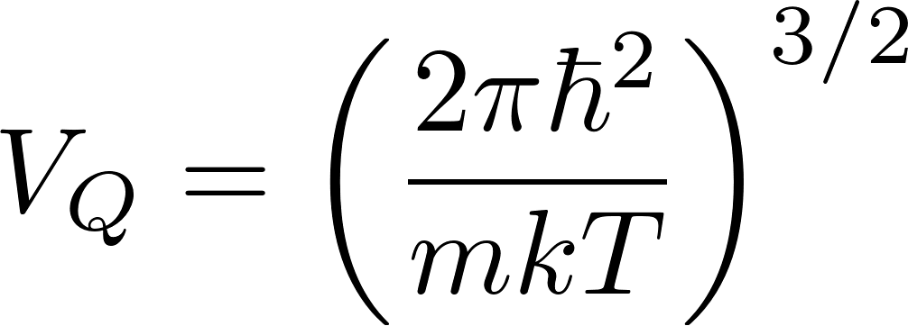
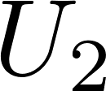
Chemical potential in an external field
We have calculated chemical potential for an ideal gas in the classical approximations as
For gas in an external constant potential U, the chemical potential would be
The reason is that the chemical potential has the meaning of the energy needed to increase the number of molecules by 1, and if the energy per molecule is higher by U due to external potential, the chemical potential has to be increased by U as well. This trick is often used by solid state physicists. The simplest example of its usage is an alternative derivation of the barometric formula. Imagine gas in two compartments connected by a hole enabling to exchange particles. Suppose in one compartment is a constant external potential $U_{1},$ in the other compartment $U_{2}$. In equilibrium the chemical potential has to be equal in both compartments, so we get
We have got the well-known barometric formula if U is the potential of gravity

Slide 10
Chemical reactions
Let us consider the chemical reaction
The reaction can run in both directions. We assume everything happens in gas phase.
If the reaction runs from left to right the binding energy $U$ per one molecule of $HCl$ is released which is manifested by the fact that the molecules $HCl$ are born in the reaction with the kinetic energies by $U$ higher than it would correspond to the temperature $T$. We can mathematically model it that there is a constant external potential -U which is not felt neither by $H_{2}$ nor by $Cl_{2}$ molecules but is felt by $HCl$ molecules.
The stoichiometric relations we express by integers $ν_{i}$ defined negative for molecules entering the reaction from left and positive for molecules leaving the reaction on the right. So we have
Let us assume we at the beginning have filled the chemical reactor with the initial concentrations of molecules
This would be the initial non equilibrium state. Let the container is kept at constant pressure and temperature. After reaching the equilibrium certain number $N_{eq}$ of reactions have to take place. Assume that at some time instant just $N$ reactions took place. We shall count $N$ as positive for reactions from left to right and negative otherwise. We can take $N$ to be the parameter of non-equilibrium and our task will be to find its equilibrium value $N_{eq}$. We shall find it by minimizing the Gibbs potential.

Slide 11
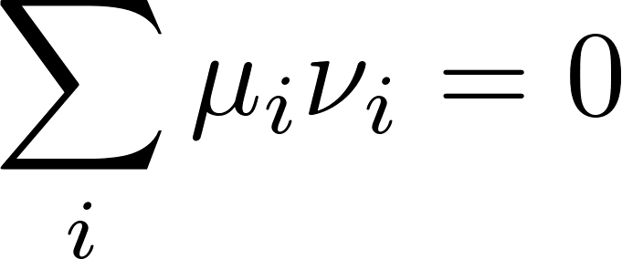
Chemical reactions - equilibrium
So suppose we are in the non-equilibrium state given by a certain value $N$ and in the next small time of development this parameter changedas
This means that the numbers of molecules considered must have changed by
where
At constant temperature and pressure the Gibbs potential will be changed by
At equilibrium the Gibbs potential should be extremal, so it has to be stationary for small changes of $N$. We get as a condition of equilibrium
In our example we have (notice that the volumes $V_{Q}$ do not depend on concentrations)

Slide 12
Chemical reactions - equilibrium
From the equilibrium condition we get
The given initial conditions are
The unknown parameter which we should find is the number of reactions till the equilibrium $N_{eq}$. The final concentrations satisfy the stoichiometry relation
after inserting this into the equilibrium condition we can determine $N_{eq}$ and the final equilibrium concentrations.

