Slide 1
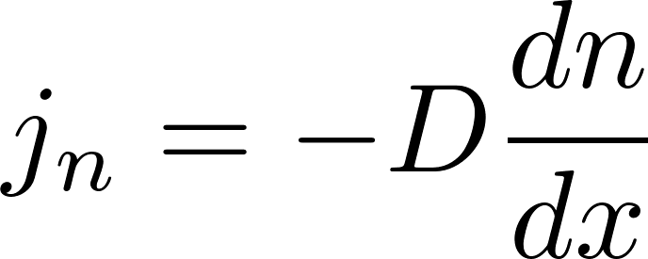
Smuggling themselves: diffusion
Let us consider a rather artificial situation. We have two types of molecules in the container. They are not uniformly distributed but in such a way, that the pressure is homogenous, therefore there is no “blow of the wind” in the container. We prepared such a thought experiment to be able to observe diffusion in a pure form free of a molecular transport by a macroscopic flow of gas.
We shall monitor just one type of molecules (for example the red ones) how they randomly move through the virtual border represented by the dashed line.
“The smugglers” do not carry anything in their backpacks, they smuggle themselves: there is a non-zero net flow of the smugglers through the border what leads to gradual homogenization of the concentration of the red molecules in the container.
We can directly write the formula for the net molecular diffusion current density (in units of molecules per the time unit per the area unit):
So the diffusion current is
$D$ is called the diffusion coefficient.

Slide 2
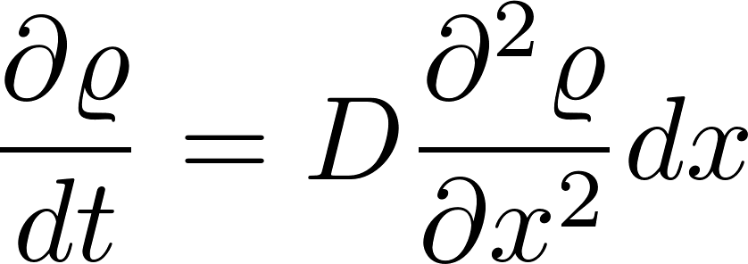
Diffusion equation
Outflow from the volume $dx$: $j_{n}\left(x+dx\right)−j_{n}\left(x\right)=$
“John the Baptist equation”

Slide 3
Brown motion is diffusion

Slide 4
Partial differential equations of physics
Parabolic
Hyperbolic
Elliptic

Slide 5
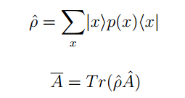
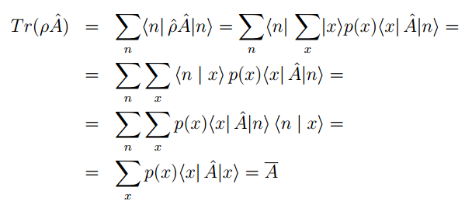

Slide 7
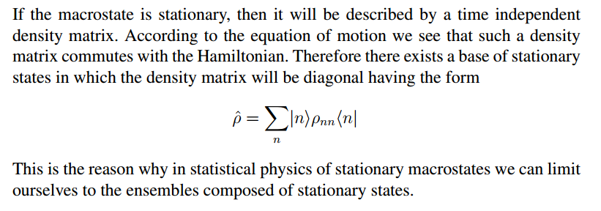

Slide 8
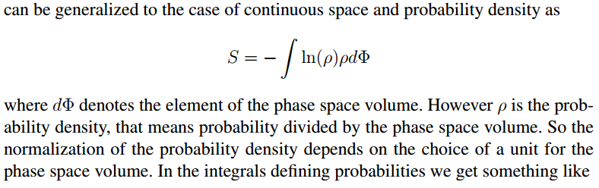
Entropy for a classical system

Slide 9
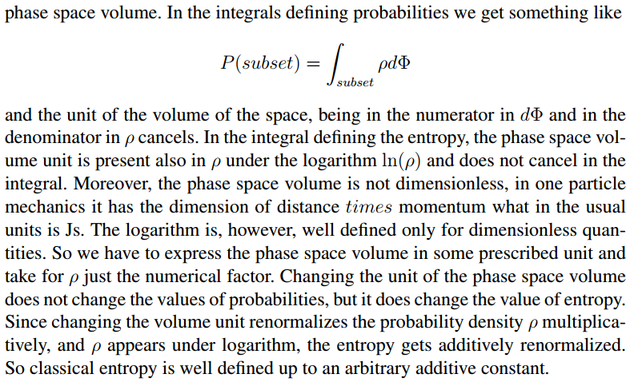

Slide 11
