Slide 1
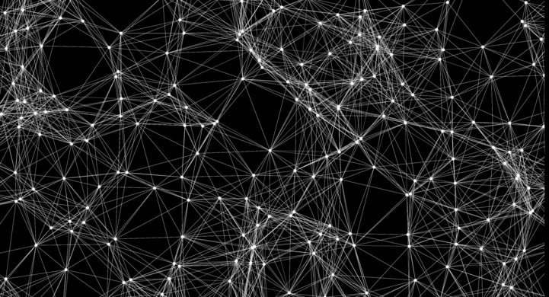

Neurónová Sieť S Exponenciálnou Vrstvou
Slavomír Holenda Zdroje k BP
pozadie : https://imgur.com/JEFlGfz

Slide 2
Základné informácie
Sanchit Tanwar
Introduction to neural networks.
Kvasnička V., Beňušková., Pospíchal J., Farkaš I., Tiňo P. a Kráľ A.
Úvod do teórie neurónových sietí

Slide 3
Generalizácia
David E. Rumelhart, Geoffrey E. Hinton, and Ronald J. Williams
Learning internal representations by error propagation
Sanghun Ha, Kukjin Kang, Jong-Hoon Oh, Chulan Kwon, Youngah Park
Generalization in a perceptron with a sigmoid transfer function

Slide 4
Parity a XOR
Aniruddha Karajgi
How Neural Networks Solve the XOR Problem
J. Bemley
Neural networks and the XOR problem
Farhana Kausar; Mohammed Ameen Ulla
A perspective of fault tolerance for XOR in neural network
Erik Hjelmas , Paul W. Munro
A Comment on the Parity Problem

Slide 5
Testovanie
V. Piuri, M.G. Sami, D. Sciuto, R. Stefanelli
A behavioral approach to testability of neural networks

