Slide 1
Deep neural networks with multiplication layers
Slavomír Holenda

Slide 2
Implementation of a multi-layer model of the summation and Quasi layers of the neural network
Activation
Backpropagation of error

Slide 3
Polynomial function with one non-linear parameter that has some properties of exponentiation [1]
[1] Malinovská, K., Holenda, S., Malinovský, Ľ. (2023). QuasiNet: A Neural Network with Trainable Product Layers. Artificial Neural Networks and Machine Learning – ICANN 2023. ICANN 2023. Lecture Notes in Computer Science, vol 14258. Springer, Cham. https://doi.org/10.1007/978-3-031-44192-9_32

Slide 4
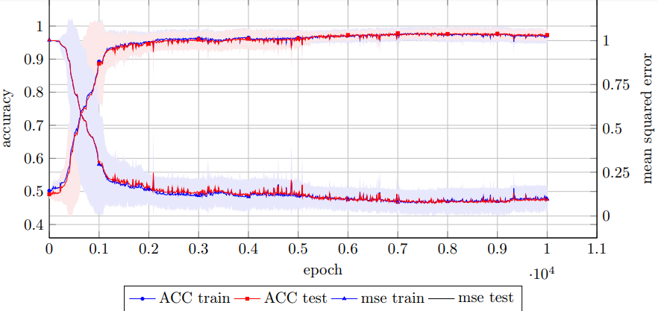
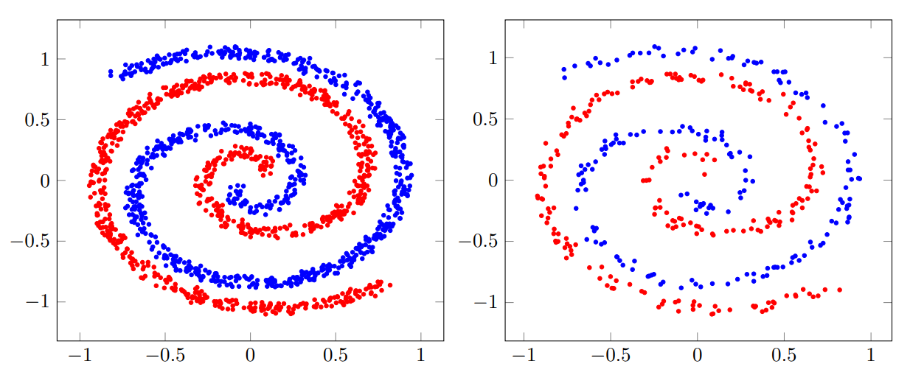
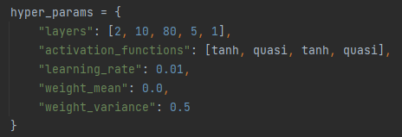
2 spirals dataset with avg ACC 98.275%
4 models reached ACC 100%

Slide 5
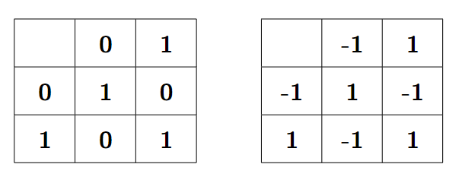
XOR data transformation

Slide 6
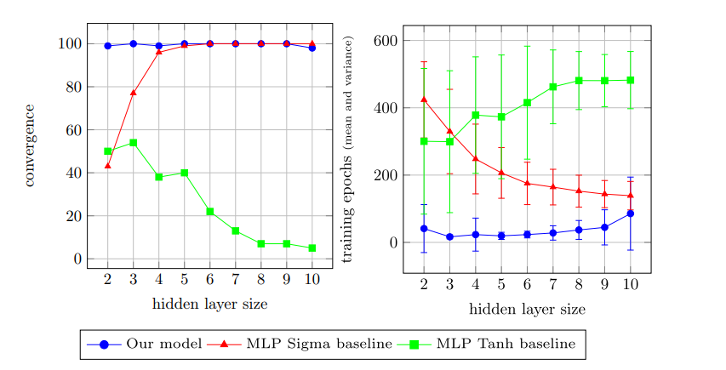
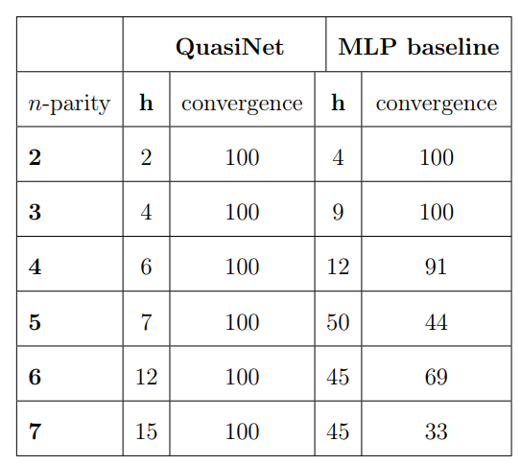
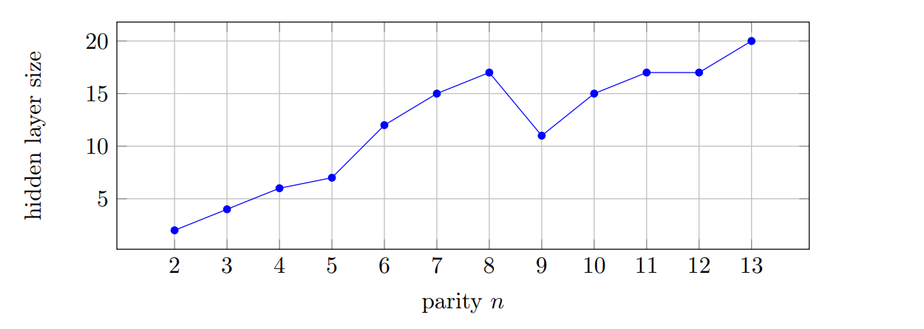
Parity performance

Slide 7
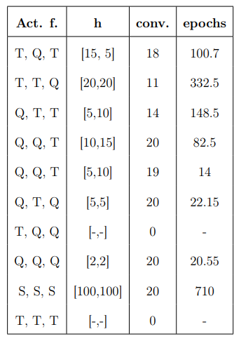
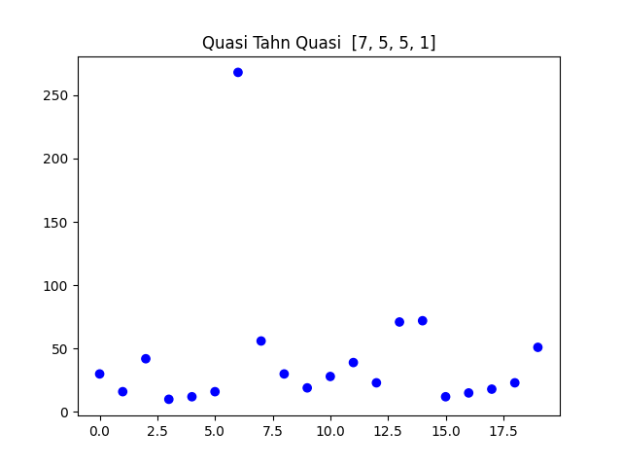
Architectures with 1 hidden layer on parity 7

Slide 8
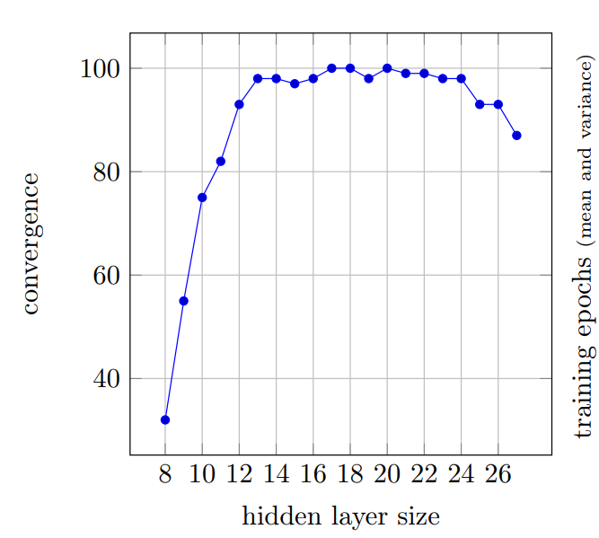
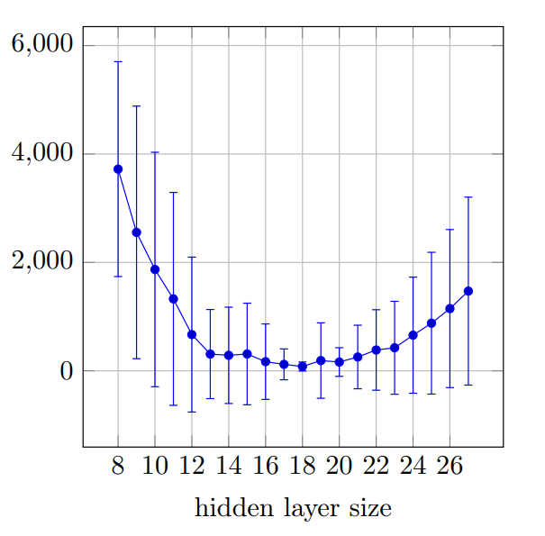
More neurons == better performance? parity 8

Slide 9
Papers:
Efficient Higher-order Neural Networks for Classification and Function Approximation https://www.researchgate.net/publication/2793545_Efficient_Higher-order_Neural_Networks_for_Classification_and_Function_Approximation
Detecting Wearable Objects via Transfer Learning
https://cogsci.fmph.uniba.sk/~rebrova/files/kraus2019.pdf
Deep Learning Ian Goodfellow and Yoshua Bengio and Aaron Courville
https://www.deeplearningbook.org

