Slide 1
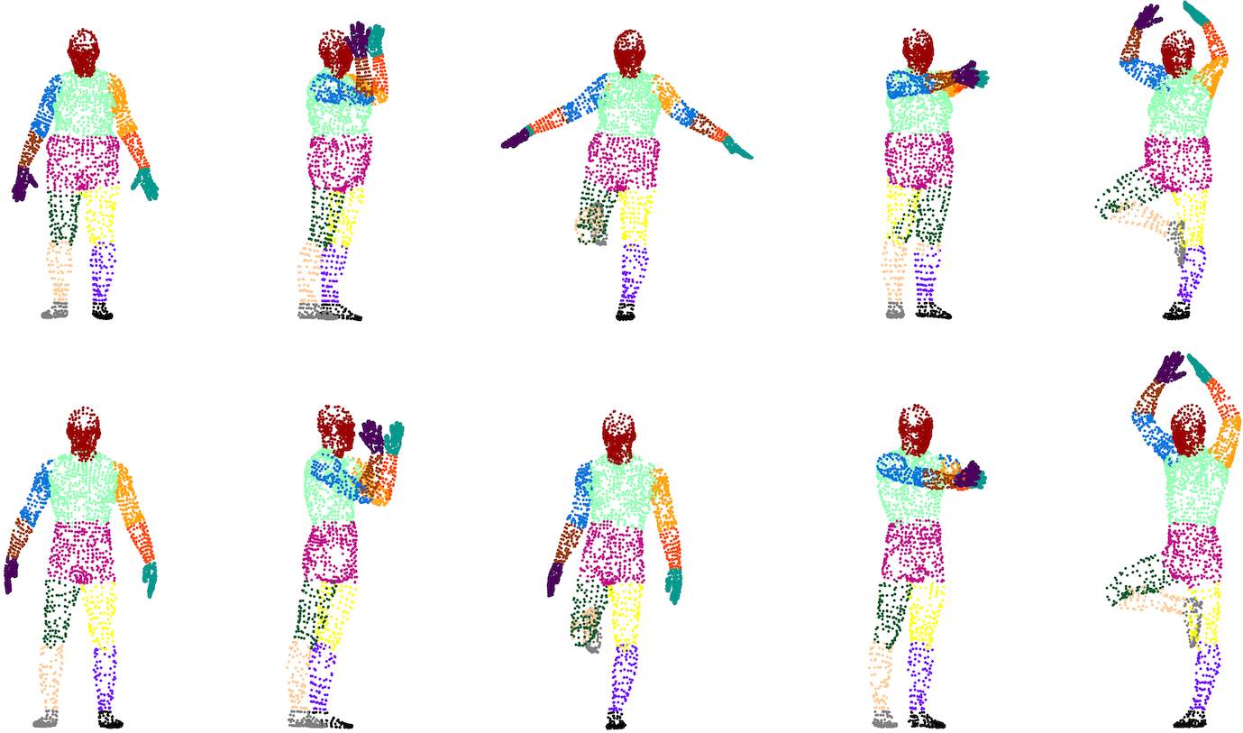
Deep Learning-Based Human Body Segmentation on 3D Body Scans
Erik Jakubovský

Slide 2
Aims and Objectives
Segmentation of human body using 3D scans
Utilise machine learning tools
3D data annotation
Neural models selection
Training and validation of selected models
Results evaluation

Slide 3
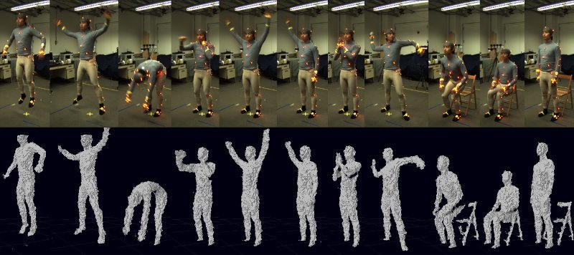
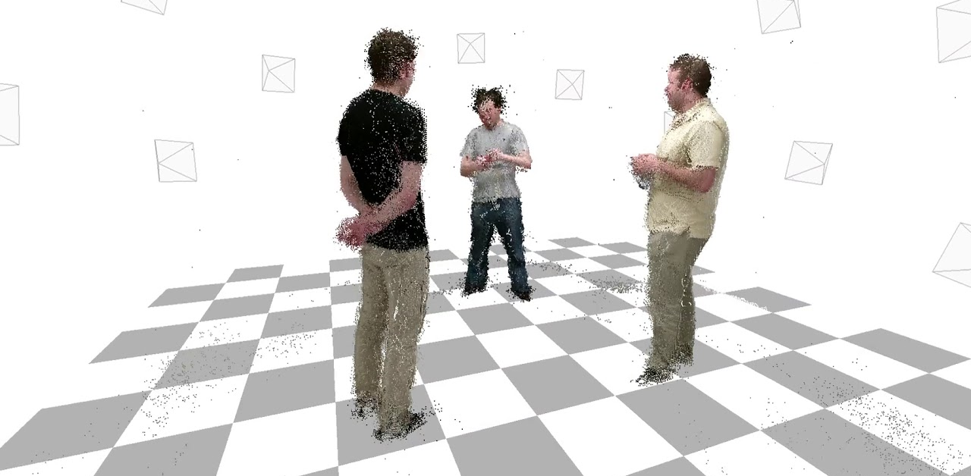
Data Preparation
Dataset selection
Data normalisation
Data modification
Data annotation

Slide 4
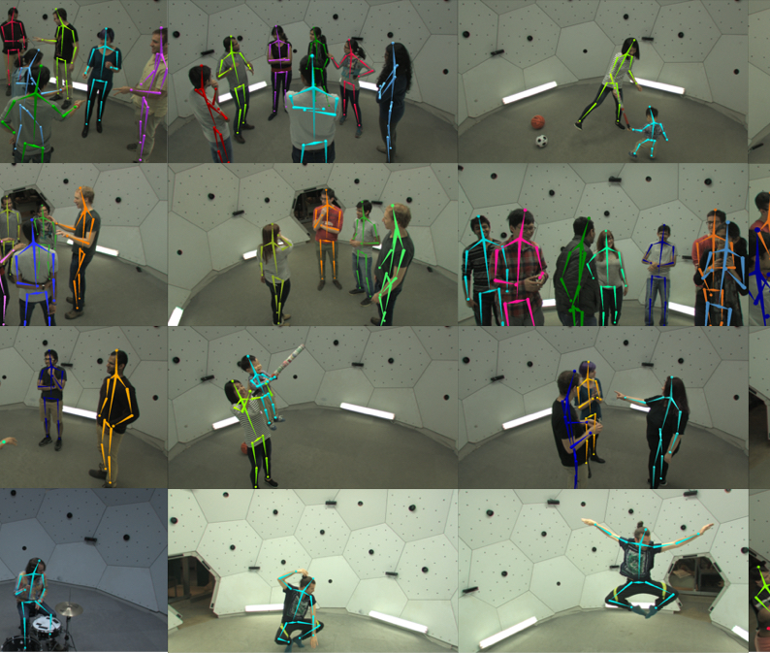
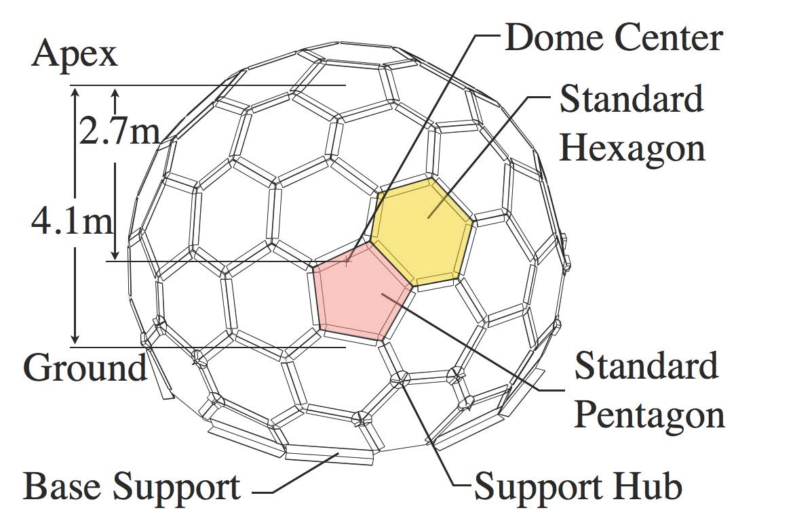
CMU Panoptic Dataset
10 synchronised RGB+D videos
3D point clouds
31 synchronised HD videos
480 VGA views
3D skeletons

Slide 5
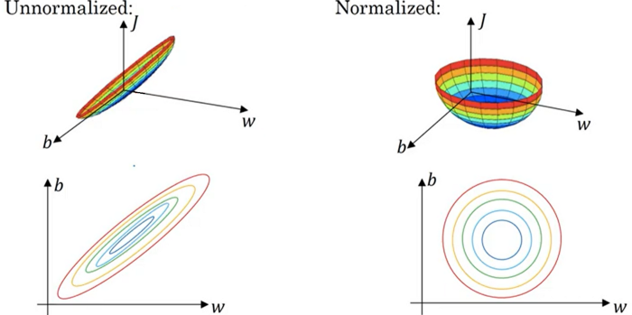
Feature Scaling
Process of bringing features to similar scale
Gradient descent converges faster
Methods:
Mean normalisation
Standardisation
Rescaling (min-max normalisation)

Slide 6
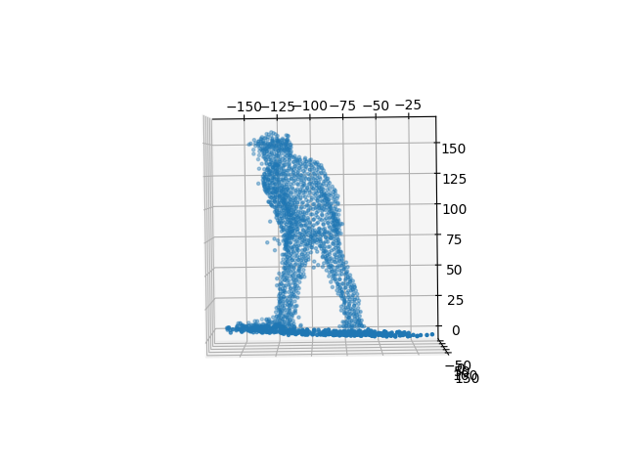
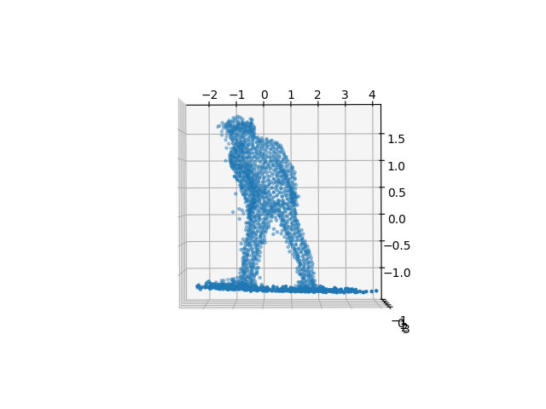

Mean normalisation
Mean normalisation:
$x^{′}=\frac{x−\operatorname{avg}\left(x\right)}{\max\left(x\right)−\min\left(x\right)}$
Standardisation:
$x^{′}=\frac{x−\operatorname{avg}\left(x\right)}{σ}$

Slide 7
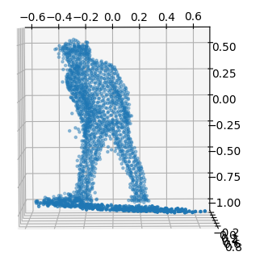
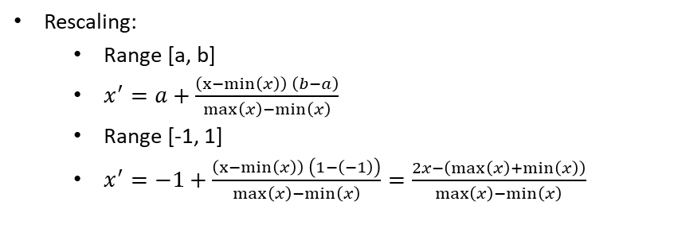
Min-Max Normalisation
Rescaling:
Range [a, b]
$x^{′}=a+\frac{\left(x−min\left(x\right)\right) \left(b−a\right)}{\max\left(x\right)−\min\left(x\right)}$
Range [-1, 1]
$x^{′}=−1+\frac{\left(x−min\left(x\right)\right) \left(1−\left(−1\right)\right)}{\max\left(x\right)−\min\left(x\right)}=\frac{2x−\left(\max\left(x\right)+\min\left(x\right)\right)}{\max\left(x\right)−\min\left(x\right)}$

Slide 8
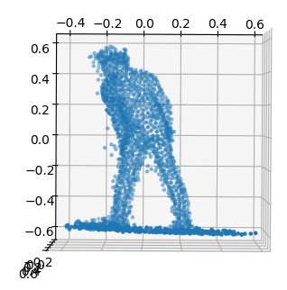
Feature Scaling
No feature scaling
Standardisation
Standardisation + min-max

Slide 9
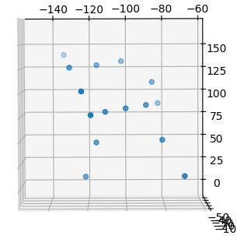
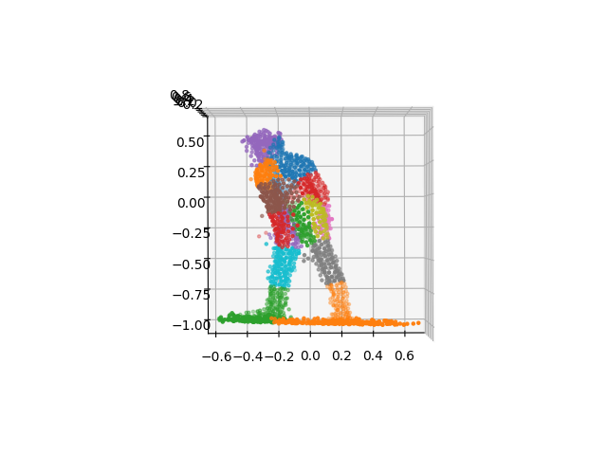
Data Annotation
Distance between points and joints of skeleton
Nearest joint classifies point

Slide 10
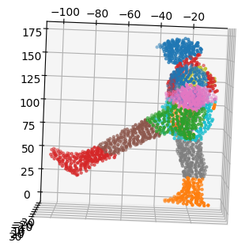
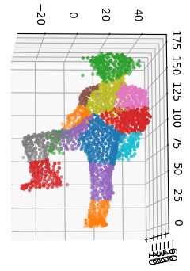
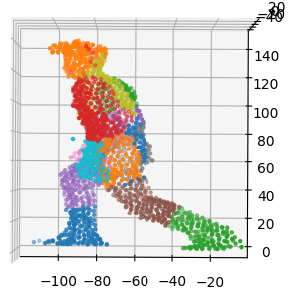
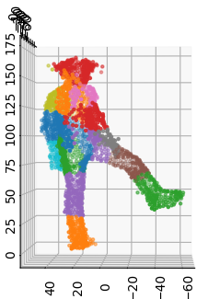
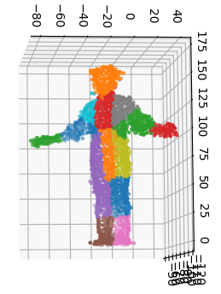
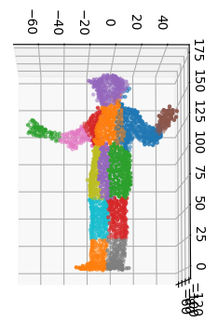
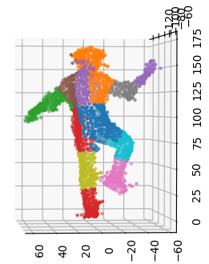
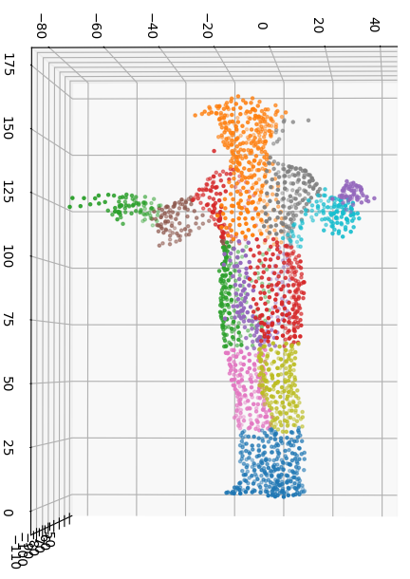

Slide 11
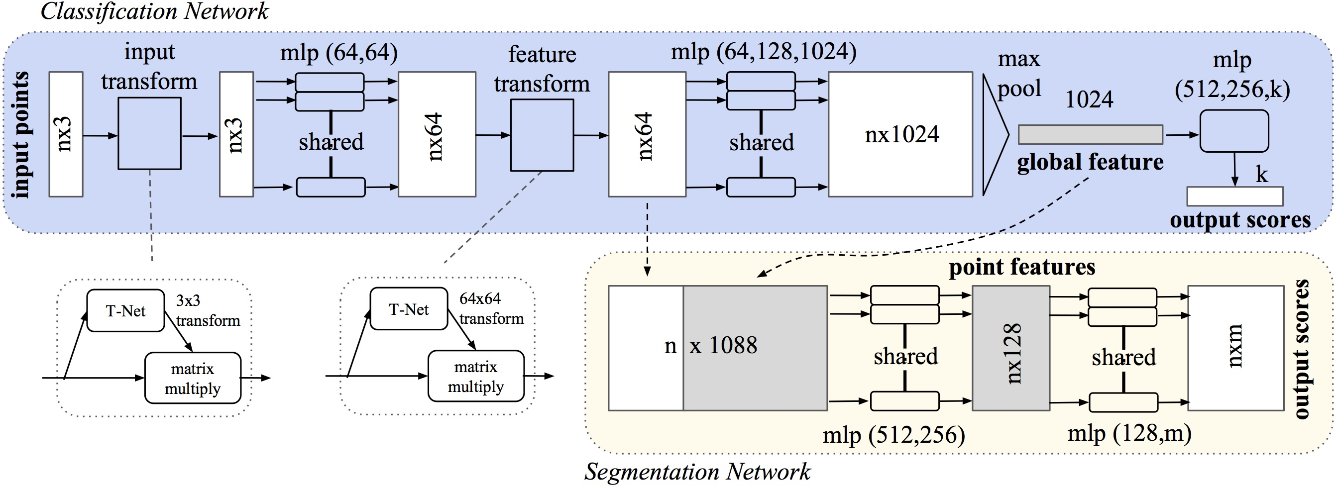
Pointnet

Slide 12
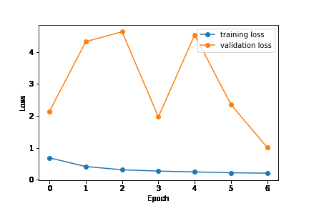
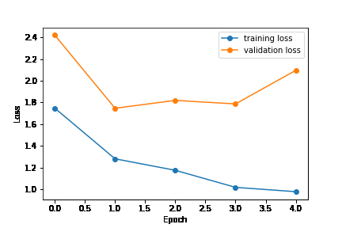
Training and Validation
Without dropout:
With dropout (p = 0.3):

Slide 13
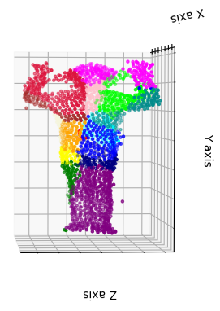
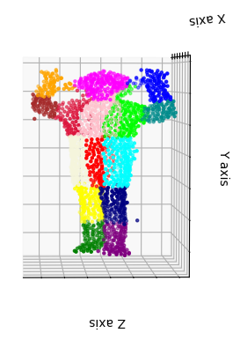
Testing
Accuracy: 33,057%
mIoU: 18,647%

Slide 14
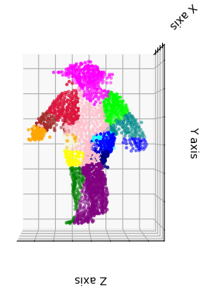
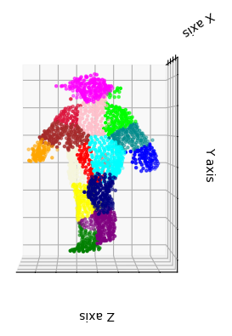
Testing
Accuracy: 45,8%
mIoU: 29,284%

Slide 15
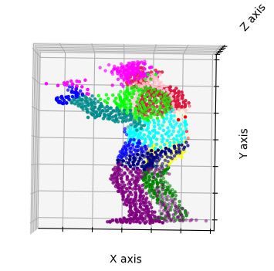
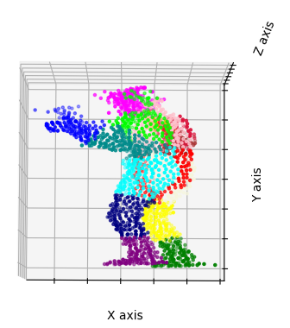
Testing
Accuracy: 43,311%
mIoU: 24,903%

Slide 16
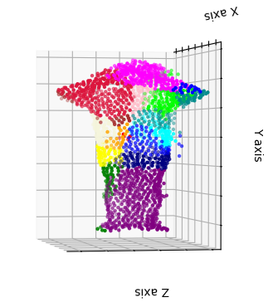
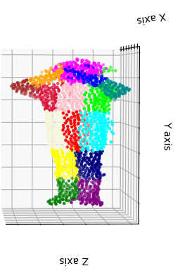
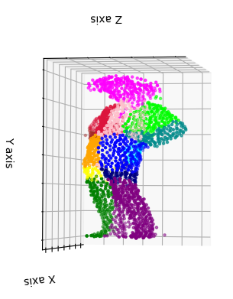
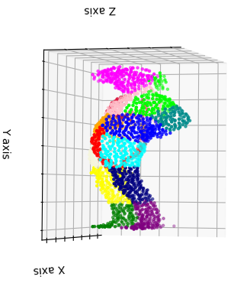
Testing
Accuracy overall: 44,432%
mIoU overall: 24,742%

Slide 17
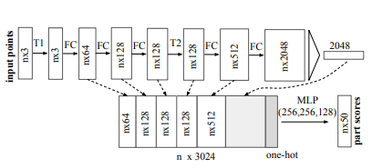
PointNet for Part Segmetation

Slide 18
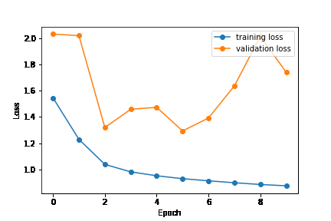
Training

Slide 19
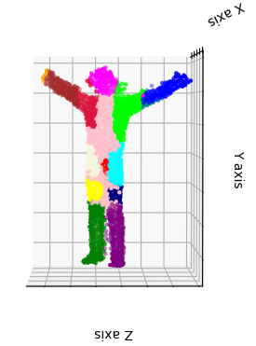
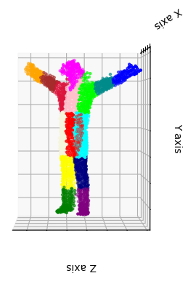
Testing
Accuracy: 60,5%
mIoU: 40,766%

Slide 20
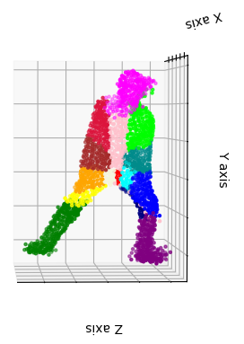
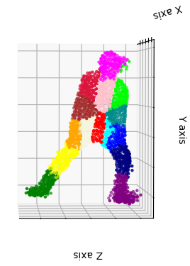
Testing
Accuracy: 60,742%
mIoU: 39,048%

Slide 21
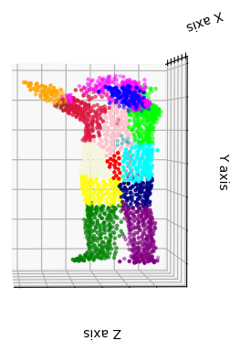
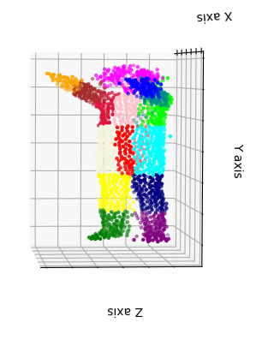
Testing
Accuracy: 65,625%
mIoU: 48,188%

Slide 22
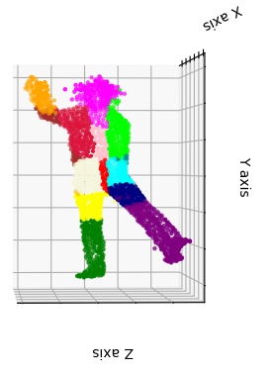
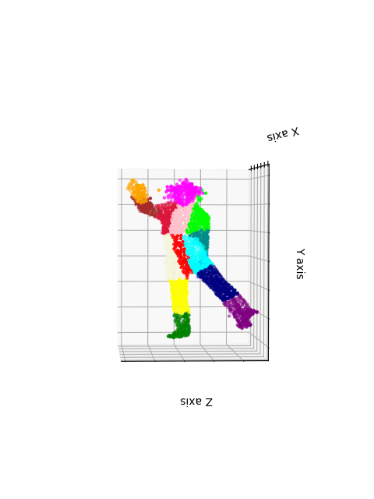
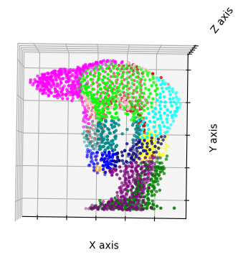
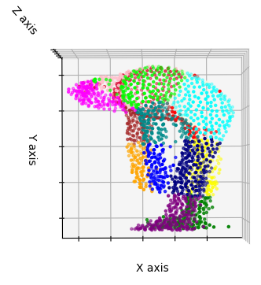
Testing
Accuracy overall: 53,39%
mIoU overall: 32,909%

