Slide 1

Test generation for software systems
Semester Project Presentation
Supervisor: doc. Ing. Ivan Polášek, PhD.
Author: Bc. Ákos Czére

Slide 2
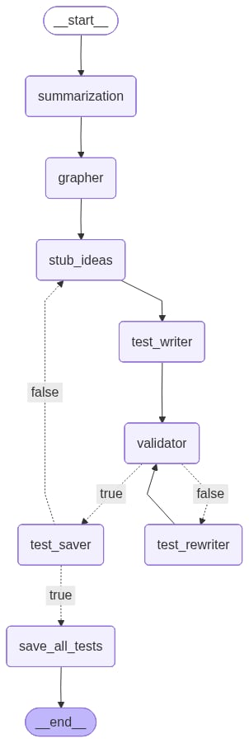
Project Overview
Goal: Build an automated test generation system using LLM agents
Technology: Python, LangGraph, Ollama, GraphRAG
Architecture: 8-node agent pipeline for full test lifecycle

Slide 3
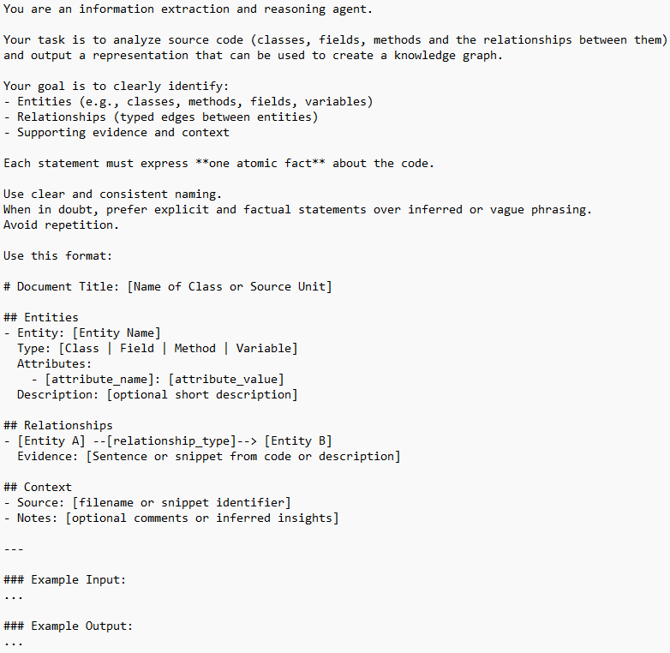
summarizationnode
Processes source code files one-by-one
Extracts structural and functional information
Produces summary files and a vector store describing repository contents

Slide 4
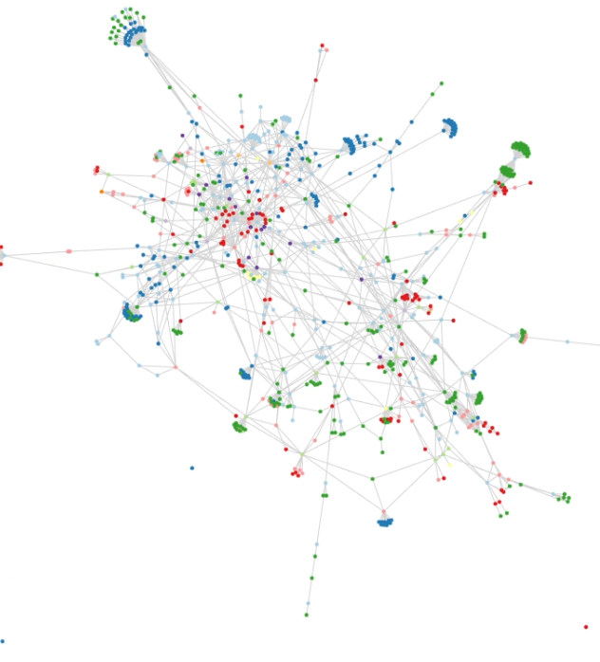
Grapher node
Loads summary file produced earlier
Initializes Microsoft's GraphRAG locally using Ollama
Builds relational graph of project entities

Slide 5
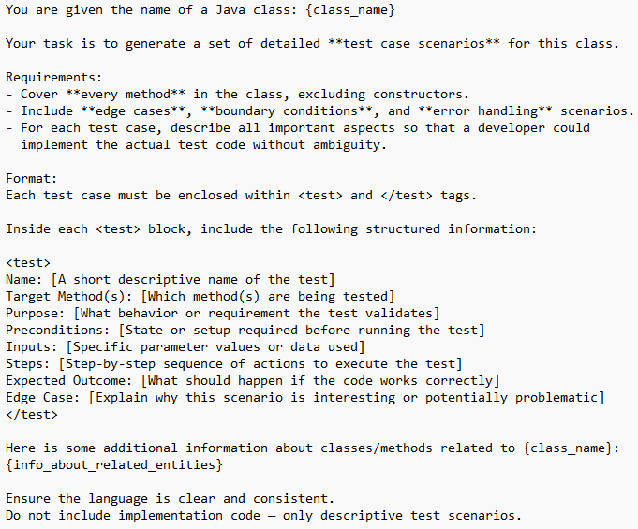
Stub ideas node
Queries GraphRAG and vector store for relevant project components
Generates structured test case scenario stubs
Provides foundation for test creation

Slide 6
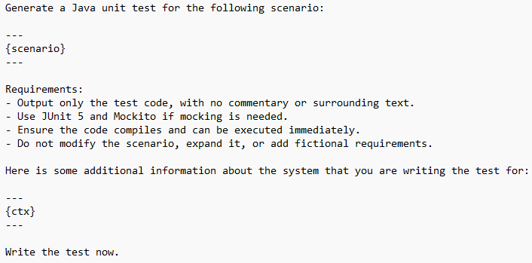
Test writer node
Converts test case scenarios into actual test code
Uses LLM to write tests
Ensures test logic aligns with original source code

Slide 7
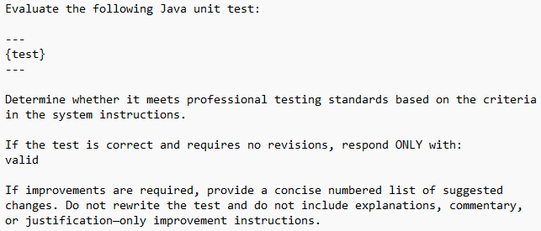
Validator node
Analyzes produced test code for correctness
Identifies missing assertions, imports, logic errors
Sends feedback to rewrite module if needed

Slide 8
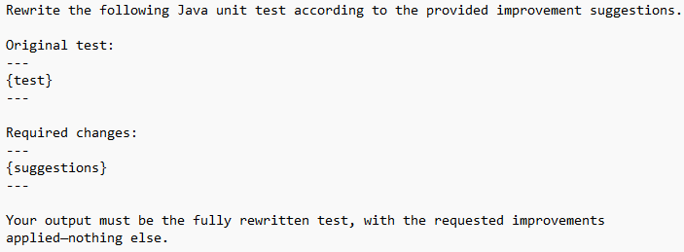
Test rewriter node
Triggered when validation fails
Rewrites tests based on validator feedback
Resubmits improved version back to validator

Slide 9
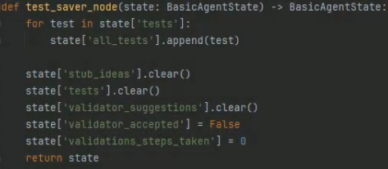
Test saver node
Stores validated tests in memory
Clears shared agent state to prepare next cycle
Routes workflow to either save all tests node or stub ideas node

Slide 10
Save all tests node
Uses deterministic script (non-LLM) to merge test files
Produces a consolidated test suite output
Saves final test file to disk
Will be changed for improved CI/CD

Slide 11
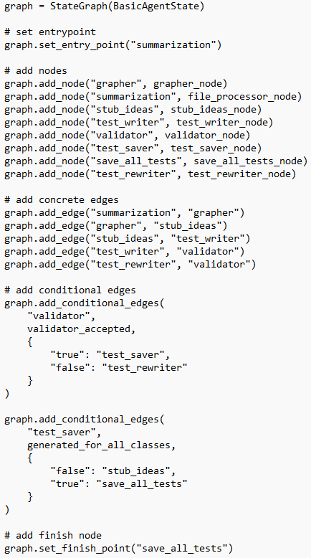
Connecting all nodes together
Set entry and finish points
Add all nodes with names
Add edges

Slide 12
Future Improvements
Adding k6 test generation
Implementing RAG to all nodes
Example-based RAG for guided test scenario generation
Improve validation and iterative refinement logic
Proposal and implementation of evaluation methods
Evaluation of multiple LLM

Slide 13
Thank you for your attention

